Slide 1
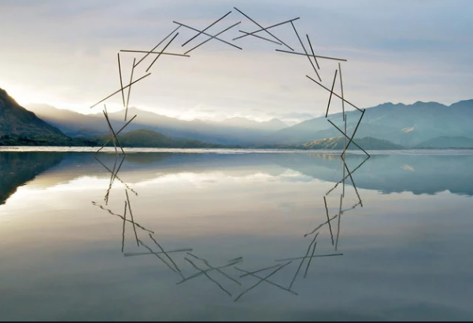
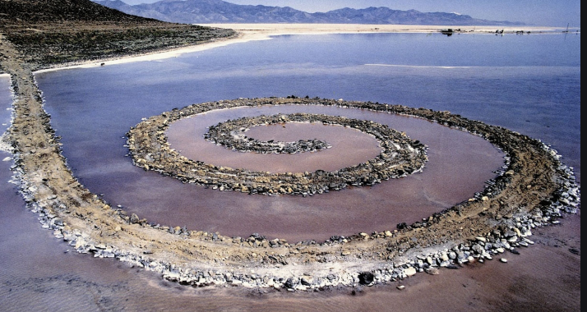
Land Art
Task description
For the next section of the Environment project I would like to see how you independently interpret things.
Lesson task: To create a well presented research page around the question 'what is land art?'
This video link will act as a good introduction:
https://www.youtube.com/watch?v=b3tLPiY6ZKk
On your page you should include:
-examples of at least three artists' work
(famous artists within this genre include Richard Long, Andy Goldworthy and Robert Smithson but do some research and see what else is out there)
-descriptions of what the work is about, how and why it was created.
-what makes something a piece of 'land art'?
-thoughts about how you might create your own piece of land art, would it be temporary or permanent? What would it comment on/be about? Where would it be created? What would you create it from and why?

