Slide 1
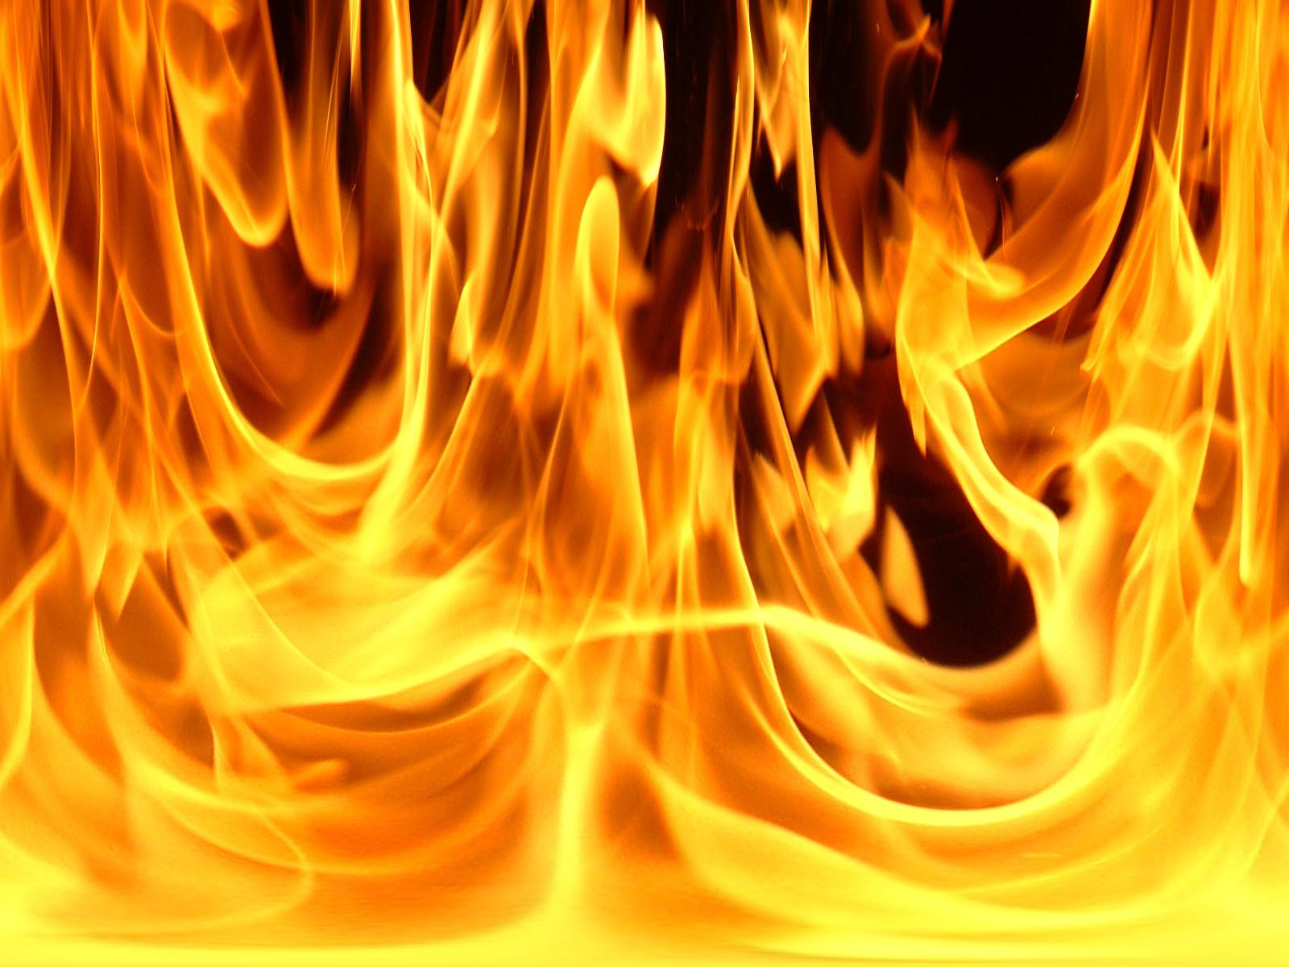
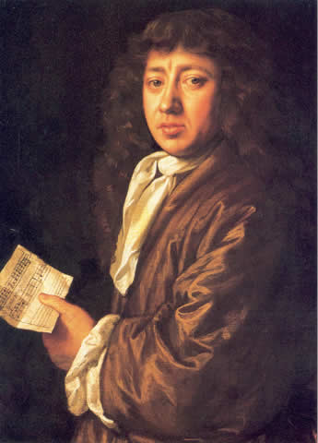
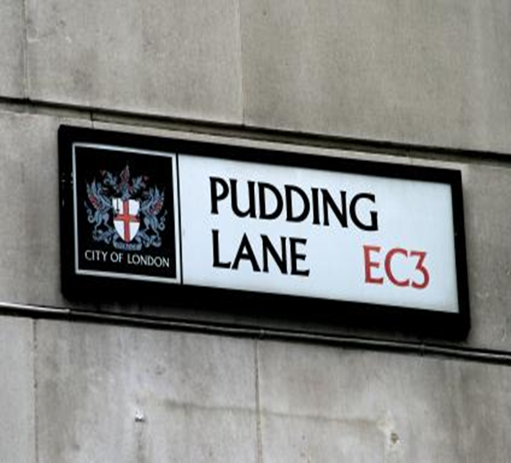
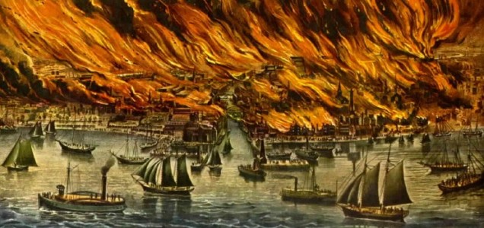
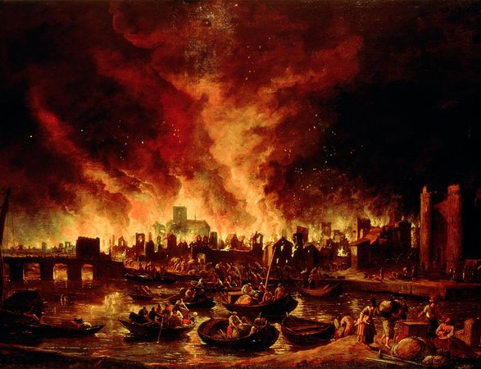
1666

Slide 2
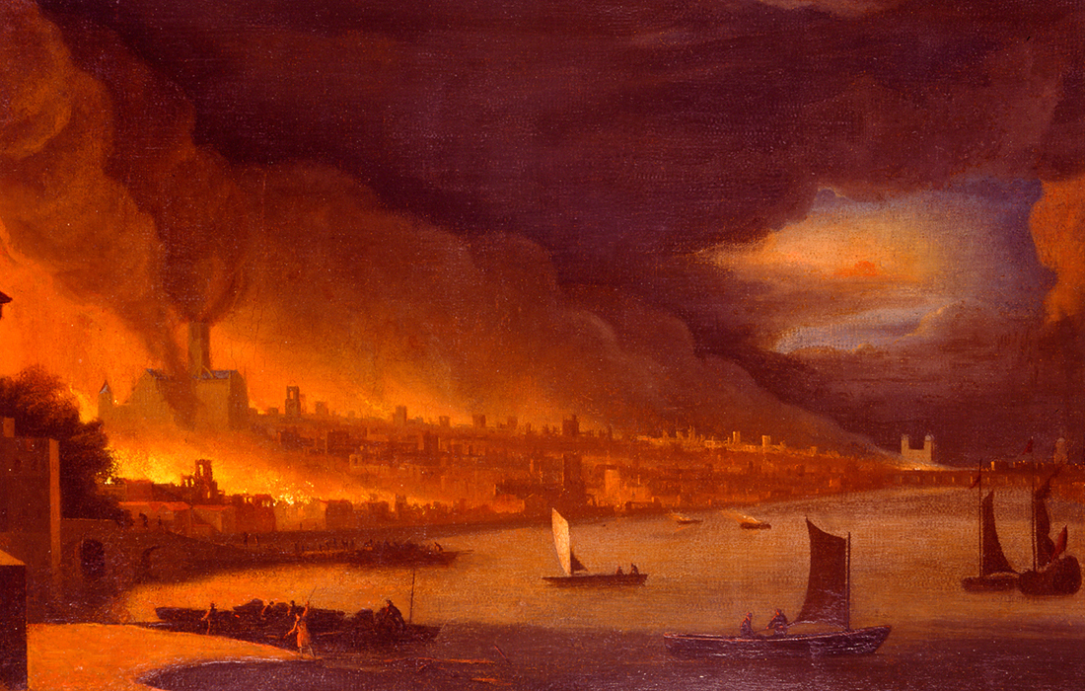
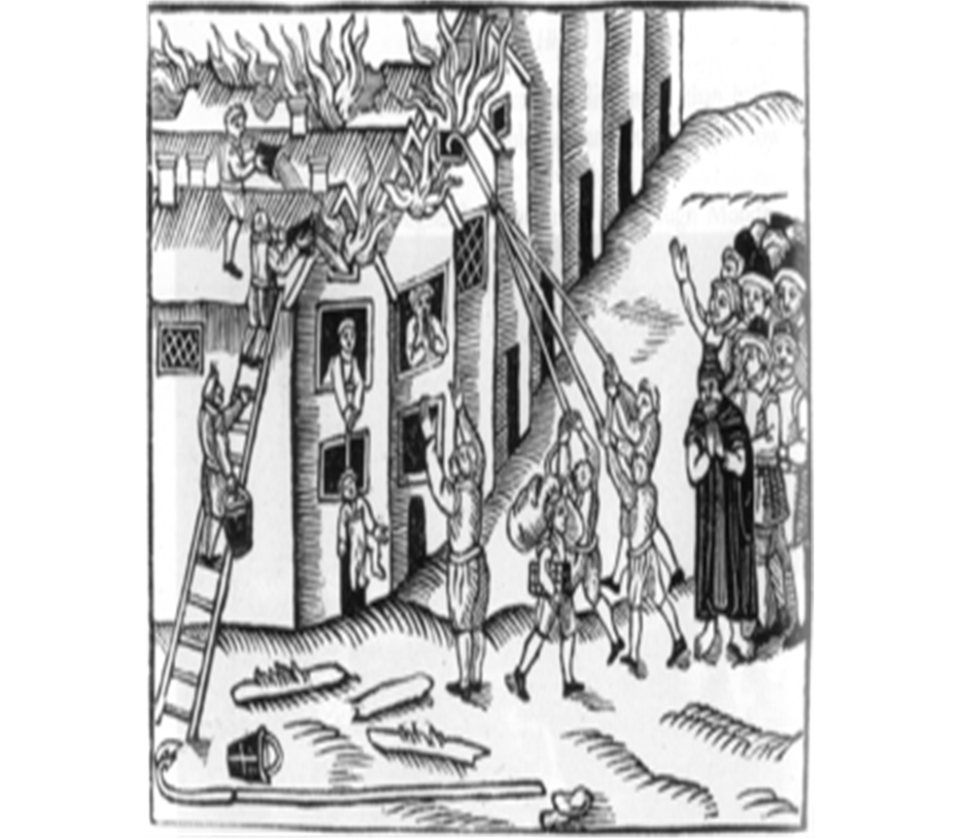
The Great Fire of London - 1666
The Fire started on the 2nd September 1666 and raged for four days and nights. It started in Pudding Lane at a baker’s shop, owned by Thomas Farynor . His maid failed to put out the ovens at the end of the night.
Once the fire started, it spread quickly. The city was made out of wood, and with September following on from the summer, the city was very dry. Strong winds fanned the flames and the fire grew.
Fire fighting services did not exist in 1666. People used leather buckets which had little effect on the fire. Houses were pulled down to stop the fire spreading from house to house. The wind eventually dropped and the fire finally stopped.
From the 2nd – 5th September, 80% of the city was destroyed and over 13,000 houses , 89 churches (including St. Paul's Cathedral) were damaged.

Slide 3
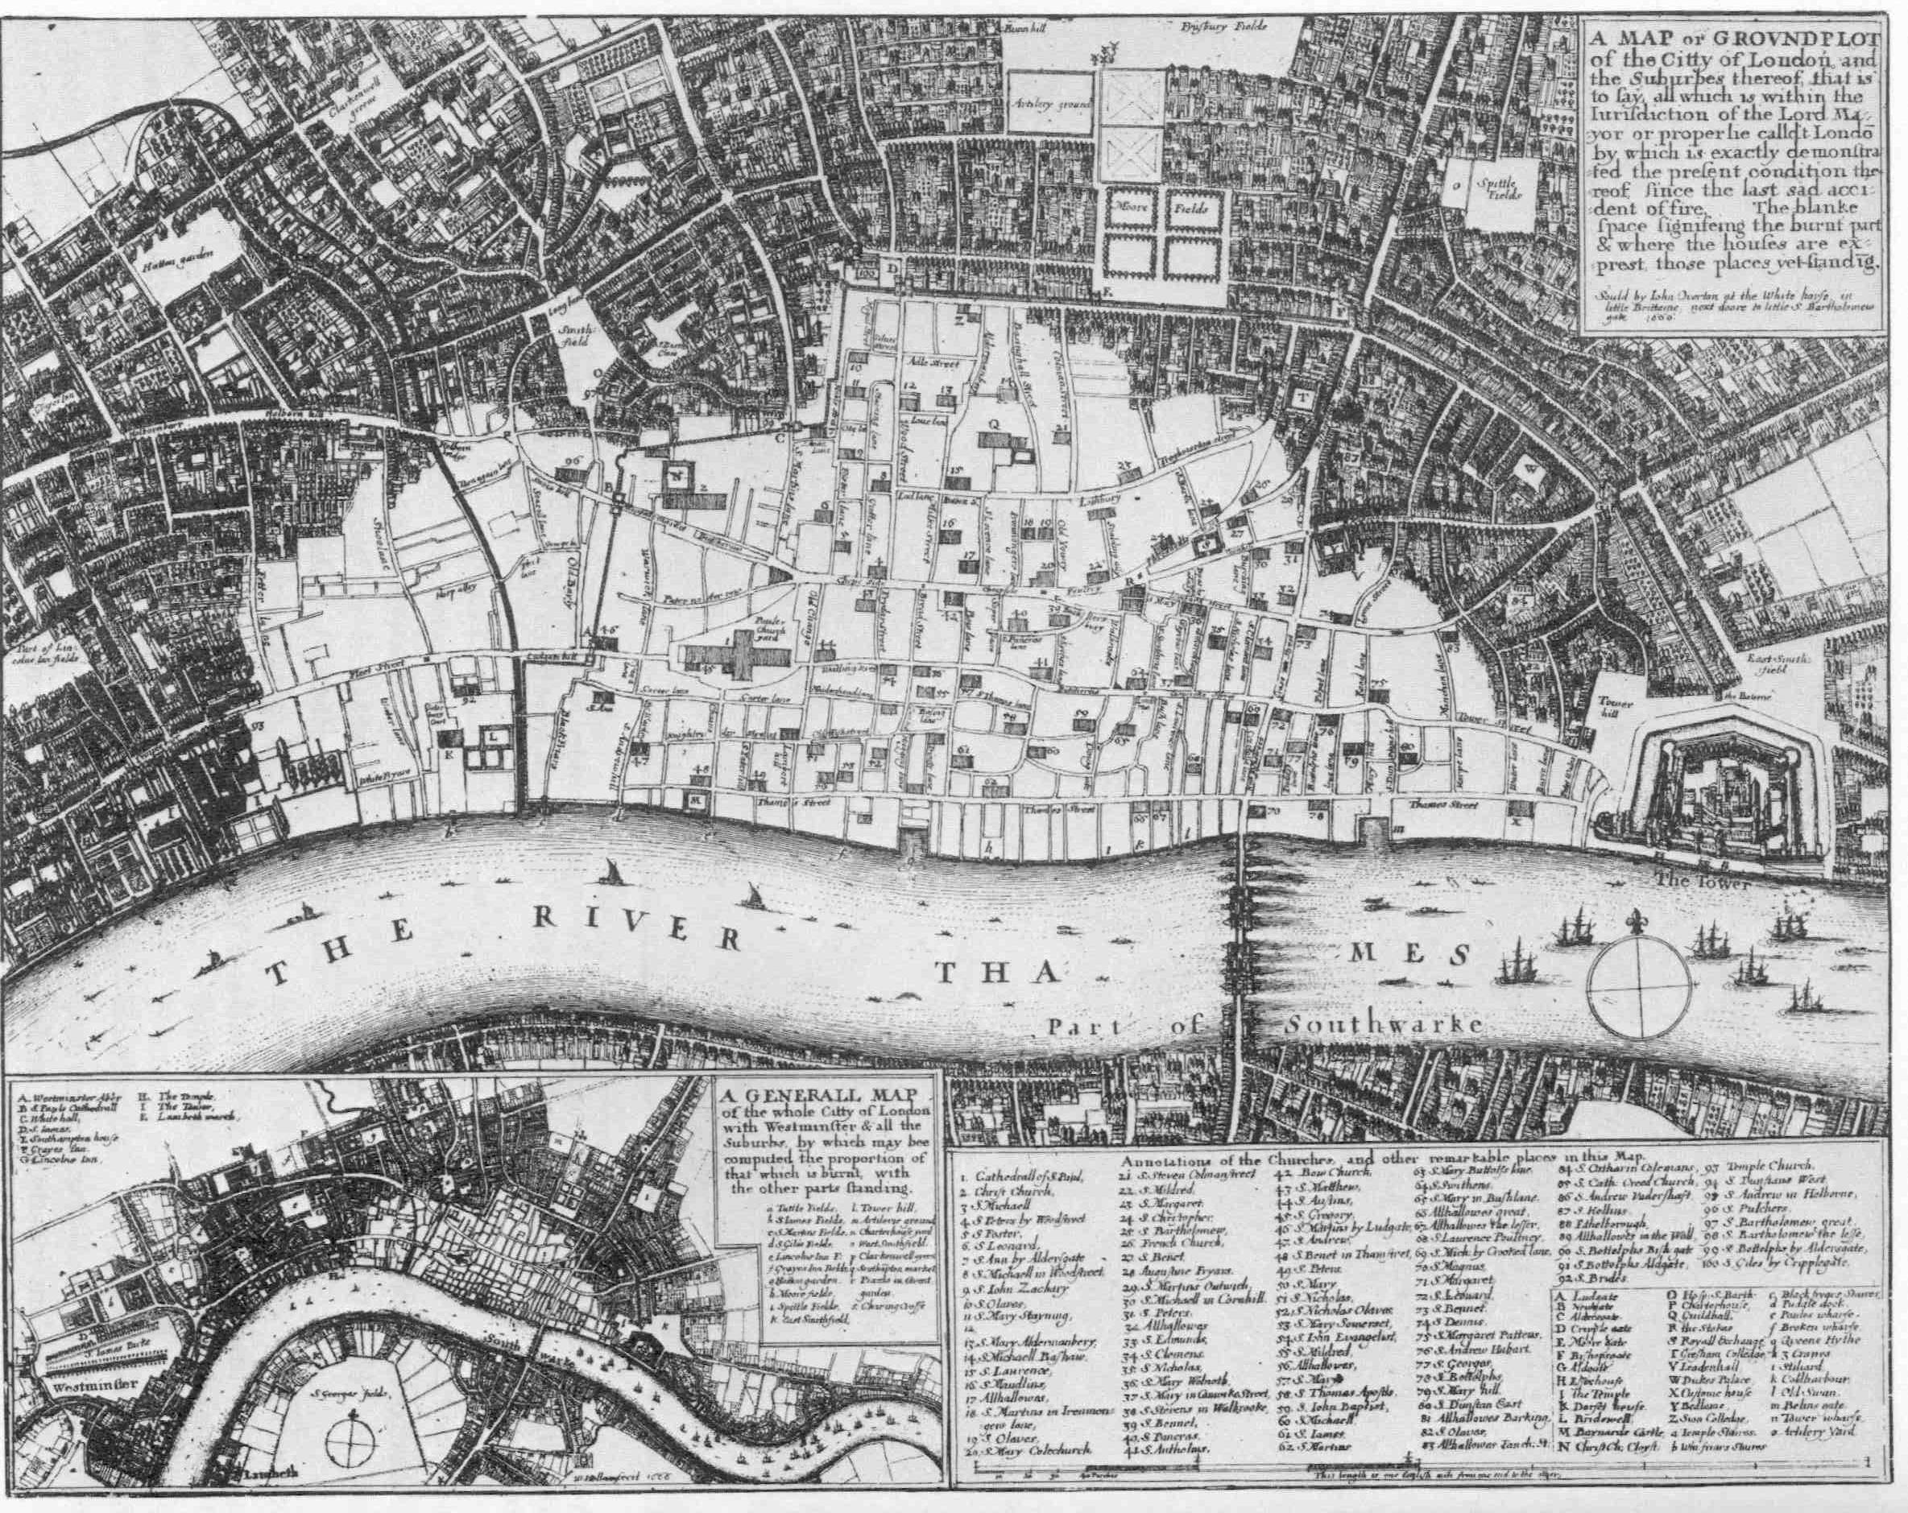
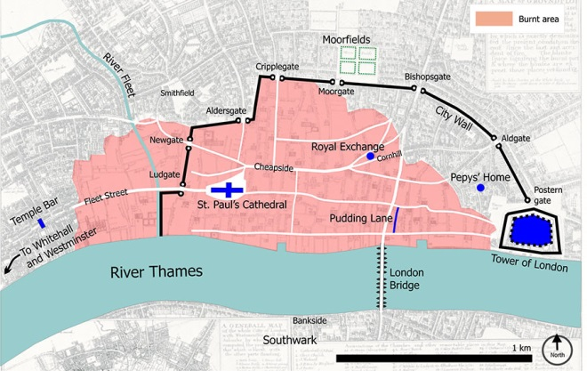

Slide 4
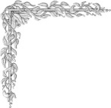
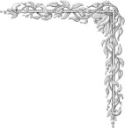
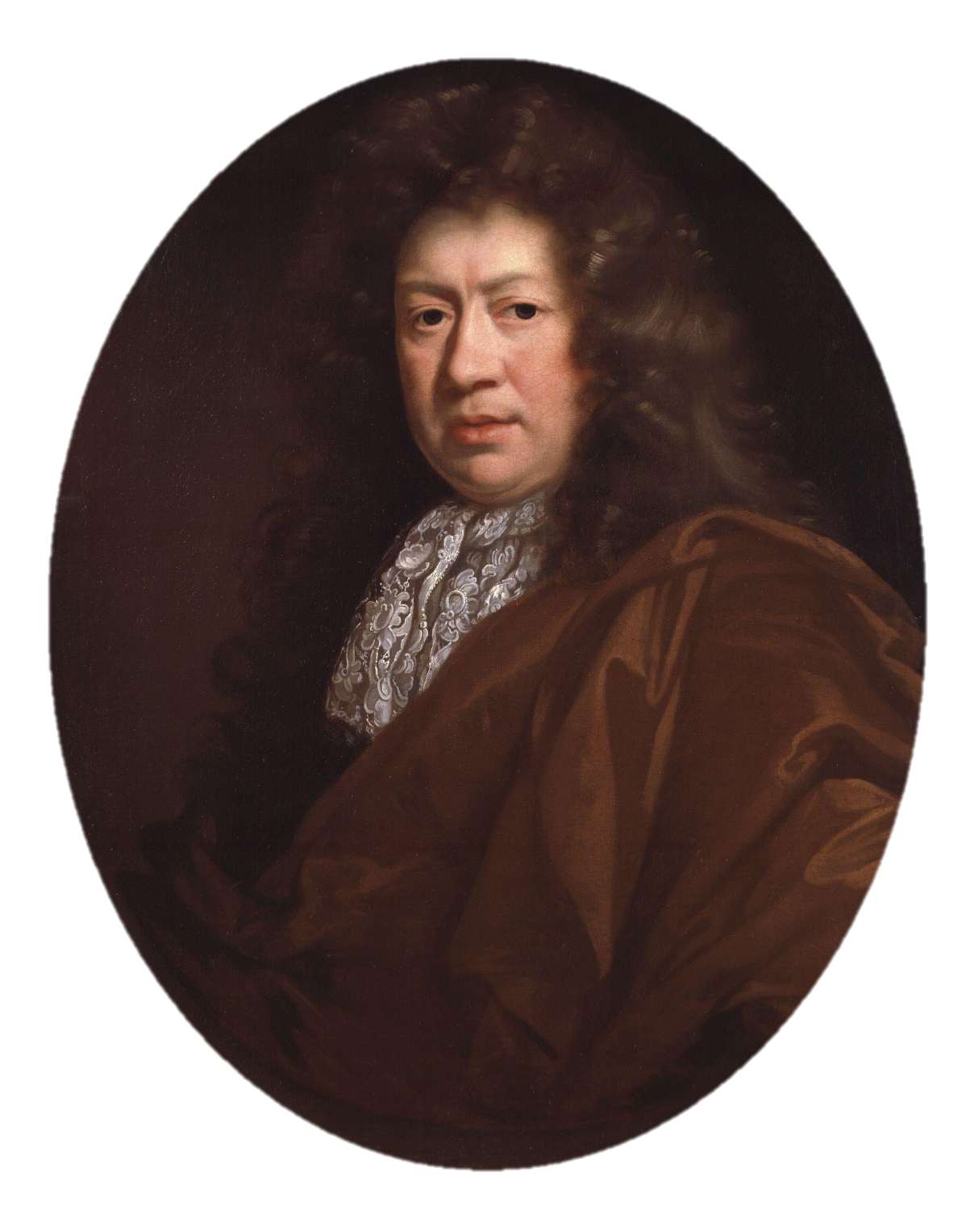
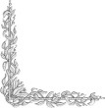
Houses were burned one from another. When we could endure no more upon the water; we to a little ale-house on the Bank side, over against the 'Three Cranes, and there stayed till it was dark and saw the fire grow; and, as it grew darker, appeared more and more, and in corners and upon steeples, and between churches and houses, as far as we could see up the hill of the city, in a most horrid malicious flame, not like the fine flame of an ordinary fire. We saw the fire as only one entire arch of fire from this to the other side the bridge, and in a bow up the hill for an arch of above a mile long: it made me weep to see it. The churches, houses, and all on fire and flaming at once; and a horrid noise the flames made, and the cracking of houses at their ruins.
September 2nd 1666. Jane called us up about three in the morning, to tell us of a great fire they saw in the city. So I rose and slipped on my nightgown, and went to her window, and thought it to be on the backside of Marke-lane at the farthest; but, being unused to such fires as followed, I thought it far enough off; and so went to bed again and to sleep. About seven rose again to dress myself, and there looked out at the window, and saw the fire not so much as it was and further off. By and by Jane comes and tells me that she hears that above 300 houses have been burned down to-night by the fire we saw, and that it is now burning down Fish Street, by London bridge.
http://www.youtube.com/watch?v=Dn6E_4g4UAw&feature=related

Slide 5
02/09/1666.
Imagine you are watching the Great Fire of London from your bedroom window in London.
Say what you can see/hear/taste/smell.
Explain what ‘fire breaks’ are.
Say what you think about the fire spreading quickly
Dear Diary,
I could see…. (At least 3 things)
I could hear… (At least 3 things)
I could taste…
I could smell...
I was scared because…
The fire was getting closer…
I decided to gather my belongings…
http://www.youtube.com/watch?v=BLmwmX-mni8&feature=related

Slide 6
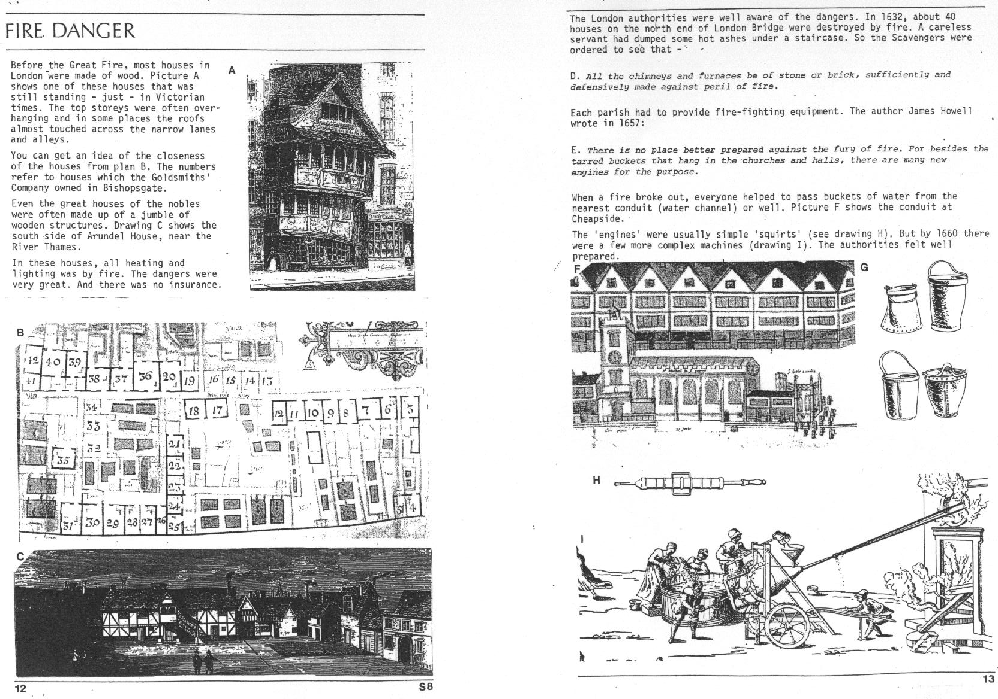
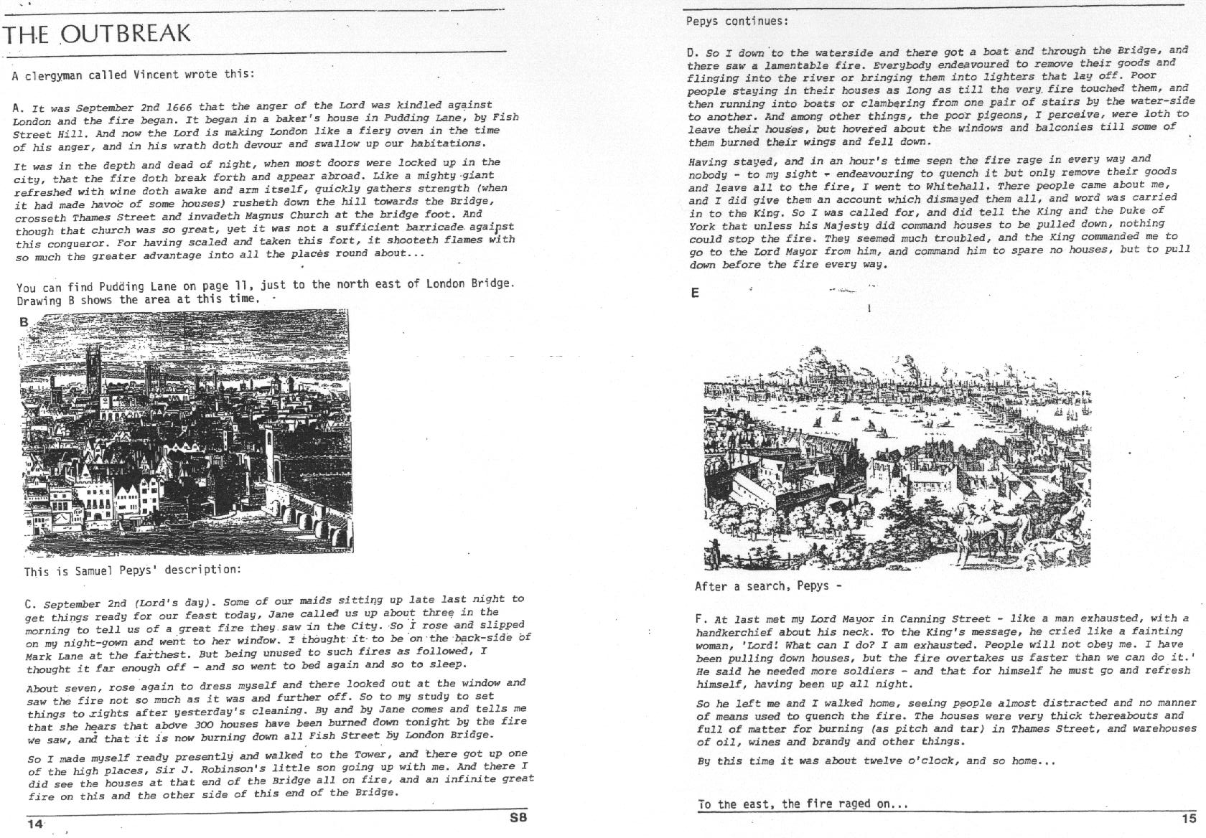
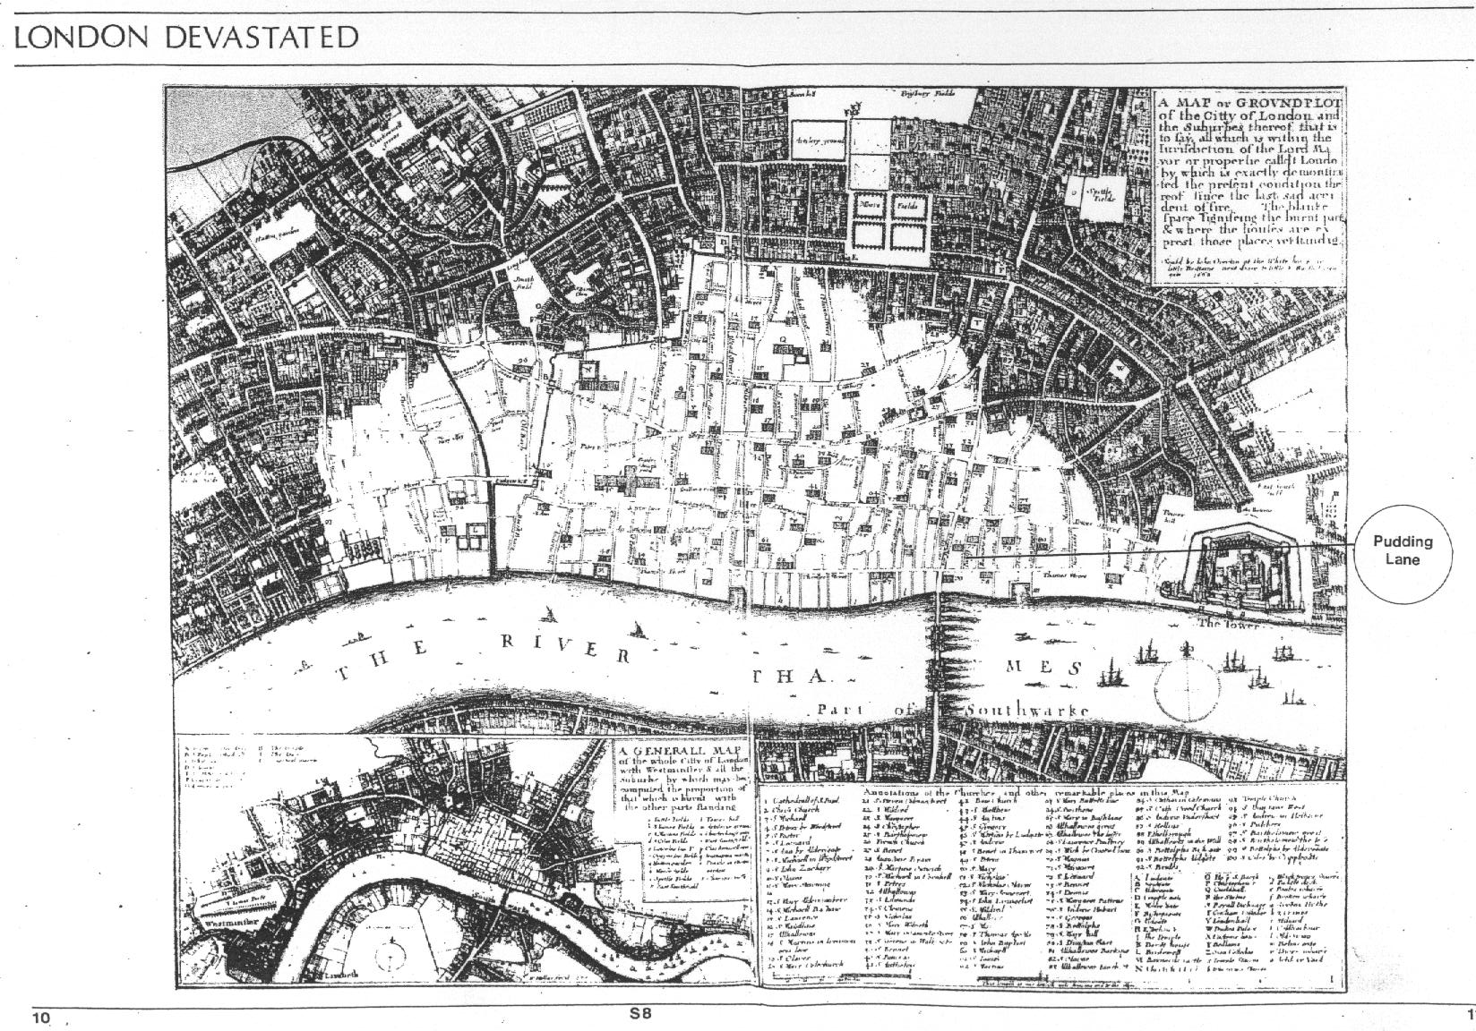
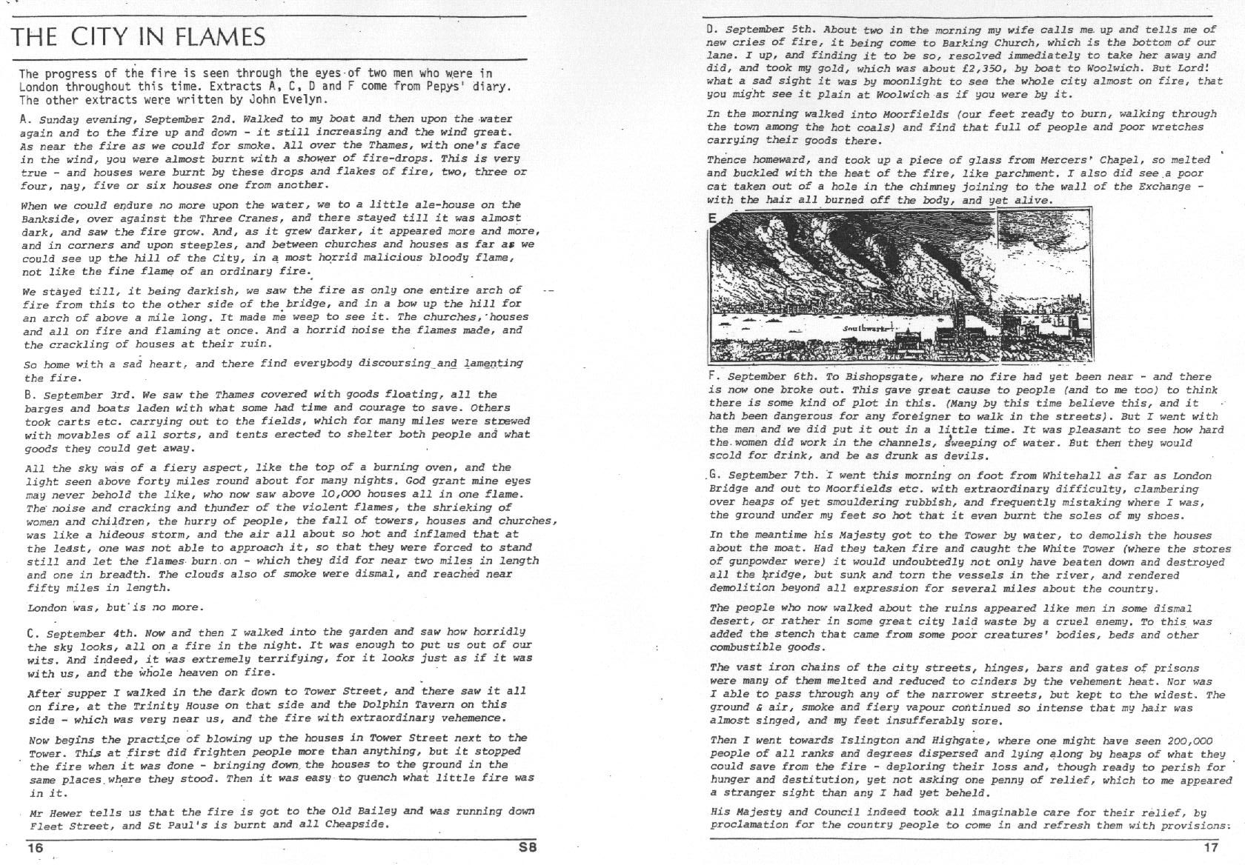

Slide 7
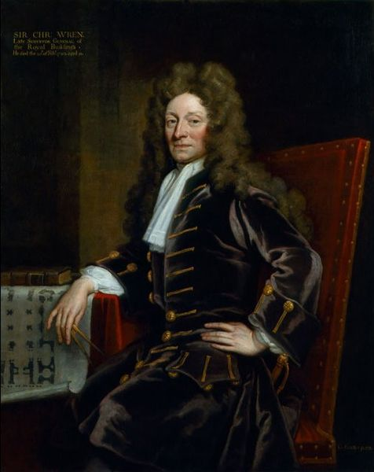
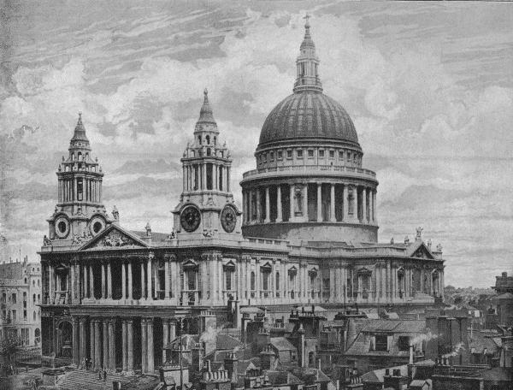
London was rebuilt using brick material.
Sir Christopher Wren - Architect

Slide 8
