Slide 1
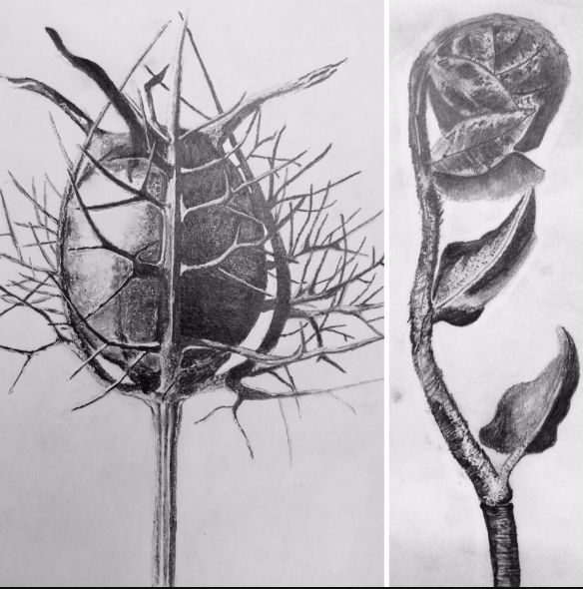
Karl Blossfeldt drawing
This is a great task to really practice your tonal drawing skills. Last year they produced some outstanding responses... I have attached them so that you can see.
I would suggest working A5 size, but you can go bigger if you wish. I want you to focus on the careful addition of detail and texture. Don't over simplify your drawing. This takes time and patience.
Time frame: I've set this for your Friday lesson and your Monday double, please submit once it is complete.
If you can, ensure that previous photos and ink drawing additions are submitted by Friday night. I do not expect you to do any work over the weekend.
Tools: 2B pencil, mechanical pencil or a very sharp H pencil, eraser, something to blend with like a cotton bud. Paper - sketchbook/cartridge
Please select a Blossfeldt image to work from (also attached).
I've found a video that may be of help https://www.youtube.com/watch?v=qMkcu8L4IIA (it is a whole plant rather than a close up, but from the 4min mark how they shade the leaves is useful) notice how they lightly sketch the outline freehand first. You do not need to use a grid to do this piece, unless you want to.
TIP: Focus on gradually building up a range of tones using small movements of the pencil. Spend a lot of time looking at the Blossfeldt image that you've chosen to work from. Look closely at the textures, try to recreate them with your pencil using mark making.

