Slide 1
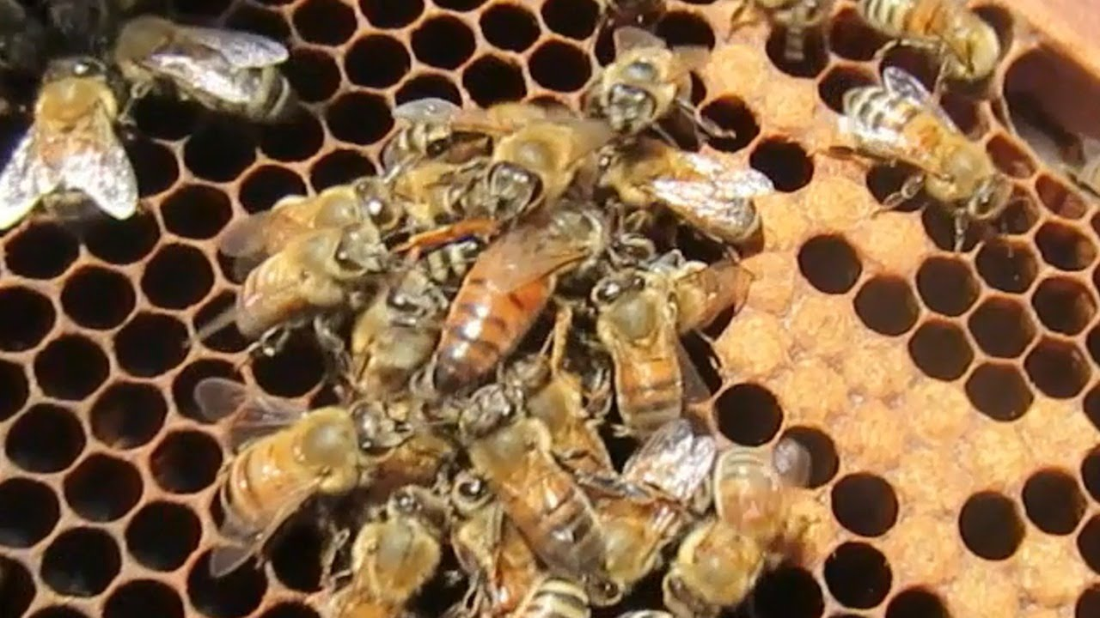
SWARM aim: to create a group installation that raises awareness of declining bee numbers
PROJECT 1
10 WEEKS

Slide 2
Ms Westmore
Mrs Gregg

Slide 3
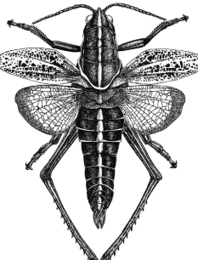
EXPECTATIONS
Sketchbooks/art packs
Aprons
Homework
Aiming High
Attitude and behaviour

Slide 4
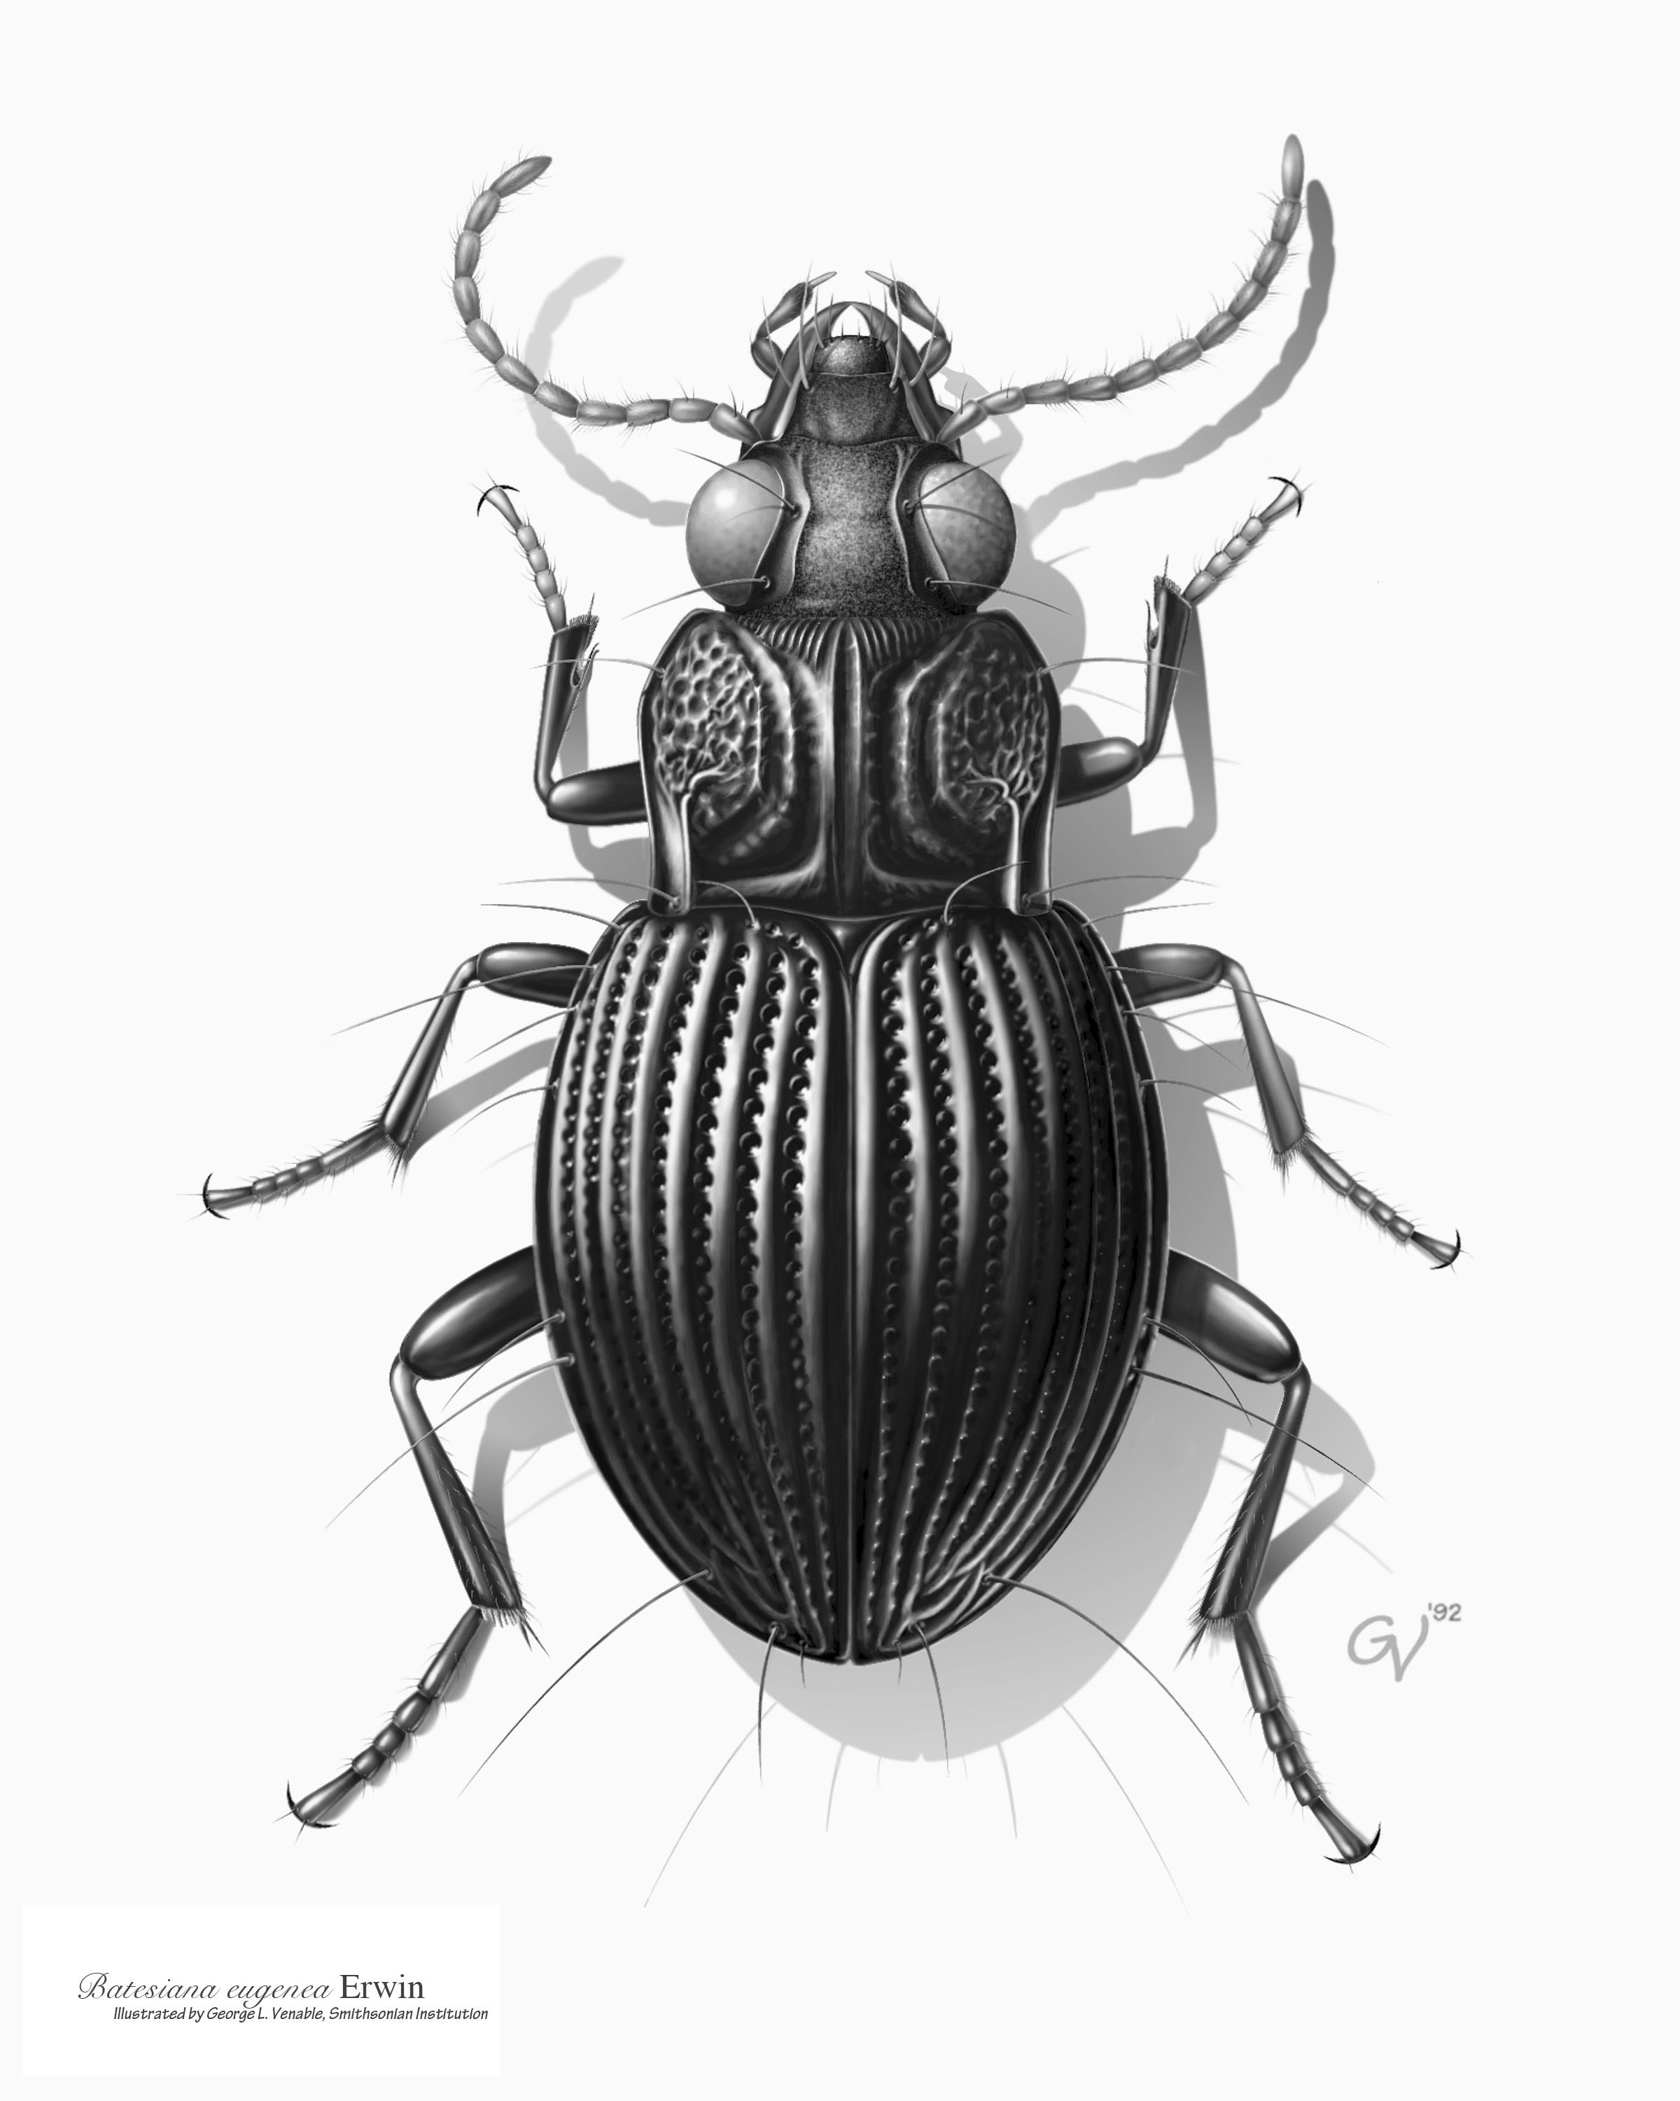
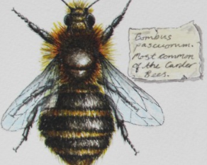
Artwork that we will look at…

Slide 5
Project Theme: swarm
Task 1 mind map
Aim to fill the page.
What sub headings could you use?

Slide 6
Project Theme: swarm
Mind map and title page - Aim to fill the page.
What sub heading could you use?
Insects, declining bee population, shapes, colours, keywords that are to do with the formal elements and the project (Ms Westmore/Mrs Gregg will tell you these).
Project aim: to create a group installation that raises awareness of declining bee numbers

