Slide 1
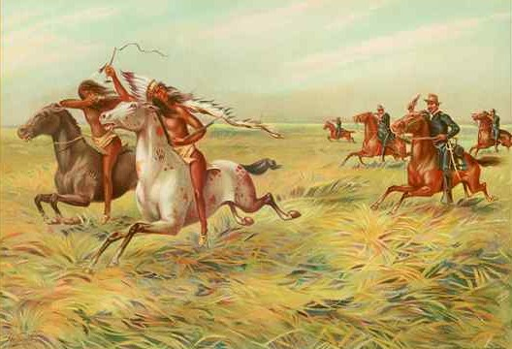
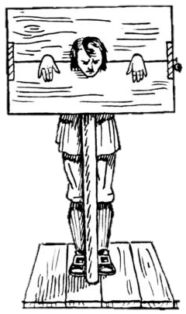
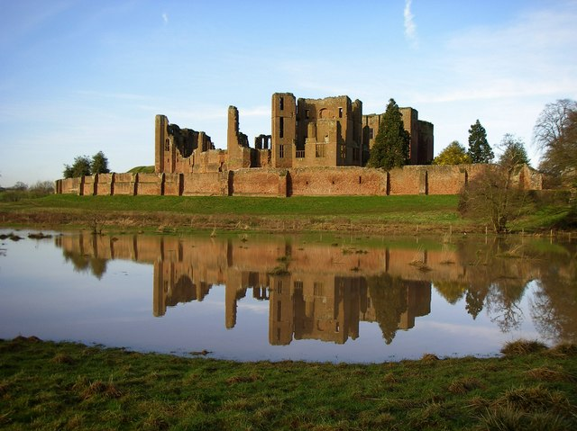
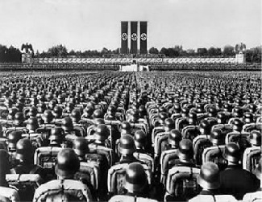
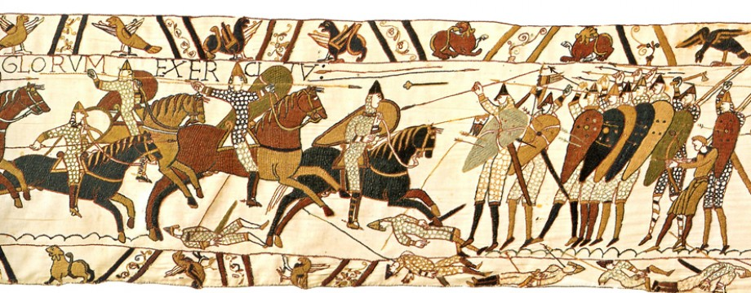
Welcome to
History at K.E.S!
Notes:
Lesson One

Slide 2
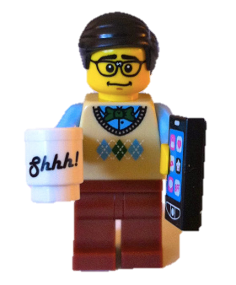
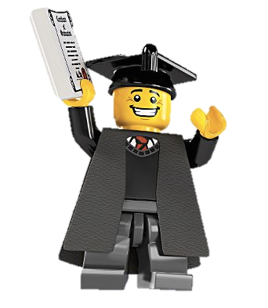
History Classroom Expectations
You enter the classroom quietly
Get out your equipment- pen, pencil & ruler
Write the title and the date down- underline both
Get on with the activity on the board
Complete all homework to a presentable standard and hand it in on time
Respect the opinions of others
Contribute and listen during class discussions
Put your hand up if you would like to ask a question
Notes:
Adapt to your needs

Slide 3
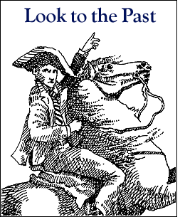
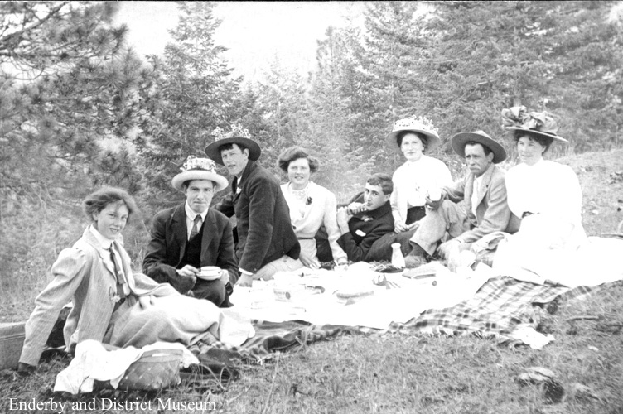
Put you left hand up if you think true... Put your right hand up if you think false …
1. History is about the past.

Slide 4
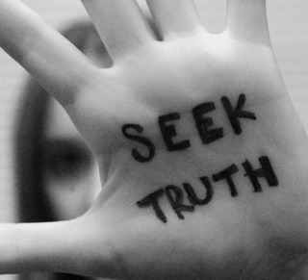
Put you left hand up if you think true... Put your right hand up if you think false …
2. History is the truth about the past.

Slide 5
Put you left hand up if you think true... Put your right hand up if you think false …
3. History is myths/ stories about the past.

Slide 6
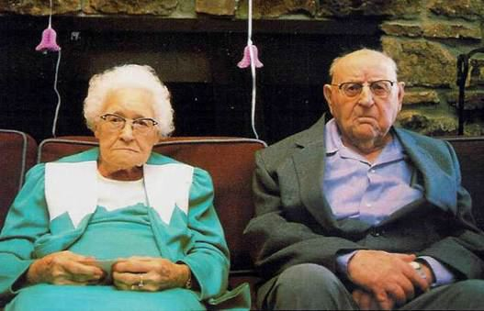
Put you left hand up if you think true... Put your right hand up if you think false …
4. History is only about old people.

Slide 7
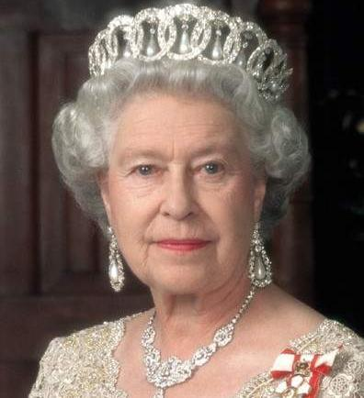
Put you left hand up if you think true... Put your right hand up if you think false …
5. History is only about important people.

Slide 8
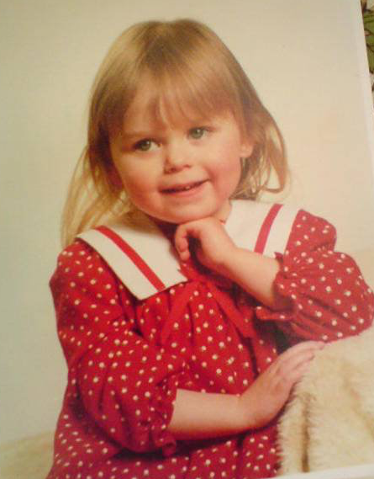
Put you left hand up if you think true... Put your right hand up if you think false …
6. We all have a history.

Slide 9
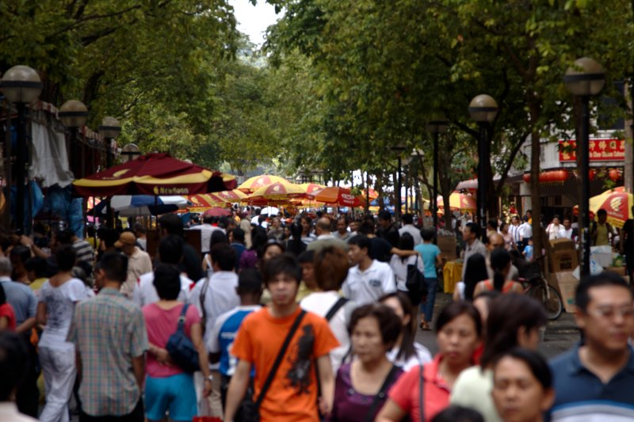
Put you left hand up if you think true... Put your right hand up if you think false …
7. We are all part of history.

Slide 10
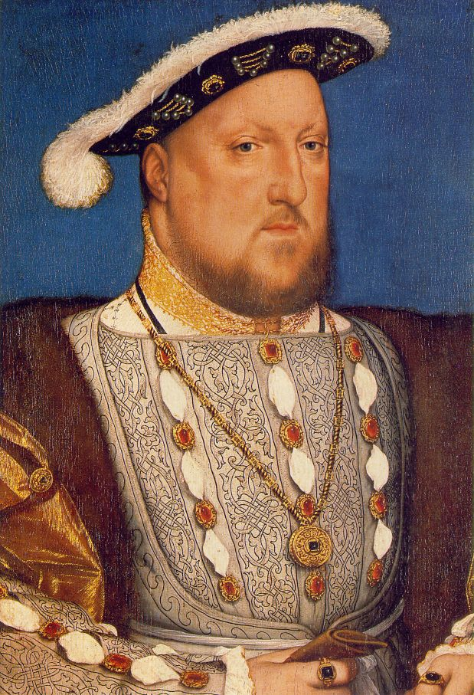
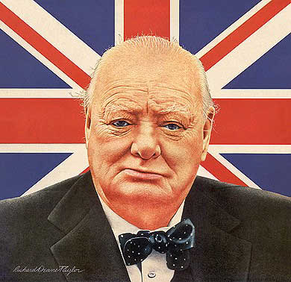
Put you left hand up if you think true... Put your right hand up if you think false …
8. History is all about men (his story)

Slide 11
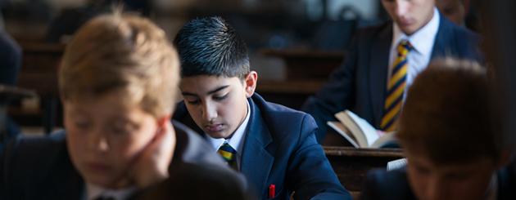
Put you left hand up if you think true... Put your right hand up if you think false …
9. History is all about me and my life and the world I live in.

Slide 12
Put you left hand up if you think true... Put your right hand up if you think false …
10. History can help me to learn new skills.

Slide 13
What skills will you develop?
Research skills
Excellent Communication & writing skills
How to handle & analyse data
How to construct an argument
How to organise information
Problem-solving
How to select evidence
The ability to question how useful sources are

Slide 14
Why do we study History?
It teaches you how ideas, beliefs, decisions and actions have shaped events in the past.
History deals with big issues e.g. racism, power, war, politics, discrimination & terrorism
To develop the TRANSFERABLE SKILLS employers want
Because it is enjoyable, interesting and thought provoking!

Slide 15
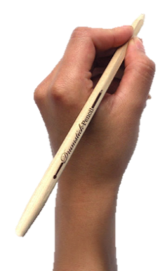
History Books
WRITE:
Full Name
7
History - Miss Galvin

Slide 16
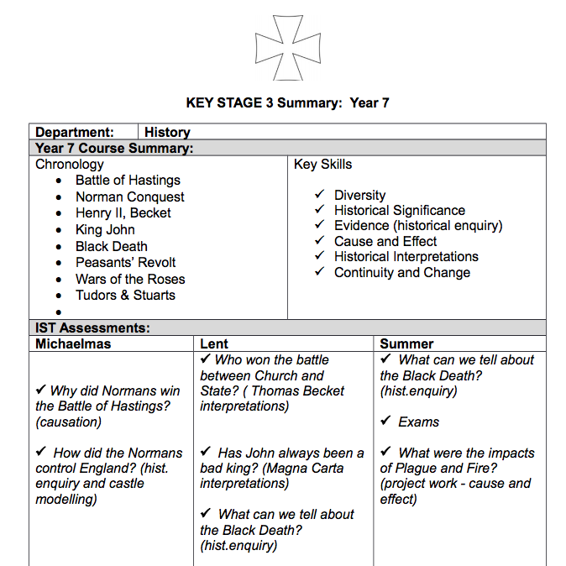

Slide 17
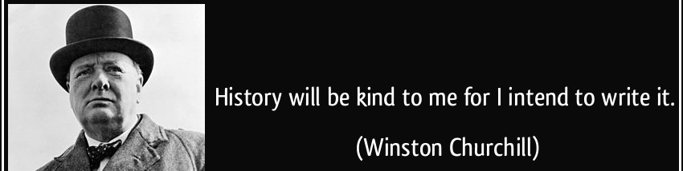
What is History?
Learning objectives
Recall, what in your opinion, History is
Describe some main events, people, time periods and skills we will be using in History
Explain historical significance of particular events and people.

Slide 18
What is history?
Answer these two questions in full sentences:
What is History? History is…
Why do we study it? I think that we study History because…
Extension: can we
ever learn from
History??
Use these key words:
People
Places
Historians
Detectives
Past
Notes:
4mins max

Slide 19
What did you learn at your primary school?
What do you hope to learn in History at K.E.S.?
Why is History important?

Slide 20
What does it mean to say that something is HISTORICALLY SIGNIFICANT?
What does it mean to say that something is PERSONALLY SIGNIFICANT?
Notes:
The importance of an event or an occasion is how worthwhile it is in the scheme of things.
The significance of an event or an occasion is the underlying meaning or interpretation of it.

Slide 21
Historical and personal significance
Learning objectives
Create a timeline of your personal history.
Recall what the difference between historical and personal significance is.
Consider what the difference between importance and significance is.
Notes:
My graduation was an important moment in my life
It was significant because the amount of work I had put into the three years.

Slide 22
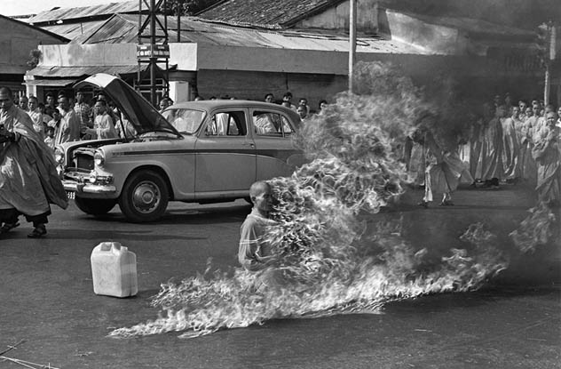
Notes:
This shocking photograph depicts Quang Duc, a monk who set himself on fire at a busy Saigon road intersection in 1963. He died protesting the persecution of Buddhists by the South Vietnamese government. The regime had made life very difficult for Buddhists, banning them from flying their traditional flag or practicing their beliefs and spiritual exercises. Thus the Buddhists decided that a message had to be sent.

Slide 23
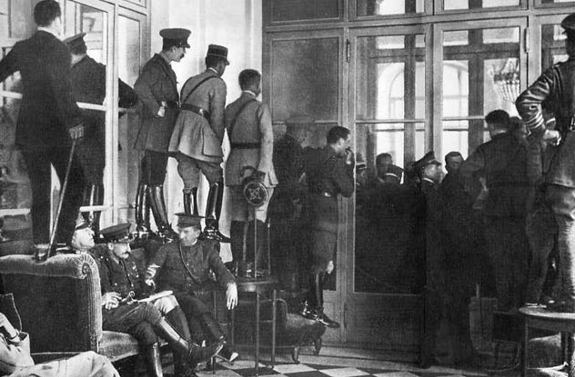
Notes:
Glimpsing The Versailles Signing
1919

Slide 24
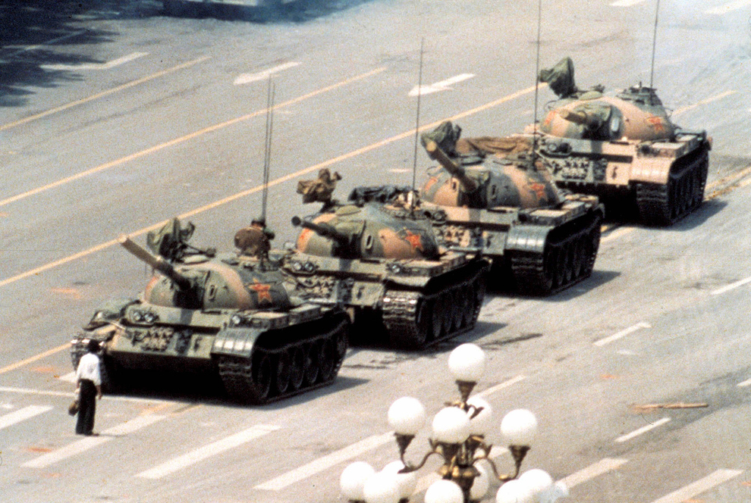
Notes:
The iconic photo of Tank Man, the unknown rebel who stood in front of a column of Chinese tanks in an act of defiance following the Tiananmen Square protests of 1989.

Slide 25
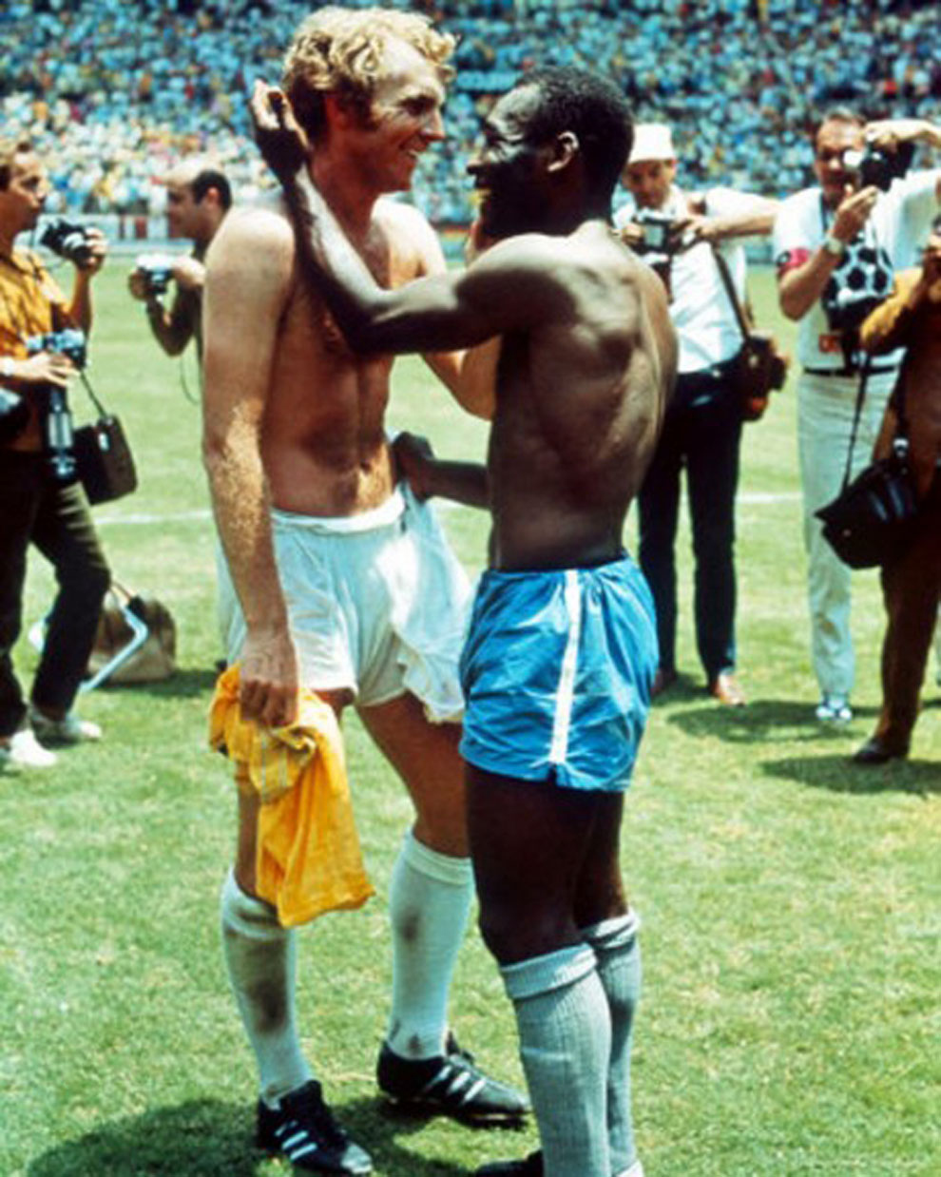
Notes:
Pele and British captain Bobby Moore trade jerseys in 1970 as a sign of mutual respect during a World Cup that had been marred by racism

Slide 26
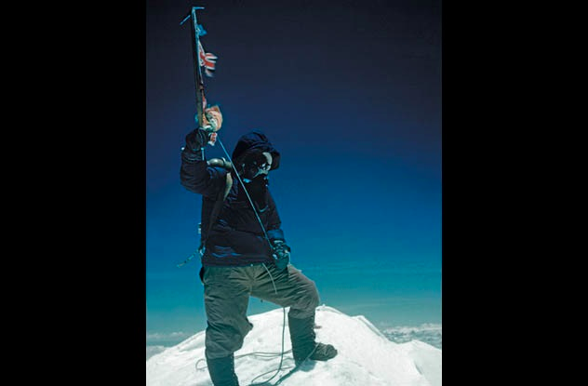
Notes:
Tenzing Norgay On Everest’s Summit
1953

Slide 27
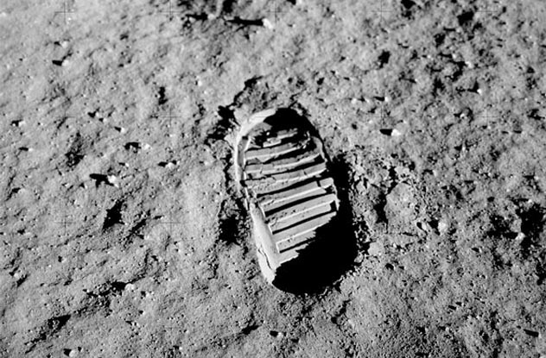
Notes:
Footprint on the moon 1969

Slide 28
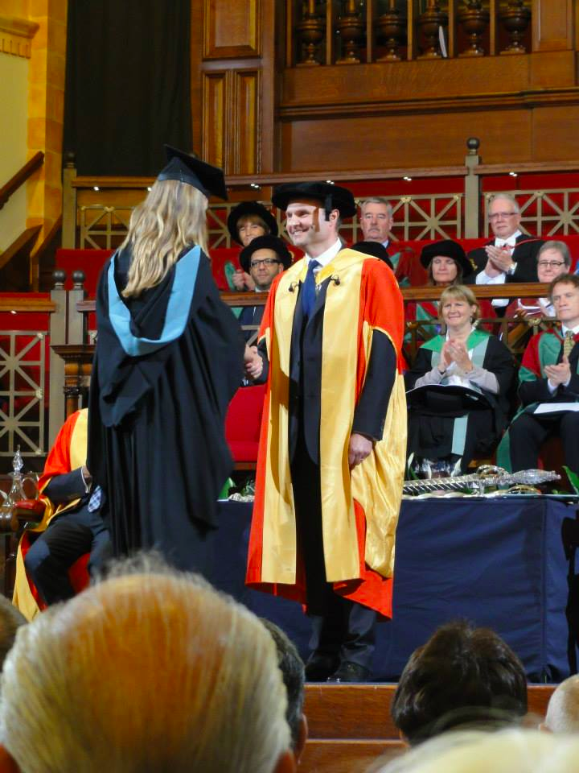

Slide 29
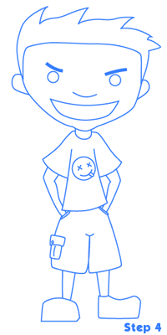
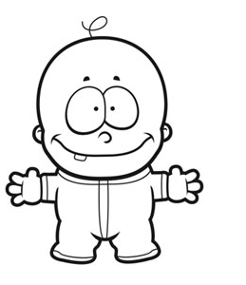
My Personal History Your job:
Double page spread.
Draw a timeline from the day of your birth up until today.
Fill in at least 10 important events on your timeline and illustrate it.
You have this lesson and next to get it done.
If you want to bring in copies of photos and pictures from newspapers/magazines to stick in, you can.

Slide 30
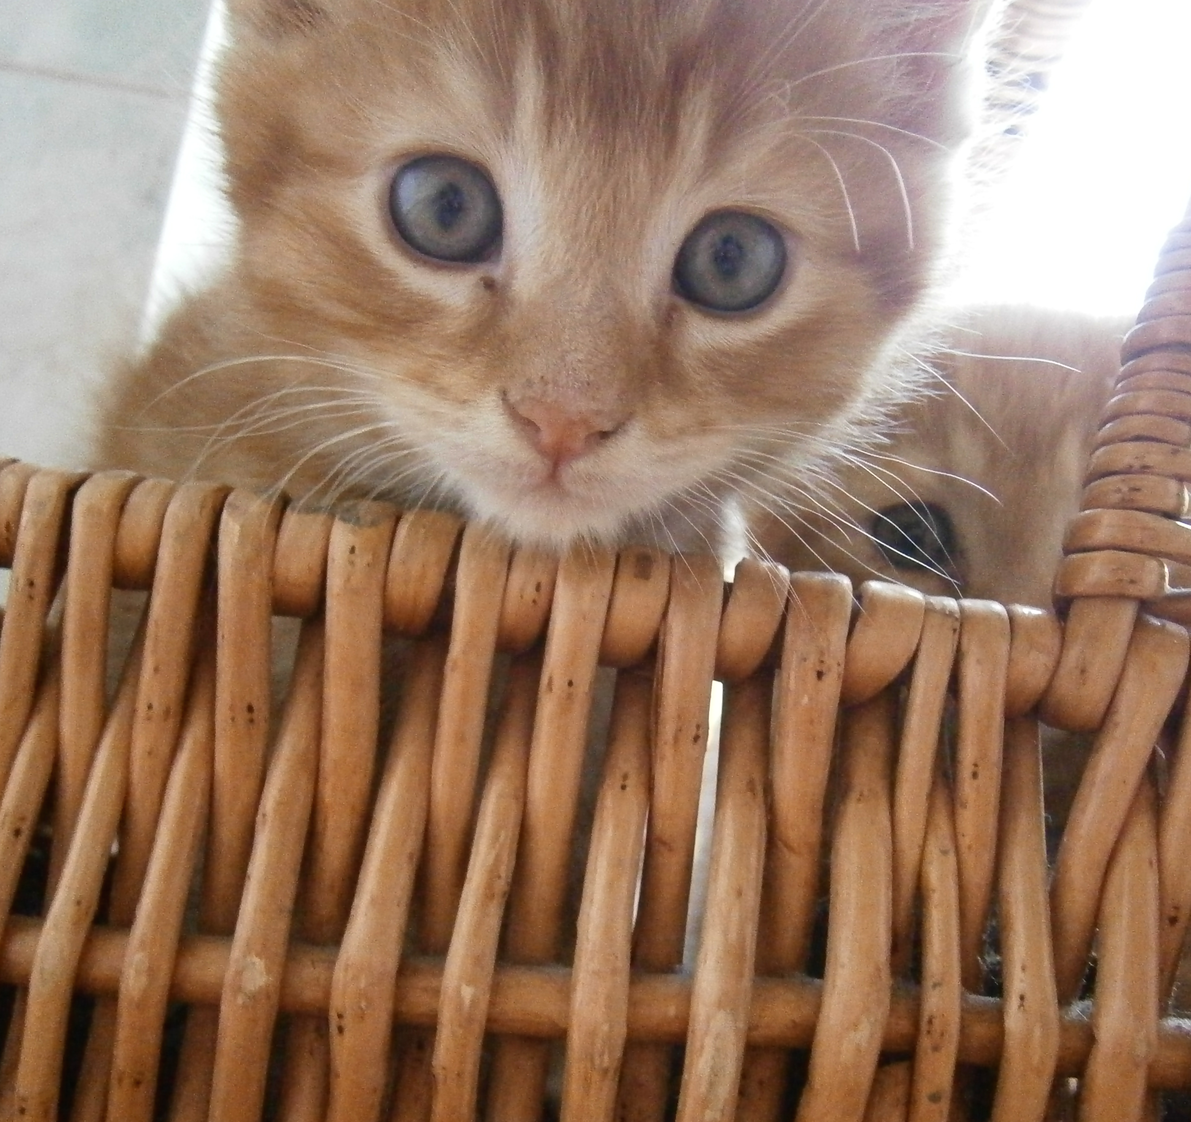
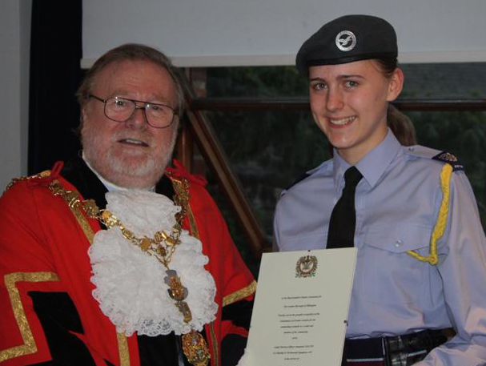
Miss Galvin’s timeline

