Slide 1
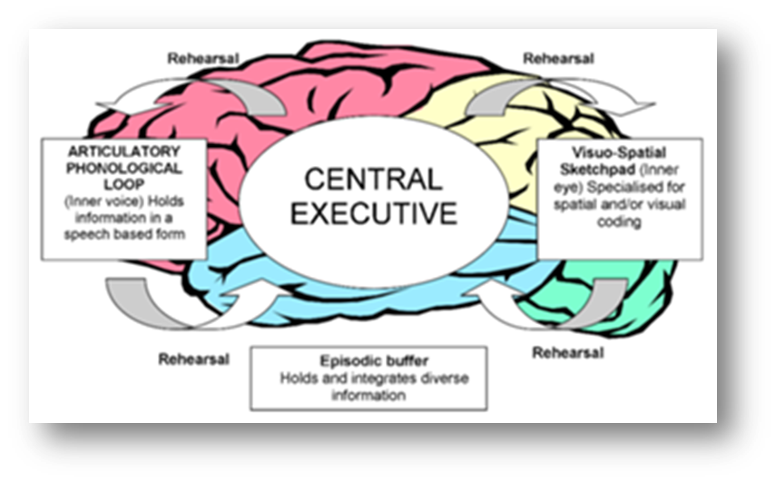
How can we evaluate the WMM? Baddeley & Hitch (1974)
Starter: Do you know what each of these exam trigger words requires:
Describe
Outline
Explain
Compare
Discuss
Evaluate
Learning objectives:
To EVALUATE the strengths and limitations of the model (A02).
To KNOW and EVALUATE research supporting the model (A02).

Slide 2
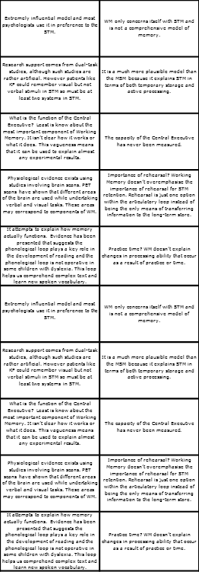
Activity – Evaluation highlight
1. Highlight each evaluation of the WMM as either a:
Strength
OR
Criticism.
Don’t forgot to evaluate memory models in longer questions in an exam.
Key words
Empirical
Dual task method
Dyslexia
ADHD
Learning objectives:
To EVALUATE the strengths and limitations of the model (A02).
To KNOW and EVALUATE research supporting the model (A02).

Slide 3
‘Dual task method’
+ Evaluation - WMM
Supported by LOTS of empirical research.
Can somebody re-cap what this entailed?
Key words
Empirical
Dual task method
Dyslexia
ADHD
Learning objectives:
To EVALUATE the strengths and limitations of the model (A02).
To KNOW and EVALUATE research supporting the model (A02).

Slide 4
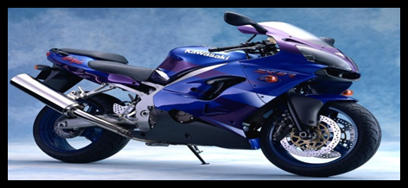
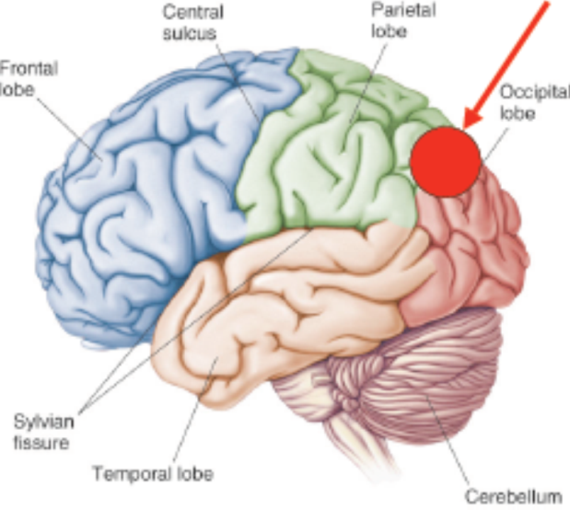
Case study - ‘KF’ Shallice & Warrington 1970
Evidence
for WMM…
What advantages are there of using case studies such as this as evidence rather than experiments.
Suggest a weaknesses.
KF suffered brain damage to his left occipital lobe following a motorcycle accident.
His short term memory for verbal materials was very poor, but was more or less normal for visual material.
This suggested he had an impaired articulatory loop.
How does this support the WMM?
Key words
Empirical
Dual task method
Dyslexia
ADHD
Learning objectives:
To EVALUATE the strengths and limitations of the model (A02).
To KNOW and EVALUATE research supporting the model (A02).

Slide 5
+ Evaluation - WMM
INFLUENTIAL!!!
Most cognitive psychologists now refer to STM as ‘working memory’.
It has simulated research and the model has been modified to account for new findings.
Key words
Empirical
Dual task method
Dyslexia
ADHD
Learning objectives:
To EVALUATE the strengths and limitations of the model (A02).
To KNOW and EVALUATE research supporting the model (A02).

Slide 6
+ Evaluation - WMM
Has important practical applications.
Can help in early identification of dyslexia.
Can be used as a basis to help treat children with ADHD and dyslexia improve working memory (allows a greater ability to hold and manipulate data). However, research into the effectiveness of this has been criticised methodologically.
Key words
Empirical
Dual task method
Dyslexia
ADHD
Learning objectives:
To EVALUATE the strengths and limitations of the model (A02).
To KNOW and EVALUATE research supporting the model (A02).

Slide 7
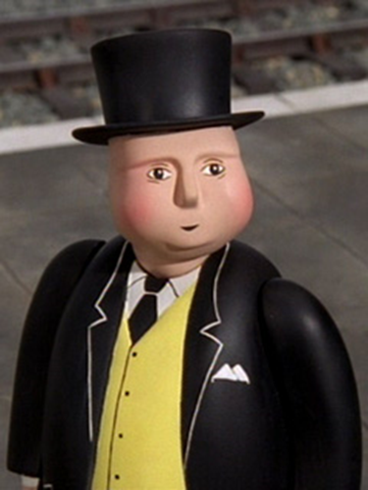
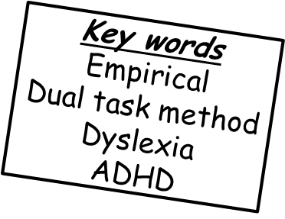
- Evaluation - WMM
There is very little research on the most important part of the WMM – the central executive.
Therefore little is known about this most important aspect of the model. The idea is simplistic and vague.
?
For example: What exactly is ‘directing attention’ and ‘allocating resources’?
Learning objectives:
To EVALUATE the strengths and limitations of the model (A02).
To KNOW and EVALUATE research supporting the model (A02).

Slide 8
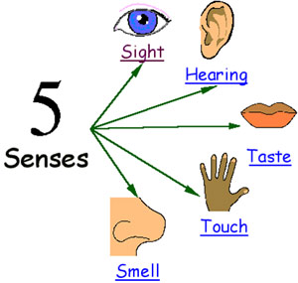
- Evaluation - WMM
Model does not make it clear how we deal with information from smell and touch senses.
Just acoustic and visual information.
X
X
Learning objectives:
To EVALUATE the strengths and limitations of the model (A02).
To KNOW and EVALUATE research supporting the model (A02).

Slide 9
- Evaluation - WMM
WM only concerns itself with STM, and does give detail into LTM. It is not a comprehensive model of memory.
Learning objectives:
To EVALUATE the strengths and limitations of the model (A02).
To KNOW and EVALUATE research supporting the model (A02).

Slide 10
Activity – Recognising A01 and A02
Read through the 12 mark exemplar answer. Highlight A01 and A02
A/A* extension: Read through the APA article on the effectiveness of practical applications of WMM research. What methodological issues are there with the research?
Remember: You MUST elaborate your evaluation points for the higher marks.
For example - There is evidence from dual task studies to support the model (1 mark). It is easier to do two tasks at the same time if they use different processing systems (verbal and visual) than if they use the same slave system (2 marks).
For example - The central executive is too simplistic and vague (1 mark). The central executive is the most vital part of the model, yet it’s exact role is unclear (2 marks).
Learning objectives:
To EVALUATE the strengths and limitations of the model (A02).
To KNOW and EVALUATE research supporting the model (A02).

Slide 11
Plenary – Match-up
If your name comes up you have to match-up one of the boxes on each side (not one that has already been done!!)
Joe
Joanna
Lily
Maz
Will S
Learning objectives:
To EVALUATE the strengths and limitations of the model (A02).
To KNOW and EVALUATE research supporting the model (A02).

