Slide 1
Starter: Create a mind map of your ideas about the question below. One idea has been added for you.
What information does the government have about the public today?
A register of all births, deaths and marriages

Slide 2
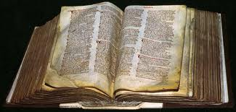
What does the Domesday Book tell us about life in the Middle Ages?
Learning Objectives
To describe aims and outcomes of Doomsday Book
To analyse and identify what the Doomsday Book tells us about Medieval life

Slide 3
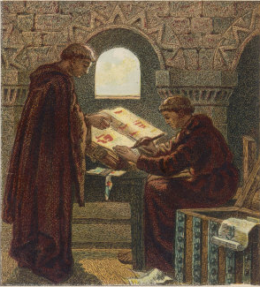
The Domesday Book
In 1085 William the Conqueror decided to commission a survey which would list all the resources held by people in the various parts of England and how much tax they therefore owned him.
He also wanted to know what was owed to him in military service.
People to whom he had given land, known as his tenants-in-chief, were expected to repay him by sending knights to fight in his army.
To ensure this happened he needed a written record of who owned which land.
It was the first time any King in England had attempted to gather all such information into one place.

Slide 4
Read the source below. Write a list of what the King wanted to know in your books
From the Ely Inquiry c. 1085
The King’s official met the priest, the reeve and the six men from each village. They inquired what the manor was called, and who held it in the time of King Edward; who holds it now; how many hides there are, how many ploughs, how many villeins, how many cottars, how many slaves, how many freemen; how much woodland, how much meadow; how many mills, what the estate is worthnow. And it was also to be noted whether more could be taken from the estate than is now being taken.

Slide 5
The Domesday Book
In 1085 William 1st ordered a survey to discover the resources and taxable values of all the boroughs and manors in England.
He wanted to discover:
Who owned what
How much it was worth
How much was owed to him as King in tax, rents, and military service.

Slide 6
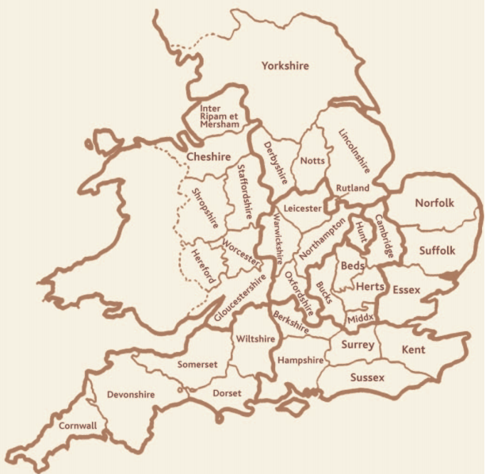
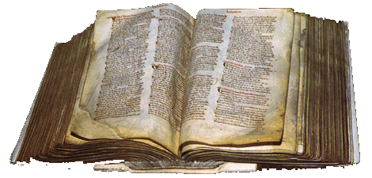
The Domesday Book
All the information was written down in two big books, which still exist today at the National Archives
The officials took over a year to visit 13,000 villages. Soldiers threatened to kill people if they did not tell the truth.
The book showed about 200 Normans controlled all the land of England
It valued England at £37,000!
It was the first survey of England and was written in Latin

Slide 7
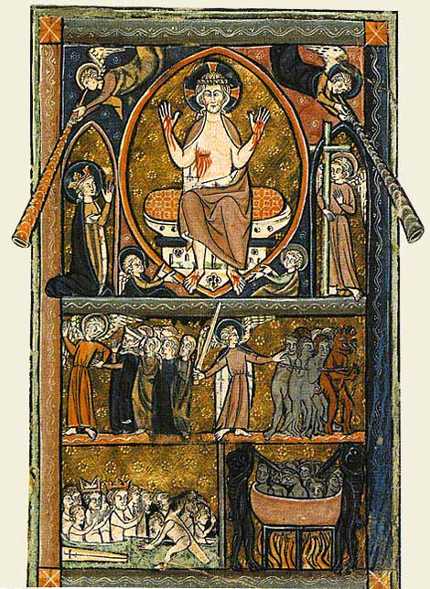
Why was it called Domesday?
Historians believe it was named after the biblical day of ‘Doomsday’
This was the Judgment day when Christ returned to judge the living and the dead
There was to be no appeal against the decisions made, and this was the same for the Doomsday Book

Slide 8
Review
L.O. Recap
What were the aims of the Doomsday Book?
What did the Doomsday Book tell William?
Bonus – Why was it called the Domesday Book?

Slide 10
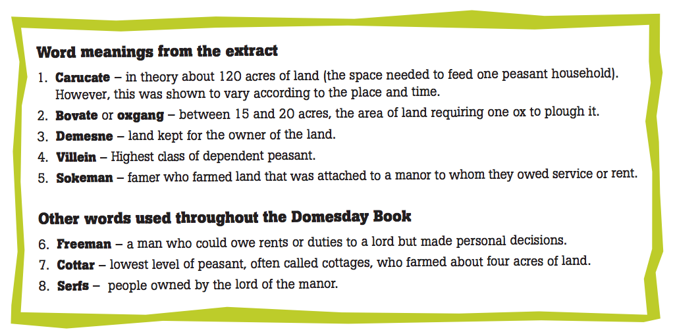

Slide 11
Conduct your own survey
This activity is to help you become familiar with the kind of information that was gathered for the Domesday Book (on a much reduced scale!)
Each of you had one character card (please stick this into your books). You need to act as your own character and collect information as a Domesday official by talking to as many other students and recording their data. Good luck!

Slide 12
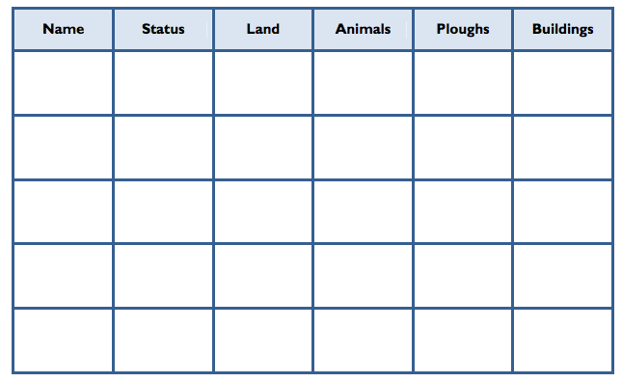

Slide 13
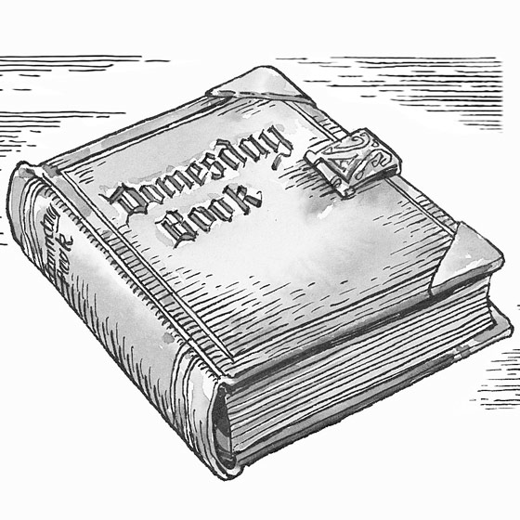
How useful is the Domesday Book?
How useful would you say the Domesday Book is?
Write a paragraph on whether you think the Doomsday Book could be useful to a historian studying life in the Middle Ages
?

Slide 14
Homework
Write your own Doomsday Book report for your town
It must include all the information we have studied today, including:
Size, value, number of people, number of animals, who owns it, peasants etc

