Slide 1
Fill in the blanks from memory using the words below.
450 volts
Learner
Authority
15 volts
Prods
Participant
Confederate
40
The shocks were real
300 volts
A shock plate
Heart condition
65%
Learning objectives:
To be able to DESCRIBE and EXPLAIN the five key factors that comprise Milgram’s explanation for why people obey.
To be able to EVALUATE the explanations (positives and criticisms)

Slide 2
Two key explanations for why we obey:
SITUATIONAL (external) explanation – Milgram.
DISPOSITIONAL (internal) explanation - Fromm
Learning objectives:
To be able to DESCRIBE and EXPLAIN the five key factors that comprise Milgram’s explanation for why people obey.
To be able to EVALUATE the explanations (positives and criticisms)

Slide 3
According to Milgram, there are five key components that together explain why people obey.
Legitimate authority
Agentic shift
Situational factors (Buffers)
Justifying obedience
Gradual commitment
SITUATIONAL (external) for why we obey.
Learning objectives:
To be able to DESCRIBE and EXPLAIN the five key factors that comprise Milgram’s explanation for why people obey.
To be able to EVALUATE the explanations (positives and criticisms)

Slide 4
1. Legitimate authority
W e accept that certain people have the right to tell us what to do. E.g. Policeman in uniform.
Learning objectives:
To be able to DESCRIBE and EXPLAIN the five key factors that comprise Milgram’s explanation for why people obey.
To be able to EVALUATE the explanations (positives and criticisms)

Slide 5
2. Agentic shift
When we shift to an agentic state we are much more likely to obey than if we are in an autonomous state, as we feel we are carrying out another person’s wishes.
The ‘authority’ takes responsibility for consequences.
Learning objectives:
To be able to DESCRIBE and EXPLAIN the five key factors that comprise Milgram’s explanation for why people obey.
To be able to EVALUATE the explanations (positives and criticisms)

Slide 6
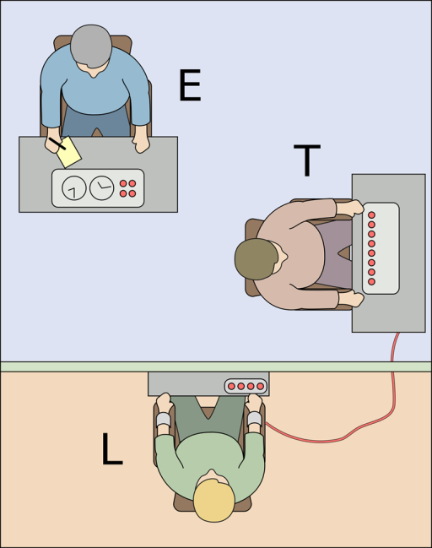
3. The role of buffers
If there is a buffer between the experience and/or consequences people are more likely to obey. E.g. Wall in Milgram’s experiment, firing a cruise missile vs. a rifle.
(If people do not have to directly acknowledge the outcome of their actions they are more likely to obey).
Buffer
Learning objectives:
To be able to DESCRIBE and EXPLAIN the five key factors that comprise Milgram’s explanation for why people obey.
To be able to EVALUATE the explanations (positives and criticisms)

Slide 7
4. Justifying obedience
If a ‘justification’ is given by the authority, obedience is more likely. E.g. ‘For science’ in Milgram’s experiment/ to rid the German of the danger of the Jews in the holocaust.
Learning objectives:
To be able to DESCRIBE and EXPLAIN the five key factors that comprise Milgram’s explanation for why people obey.
To be able to EVALUATE the explanations (positives and criticisms)

Slide 8
5. Gradual commitment
A person is told to do something small. Gradually the orders become more extreme but by then they feel they can’t say no.
By the time they realise just what they are doing, it is almost too late to stop.
Learning objectives:
To be able to DESCRIBE and EXPLAIN the five key factors that comprise Milgram’s explanation for why people obey.
To be able to EVALUATE the explanations (positives and criticisms)

Slide 9
Q: Using your knowledge of psychology, explain why a pupil would be less likely to pick up an empty can in the playground when told to do so by a fellow pupil than when told to do so by the head teacher (3 marks)
Use of research to back up point.
Research has indicated that people are less likely to obey a request from someone who is not perceived as having legitimate authority. Milgram’s study demonstrated that obedience fell when the experimenter was not wearing his lab coat (an indication of his status and authority). Therefore the pupil is likely to obey the legitimate authority of the head teacher, but less likely to obey the pupil who has no legitimate authority.
Application to the ‘stem’
Use of key psychological terminology.
Learning objectives:
To be able to DESCRIBE and EXPLAIN the five key factors that comprise Milgram’s explanation for why people obey.
To be able to EVALUATE the explanations (positives and criticisms)

Slide 10
Evaluation of Explanations
Mandel (1998): Milgram’s explanations are too simple when applied to the Holocaust and Nazi Germany. He ignored many other plausible explanations.
Goldhagen (1996) – Anti Semitism was the main motivation in the Holocaust, not obedience. This was countless and unnecessary cruelty.
There is a major difference between Milgram’s participants and the Holocaust guards. The perpetrators of the holocaust carried out duties over months and years and knew they were going to cause physical harm/death. The participants in Milgram’s study were obeying for half an hour and were told that no permanent damage would be caused. Therefore, Milgram’s explanations cannot be applied to all real life situations of obedience!
The suggestion that Holocaust perpetrators were just obeying orders, is distressing for those affected by it. Obeying orders is not a good enough reason for committing crime!
Learning objectives:
To be able to DESCRIBE and EXPLAIN the five key factors that comprise Milgram’s explanation for why people obey.
To be able to EVALUATE the explanations (positives and criticisms)

Slide 11
An alternative explanation…
Fromm (1941) suggested there was a certain disposition that meant people obeyed. ‘The authoritarian personality’ is more likely to obey (insecure so hostile towards those who ‘different’ to themselves, a belief that ‘toughness’ can reduce anxiety).
Evidence?
Those who scored most highly in terms of obedience in Milgram’s study correlated with highest scores for ‘authoritarian personality’ using the ‘F’ (fascist!) scale.
Zilmer et al. (1995) found that many Nazi war criminals also correlated highly on the scale.
Learning objectives:
To be able to DESCRIBE and EXPLAIN the five key factors that comprise Milgram’s explanation for why people obey.
To be able to EVALUATE the explanations (positives and criticisms)

Slide 12
An alternative explanation…
Problems with dispositional? (A02 – evaluation)
‘F’ scale a flawed personality test in terms of response bias.
Theory politically biased, as suggests only those on ‘the far right’ are obedient.
Learning objectives:
To be able to DESCRIBE and EXPLAIN the five key factors that comprise Milgram’s explanation for why people obey.
To be able to EVALUATE the explanations (positives and criticisms)

Slide 13
Memory matched pairs
20 minutes
Create a match pairs games.
You must have the names of the five factors explaining obedience on 5 cards.
And a description of their corresponding explanation on the other.
Then combine yours with a partners, turn all of them over, and play ‘matched pairs’ (if you turn two over that
OR…
Learning objectives:
To be able to DESCRIBE and EXPLAIN the five key factors that comprise Milgram’s explanation for why people obey.
To be able to EVALUATE the explanations (positives and criticisms)

Slide 14
Exam practice…
Q. Give one reason why people obey. Show support for your answer with evidence (4 marks)
A. Another factor that influences obedience is Gradual Commitment. This is [explain what it means]. Milgram found that [outline the study and findings]. This shows that [comment on what the finding means]
Learning objectives:
To be able to DESCRIBE and EXPLAIN the five key factors that comprise Milgram’s explanation for why people obey.
To be able to EVALUATE the explanations (positives and criticisms)

Slide 15
Task: Elaboration Ladders
20 minutes
Elaborate
Milgram’s evidence supports the idea that individuals will only obey if they believe the reason for doing it is for a purpose, such as for science.
In Milgram’s study, the participants were initially told they were delivering electric shocks because they wanted to investigate if people could learn through reward and punishment. It was in the name of science. The participants who were less likely to obey were told to take orders because ‘the experimenter requires it.’
Evidence
Point
Justification of Obedience. People are more likely to obey to orders if they feel they are doing it for a good cause or the reason is important.
Learning objectives:
To be able to DESCRIBE and EXPLAIN the five key factors that comprise Milgram’s explanation for why people obey.
To be able to EVALUATE the explanations (positives and criticisms)

Slide 16
Task: Elaboration Ladders
20 minutes
For each remaining explanation of Obedience complete an elaboration ladder.
Make a Point – Describe the Explanation
State the Evidence – What evidence is there from Milgram’s study?
Elaborate on how this explains obedience to authority.
Elaborate
Evidence
Point
Learning objectives:
To be able to DESCRIBE and EXPLAIN the five key factors that comprise Milgram’s explanation for why people obey.
To be able to EVALUATE the explanations (positives and criticisms)

