Slide 1
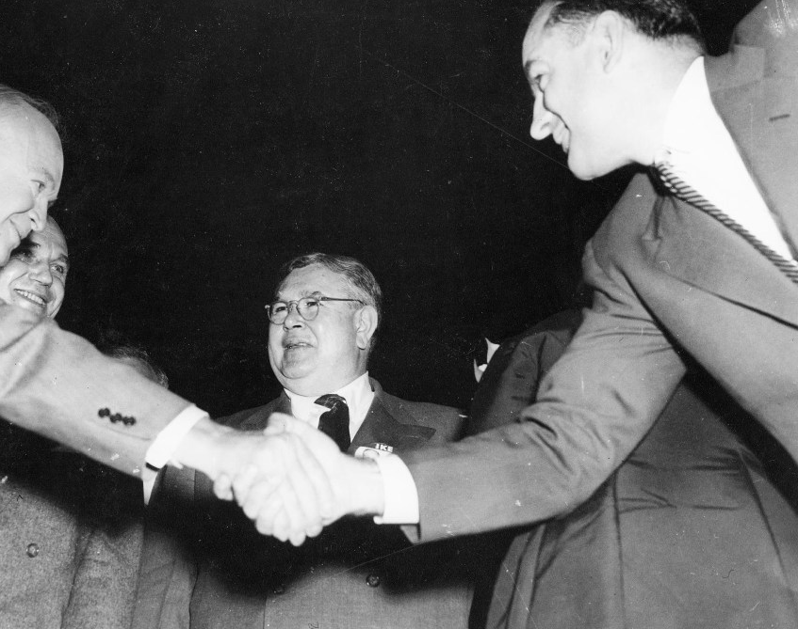
Recap: Did Eisenhower contribute to McCarthy’s downfall?

Slide 2
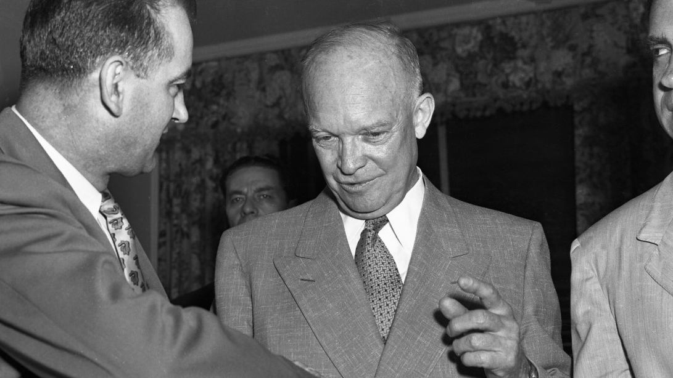
McCarthy immediately made trouble for the new administration.
McCarthy opposed many of Eisenhower’s nominations, including James B. Conant (High Commissioner to Germany) and Charles E. Bohlen (Ambassador to the Soviet Union).
Eisenhower thought that if a president attacked him directly, it would serve only to give McCarthy more publicity.
He worked behind the scenes to oppose him and them help to bring him down.

Slide 3
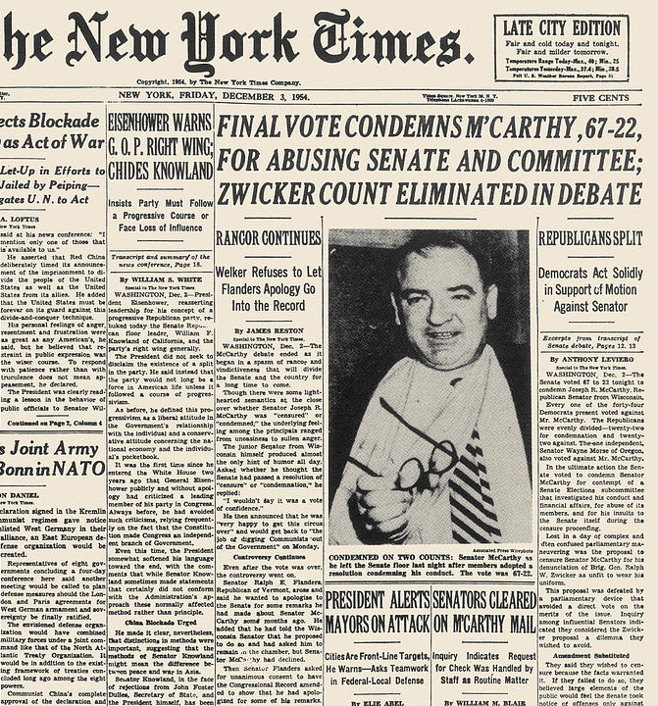
Eisenhower refused to give access a full FBI file on Bohlen’s personal life.
The President agreed to support Joe Meek in April 1954 if he supported the administration and did not invite McCarthy to campaign for him.
The administration released a chronology tracing the efforts of McCarthy and his aide, Roy Cohn, to gain preferential treatment for Cohn’s friend and associate, G. David Schine.
Eisenhower asserted “executive privilege” and refused to allow White House Staff to testify.
In December 1954 the Senate voted 67-22 to censure McCarthy for behaviour that brought the Senate into “dishonour and disrepute.”

Slide 4
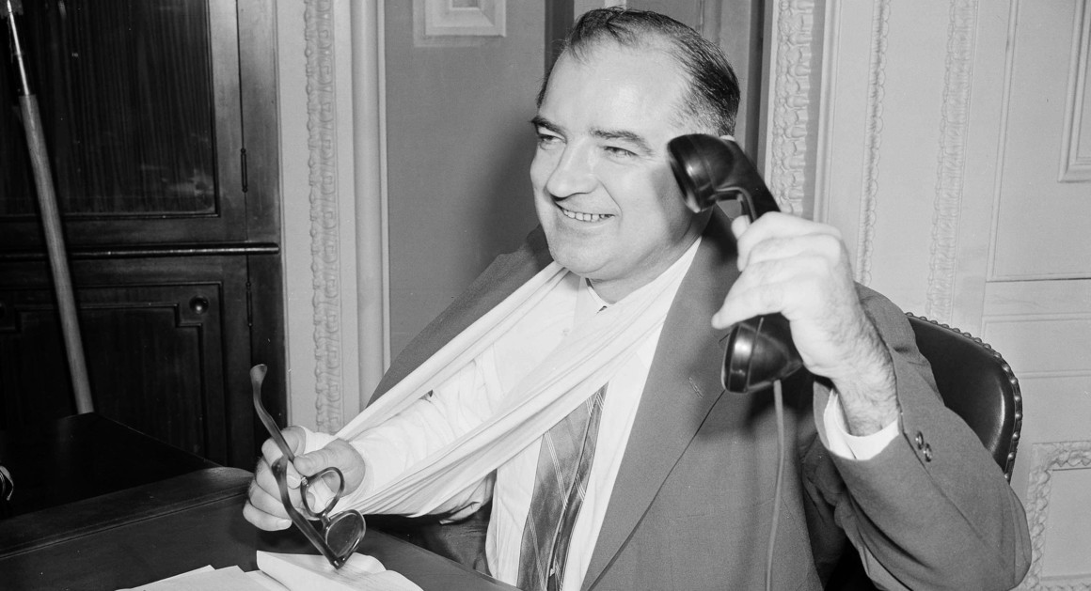
Fred Greenstein: “It is difficult to see how … another technique would have worked faster and more decisively in the context of the time.”
Robert Griffith wrote that Eisenhower’s approach “arose in part from his realistic, if cynical, respect for McCarthy’s support among Senate Republicans, in part from his personal dislike for the Phillipe mode. It also derived, however, from his sophisticated analysis of the relationships between McCarthy, the media and the presidency.”

Slide 5
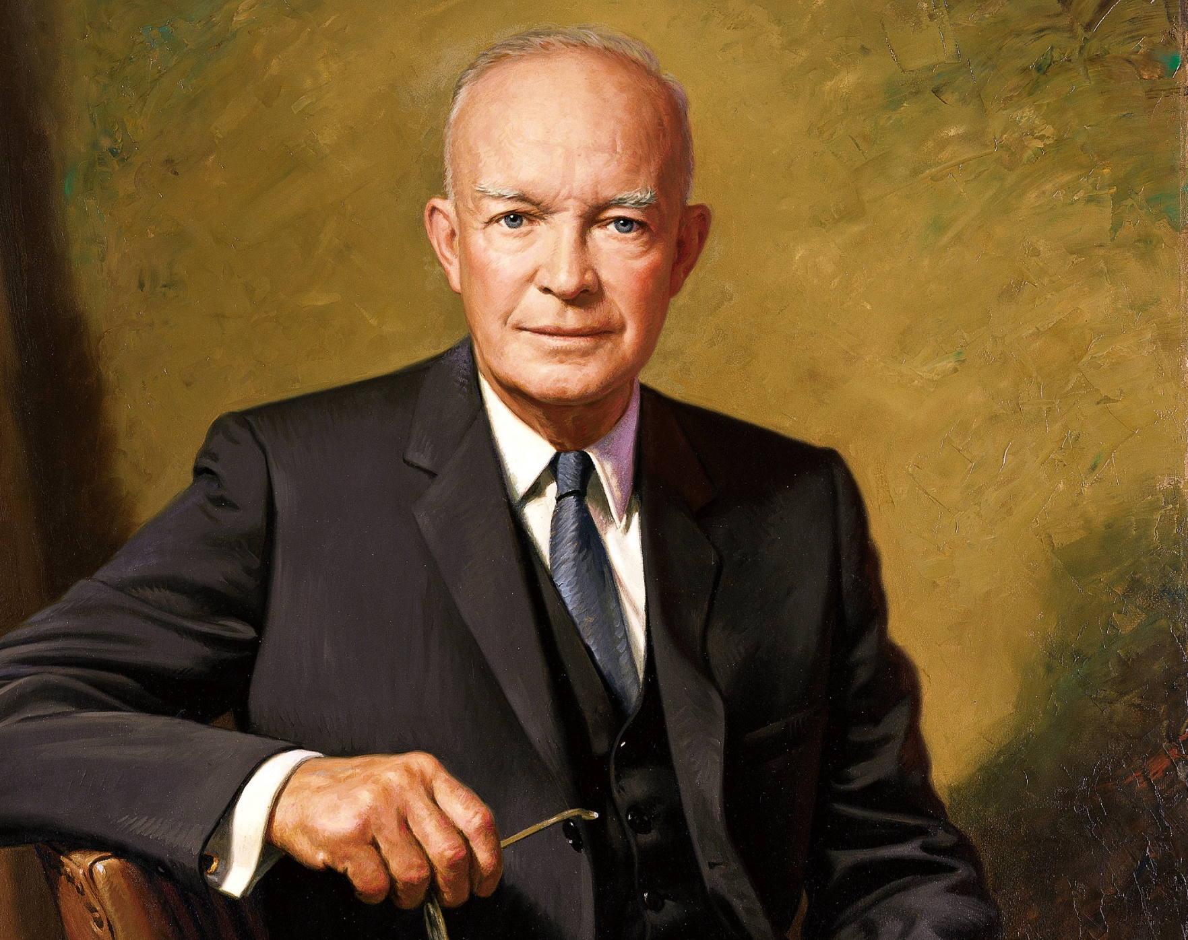
How far did Eisenhower’s New Look policy mark a shift in foreign policy?

Slide 6
What were the main features of foreign policy under the Truman administration?

Slide 7
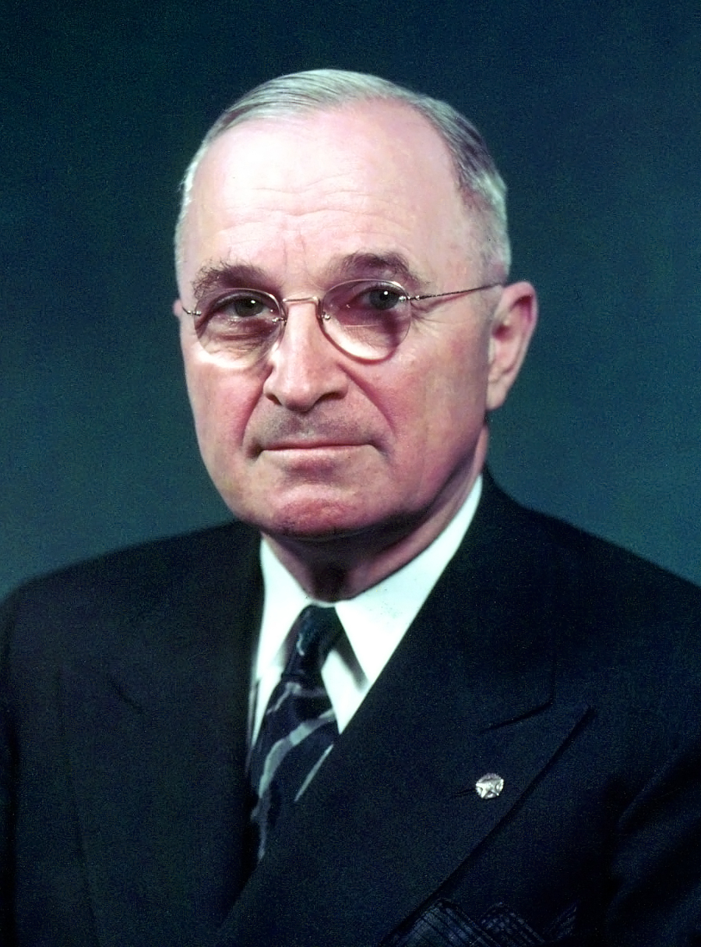
Accepted recommendations set out in NSC-68
Adopted an ‘iron fist’ approach
SoS James F. Byrnes pushed for the use of the US’s economic power to penetrate Europe.
Fell under the influence of men who wanted to take a hard-line stance against the USSR.
Truman Doctrine (March 1947)
Marshall Plan (April 1948)
High defence spending with focus on convention forces
Creation of NATO in 1949
Preferred indirect action but compelled to intervene in Korea under the UN.

Slide 8
Read the following source. What evidence is there of continuation from Truman’s approach to foreign policy? Is there evidence of change?
From Dwight D. Eisenhower’s inaugural address as the incoming US president in 1953:
Knowing that only a United States that is strong and immensely productive can help defend freedom in our world, we view our nation’s strength and security as a trust upon which rests the hope of free men everywhere. It is the firm duty of each of our free citizens and of every free citizen everywhere to place the cause of his country before the comfort, the convenience, of himself.
Appreciating that economic need, military security, and political wisdom combine to suggest regional groupings of free peoples, we hope, within the framework of the United Nations, to help strengthen such special bonds the world over. The nature of these ties must vary with the different problems of different areas.

Slide 9
From Dwight D. Eisenhower’s inaugural address as the incoming US president in 1953:
Knowing that only a United States that is strong and immensely productive can help defend freedom in our world, we view our nation’s strength and security as a trust upon which rests the hope of free men everywhere. It is the firm duty of each of our free citizens and of every free citizen everywhere to place the cause of his country before the comfort, the convenience, of himself.
Appreciating that economic need, military security, and political wisdom combine to suggest regional groupings of free peoples, we hope, within the framework of the United Nations, to help strengthen such special bonds the world over. The nature of these ties must vary with the different problems of different areas.

Slide 10
Dwight D. Eisenhower (1890-1969)
Eisenhower was Allied commander during the invasion of Europe in 1944. As president (1953061) he had his secretary of state, John Foster Dulles, developed the ‘New Look’ national security policy, encouraging US policy makers to consider a long-term Soviet threat. Eisenhower’s presidency witnessed the end of the Korean War and deepening rivalry with the USSR in the space race. He authorised U-2 reconnaissance aircraft flights over the Soviet Union and initiated the plans to invade Cuba that were later carried out by his successor, John F. Kennedy.
John Stanley, History for the IB Diploma: The Cold War and the Americas 1945-1981 (Cambridge, 2012) p.29

Slide 11
John Foster Dulles (1888-1959)
Dulles was US Secretary of State from 1953 until his death in 1959, and was a major influence on US foreign policy during the Cold War. He regarded politics after the Second World War as essentially an ideological fight between good and evil, and believed firmly in ‘massive retaliation’. This policy committed a state to a disproportionate action in response to an attack – including the use of nuclear weapons.
John Stanley, History for the IB Diploma: The Cold War and the Americas 1945-1981 (Cambridge, 2012) p.29

Slide 12
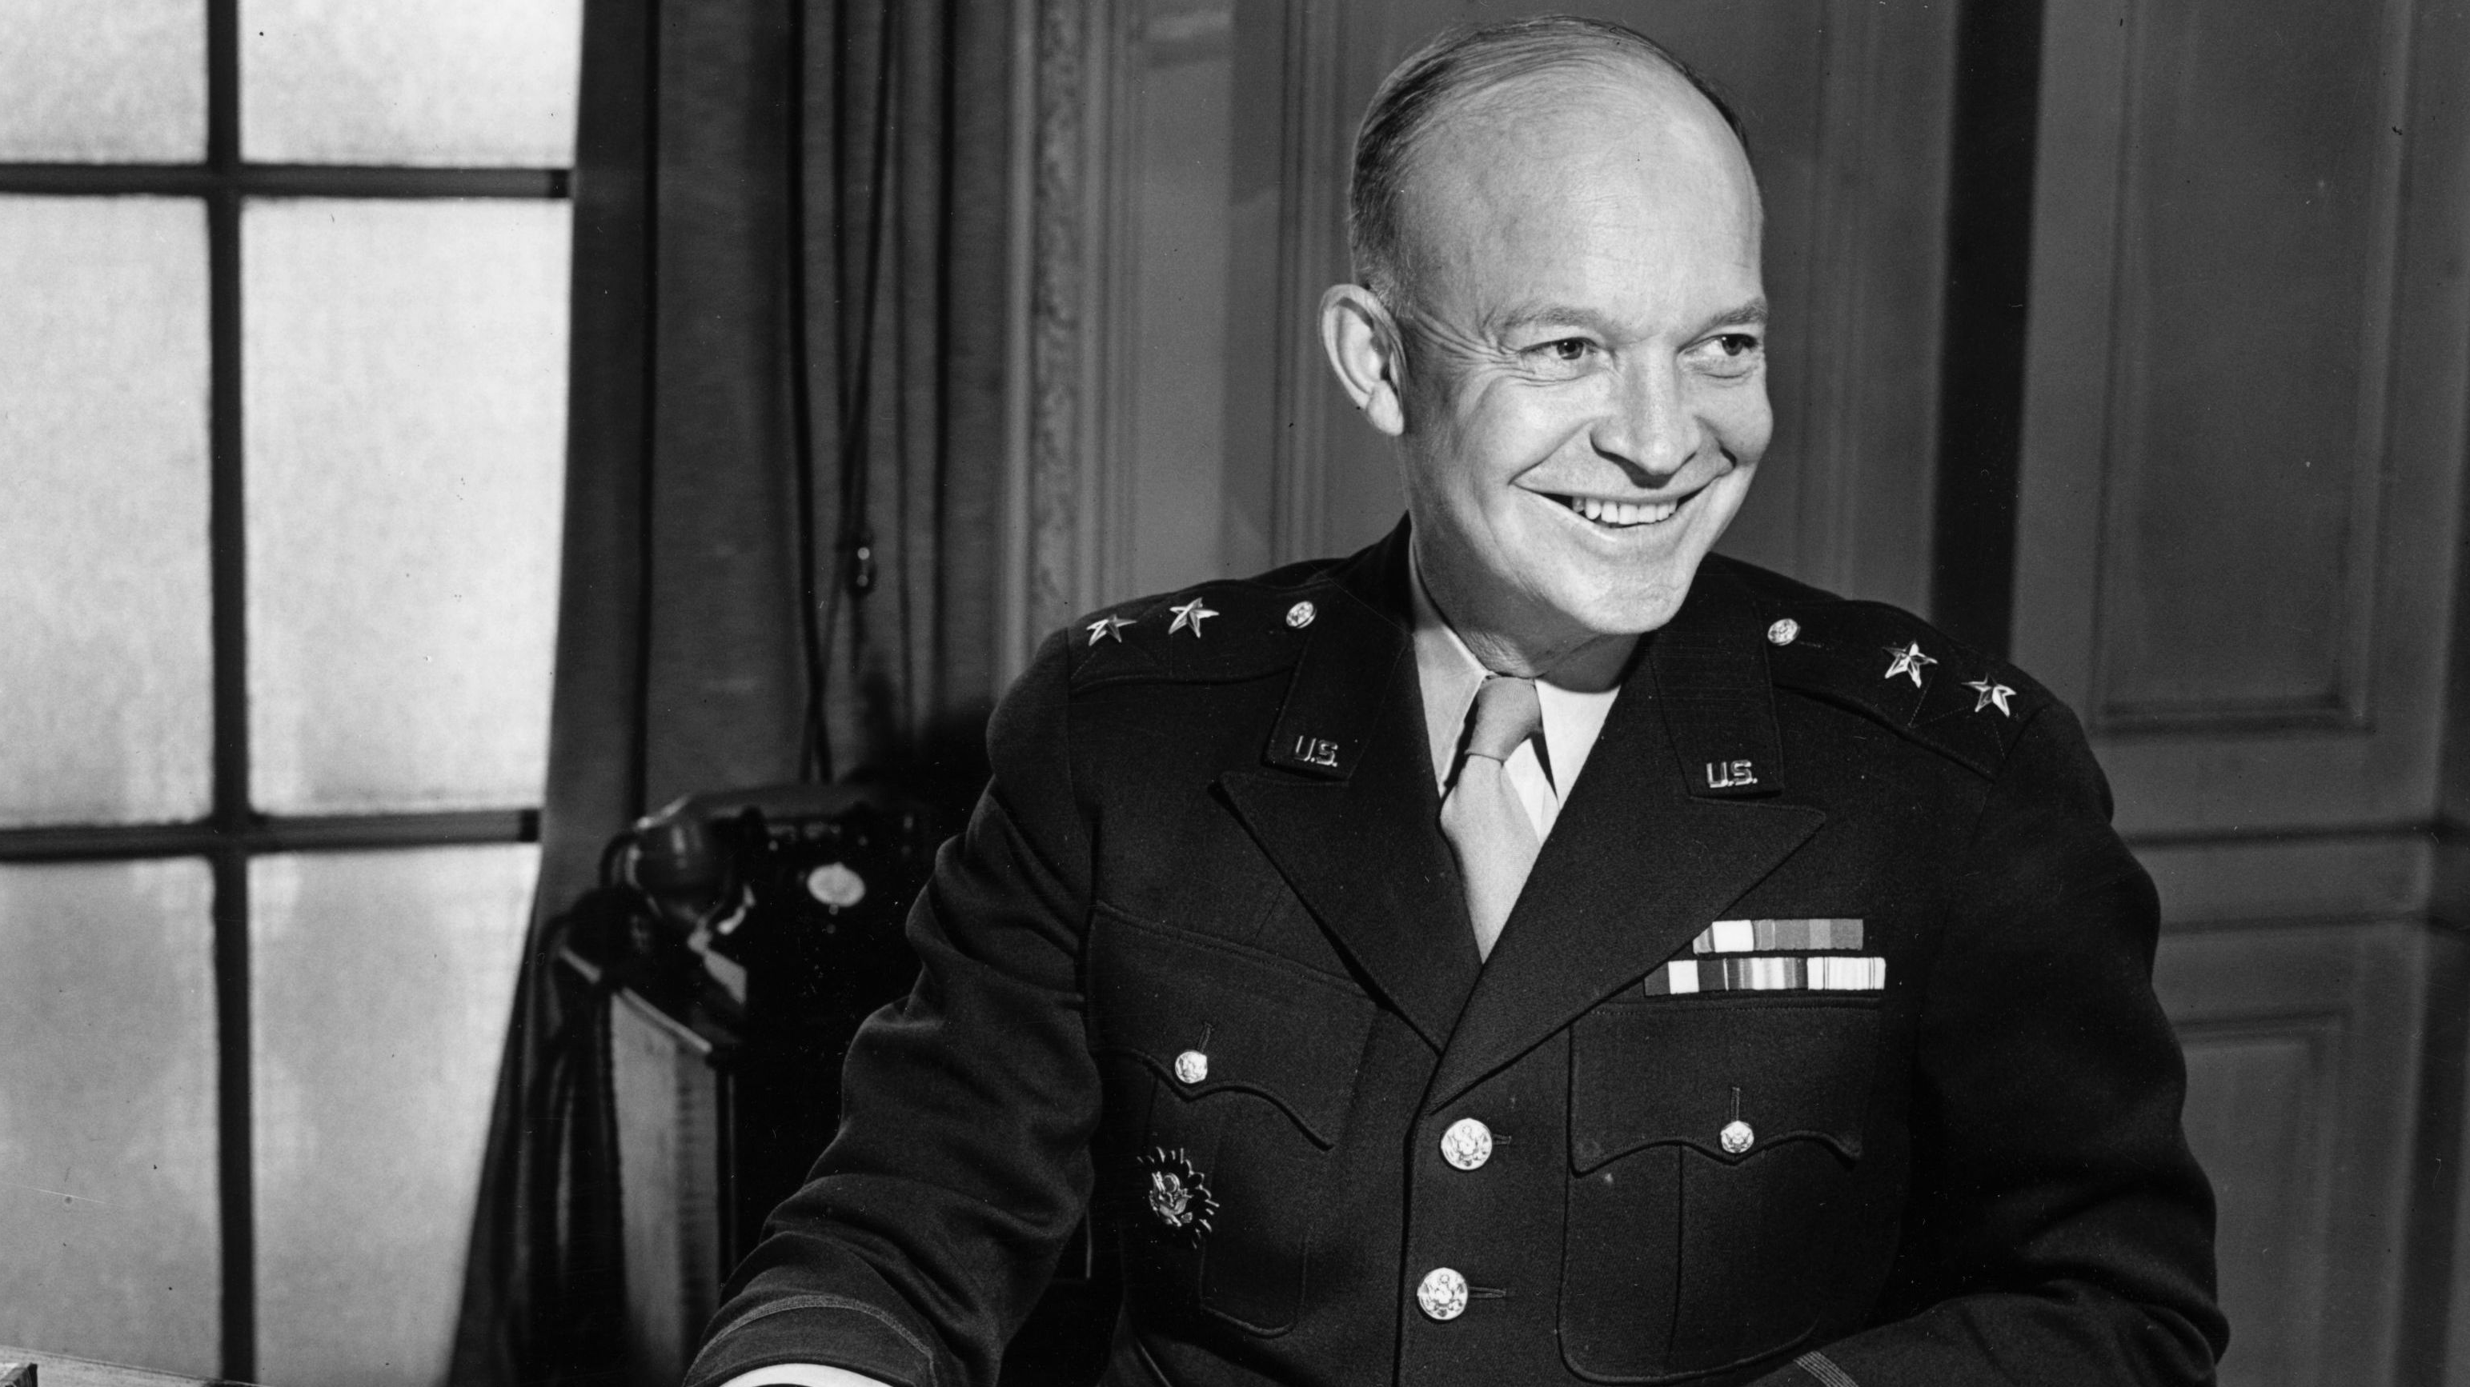
Eisenhower used his immense popularity as an effective political tool.
He frequently described his politics as policies as middle-of-the-road - the Democrats controlled Congress for ¾ of his presidency.
Eisenhower had no plans to dismantle the New Deal, but felt big government threatened free enterprise.
The New Deal
Roosevelt introduced his New Deal programme of reforms in 1933, a large scale plan to use federal government resources to combat the effect of the Depression and bring about reform in US society.

Slide 13
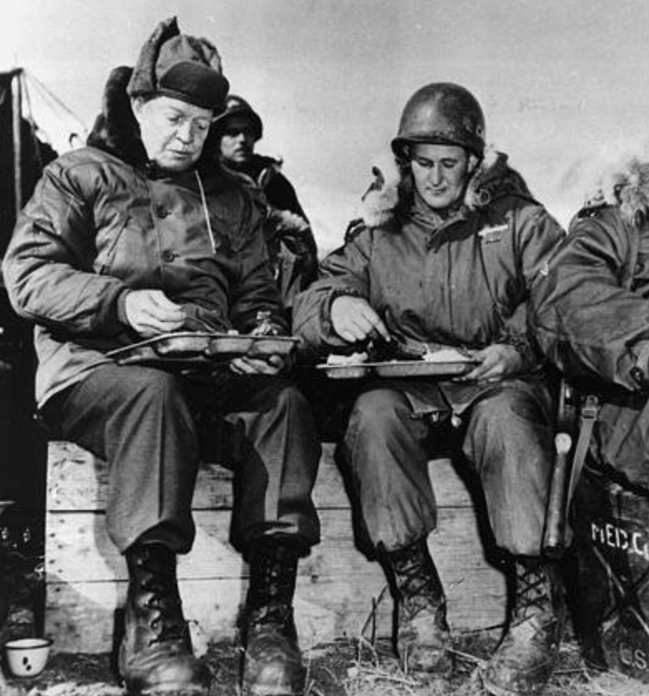
The Korean War
The most pressing matter facing Eisenhower when he became president was the ongoing war in Korea.
Eisenhower and Dulles were convinced that their nuclear diplomacy brought the Communists to an agreement
However, the continuing heavy toll of casualties suffered by the Chinese and North Koreans and the death of Stalin in March 1953 certainly had a large (potentially larger) part to play.
President Eisenhower eats with troops during the Korean War

Slide 14
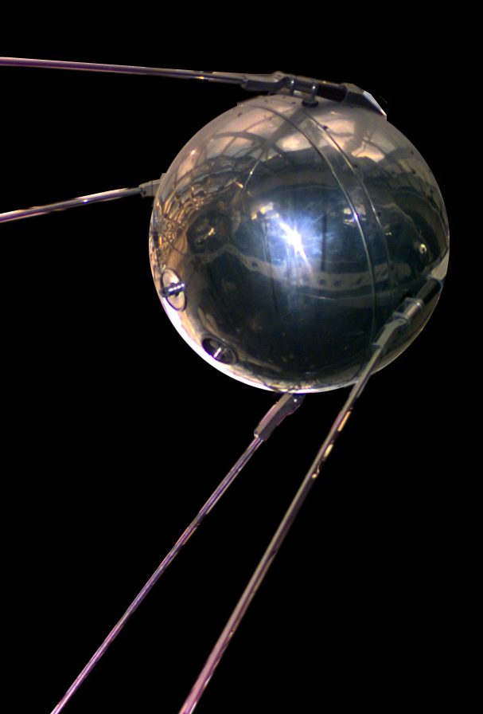
National Defence Education Act
In 1958, after the Soviet Union launched Sputnik and many Americans frantically worried that the US had fallen behind the Soviets in technology.
Eisenhower proposed and Congress passed the National Defence Education Act.
The act provided low-interest loans for deserving college students and for grants to improve the teaching of maths and science in schools.

Slide 15
Cathay Pacific Douglas DC-4 shootdown
Eisenhower differed from Truman before him and Kennedy after in that he sought to avoid confrontation and to defuse tensions.
In July 1954 Chinese Communists shot down a British commercial airliner.
Two US aircraft carriers from the Asian fleet were sent to aid any survivors. The ships came under attack by Chinese fighter planes and the Americans shot down two of them planes.
Rather than play up the incident, Eisenhower moved to ease tensions.

Slide 16
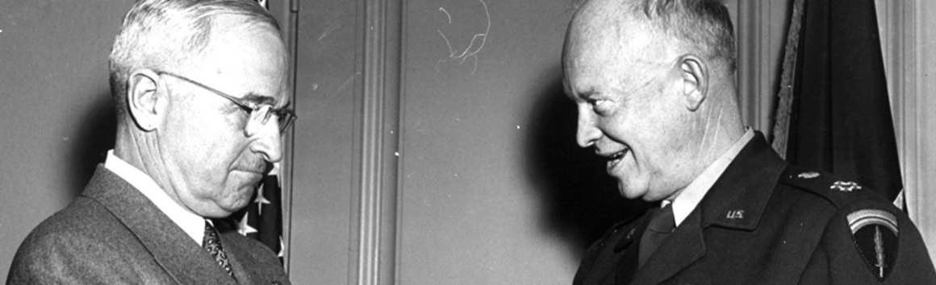
Despite differences in approach, Eisenhower’s foreign policy had much more in common with Truman than it did with the right wing of his own party.
Eisenhower sided with the liberal Republicans and the Democrats supporting Truman’s basic approach to the Cold War.
He felt, however, that the Truman administration had failed to balance conduct in the Cold War and international commitments with their limited resources.
He believe too that Truman and his advisers had overestimated the military aspect of the Soviet threat and expressed concern about the high level of defence spending.

Slide 17
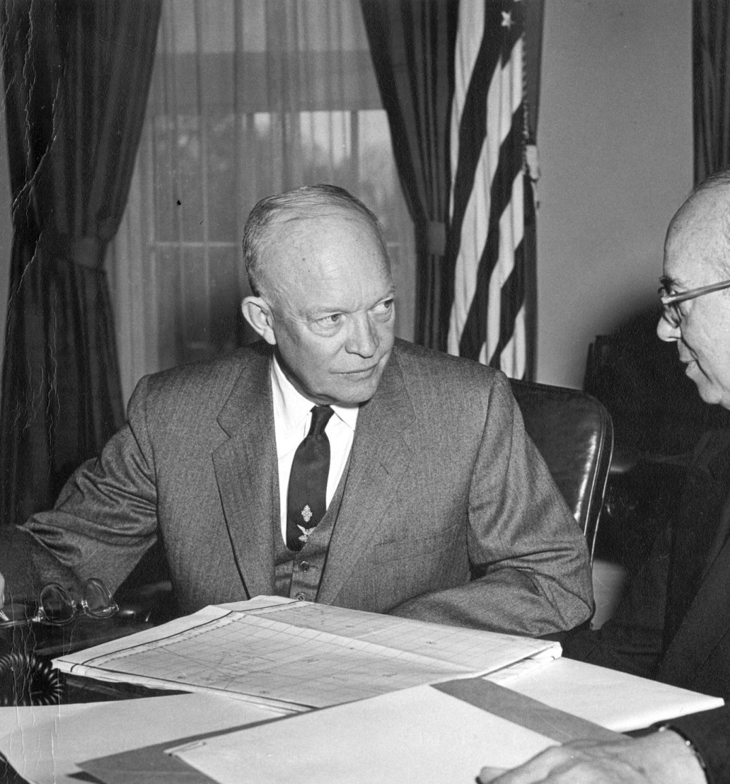
“New Look”
The 1955 defence budget (which became known as the ‘New Look’) reflected a concern for balancing military commitments with financial resources.
His “New Look” provided for an expanded strategic air force and reduction in conventional forces.
Secretary of Defence Charles R. Wilson summed up the policy with the phrase “more bang for the buck.”
Expensive though weapons systems were, they offered a less expensive means of projecting force than the use of conventional forces.
Eisenhower felt that preparing to fight conventionally in Europe, where the Soviets had strategic and logistic advantage in both weapons and men was senseless.

Slide 18
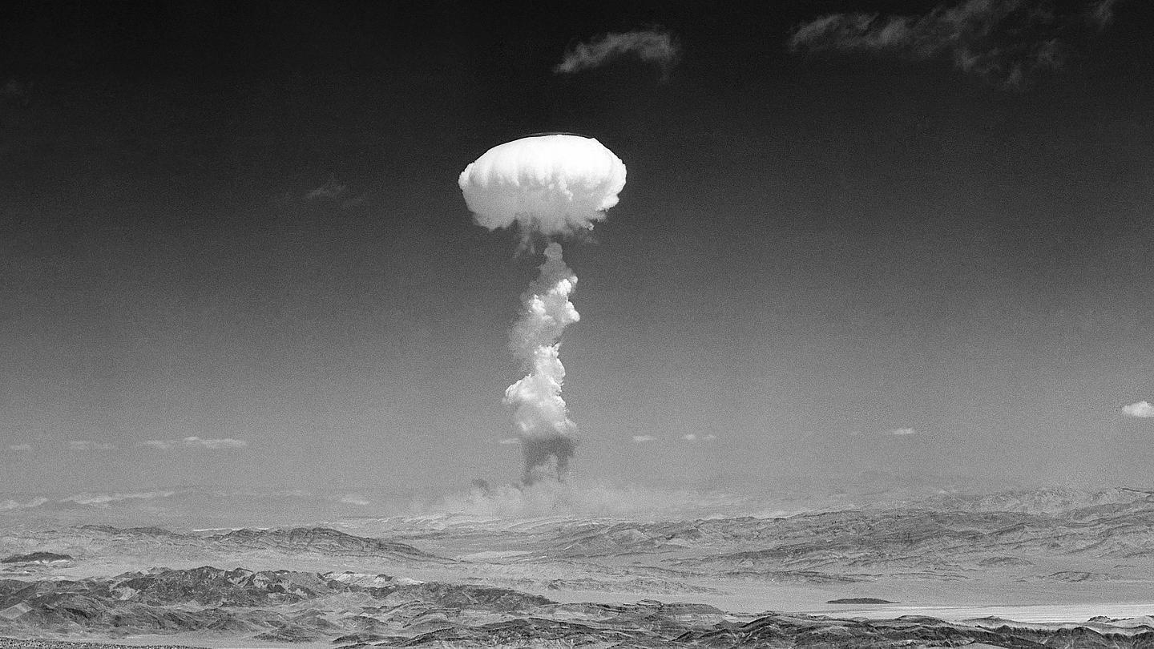
“Massive Retaliation”
In an address to the Council on Foreign Relations in Jan 1954, Dulles explained that the US would deter further communist aggression by aiding local defences and developing “massive retaliatory power.” This would provide “maximum deterrent at a bearable cost.”
This did not mean that the US would resort to all-our nuclear war to meet every exigency but the threat was to deter communist aggression.
Truman’s proposed defence budget for 1954 at $45 billion, which Eisenhower considered unsustainable.
Eisenhower and his administration reduced Truman’s defence budget to $43.2 billion and projected spending $40 billion for defence in 1955 and $35 billion in 1956.
Spending for defence fell to $37.5 billion in 1955 and roughly $33.5 billion in 1957. His last defence budget was $40 billion.

Slide 19
Task: Looking at sources A and extract B, write a list of any contradictions you find between the theory and practice of US foreign policy.
Extract B:
Aldred, J, Aspects of International Relations 1945-2004 (Cheltenham, 2010) p.43
When the administration was actually faced with rolling back the Russians in Hungary in 1956, they did nothing other than express loud protests. A similar response had followed in June 1953, when a strike by East Berlin construction workers turned into an uprising across East Germany which was suppressed by Soviet armed forces. Roll-back was nothing more than a paper-tiger and did little to impede improved East-West relations.
Source A:
John Foster Dulles, describing brinkmanship, 1956
The ability to get to the verge without getting into war is the necessary art. If you cannot master it, you inevitably get into war. If you try to run away from it, if you are scared to go to the brink, you are lost.

Slide 20
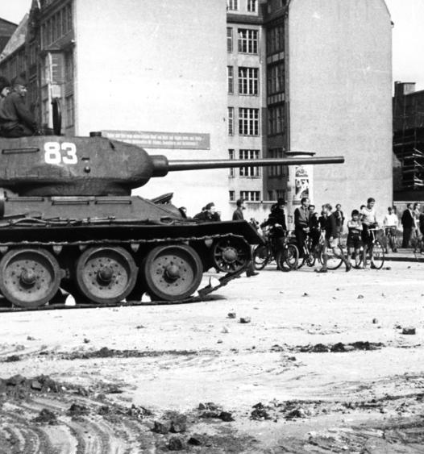
Peaceful co-existence?
In April 1953, Eisenhower delivered a major speech titled “A Chance for Peace” to the American Society of Newspaper Editors.
Here he discussed the cost of the arms race and the conditions for a general reduction in tension.
However, the administration became convinced that the Soviet “peace offensive” amounted to nothing more than a cynical attempt to divide the Western alliance.
The use of Soviet tanks to put down rioting in East Germany in June 1953 served to confirm their scepticism.

Slide 21
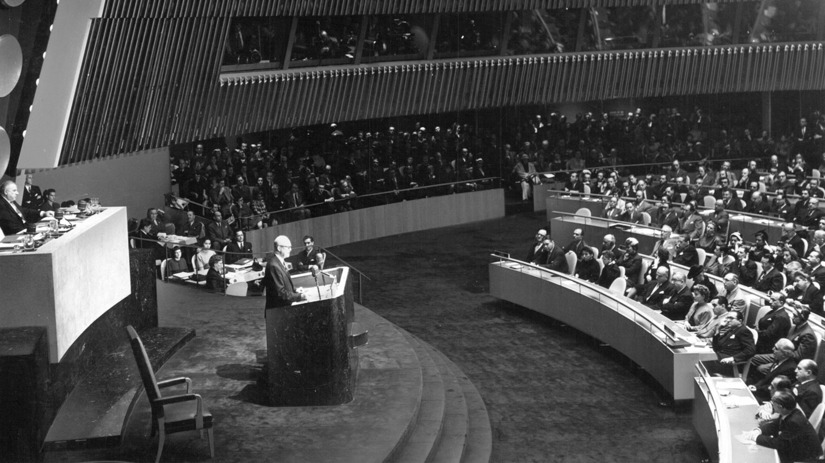
“Atoms for Peace”
Eisenhower repeatedly expressed his concern about the escalating nuclear arms race.
Three months after the Soviet Union detonated a thermonuclear devise (Dec 1953) Eisenhower gave a speech at the UN General Assembly in which he called on all nuclear powers to donate a set amount of fissionable material to be used for peaceful purposes under the auspices of the UN.
The Soviet rejected “Atoms for Peace” but even if they had accepted it, it would have done nothing to halt the arms race.

Slide 22
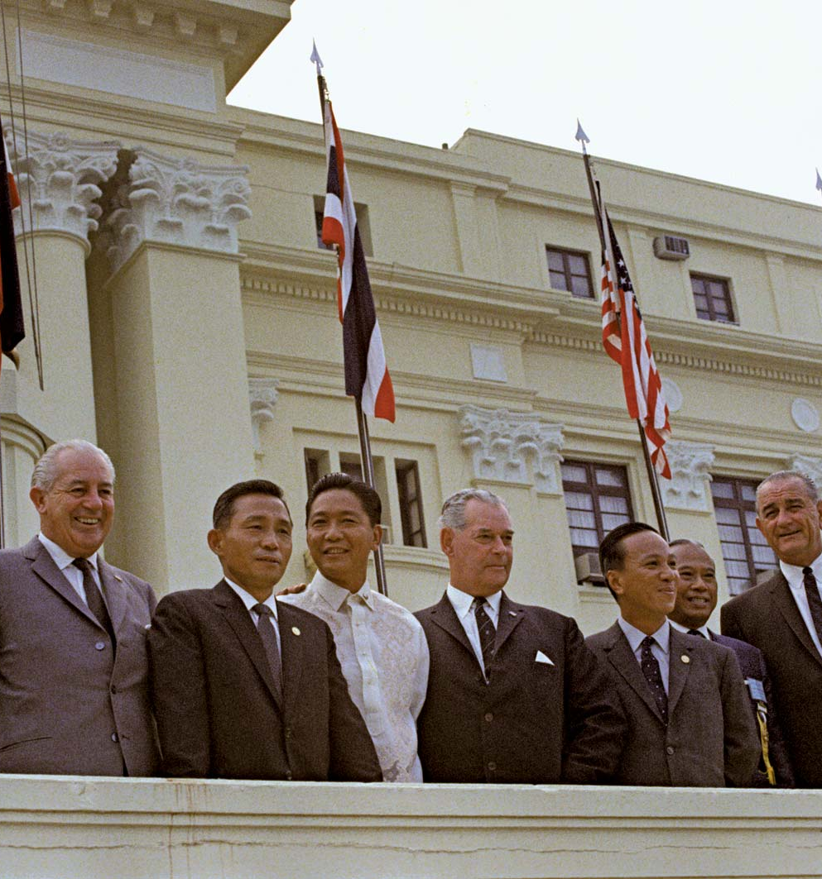
SEATO (8 September 1954)
In September 1954, the US, France, GB, New Zealand, Australia, the Philippines, Thailand and Pakistan formed the Southeast Asia Treaty Organization, or SEATO
U.S. officials believed Southeast Asia to be a crucial frontier in the fight against communist expansion, so it viewed SEATO as essential to its global Cold War policy of containment
Unlike NATO, SEATO had no independent mechanism for obtaining intelligence or deploying military forces
Because it incorporated only three Asian members, SEATO faced charges of being a new form of Western colonialism

Slide 23
The Baghdad Pact (24 February 1955)
The alliance would link the southernmost member of NATO, Turkey, with the westernmost member of SEATO, Pakistan.
Turkey and Pakistan signed an agreement in 1954.
In April, UK announced its intention to adhere to the Pact, and it was followed by Pakistan and Iran
The US signed individual agreements with each of the nations in the Pact, but it did not formally join. The US participated as an observer and took part in committee meetings.

Slide 24
Re-arming west Germany
Eisenhower adopted a plan to rearm West Germany and integrate its forces into the European Defence Community.
The French opposed this and the British took the opportunity to suggest that Germany be admitted to NATO.
The Paris Accords of October 1954 provided for West German sovereignty and the creation of a West German army integrated into the defence structure of NATO.
The FRG formally entered NATO in May 1955.
The Soviet Union responded by forming its own military organisation, the Warsaw Pact.

Slide 25
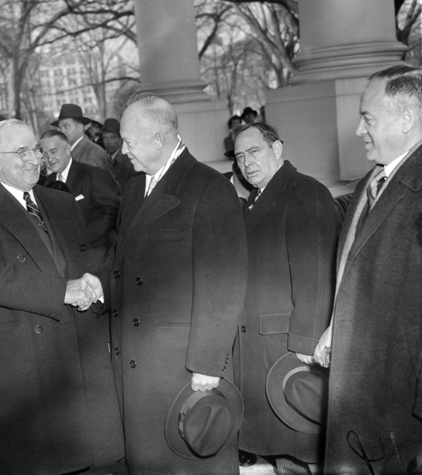
Did Eisenhower’s New Look policy mark a shift in foreign policy??
In foreign policy, Eisenhower “ended one war and did not begin another.”
He sometimes resorted to more aggressive measures, although usually with covert operations rather than the use of American military force.
Interventions in Iran and Guatemala looked like successes in the short term but had long-term negative consequences.
The question is, did he mark a decisive shift in foreign policy??

Slide 26
Task
Write out two lists, one detailing the key aspects of Truman’s foreign policy, the other detailing Eisenhower’s.
Once you’ve done this, cross reference your list, where are the similarities, where are the differences?
Assign numbers to your points and plot them in a diagram, similar to the one below.
Truman
Eisenhower

Slide 27
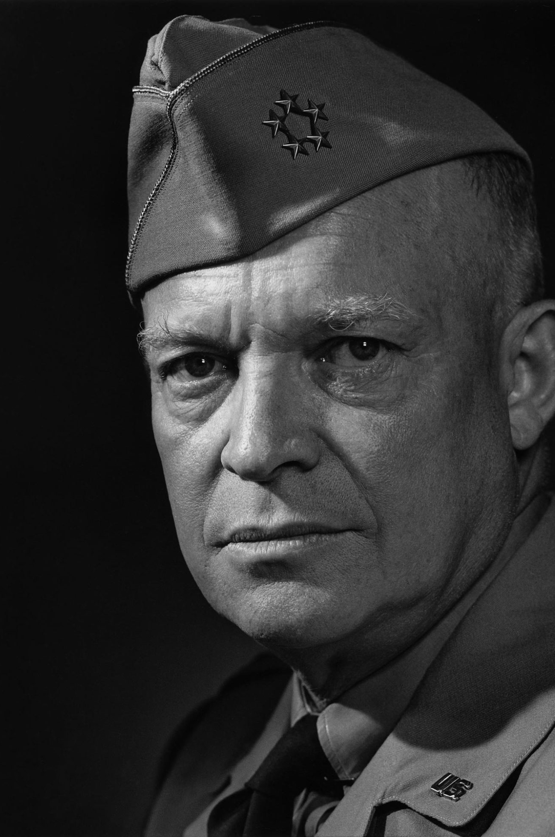
Bibliography
Michael S. Mayer, Presidential profiles: The Eisenhower Years (New York, 2010) pp.vii-li
John Stanley, History for the IB Diploma: The Cold War and the Americas 1945-1981 (Cambridge, 2012) pp.28-30

