Slide 1
Title: What happens when an attachment is disrupted?
Starter: Complete the odd one out you have been given.
5 mins
Learning objectives:
To KNOW the difference between ‘deprivation’ and ‘privation’.
To DESCRIBE + EXPLAIN the negative consequences of disrupting an attachment on the social and emotional development of an individual.
To DESCRIBE and EVALUATE research into attachment deprivation.

Slide 2
Listen to TWO Podcasts:
‘Life Scientific’ podcast where Rutter is interviewed:
http://www.bbc.co.uk/programmes/b04581j9
Romania’s lost orphans
On moodle
Learning objectives:
To KNOW the difference between ‘deprivation’ and ‘privation’.
To DESCRIBE + EXPLAIN the negative consequences of disrupting an attachment on the social and emotional development of an individual.
To DESCRIBE and EVALUATE research into attachment deprivation.

Slide 3
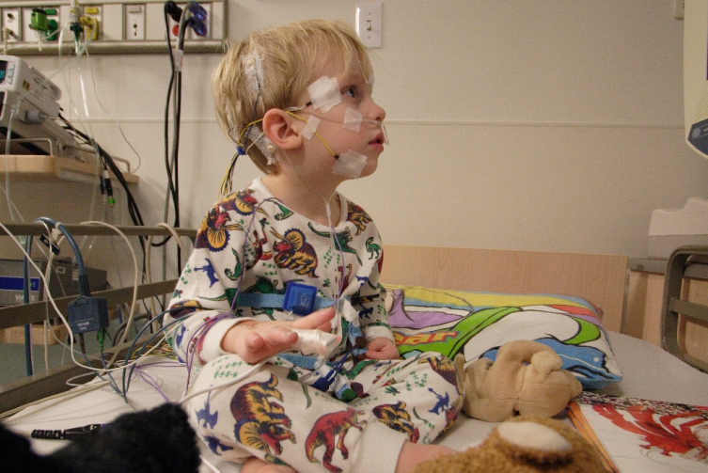
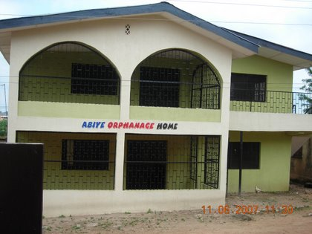
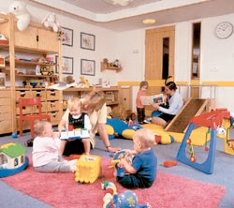
Privation
Separation/deprivation
How can an attachment be disrupted, or even never form in the first place (privation)?
Deprivation
Privation
Separation/deprivation
Learning objectives:
To KNOW the difference between ‘deprivation’ and ‘privation’.
To DESCRIBE + EXPLAIN the negative consequences of disrupting an attachment on the social and emotional development of an individual.
To DESCRIBE and EVALUATE research into attachment deprivation.

Slide 4
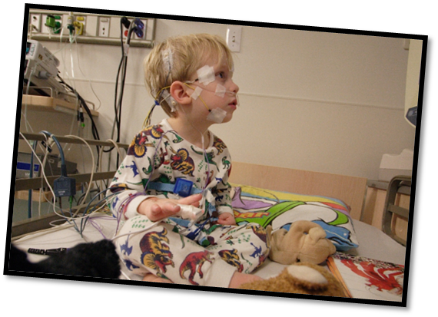
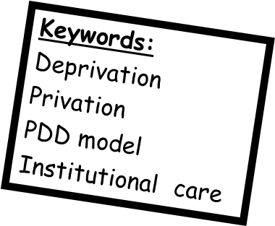
Deprivation = Child loses an attachment that had formed. (Can be long-term e.g. substantial time in hospital, or permanent e.g. death.
Privation = Attachment never formed. More serious in terms of later consequences than separation or deprivation.
Learning objectives:
To KNOW the difference between ‘deprivation’ and ‘privation’.
To DESCRIBE + EXPLAIN the negative consequences of disrupting an attachment on the social and emotional development of an individual.
To DESCRIBE and EVALUATE research into attachment deprivation.

Slide 5
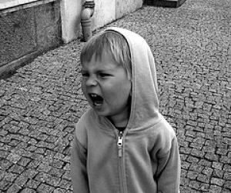
Case studies of children experiencing privation have found…
Social and emotional problems
Physical deformity
Cognitive problems
Reactive or disinhibited attachment disorder.
Learning objectives:
To KNOW what is meant by ‘privation’, and how it differs from deprivation.
To UNDERSTAND how privation negatively impacts a child’s development.
To KNOW and EVALUATE the following key studies: Hodges and Tizard (1989), Rutter (2007), case study of ‘Genie’, case study of the ‘Czech twins’.

Slide 6
The Czech twins (Koluchova 1976)…
Locked in a basement at 18 months, beaten and abused until 7.
When first ‘discovered’ couldn’t talk, below average intelligence, rickets.

Slide 7
Evaluation Czech twins study?
Potentially shows that the effects of early, severe privation are reversible……
……However, they had been raised in a normal home until they were eighteen months old, so they may have had opportunities to form attachments, and this would make this a case of deprivation rather than privation.
Also, the boys were together when they were locked in the cellar and, therefore, may have formed attachments with each other.
Learning objectives:
To KNOW what is meant by ‘privation’, and how it differs from deprivation.
To UNDERSTAND how privation negatively impacts a child’s development.
To KNOW and EVALUATE the following key studies: Hodges and Tizard (1989), Rutter (2007), case study of ‘Genie’, case study of the ‘Czech twins’.

Slide 8
Watch the BBC Horizon documentary of ‘Genie’.
Answer the questions below as you watch.
In what ways was Genie’s childhood, and experience of attachment, different to most children's’?
What physical and mental consequences did privation, deprivation and isolation have on Genie?
What types of research did scientists conduct on Genie?
Outline the progress she made after medical staff intervened.
Why might the doctors be criticised on ethical grounds?
Learning objectives:
To KNOW what is meant by ‘privation’, and how it differs from deprivation.
To UNDERSTAND how privation negatively impacts a child’s development.
To KNOW and EVALUATE the following key studies: Hodges and Tizard (1989), Rutter (2007), case study of ‘Genie’, case study of the ‘Czech twins’.
Notes:
BBC horizon Genie documentary. Also at: http://www.youtube.com/watch?v=KfOlPK2P_G8 (alternative documentary ‘wild child’).

Slide 9
Read the article from ‘The Psychologist’ magazine.
Learning objectives:
To KNOW the difference between ‘deprivation’ and ‘privation’.
To DESCRIBE + EXPLAIN the negative consequences of disrupting an attachment on the social and emotional development of an individual.
To DESCRIBE and EVALUATE research into attachment deprivation.

Slide 10
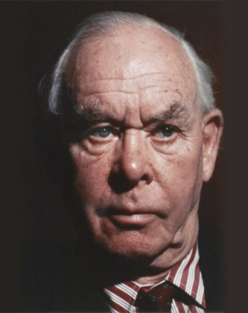
Bowlby’s theory suggests that attachment is essential for healthy social and emotional development. It therefore follows that a disruption of an attachment is likely to have negative impacts on these things. Bowlby’s research suggested that long-term maternal deprivation leads to affectionless psychopathy, low IQ and delinquency, among other things.
Privation
Separation/deprivation
How can an attachment be disrupted, or even never form in the first place (privation)?
Deprivation
Privation
Separation/deprivation
Learning objectives:
To KNOW the difference between ‘deprivation’ and ‘privation’.
To DESCRIBE + EXPLAIN the negative consequences of disrupting an attachment on the social and emotional development of an individual.
To DESCRIBE and EVALUATE research into attachment deprivation.

Slide 11
The ‘Protest, Despair, Detachment’ (PDD) model, shows the phases an child goes through when an attachment is disrupted in the short term and the child is separated from the attachment figure…
E.C. Not all children go through these stages (individual differences)
Protest: Child cries, screams and clings a lot.
Despair: Child becomes apathetic and uninterested in surroundings. Becomes withdrawn and doesn’t eat or sleep well.
Detachment: Child’s interest returns, but only superficially. If caregiver returns child shows little interest and/or attempts to resist them.
Learning objectives:
To KNOW the difference between ‘deprivation’ and ‘privation’.
To DESCRIBE + EXPLAIN the negative consequences of disrupting an attachment on the social and emotional development of an individual.
To DESCRIBE and EVALUATE research into attachment deprivation.

Slide 12
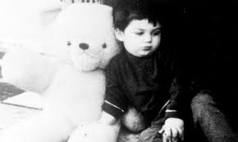
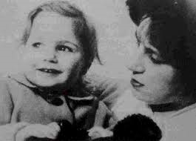
Evidence for PDD model…
Key study
Robertson and Robertson (1968)
Task: Using the textbook, come up with a: - Procedure, Findings and Conclusion of Robertson and Robertson’s research.
Vs.
John
Jane
Learning objectives:
To KNOW the difference between ‘deprivation’ and ‘privation’.
To DESCRIBE + EXPLAIN the negative consequences of disrupting an attachment on the social and emotional development of an individual.
To DESCRIBE and EVALUATE research into attachment deprivation.

Slide 13
Evaluation of Robertson and Robertson (1968)…
Key study
Answer the past exam questions below to help guide you in evaluating this research:
1. Explain the advantages and disadvantages of using this case study method to investigate attachment disruption
(4 marks).
2. a Explain one difficulty in drawing conclusions about the effects of separation from this study.
(2 marks)
2. b Explain how this problem could be overcome
(2 marks)
Jane
John
Learning objectives:
To KNOW the difference between ‘deprivation’ and ‘privation’.
To DESCRIBE + EXPLAIN the negative consequences of disrupting an attachment on the social and emotional development of an individual.
To DESCRIBE and EVALUATE research into attachment deprivation.

Slide 14
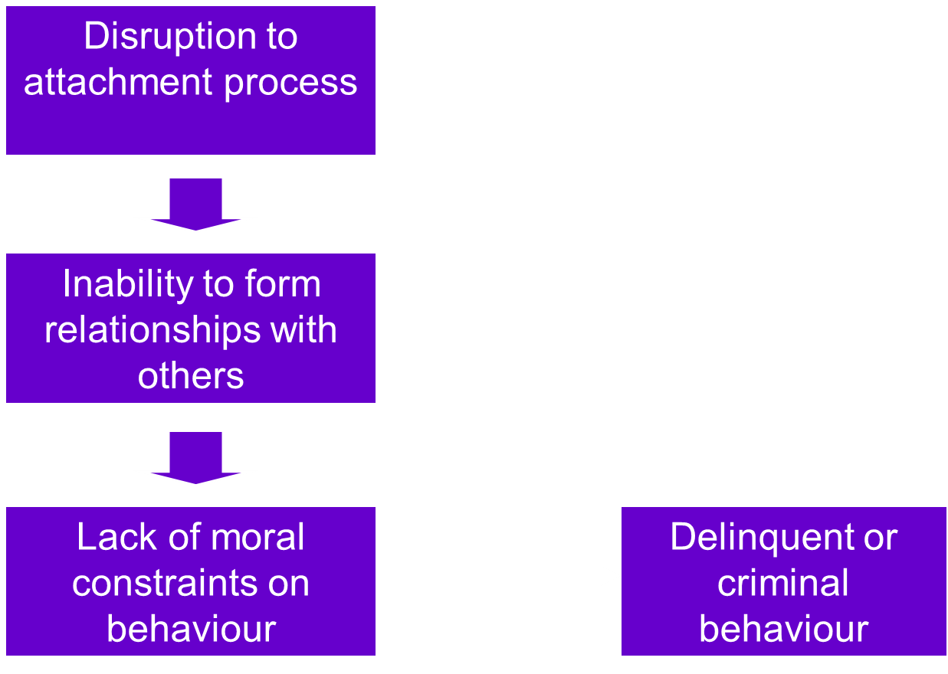
In the long-term….
Bowlby’s “Maternal Deprivation Hypothesis”
Cognitive damage
Social damage
Emotional damage
Delinquent or criminal behaviour and/or affectionless psychopathy
Learning objectives:
To KNOW the difference between ‘deprivation’ and ‘privation’.
To DESCRIBE + EXPLAIN the negative consequences of disrupting an attachment on the social and emotional development of an individual.
To DESCRIBE and EVALUATE research into attachment deprivation.

Slide 15
Evidence for maternal deprivation
Bowlby (1946) ‘44 thieves study’.
Comparison of ‘delinquent’ (i.e. criminal) and ‘disturbed’ children.
32% of delinquents had an ‘affectionless character’ (an apparent form relationships with others).
86% of delinquents had experienced maternal deprivation.
Evaluation
The study relies on the recollections of participants, which may be unreliable
Bowlby investigated IQ, emotional state, age and experiences with the mother, but there are other important factors in a child’s development which perhaps should have been looked into, such as the relationship with the father and school experiences
Use the information on this website: http://www.integratedsociopsychology.net/44_juvenile_thieves.html to order the sentences into a paragraph that describes Bowlby’s (1944;1946) ‘44 thieves study’ and a paragraph that describes Spitz’s study.
Keywords:
Deprivation
Privation
PDD model
Institutional care
Learning objectives:
To KNOW the difference between ‘deprivation’ and ‘privation’.
To DESCRIBE + EXPLAIN the negative consequences of disrupting an attachment on the social and emotional development of an individual.
To DESCRIBE and EVALUATE research into attachment deprivation.

Slide 16
Maternal deprivation hypothesis problems…
Criticisms of Bowlby (1946):
Retrospective data
‘Affectionless’ diagnosis made by Bowlby – possibility of bias
Overemphasized the fact of separation at the expense of the reasons for separation. Rutter claims institutionalization more important (lack of social skills, interactions etc.) rather than ‘attachment’ itself.
What criticisms have (especially Rutter) been made of MDH and the supporting research?
Learning objectives:
To KNOW the difference between ‘deprivation’ and ‘privation’.
To DESCRIBE + EXPLAIN the negative consequences of disrupting an attachment on the social and emotional development of an individual.
To DESCRIBE and EVALUATE research into attachment deprivation.

Slide 17
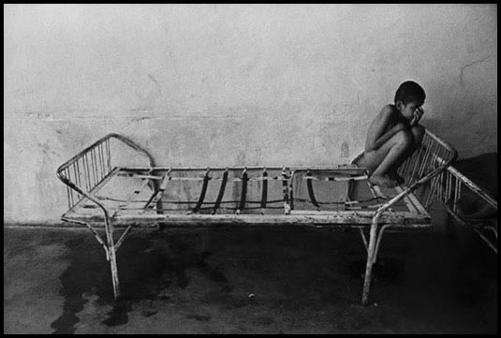
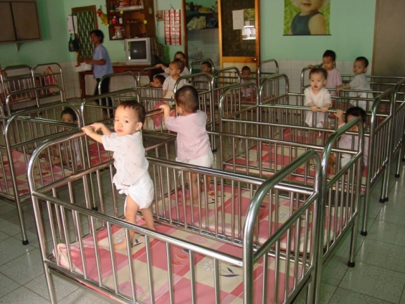
The effects of institutionalisation…
Watch the situation in Romania on which much deprivation and privation research has been conducted
Hodges & Tizard (1989) found negative social effects such as attention seeking behaviour and problems with peer relationships in both adopted and restored children.
Rutter’s (2007) longitudinal study of Romanian orphans showed negative effects on social and cognitive development, especially for children who had spent the longest time in an institution.
Create an APFC of Rutter’s longitudinal study
Use: http://www.integratedsociopsychology.net/romanian_orphans_investigation.html or textbook
Learning objectives:
To KNOW what is meant by ‘privation’, and how it differs from deprivation.
To UNDERSTAND how privation negatively impacts a child’s development.
To KNOW and EVALUATE the following key studies: Hodges and Tizard (1989), Rutter (2007), case study of ‘Genie’, case study of the ‘Czech twins’.

Slide 18
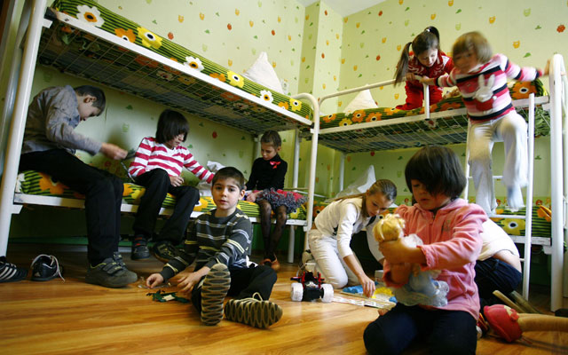
APPLY YOUR KNOWLEDGE….
Russian institutions are bursting with children abandoned at birth. They now total more than 600,000 children defined by the state as being without parental care.
Watch the video. Think about what you have learnt. What might be the long-term effects of this kind of early experience?
Learning objectives:
To KNOW what is meant by ‘privation’, and how it differs from deprivation.
To UNDERSTAND how privation negatively impacts a child’s development.
To KNOW and EVALUATE the following key studies: Hodges and Tizard (1989), Rutter (2007), case study of ‘Genie’, case study of the ‘Czech twins’.

Slide 19
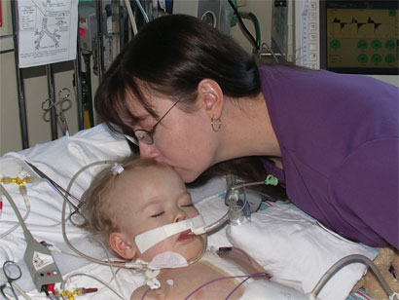
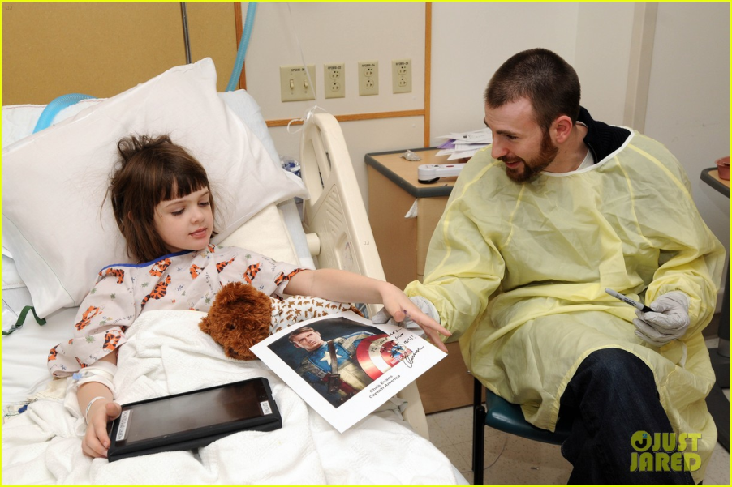
How has this research had practical applications?
Keywords:
Deprivation
Privation
PDD model
Institutional care
Learning objectives:
To KNOW the difference between ‘deprivation’ and ‘privation’.
To DESCRIBE + EXPLAIN the negative consequences of disrupting an attachment on the social and emotional development of an individual.
To DESCRIBE and EVALUATE research into attachment deprivation.

Slide 20
Read the information on the moodle course about the economic implications
Learning objectives:
To KNOW the difference between ‘deprivation’ and ‘privation’.
To DESCRIBE + EXPLAIN the negative consequences of disrupting an attachment on the social and emotional development of an individual.
To DESCRIBE and EVALUATE research into attachment deprivation.

Slide 21
Time practice! (15 mins)
Answer the long-mark question.
Discuss research into the disruption of attachment (12 marks)
Use the basic scaffold at the bottom, and the information, as well as what you have learnt today, to answer the question.
Learning objectives:
To KNOW the difference between ‘deprivation’ and ‘privation’.
To DESCRIBE + EXPLAIN the negative consequences of disrupting an attachment on the social and emotional development of an individual.
To DESCRIBE and EVALUATE research into attachment deprivation.

Slide 22
Peer assessment
The following letter appeared in a parenting magazine
Is it too late for Jack?
I am about to adopt jack, who is nearly 12 years old. He lived with his own mother until he was 9 months old, but has been in children’s homes or with various foster parents since then. I sometimes wonder whether Jack will ever be able to form a really strong attachment to me. I am also worried about Jack’s behaviour at school. His teacher says he is not very bright and his last school report said he was disruptive and difficult.
Outline Bowlby’s theory of maternal deprivation. Refer to the case of Jack in your answer. (6 marks)
Learning objectives:
To KNOW the difference between ‘deprivation’ and ‘privation’.
To DESCRIBE + EXPLAIN the negative consequences of disrupting an attachment on the social and emotional development of an individual.
To DESCRIBE and EVALUATE research into attachment deprivation.

Slide 23
Peer assessment…
[AO1 = 3, AO2 = 3]
AO1 Up to 3 marks for an outline of Bowlby’s theory. Award one mark each for any of the
following points: without continuous care in first 5 years; of a single adult (most usually
mother); there will be irreversible damage; long term consequences, e.g. delinquency/
affectionless behaviour/low IQ; lack of an internal working model for future
relationships.
AO2 Up to 3 marks for application to the text. Accept any of the following points:
Jack passed the critical period for attachment (so it could be too late)
Jack did not have a monotropic relationship
Jack shows signs of delinquent behaviour - disruptive/difficult
Jack shows intellectual or cognitive retardation/has a low IQ - not very bright.
Learning objectives:
To KNOW the difference between ‘deprivation’ and ‘privation’.
To DESCRIBE + EXPLAIN the negative consequences of disrupting an attachment on the social and emotional development of an individual.
To DESCRIBE and EVALUATE research into attachment deprivation.

