Slide 1
What was England like in the 1500s?
Starter: Complete your true or false quiz and stick it underneath your date and title.

Slide 2
Objectives!
By the end of the lesson you will (hopefully) be able to…
Describe what life was like during the Tudor period.
Explain what the different ‘ranks’ were among the English people.
Assess the gendered experience in Tudor England.

Slide 3
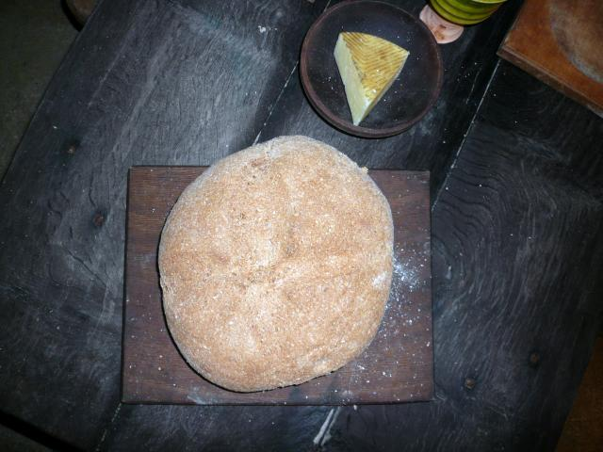
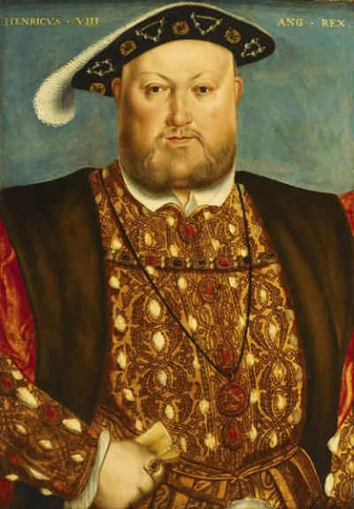
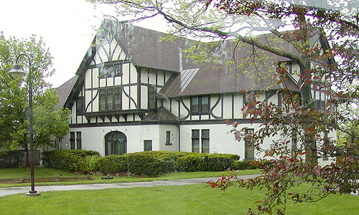
A Tudor Quiz
At the start of the lesson lets see what you think you know about what it was like to live during the Tudor period.

Slide 4
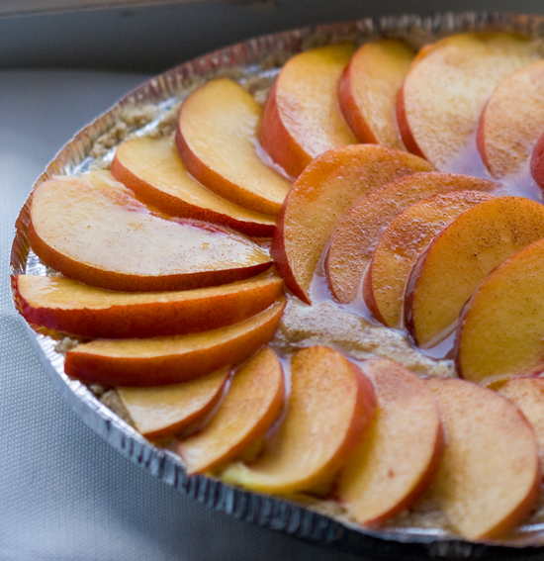
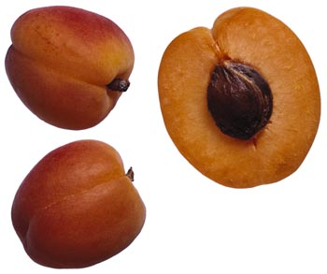
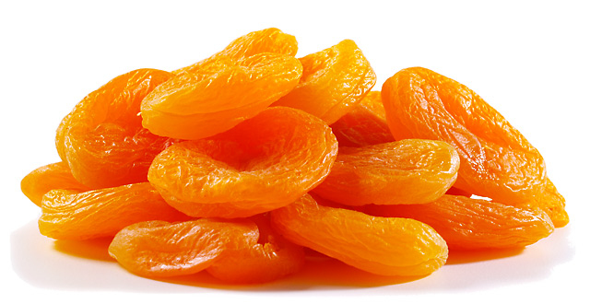
Fruits such as peaches and apricots were available to all, true or false?

Slide 5
Water supplies were always clean and plentiful, true or false.

Slide 6
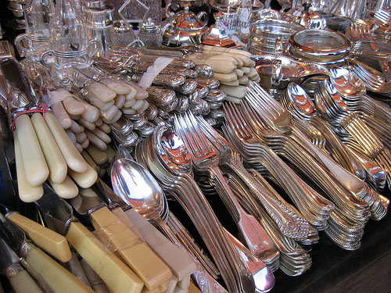
Some Tudors ate with knives and forks, true or false?

Slide 7
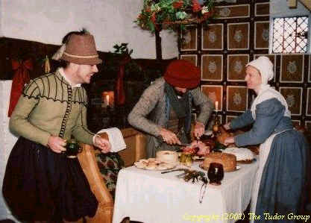
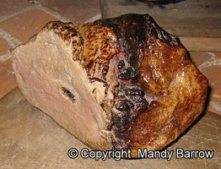
Meat was luxury, true or false?

Slide 8
Tudor wallpaper was a common feature of most Tudor homes, true or false.
Only the very rich had wallpaper.

Slide 9
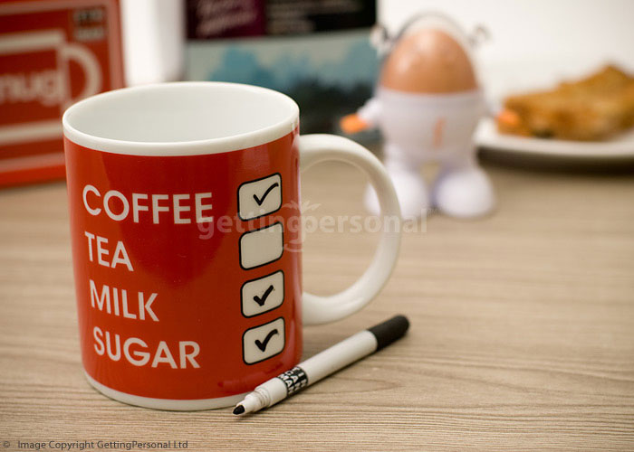
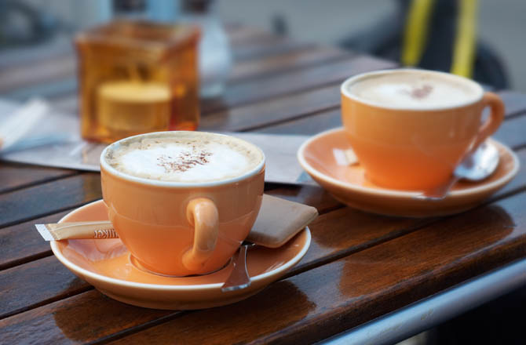
Some Tudors did not drink tea and coffee, true or false?

Slide 10
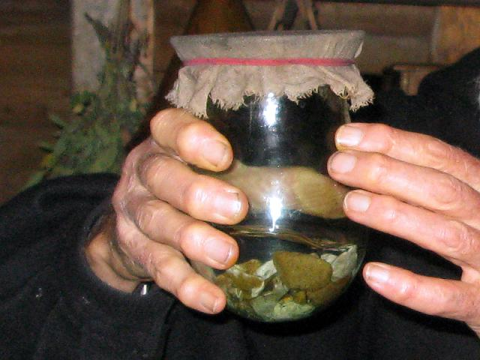
In Tudor times leeches were a delicacy only eaten by the rich, true or false?

Slide 11
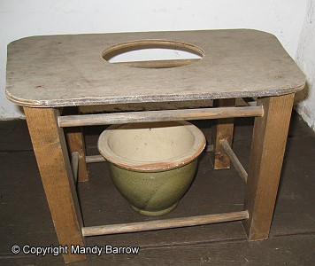
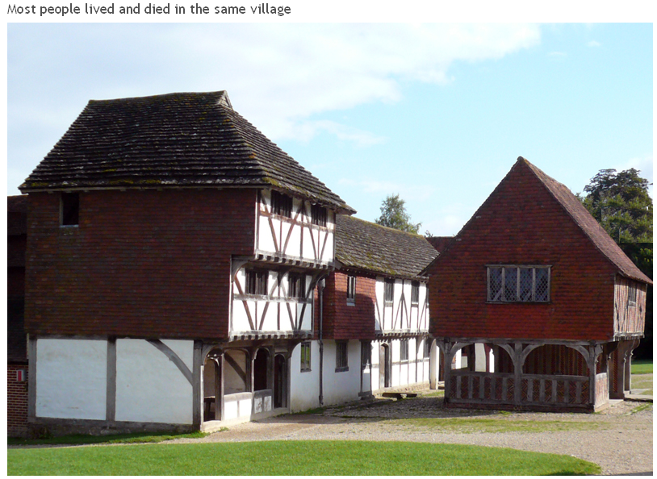
Tudor homes had working toilets, true or false?

Slide 12
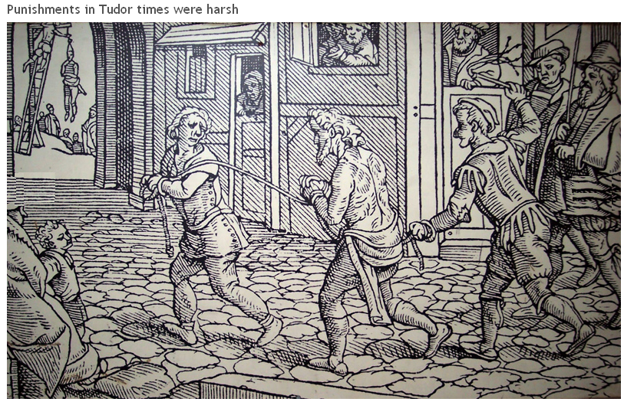
Punishment during Tudor times was very harsh, even for the smallest crimes , true or false?

Slide 13
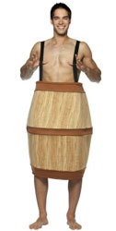
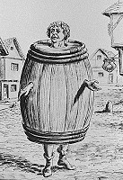
Drunk people were forced to walk the streets dressed in silly outfits like a beer barrel, true or false.

Slide 14
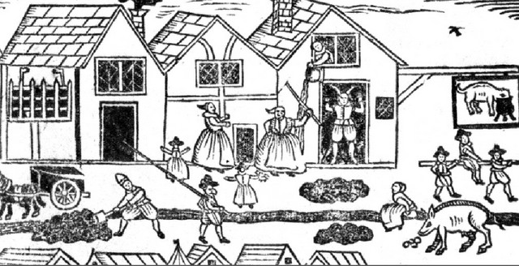
What would you find in a Tudor Town street:
Circle at least 6 activities that you think could cause problems in a Tudor town street. Explain why they might cause Tudor problems.
Success criteria
A lady is going to toilet in the water supply. This could make people sick if they drank the water.

Slide 15
What would you find in a Tudor Town street:
The 6 activities you could have found were:
Children playing in the dirty streets.
A person throwing toilet waste out of the window into the street.
A dog eating out of the pot that people would cook in.
A lady is going to toilet in the water supply.
A man shovelling human and animal waste next to the towns water supply.
Human and animal waste piled next to the towns water supply.
Animals drinking and going to toilet in the water supply.

Slide 16
Using your worksheets and The Making of the United Kingdom, complete activities 1-4.
Task!
 | PRESENT | 1500
POPULATION | About 57m. | 2.7m
TOWNS | Many towns, some very large, up to 4-500,000 people. | Fewer towns, often little bigger than present day villages. A few hundred people.
HOUSES/ FURNITURE | Built of varied materials – brick, stone, concrete, steel, glass. Comfortable, soft furniture. | Wood, thatch, lime plaster, dung(!) – stone and new materials brick and glass for those who could afford it. Furniture generally hard.
MEALS | Wide variety from home and abroad – balanced diet available. | Mainly meat, vegetables, cheese, bread beer – home grown fruit. No potatoes/rice – unbalanced diet.
INDUSTRY | Electronic, automotive, chemical, engineering, textiles. | Cloth making – based on sheep farming for wool. Manufacture in the home or in workshops.
JOBS | Huge variety, mainly industrial, professional or service or retail. 11/2% population work on the land! | Subsistence (lived on what you could grow and sell). Skilled crafts and spinning and weaving. 90% of the population lived on the land.
COUNTRYSIDE | Managed or farmed Protected for leisure use or landscape | Largely forested, great areas of wilderness, especially in the north. Open field, village based farming. Danger of wild animals – even wolves!

Slide 17
Homework
Gentlemen were born rich and came from families with titles - Barons, Earls and Dukes. Most owned large country estates and were often given important positions in government. Therefore status was extremely important.
Baring this in mind, I would like you to create a family crest, as many wealthy families of the time would have had, that represents you and highlights your prestige. This should be completed on one A4 side, either in your books or on the computer. If you use a computer you must remember to print it out before our lesson.

