Slide 1
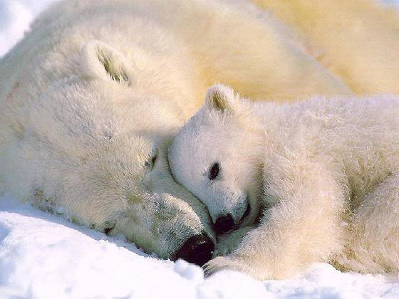
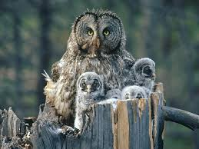
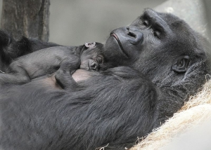
Title: What has animal research into attachments shown?
Learning objectives:
To OUTLINE and EVALUATE Lorenz (1935) research.
To OUTLINE and EVALUATE Harlow’s (1959) research.
To UNDERSTAND the advantages and disadvantages of animal research

Slide 2
Home learning:
Listen to BBC radio 4 mind changers – Harlow’s monkeys
http://www.bbc.co.uk/programmes/b00ly7lp
Learning objectives:
To OUTLINE and EVALUATE Lorenz (1935) research.
To OUTLINE and EVALUATE Harlow’s (1959) research.
To UNDERSTAND the advantages and disadvantages of animal research

Slide 3
Much early research into attachment was undertaken on animals.
Why might this have been? What are the advantages of animal research?
More ethical than babies.
Learning objectives:
To OUTLINE and EVALUATE Lorenz (1935) research.
To OUTLINE and EVALUATE Harlow’s (1959) research.
To UNDERSTAND the advantages and disadvantages of animal research

Slide 4
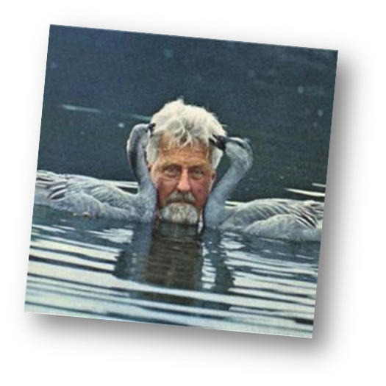
Lorenz (1935)
A: Investigated imprinting in geese.
P: Split goose eggs into two batches:
One half hatched naturally.
One half hatched in an incubator, with him being the very first thing they saw.
Recorded both groups behaviours.
F: Naturally hatched followed mother, whereas others followed him, and paid no heed to natural mother. Also later tried to mate with humans not geese!!
C: Geese ‘imprinted’ on Lorenz (a form of attachment in birds). The fact that imprinting is irreversible suggests strongly biological.
?
Learning objectives:
To OUTLINE and EVALUATE Lorenz (1935) research.
To OUTLINE and EVALUATE Harlow’s (1959) research.
To UNDERSTAND the advantages and disadvantages of animal research

Slide 5
Lorenz (1935)- Applications?
Follow up research found that imprinting only occurs within a brief period (up to 25 hours), this influenced Bowlby’s idea of a ‘critical period’ of attachment in humans.
The sexual desire for humans rather than birds, supports the idea of behaviour on future relationships (continuity hypotheses) .
Practical applications of research: Lamb’s imprint olfactory – skin the dead lamb and place on it on orphan, skin dead mother and place it on ewe whose lamb died and an attachment will likely form between the two.
What criticisms might there be of his research? How might this affect the validity of the research?
-Extrapolation issues
- Unethical
Learning objectives:
To OUTLINE and EVALUATE Lorenz (1935) research.
To OUTLINE and EVALUATE Harlow’s (1959) research.
To UNDERSTAND the advantages and disadvantages of animal research

Slide 6
Imprinting can occur on other animals IF they don’t kill the young birds….
Watch the video
Learning objectives:
To OUTLINE and EVALUATE Lorenz (1935) research.
To OUTLINE and EVALUATE Harlow’s (1959) research.
To UNDERSTAND the advantages and disadvantages of animal research

Slide 7
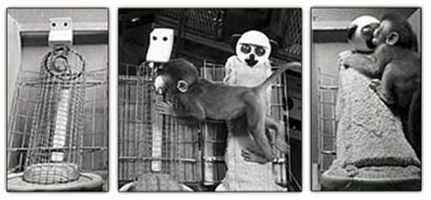
Harlow (1959)- Applications?
Contact and comfort is more important than food: Harlow’s monkeys.
Watch the video.
What did Harlow do?
What did find?
Harlow also did two follow up experiments:
Video
What did these find?
What criticisms might there be of his research? How might this affect the validity of the research?
-Extrapolation issues
- Unethical!!
Learning objectives:
To OUTLINE and EVALUATE Lorenz (1935) research.
To OUTLINE and EVALUATE Harlow’s (1959) research.
To UNDERSTAND the advantages and disadvantages of animal research

