Slide 1
What is peer review? And why is it important in psychological research?
Starter: Can you name 4 features of science from memory?
Key words
Peer review
Journal
Academic research

Slide 2
What is peer review?
Work out what peer review is by writing out the paragraph using the words below to fill in the blanks.
____________ is a process that takes place ___________ a piece of research has been conducted to assess its _____________. It is extremely ____________ in producing high quality science.
The piece of research is reviewed by ____________ not involved in the research, but working in a __________ field.
If the methods, procedures and conclusions are deemed to be valid, the research is published in a ‘___________’.
These vary in how often they are published, however, it is usually once a month or ___________.
Watch the video
important
after
quarterly
validity
similar
Peer review
experts
journal
Learning objectives:
To KNOW how the process of peer review works.
To UNDERSTAND the importance of peer review in validating new knowledge

Slide 3
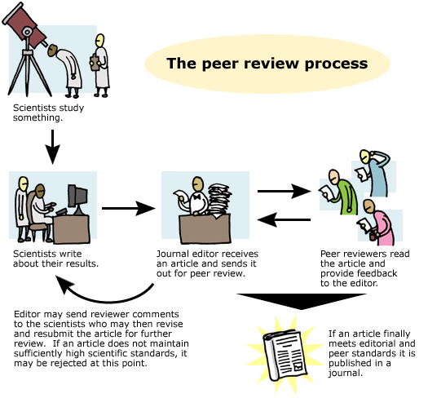

Slide 4
Why is peer review important?
Peer review is important because..
It is away of making a judgement about the validity, originality, quality and importance of the research before publication.
It is a way of judging the significance of the research in a wider context
Whether or not the methods and designs used are appropriate can be assessed.
‘Peers’ can share whether they believe the research should be published in its original form or changed in some way by suggesting recommendations or future improvements to ensure once it is published it is well-respected.
Keywords:
Peer review
Journal
Academic research
Learning objectives:
To KNOW how the process of peer review works.
To UNDERSTAND the importance of peer review in validating new knowledge

Slide 5
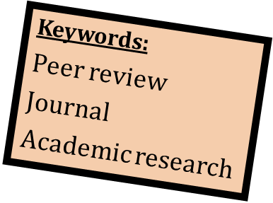
What are the conventions of psychological research submitted for peer review?
Read through the pieces of real published research (most of them studies that you are/or have been learning about).
Skim read at least 3 and come up with the conventions.
What do they all have?
How is their work set out structurally?
What do they all have at the beginning? Why?
What do they all have at the end? Why?
Having your research published in a scientific journal is a major goal for all psychologists.
It determines where research funding (the money that pays your wages and department equipment etc.) goes.
Learning objectives:
To KNOW how the process of peer review works.
To UNDERSTAND the importance of peer review in validating new knowledge

Slide 6
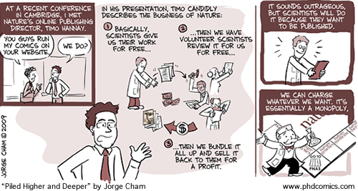
Evaluation of peer review?
+ Process produces highly valid and reliable science as research will not get published if it is not of a high enough standard.
- Expensive system.
- Can sometimes be a ‘publication bias’ towards positive results.

