Slide 1
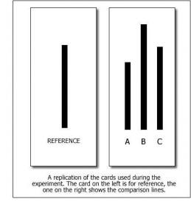
Asch’s line experiment study recap…
Asch wanted to know how likely it would be for an individual to go against a group norm when there is no uncertainty (unlike Sherif’s research), and they actually knew the right answer.
In Asch’s studies he studied conformity in groups of six to nine men. There was one participant, and the rest of the 6 -8 people in the group were confederates (people who were pretending to be participants). Asch told the participants that he was testing visual perception and showed the group lines of different lengths. Each person in turn had to say whether line A, B or C was the same length as the test line. The ‘real’ participant was one of the last to give their judgement.
Asch found that the participant in the group often gave the same answer as the confederates. It was found that 37% of participants conformed to the rest of the group on most of the occasions when the group was wrong, and overall 75% of participants conformed to the wrong answer at least once. When participants were interviewed afterwards most said they knew they were giving the wrong answer but they didn’t want to look a fool or upset the experiment.
Asch therefore concluded that the participants conformed because they wanted to fit in with the group, but privately did not agree with groups view on line length. The experiment is therefore evidence for normative social influence.
A
P
F
C
Learning objectives:
To OUTLINE and EVALUATE Asch’s procedure.
To KNOW how variations of Asch’s study (including group size, presence of an ally and task difficulty) led to changes in levels of conformity.

Slide 2
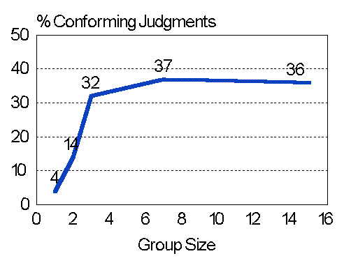
Factors that affect likelihood to conform:
Evidence from variations of Asch’s experiment…
1. Group Size
The size of the group of confederates affected the level of conformity – up to a point.
The bigger the group, the higher the likelihood of conformity, up to 3 people. After this number, level of conformity levelled off.
This shows that a small majority is not enough to induce conformity, but that equally it makes little difference whether it is a ‘significant’ majority or a massive majority.
Learning objectives:
To OUTLINE and EVALUATE Asch’s procedure.
To KNOW how variations of Asch’s study (including group size, presence of an ally and task difficulty) led to changes in levels of conformity.

Slide 3
Factors that affect likelihood to conform:
Evidence from variations of Asch’s experiment…
2. Presence of an ally
The presence of another person who disagreed with the group (a confederate told to give the correct answer to line length) meant that the participant was less likely to conform (conformity dropped from 37% to 25%)
This suggests that a group being unanimous is an important factor in influencing conformity.
Learning objectives:
To OUTLINE and EVALUATE Asch’s procedure.
To KNOW how variations of Asch’s study (including group size, presence of an ally and task difficulty) led to changes in levels of conformity.

Slide 4
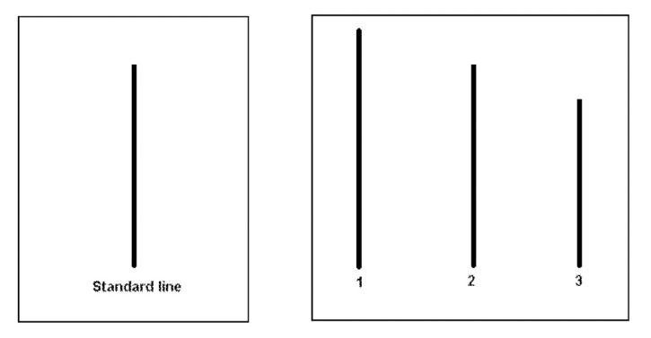
Factors that affect likelihood to conform:
Evidence from variations of Asch’s experiment…
3. Task difficulty
When the line matching task was made harder (more ambiguous) conformity increased.
This is because the participant thought it more likely the group were correct. Therefore the level to which a person knows they’re right influences conformity, as people begin to conform due to informational social influence, as well as NSI.
Learning objectives:
To OUTLINE and EVALUATE Asch’s procedure.
To KNOW how variations of Asch’s study (including group size, presence of an ally and task difficulty) led to changes in levels of conformity.

Slide 5
Evaluating (A02) findings from variations of Asch’s experiment…
Same issues as Asch’s original study:
Deception
Results a ‘child of the time’ (Perrin and Spencer)
Low ecological validity (low mundane realism and demand characteristics).
Low population validity (not large or representative samples).
Learning objectives:
To OUTLINE and EVALUATE Asch’s procedure.
To KNOW how variations of Asch’s study (including group size, presence of an ally and task difficulty) led to changes in levels of conformity.

