Slide 1
Year 9 exam
Duration: 5 hours
Purpose: To demonstrate your technical ability with regards to one of the taught skills from this year.
To have a clear idea of how to manage your time across a longer exam period.

Slide 2
Pick one of the following tasks to do in the exam time. You should do preparation work and planning beforehand. You should also practice your chosen technique. See the following slides for support resources for each option.
To create a poster using Photoshop for a movie that is set in a natural or urban setting. You will get more marks if the majority of images used are your own photographs.
To create a detailed etching of an animal.
To create a detailed tonal drawing of an architectural detail in response to the work of Ian Murphy.
To create a painting of a landscape either in the style of Turner (watercolour) or Monet (acrylic).
To create a 3D model that references a specific period of architecture.

Slide 3
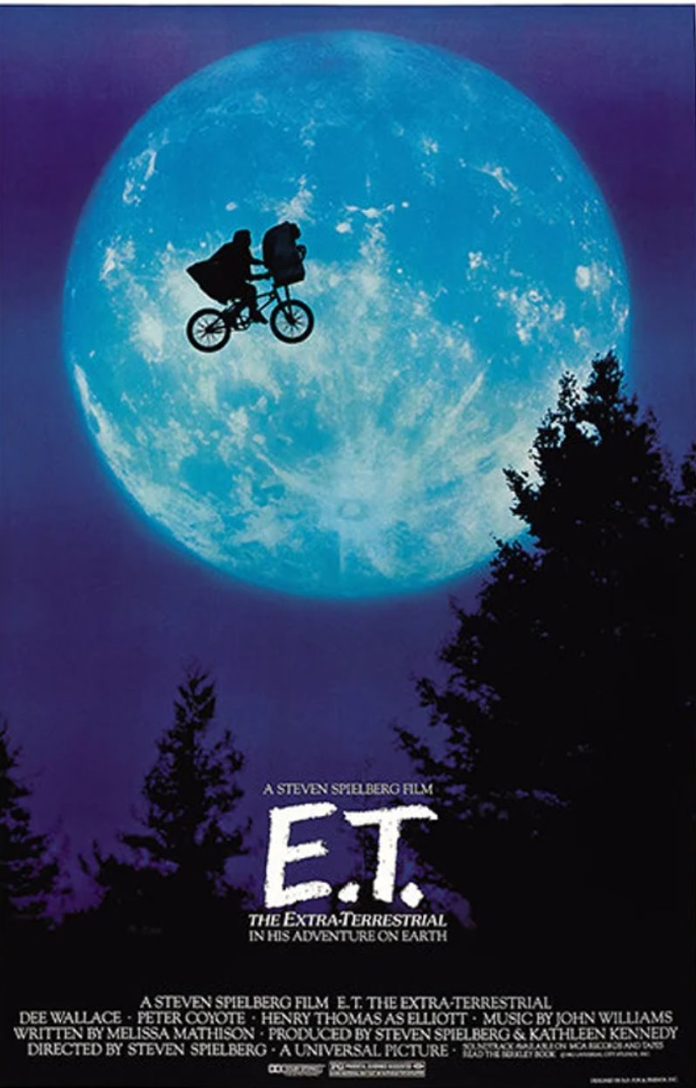
To create a poster using Photoshop for a movie that is set in a natural or urban setting. You will get more marks if the majority of images used are your own photographs.
Before the exam you will need to plan your design plus narrative and take the necessary photos. The photos should be accessible in your onedrive/on teams/ or in your documents. Check this is sorted before the day of the exam please.
To be successful you should have:
-Looked at existing movie posters for ideas regarding composition and the information to include.
-Made sure most of your imagery is from your own photos.
-Effective composition.
-Good use of layering and opacity.
-Sensitive use of filters and colour to create the appropriate mood.
-Effective text design and placement
-Billing card along the bottom
-Option to add a tagline and/or production logos

Slide 4
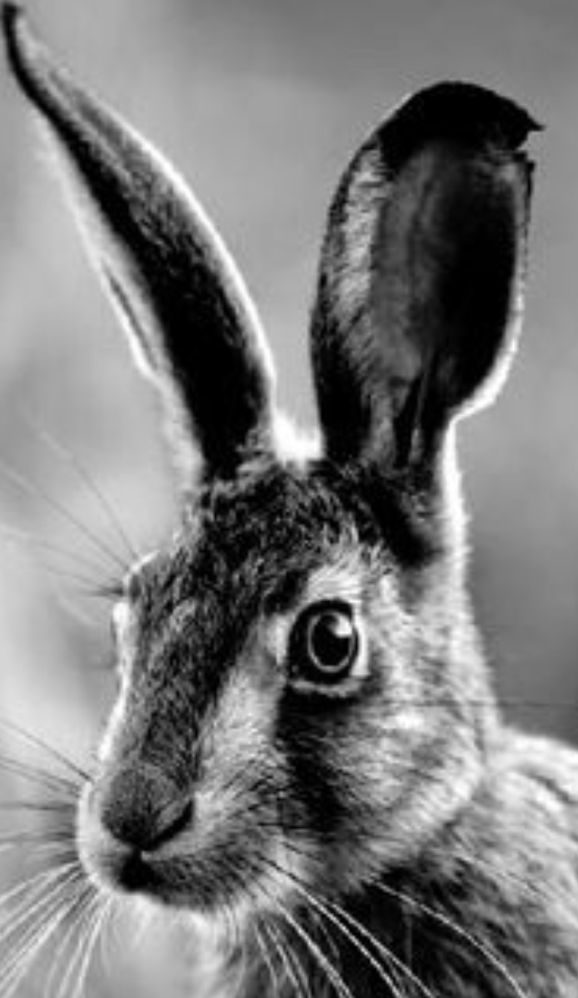
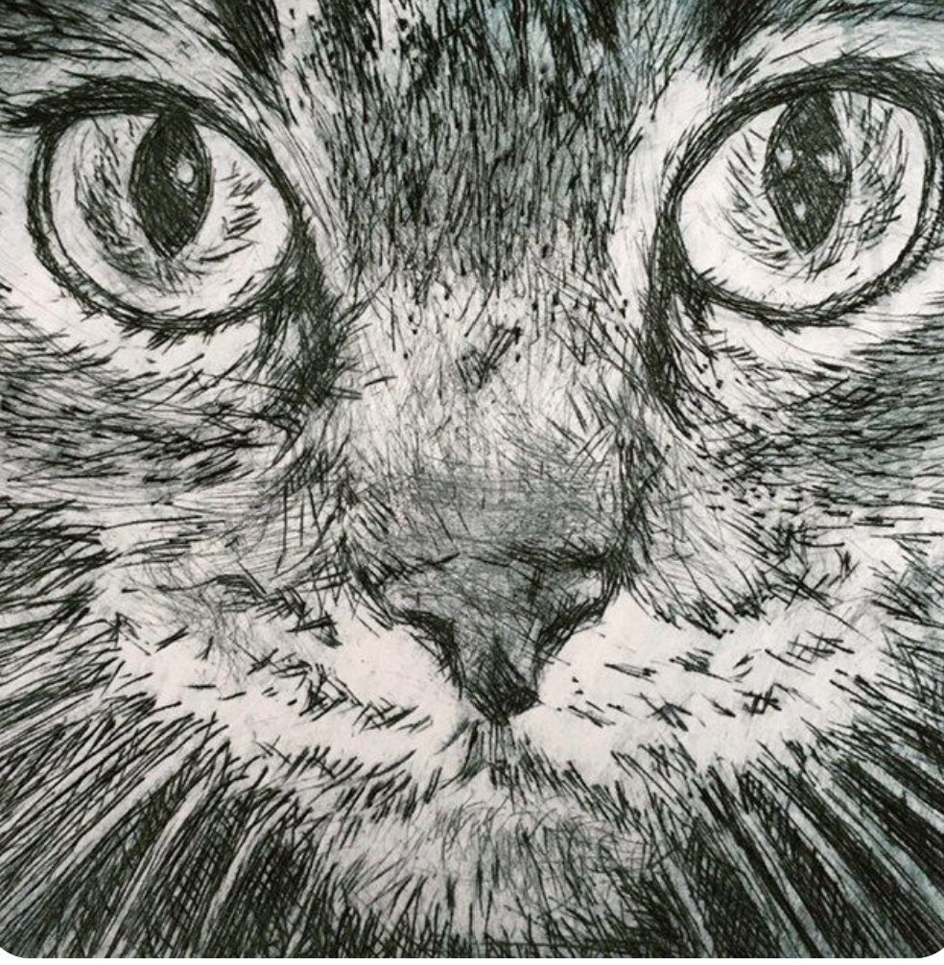
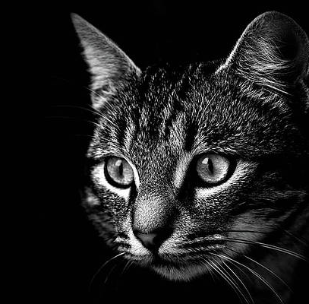
To create a detailed etching of an animal.
Find a photo, you don't have to take your own unless you can get a really good one. I'd strongly suggest doing an animal with fur and make sure you have a high-quality image (search ….. 'Black and white photography') . Note: it has the potential of being more impressive if you do the etching from your own preprepared drawing.
Print your image a suitable size to work from in the exam. Please note you will NOT be able to have your phones in the exam. Base this on the fact you have 5 hours and you need to get it printed as well.
To be successful you should:
Use marks effectively to convey texture.
Vary density of line to convey tonal variation.
Use printing techniques (ink application and the press) effectively to get a good print.

Slide 5
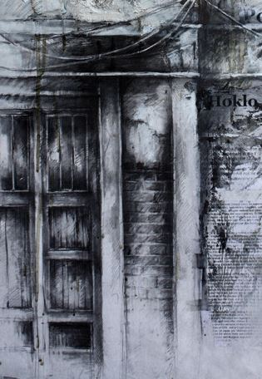
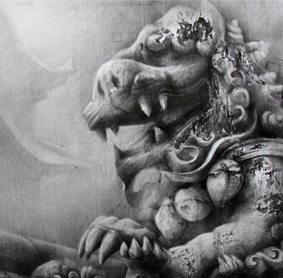
To create a detailed tonal drawing of an architectural detail in response to the work of Ian Murphy.​
Ian Murphy is a living artist whose work often focuses on the architecture seen during his travels. For your mock exam you are to respond to his work. I advise you do it in the following way:
Have a look at his featured work (top two images). Pay attention to how detailed and textural they are. You will need to pick your own close up to do in response.
Think about where you could take a close up photo of interesting architectural details (a range of tones and textures will make the image more interesting to study and draw from). See example bottom right.
Take your photo, edit it into black and white and play with the contrast and cropping if necessary.
Print your image a suitable size to work from in the exam. Please note you will NOT be able to have your phones in the exam.
Select an appropriate size to work based on the fact you have 5 hours and will be working in pencil.
Decide what technique you will use to draw, e.g. freehand or gridding. If the latter you may grid your photo out in advance.
To be successful you should:
Draw accurately.
Use a full range of tones (at least 6).
Convey textural details through appropriate marks.

Slide 6
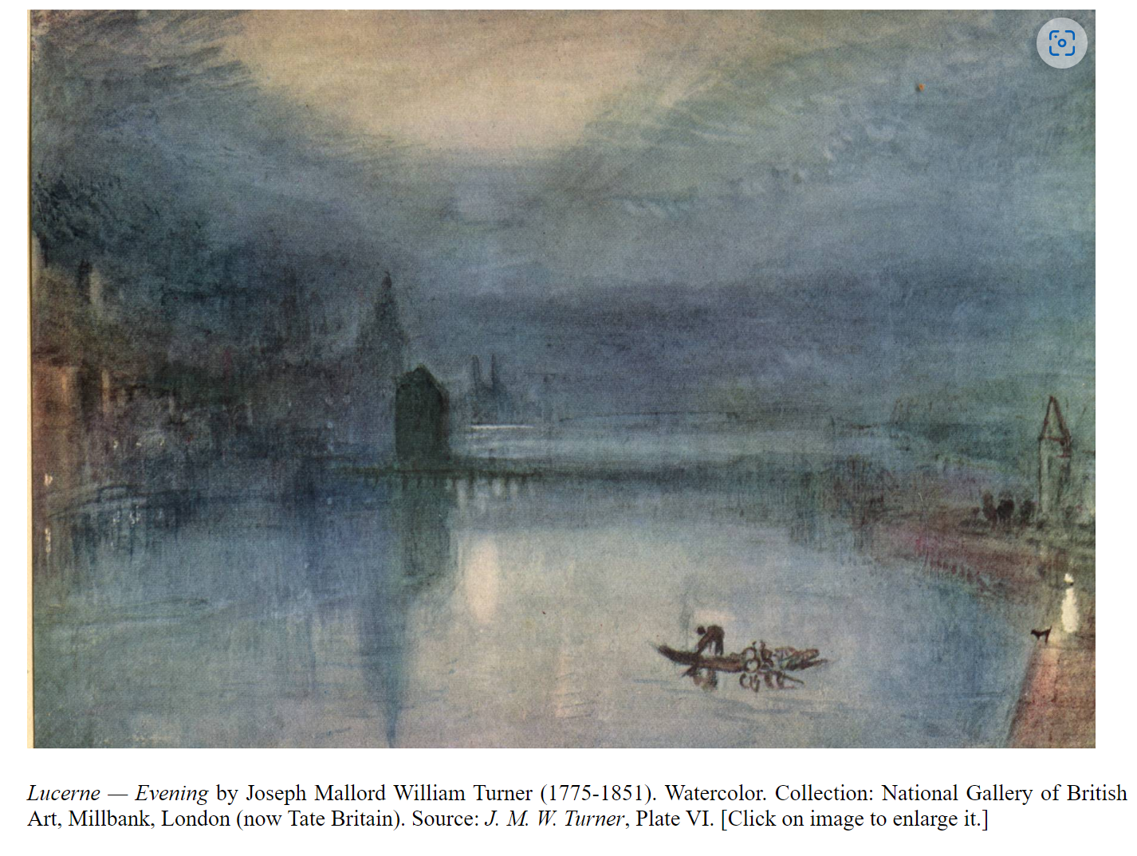
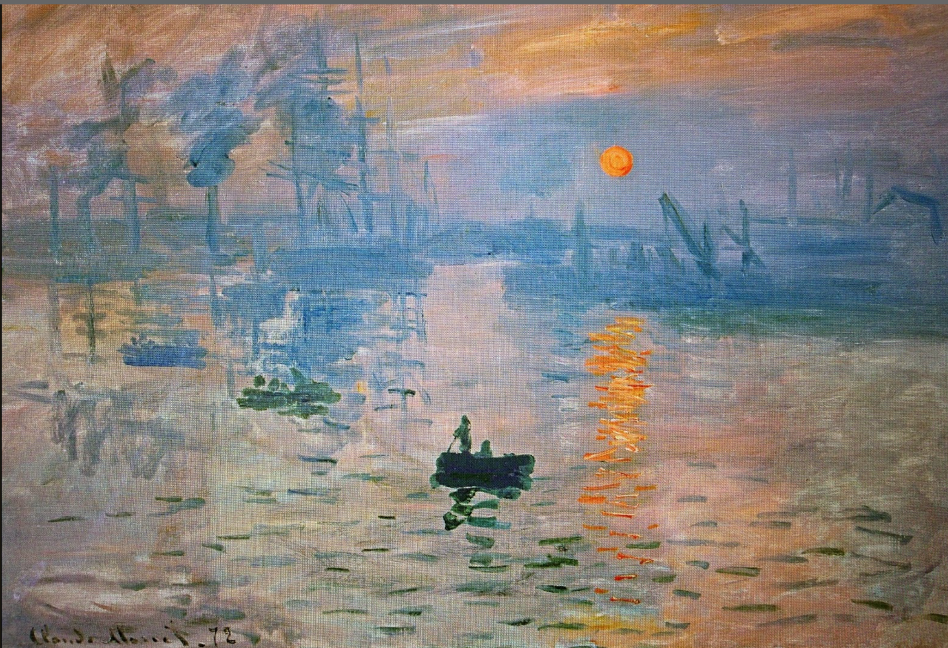
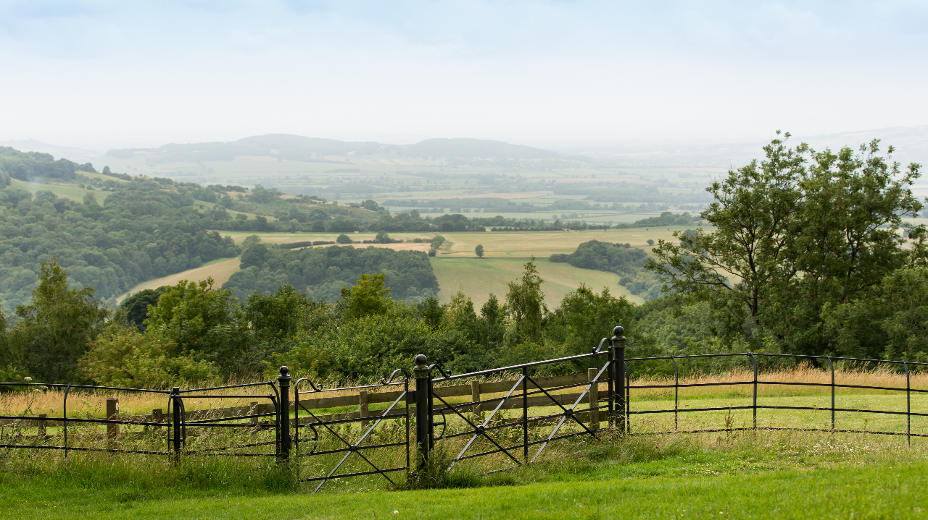
To create a painting of a landscape either in the style of Turner (watercolour) or Monet (acrylic).
Have a look at one of the artists' work. Pay attention to how the paint is applied and the colour palette used. You will need to pick your own landscape to do in response.
Think about where you could take a landscape photo.See example bottom right.
Take your photo, edit it to enhance colours if you wish, crop it if necessary.
Print your image a suitable size to work from in the exam. Please note you will NOT be able to have your phones in the exam.
Select an appropriate size to work based on the fact you have 5 hours and will be working in paint.
To be successful you should:
Show an understanding of how Monet/Turner has applied paint (the use of layering and brushstrokes).
Effectively mixed a range of tints, tones and shades of colours so that the piece has depth.
Produced an atmospheric painting with a successful composition.
Title: Impression, Sunrise
Artist: Claude Monet
Year: 1872
Material: oil on canvas
Dimension: 48 cm × 63 cm

Slide 7
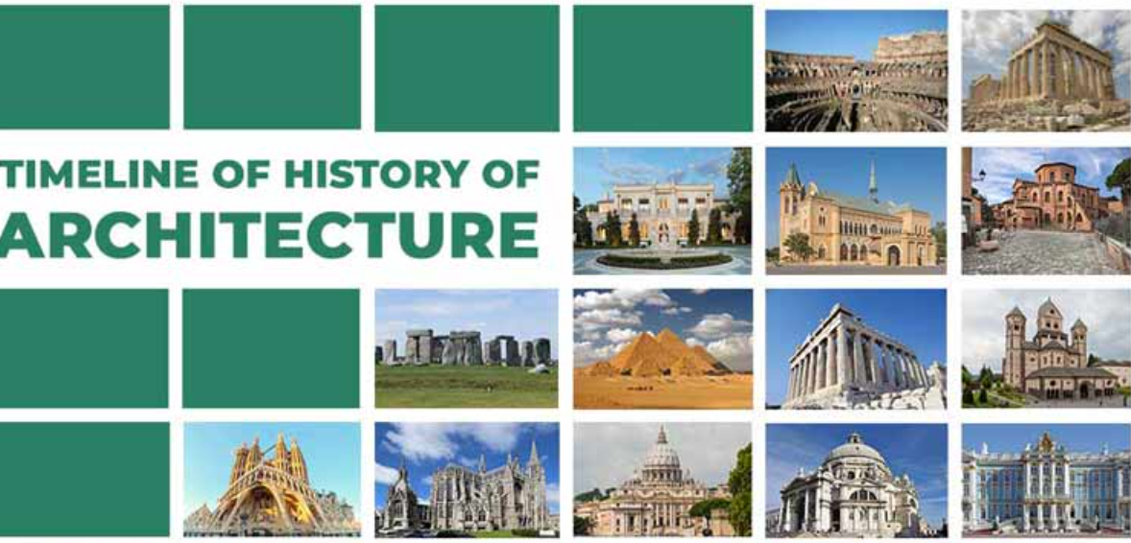
To create a 3D model that references a specific period of architecture.
Find photos of your chosen section of building (given the 5hrs do not aim to do a full building, just a small section) from different angles and print out. Decide on the scale you will create.
Print your image a suitable size to work from in the exam. Please note you will NOT be able to have your phones in the exam.
You must use the materials that we used in the lessons.
To be successful you should:
-pick one style of architecture. If considering Western Architecture look at this timeline of examples first:
https://www.thoughtco.com/architecture-timeline-historic-periods-styles-175996
https://urbandesignlab.in/timeline-of-the-history-of-architecture/
You are obviously welcome to look at other cultures too.
https://www.worldatlas.com/articles/the-most-famous-structures-in-the-world.html
This is a quick guide to global architecture:
https://www.youtube.com/watch?v=1QimcyFYAg4&t=130s
Effectively convey form.
Effectively covey the texture of the surfaces by using appropriate materials.
Accurate colour mixing and application of paint.

