Slide 1
Watch this famous US public information film about the perils of a nuclear attack on America.
What does it tell us about the way the government responded to the threat of nuclear war in the 1950s and 60s?
Notes:
https://www.youtube.com/watch?v=N_1jkLxhh20

Slide 2
How far did the nuclear arms race escalate the Cold War?
1945-1962

Slide 3
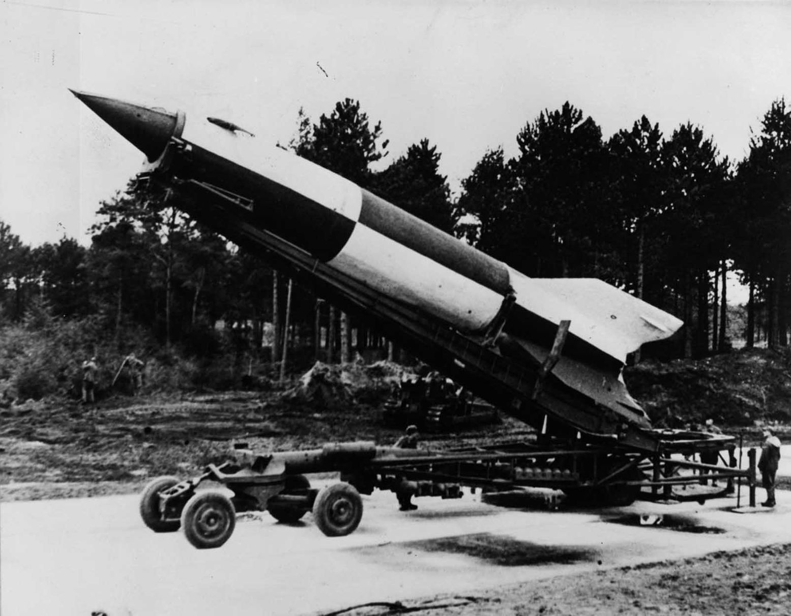
Origins of the arms race
World War II saw the development of weapons with more destructive power than ever before.
The Nazi V1 and V2 rockets were the first rocket-propelled weapons.
The USA exploded the first atomic bomb over Japan in 1945.
World War II technology showed a glimpse of the terrible destructive possibilities of weapons.

Slide 4
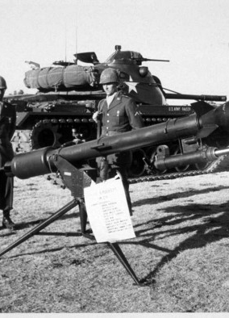
Causes of arms race
Growth of international tensions – keeping ahead in the technology race helped safeguard the interests of the nation
National pride – way of measuring the achievements of East or West
Political insecurities of leaders – e.g. Eisenhower & Kennedy increased defence spending in reaction to public demands
Insurance policy– use of nuclear weapons was so unimaginable war could be avoided
Military-industrial complex – arms race provided jobs
New technology – hydrogen, lithium, ICBM etc.

Slide 5
Justifications for nuclear build up
The growth in enemy stocks required a balanced growth in one’s own arsenal to ensure parity. There also had to be continual refinement of delivery systems to ensure that the threat of retaliation remained a credible one.

Slide 6
Justifications for nuclear build up
A wide variety of nuclear weapons systems were now required to ensure maximum flexibility in responding to any situation, from a localized tactical affair with battlefield weapons to an all-out holocaust.

Slide 7
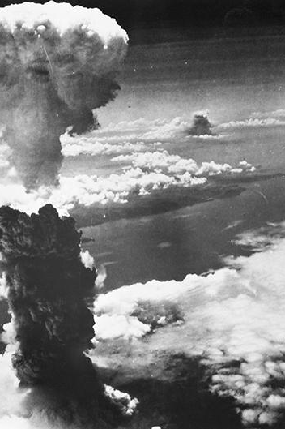
Bombs instead of armies
The atomic bomb was first used on 6 August 1945 on the Japanese city of Hiroshima. The USA said it was to end the war quickly with a minimum number of US losses. It certainly worked.
A later overt use of the bomb during the Cold War in support of foreign policy took place in July 1948, when Truman dispatched B-29 bombers to Europe during the Berlin crisis.
What other reason might the USA have had for exploding atomic bombs on Hiroshima and Nagasaki?

Slide 8
US nuclear build up
The US built up its nuclear arsenal, slowly at first, but with increasing urgency as relations with the SU deteriorated.
September 1948, Truman endorsed a National Security Council paper (NSC 30), “Policy on Atomic Warfare”
“utilize promptly and effectively all appropriate means available, including atomic weapons, in the interest of national security and must therefore plan accordingly.”

Slide 9
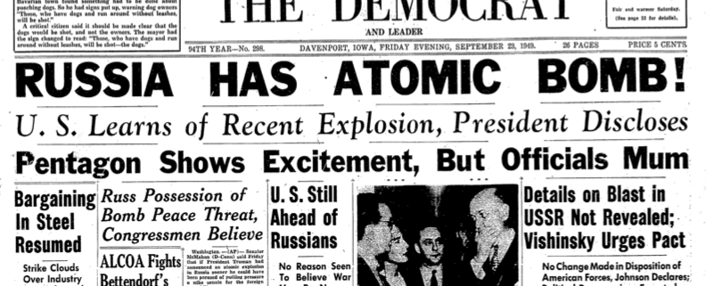
Soviet nuclear build up
The first Soviet test took place on 29 August 1949
In 1950 the Soviet image of a future war was very much the same as the American
In the first five years after the war, neither American nor Soviet military planners saw the atomic bomb as a weapon that would by itself win a world war.

Slide 10
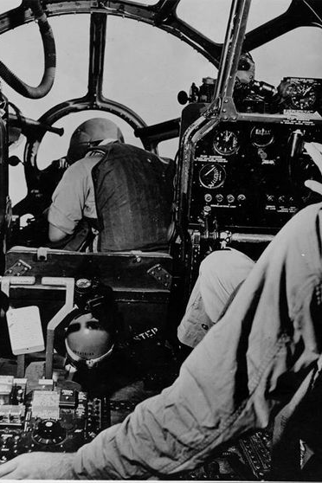
Nuclear arms in the Korean War
Those opposed to entry feared that the United States would use the atomic bomb in order to avoid defeat. Those in favour argued that China’s alliance with the Soviet Union would deter the United States from using nuclear weapons.
On November 30, 1950, Truman created the impression, in answer to a reporter’s question, that the atomic bomb might be used in Korea at General Douglas MacArthur’s discretion.
Clement Attlee flew to Washington on December 4 for reassurance that Truman was not actively considering the use of the bomb

Slide 11
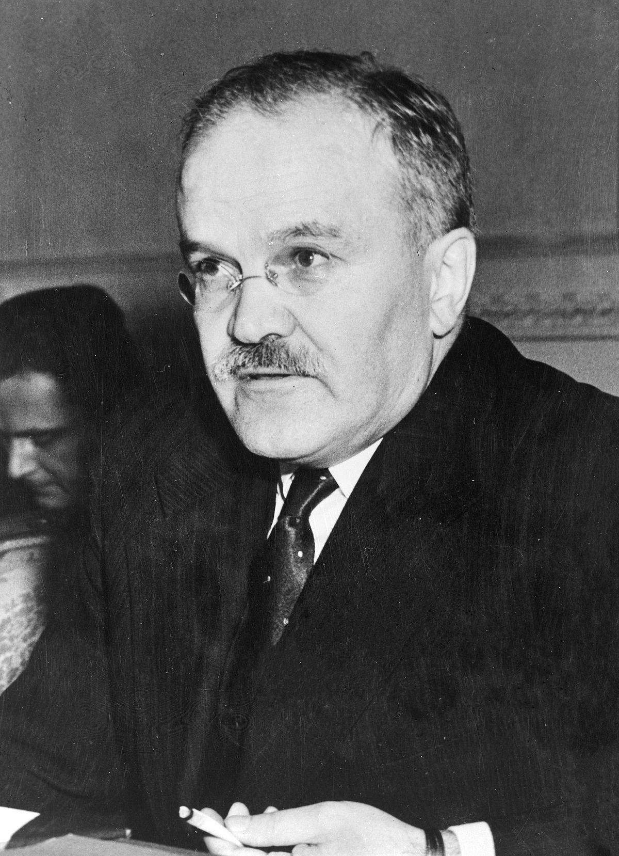
Nuclear arms in the Korean War
Truman was forthright in defending his decision to bomb Hiroshima and Nagasaki but he did not want to use this terrible weapon again.
President Eisenhower was more willing to contemplate its use.
Eisenhower later claimed that it was the threat to use the bomb that made possible the armistice signed on 27 July 1953
Viacheslav Molotov said many years later that the Cold War involved pressure by each side on the other, but “of course you have to know the limits.”
Molotov – Minister of Foreign Affairs 1939-1949, 1953-1956

Slide 12
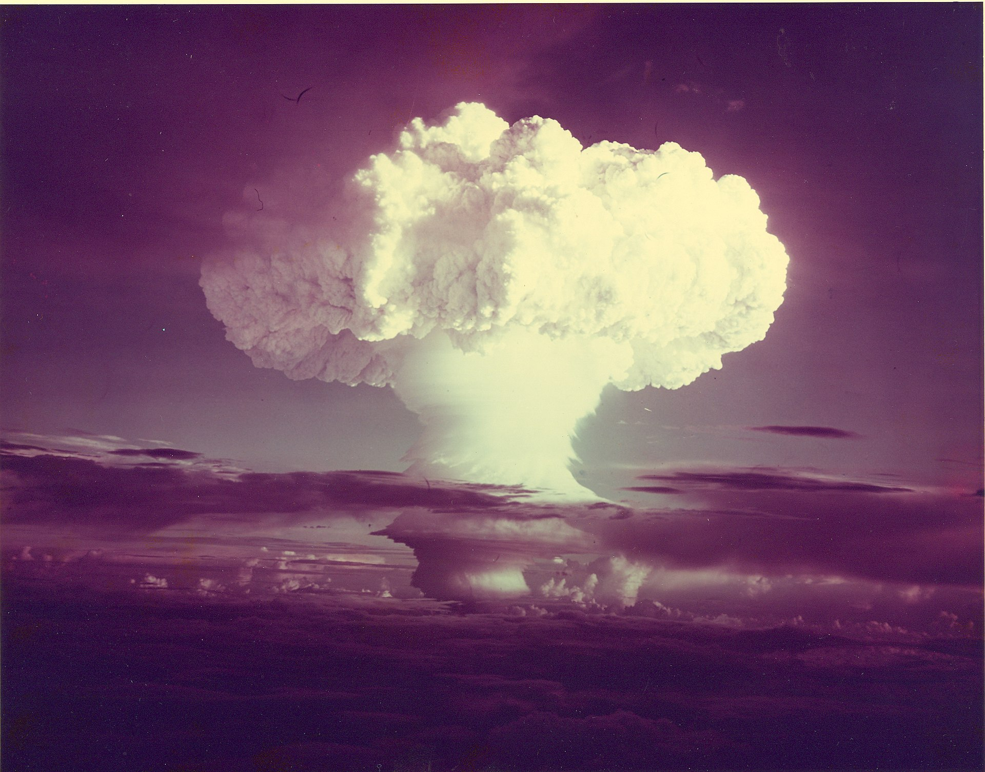
The hydrogen bomb
The “Mike” test on 1 November 1952, produced an explosive yield of 10 megatons
Spring 1954, the United States conducted a series of thermonuclear tests in the South Pacific
In August 1953, the USSR tested an intermediate type of hydrogen bomb, and in November 1955 it conducted a test that showed that it too knew how to build a superbomb

Slide 13
SLBM: Submarine launched ballistic missiles were much more mobile and therefore harder to detect than land-based missiles. The USSR was not able to keep as many nuclear submarines at sea as the USA, because it lacked access to naval bases around the world.
ICBM: Land based inter-continental ballistic missiles were rockets that could deliver nuclear weapons across much greater distances than earlier missiles.
ABM: Anti ballistic missile systems were intended to knockout every enemy missiles before they reached their target. Although the USSR was the first to develop these, the US followed very quickly and soon had a big lead in this area.
MIRV: Multiple independently targeted re-entry vehicles were missiles with multiple warheads each one capable of being directed to a different target. To a large extent, they reduced the effectiveness of any anti ballistic missile system.
Mutually Assured Destruction (MAD): MAD was the idea that the risk of nuclear a war would cause both sides to avoid any future crisis getting out of control. In many ways, this was a reversion to Eisenhower's idea of massive retaliation.

Slide 14
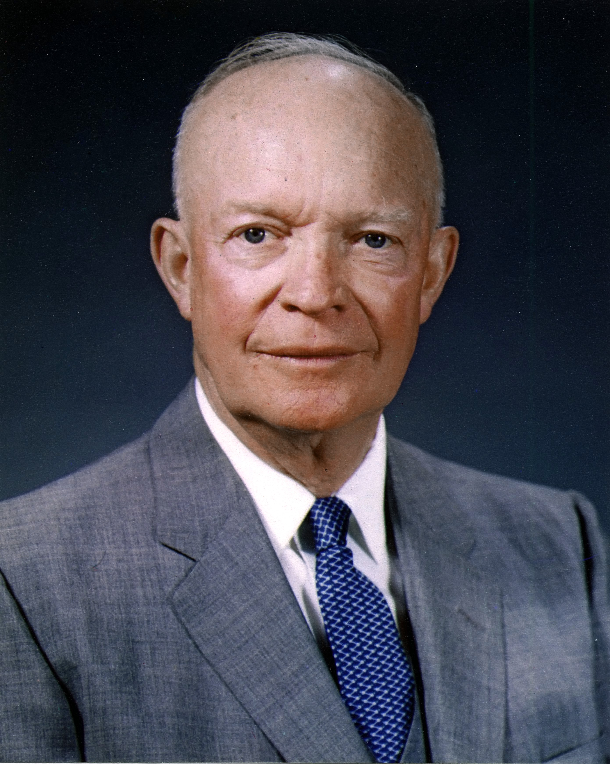
New Look and nuclear deterrence
Nuclear deterrence became the organizing principle of the US national security policy.
Eisenhower expedited the development of ICBMs, SLBMs and reconnaissance satellites.
The Soviets also placed increasing emphasis on nuclear weapons and ballistic missiles, creating the Strategic Rocket Forces in December 1959 to spearhead Soviet military power.

Slide 15
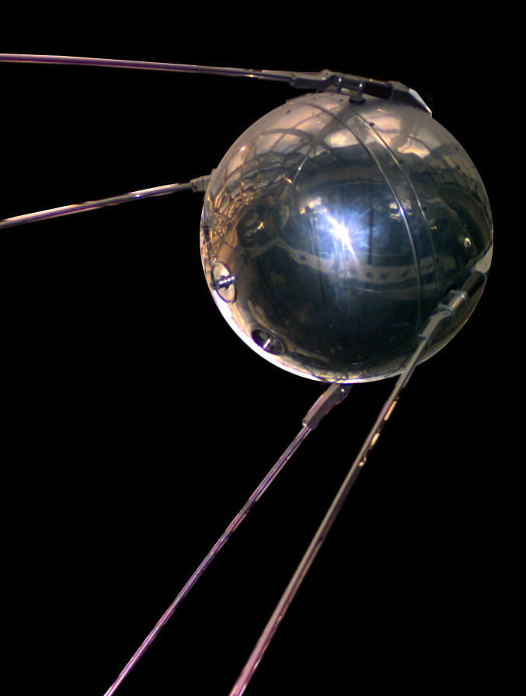
A “missile gap”
The Soviets launched Sputnik in October 1957 – the first artificial earth satellite sent into orbit.
Exaggerated fears emerged in Washington that a “missile gap” had emerged.
Eisenhower appointed a commission to examine the actual state of the nuclear-arms balance.
the Gaither Commission’s highly classified report, completed in 1958, concluded that a gap existed.
In reality the situation was the opposite.

Slide 16
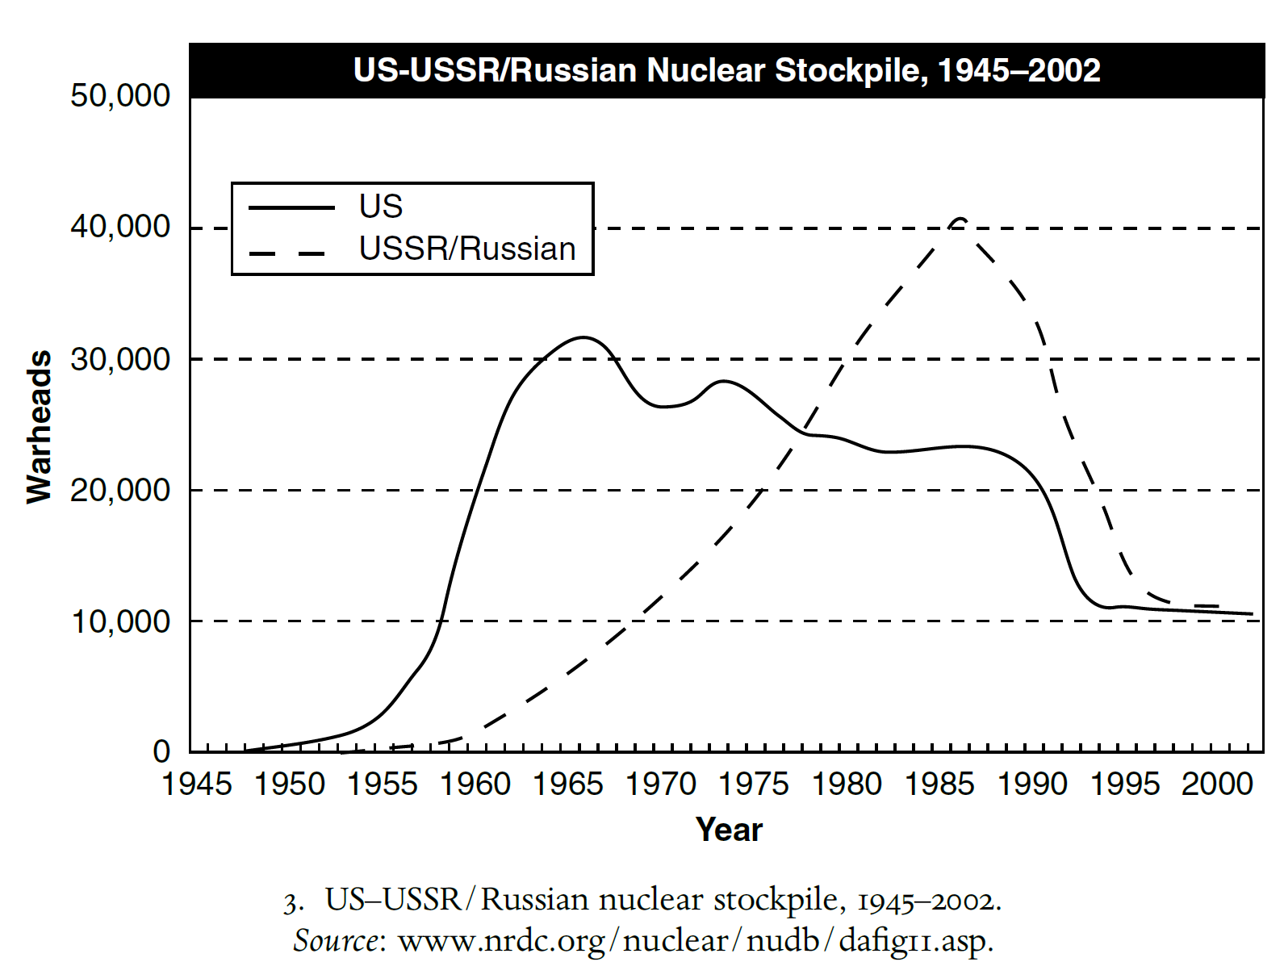
Stockpiling
By 1961, reconnaissance indicated the US were ahead.
Between 1950 and 1962, the US nuclear stockpile grew from 369 weapons to over 27,000; the Soviet stockpile grew from a handful of bombs to around 3,300.
The US were superior in long-range bombers, the Soviets focused on medium-range missiles to strike US bases abroad.

Slide 17
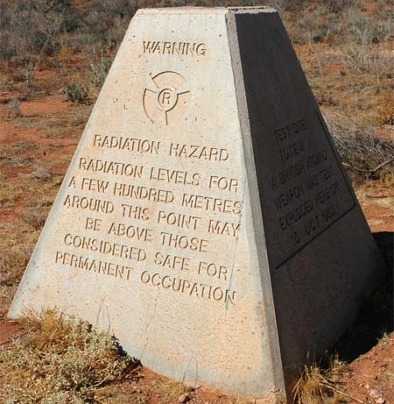
The UK
The US stopped cooperation with the UK following WWII.
Britain tested the A-bomb in October 1952, and the hydrogen bomb in May 1957.
In 1958, the US amended the Atomic Energy Act which allowed greater cooperation with the UK.

Slide 18
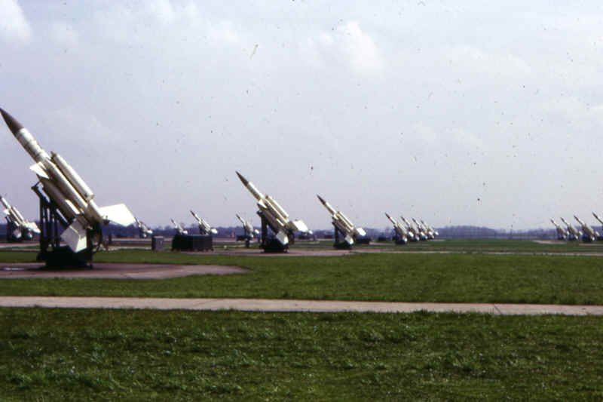
Bloodhounds of No 62 Squadron at RAF Woolfax Lodge 1960 - 1963

Slide 19
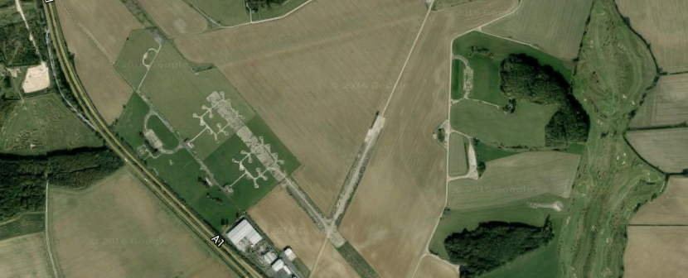

Slide 20
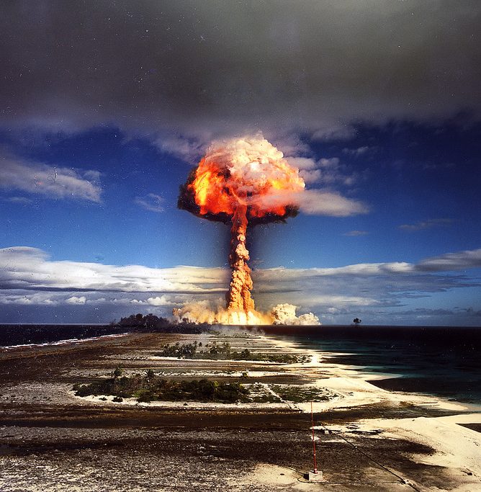
France
After WWII, France focused on peaceful uses of atomic energy
In 1954, the government decided France should build the bomb, and the first was tested in February 1960 in the Sahara.
France wanted to have a voice on the international stage.

Slide 21
Use of nuclear threats in diplomacy - US
Eisenhower considered using nuclear weapons in three crisis in Asia – Vietnam, and the two Taiwan Straits Crises.
There was discussion in 1953 that nuclear weapons could be used to relieve the French at Dien Bien Phu.
In 1954 and 1958, the Chinese Communists bombarded the islands of Quemoy and Matsu (Nationalist held)
Although he was not eager, Eisenhower gave serious consideration to the possibility of using nuclear weapons.
In each case the crisis ended when the Chinese expressed their desire for a peaceful settlement

Slide 22
Use of nuclear threats in diplomacy - USSR
On 5th November 1956, Khrushchev sent notes to London and Paris threatening them with missile attacks if they did not withdraw their forces from Egypt.
He was convinced that nuclear threats here were effective (but most historians give greater weight to Eisenhower’s opposition and financial pressure).
Both Eisenhower and Kennedy stood firm against Khrushchev’s pressure regarding Berlin.

Slide 23
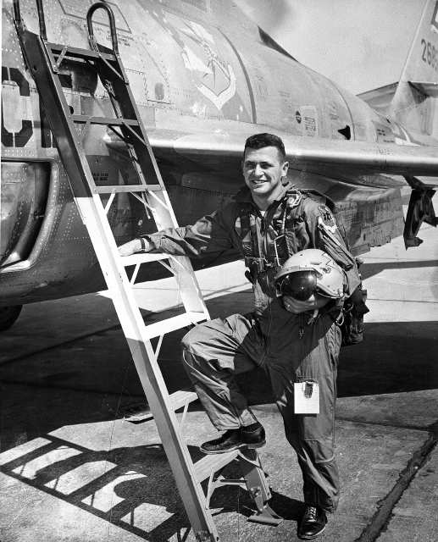
The U2 spy plane incident
In 1960, both Eisenhower and Khrushchev had hopes of an arms reduction treaty, to be discussed at the Paris Summit.
Unfortunately, a US U-2 spy plane was shot down over the USSR at that time. Eisenhower refused to apologise for the plane being in Soviet airspace, and the summit collapsed.
The Arms Race was back on, not least with Kennedy coming to power. Kennedy wanted to appear strong and so rapidly began to build up US weapons again.

Slide 24
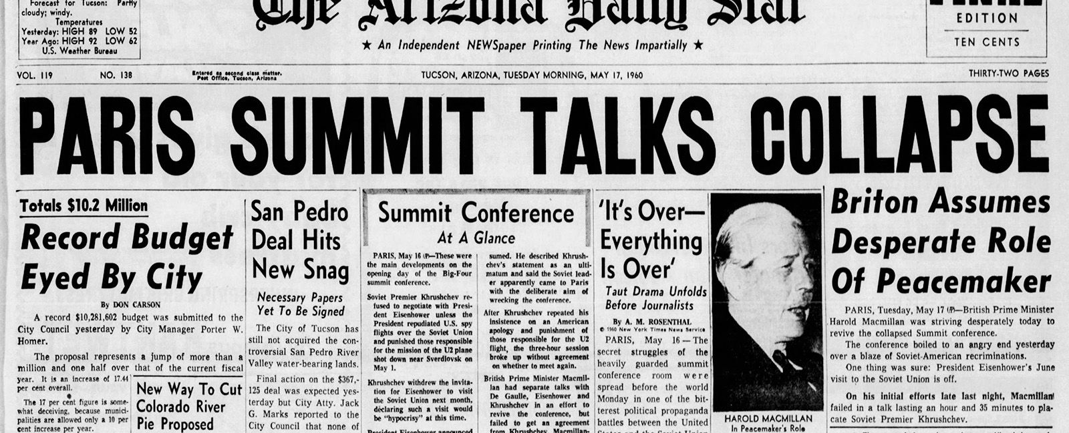
The US was shown up as Khrushchev tricked them into lying about the spy plane.
Khrushchev refused to attend the Paris meeting.
He gave the event as much publicity as possible to show that the West cannot be trusted.
Hopes of easing Cold War Tension disappeared.
Consequences

Slide 25
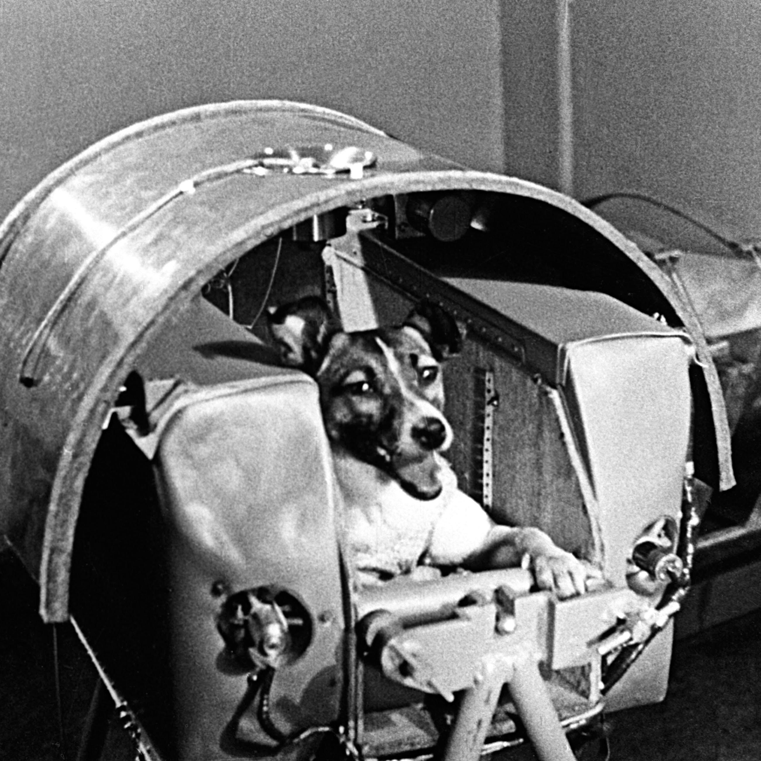
The Space race - activities
Watch the following clip: https://www.youtube.com/watch?v=-0th7z7ybUY
Complete the task ‘Who won the space race?’
Read the following article: https://www.nasa.gov/pdf/549312main_42s_leading_race_to_space.pdf

Slide 26
Bibliography
David Holloway, ‘Nuclear weapons and the escalation of the Cold War, 1945–1962’ in Melvyn P. Leffler and Odd Arne Westad eds., The Cambridge History of the Cold War: Volume I Origins (Cambridge, 2010) pp. 376-397
Alan Todd, History for the IB Diploma Paper The Cold War: Superpower Tensions and Rivalries (Cambridge, 2015) p.31

