Slide 1
The Athenian Empire
Athens as the leader of an empire
Her treatment of allied states.
Did Athens behave like a tyrant
to the allied states of her empire?
How different was life for the Ionian
and island Greeks
as members of the Athenian empire
from being part of the Persian empire?
Were there advantages in being a member
state of the Athenian empire?
How welcome a prospect to Athens’ allies was liberation by Sparta?

Slide 2
The Chalcis Decree mid 440s (after the revolt of Euboea)

Slide 3
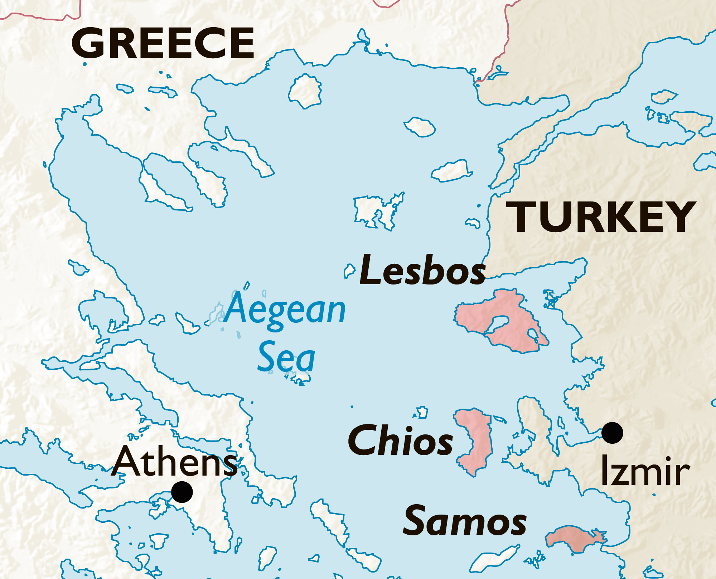
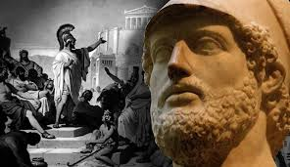
Revolt of Mytilene 428BC
Revolt of Mytilene, Thucydides 3.2-
Unless preventative measures were taken at once, Athens would lose Lesbos. 2.3
Directly after the invasion of the Peloponnesians, the island of Lesbos, except for Methymna, revolted from Athens. 3.2
This was a carefully premeditated revolt. The city of Mytilene was in communication with Thebes and Sparta and was planning to unite Lesbos under her control.
Their allies were to be handled firmly, since, he said, the strength of Athens came from the money paid in tribute by her allies, and victory in war depended on a combination of intelligent resolution and financial resources.’ 2.13
Her plans were leaked prematurely to the Athenians, who
‘at first - through a process of wishful thinking –
believed that the accusations were untrue.’ 3.3
These plans included:
narrowing the mouths of their harbours for defence
‘finishing the fortifications and ship-building which they had in hand’ 3.2
laying in supplies from the Black Sea, including archers and corn.

Slide 4
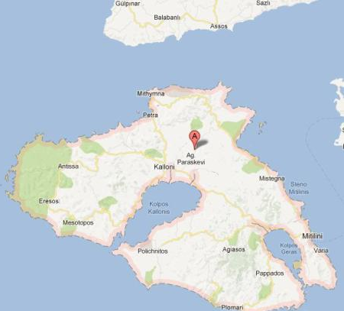
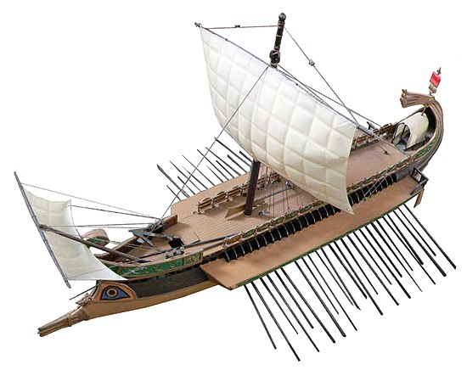
428BC
Methymna
Mytilene
Lesbos
Athens decided– after her initial disbelief – to send out representatives, to take action before it was too late. They hurriedly sent a fleet of 40 ships with Cleippides (due to sail around the Peloponnese) and hoped to catch the Mytileneans celebrating a festival outside their city. 3.3
The Mytileneans got wind of this and stay inside their city. After a brief skirmish at sea an armistice was agreed. The Mytileneans sent representatives to Athens to assure them of their good faith, but also secretly send a trireme to Sparta.
Negotiations got nowhere in Athens. ‘The Mytileneans now marched out in full force against the Athenian camp and had rather the better of things, but they lacked confidence and retired to their city, not wishing to try their fortune again until they had the support of whatever forces might be coming to them from the Peloponnese. They send another trireme to Sparta. Meanwhile Athens ‘much encouraged by the Mytileneans inactivity;, strengthens built two forts, blockaded the harbour and gathered forces. They thus deprived Mytilene of the use of the sea. 3.6

Slide 5
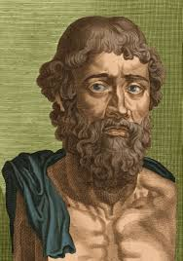
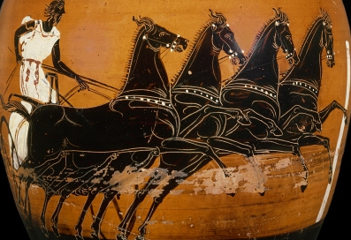
OLYMPIC GAMES 428BC
The ambassadors from Mytilene who had come in the first ship had been told by the Spartans to come to Olympia, so that the other allies also could hear and discuss what they had to say. After the festival was over, a meeting of the allies was called.
The alliance between us and Athens dates from the
end of the Persian war, when you withdrew from the leadership and the Athenians stayed to finish what was left to do.
Thucydides reports a long speech delivered by the Mytileneans to the Peloponnesian League. 3.9-14
When we saw that they were becoming more and more interested in enslaving their own allies, then we became frightened.
We shall take the initiative in breaking away from them, instead of waiting to be destroyed by them later. Never has there been such an opportunity. The Athenians are in a state of exhaustion owing to the plague and the expenses they have incurred.
If you invade for the second time this summer with naval and military forces at the same time, they will either be unable to resist your fleet, or will have to withdraw their own from your shores and ours.*
Come to the help of Mytilene. Be our allies and do not desert us.
Be the men that the Hellenes think you and that our fear requires you to be.
As a result of this appeal, calculating that the Athenians were overstretched (*with 30 ships going around the Peloponnese and 40 with Cleippides at Mytilene), the Spartans agreed to invade Attica the following spring and to bring ships across the isthmus for simultaneous attacks by sea.‘In all this they showed great energy.’
The Athenians were aware that these preparations were being made on the theory that they themselves were weak, and wished to make it clear that the theory was a mistaken one. They manned 100 ships with their own citizens (knights and pentacosiomedimnoi excluded) and sailed to the Isthmus, where they made a demonstration of their power.

Slide 6
427BC
this was the worst invasion of all, except the second.
4th Invasion of Attica by the Peloponnesians under Cleomenes Thucydides 3.26 They invaded Attica so that the Athenians would have trouble on two fronts at once and would find it more difficult to take action against the fleet going to Mytilene.
Peloponnesian fleet of 42 ships sent out to Mytilene under Alcidas. Thucydides 3.26
The enemy prolonged their stay in Attica and overran most of the country, since they were constantly waiting to hear news of what their fleet, which they thought must have arrived by now, had done in Lesbos.
Meanwhile...
The Siege of Mytilene
The Athenians presumably expected a long siege (see 3.19), but this turned out not to be the case:
Meanwhile the Mytileneans were forced to come to terms with the Athenians. Their supplies of food had run out, and the ships from the Peloponnese, so far from putting in an appearance, continued to waste time on the way.
Not all the people of Lesbos – or even all the citizens of Mytilene – supported the revolt.
So what had happened?
The Spartan Salaethus himself had given up hope of the arrival of the ships and issued heavy armour to the people. 3.28
‘As soon as the people found themselves properly armed, they refused any longer to obey the government. They held meetings among themselves. The government realised that they were quite incapable of preventing this and therefore joined in coming to terms with Paches and the Athenian army.’
^{3.16}

Slide 7
The Mytilenean Debate 427BC
https://www.bbc.co.uk/programmes/m000614s

Slide 8
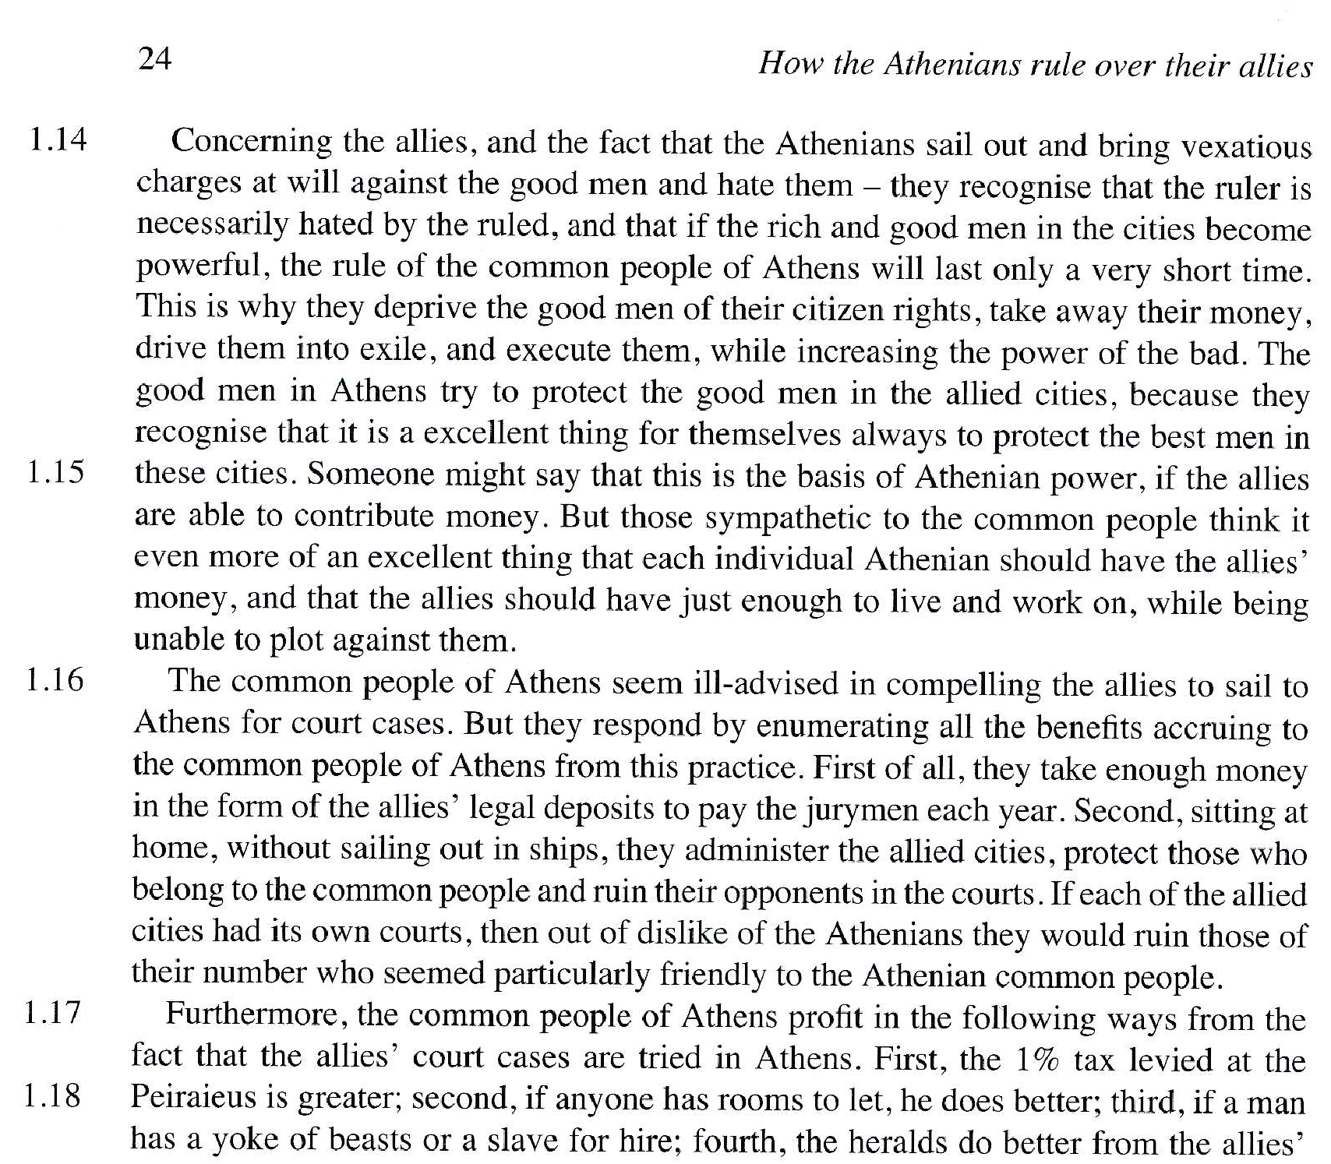
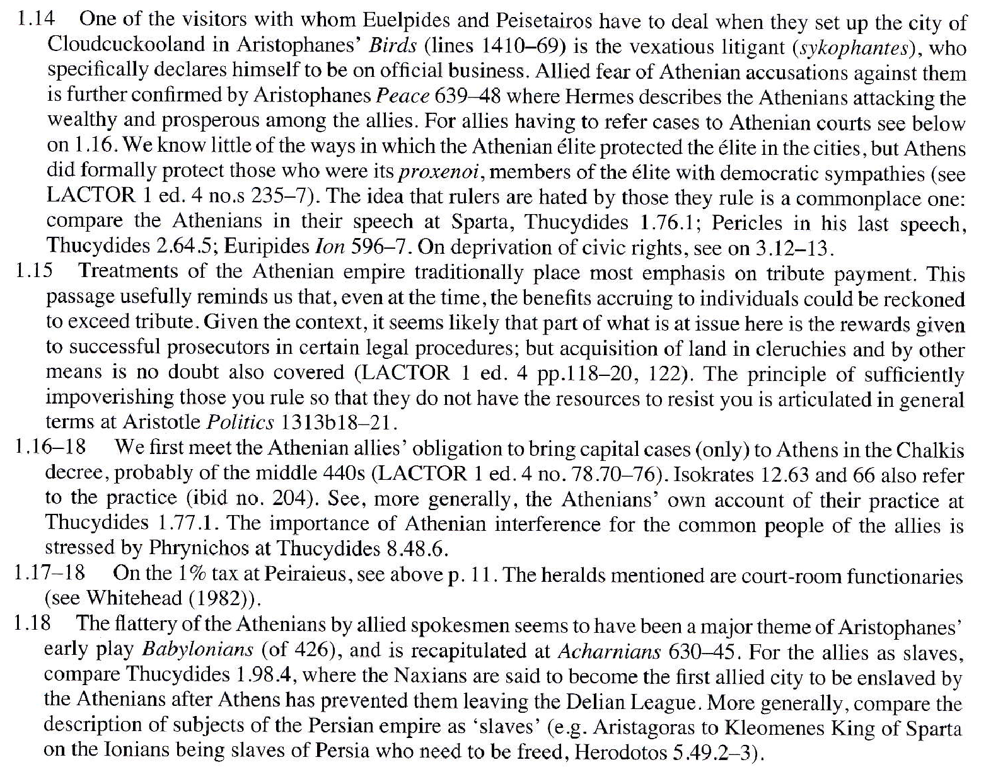
‘The Old Oligarch’ Pseudo-Xenophon
Probably an Athenian writing in the 420s BC

Slide 9
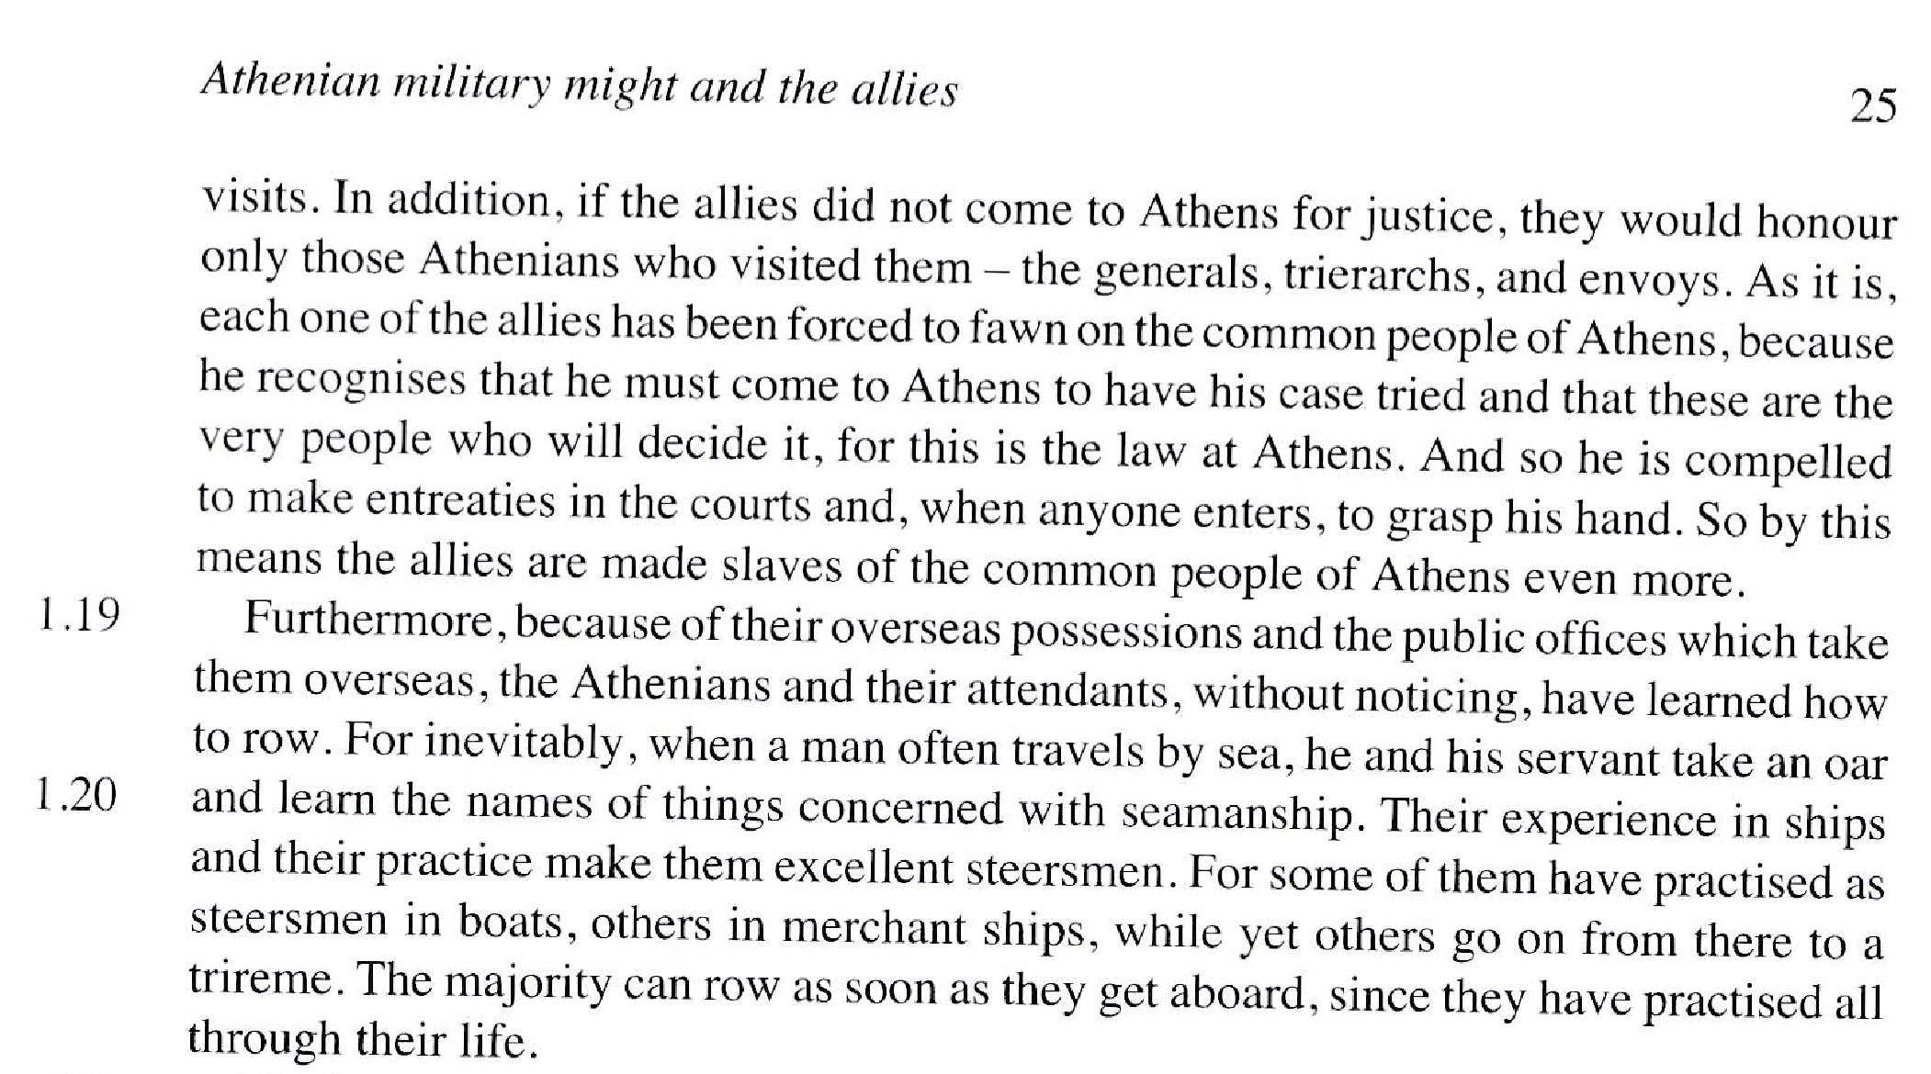
‘The Old Oligarch’ Pseudo-Xenophon
Probably an Athenian writing in the 420s BC

Slide 10
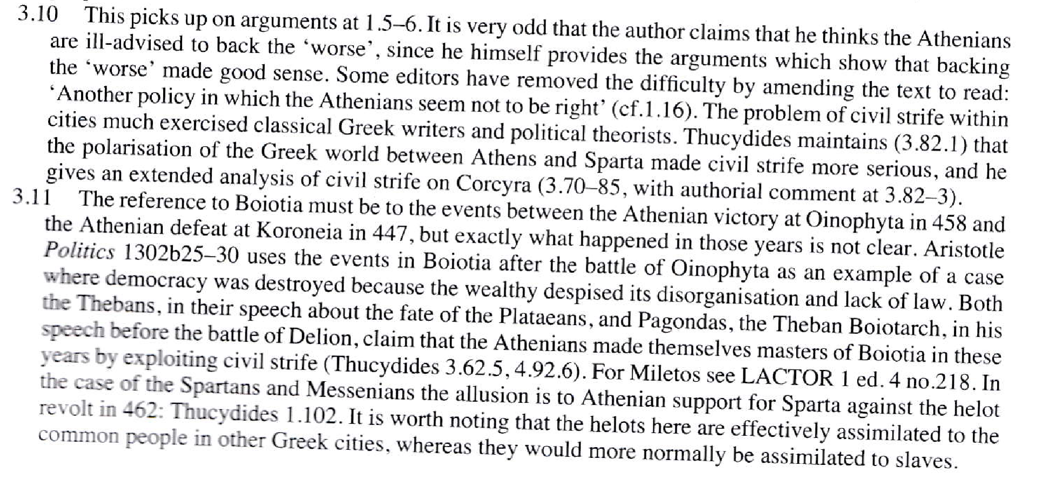
‘The Old Oligarch’ Pseudo-Xenophon
Probably an Athenian writing in the 420s BC

Slide 11
The Thoudippos Decree 420s (after Pylos)

Slide 12
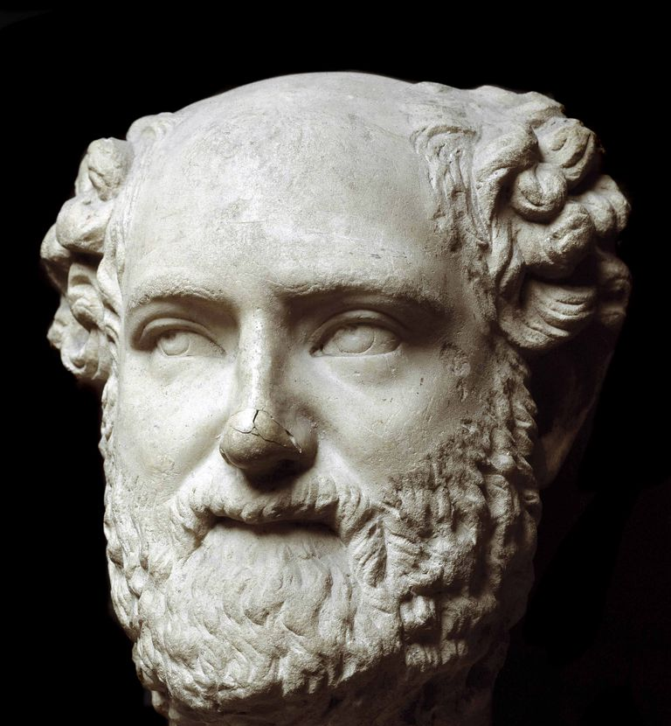
Aristophanes
Aristophanes
An Athenian writing in the 420s BC
Acharnians, 425BC
Chorus: He (Aristophanes) says that he’s done a great deal for you. For example, the fact that you are no longer so easily persuaded by foreigners who come here trying to seduce you and cheat you with flattery, is due to his good teaching.
The fact that you are no longer the twits that you once were, is thanks to Aristophanes. In earlier days, all these foreign ambassadors had to do was to call you violet-crowned men and the word “violet” would have raising your bums to the wind. Or, if one of them tickled your vanity with “Athens is a rich and sleek city,” well! That word, “sleek” would get him anything he wanted.
For god’s sake he used the adjective one uses to describe anchovies drenched in oil! I mean, “sleek,” for goodness sake! He has served you well, our poet, simply by the fact that he warned you against these awful tricks.
He has also shown the governments of our subject States how our sort of Democracy is really governing them!
Now, the next time these ambassadors come to pay their taxes, they would want to see the best of your poets, the one who put himself in so much danger so as to show the Athenians what justice is.
His fame and audacity has reached so far that the Great King himself, examining the Spartan ambassadors about the fate of our war, asked them first who has the best navy and then he wanted to know about which side the poet says nasty things.
Because, the Great King thinks, those who take Aristophanes’ advice will become better human beings and they’ll also be the ones who’ll win the war. That’s why the Spartans are asking for peace and demand to keep our poet’s birth place, Aigina. Not because they want the little island for extra territory but because they can then claim our poet to be one of them. And you, you ought never give him up because his comedies will always be a fight for justice.
Parabasis, 639-648
Peace 421BC
Hermes: Then they (the politicians) started attacking our allies – the rich and fat ones, accusing them of being sympathisers of Brasidas.
639-648

Slide 13
Development of Athenian control: from League to Empire.
What key dates or events in the fifth century are relevant to this issue?
Did the membership of the Athenian empire change over the course of the fifth century?

Slide 14
Promoting democracies in allied states
The Athenian democracy sought to restrict the power of individuals and remove oligarchic elites from positions of influence, setting up democracies in their place.
Were all Athenian subject allies ruled by democracies?
Did the type of government matter?

Slide 15
Tribute
Why did the allied states pay tribute in the first place?
Was the level of contribution considered fair?
Thucydides 1.96 Aristides set the level of tribute at 460 talents.
How frequently was the level of contribution re-assessed?
Thucydides 2.13 The income from tribute-paying allies at the start of the Peloponnesian War was 600 talents.
The Old Oligarch (Pseudo-Xenophon) argues that by charging too much tribute the Athenians did not consider the longer-term impact on allies who were reduced to poverty by their contributions.
How was the tribute collected?
What happened if an ally failed to pay?
What was the tribute actually used for?

Slide 16
Decision-making
How much autonomy did the allied states have?
How and where were key decisions affecting local government made?
The Old Oligarch (Pseudo-Xenophon) argues that the Athenians took a short-sighted and self-interested approach to running their empire.

Slide 17
Justice and Legal Redress
Members of the allied states were forced to come to Athens for trials.
What was the reason for this practice and did it work?

Slide 18
Revolts and Defection
How often and why did allies revolt from Athens?

Slide 19
Perceptions from outside the empire
What was the attitude of other Greek States to Athens’ empire?

Slide 20
Perceptions from within the empire
What was the attitude of subject Greek States to Athens’ empire?

Slide 21
Perceptions from Athens
What was the attitude of Athenians to their empire?

