Slide 1
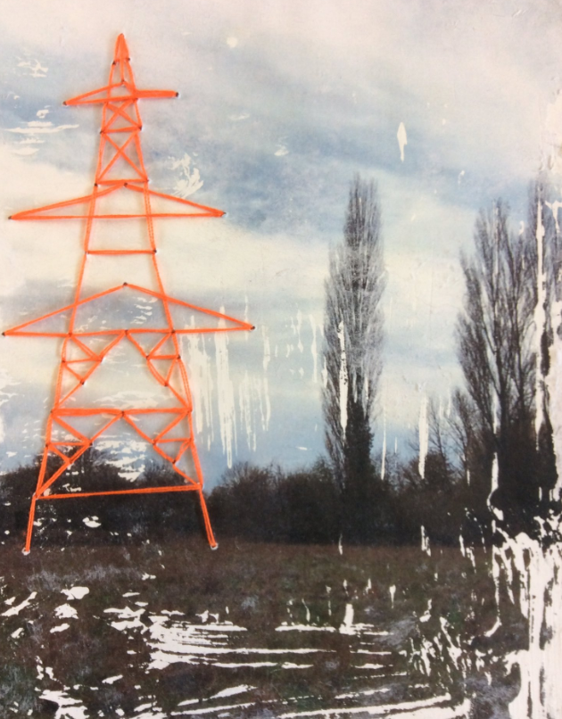
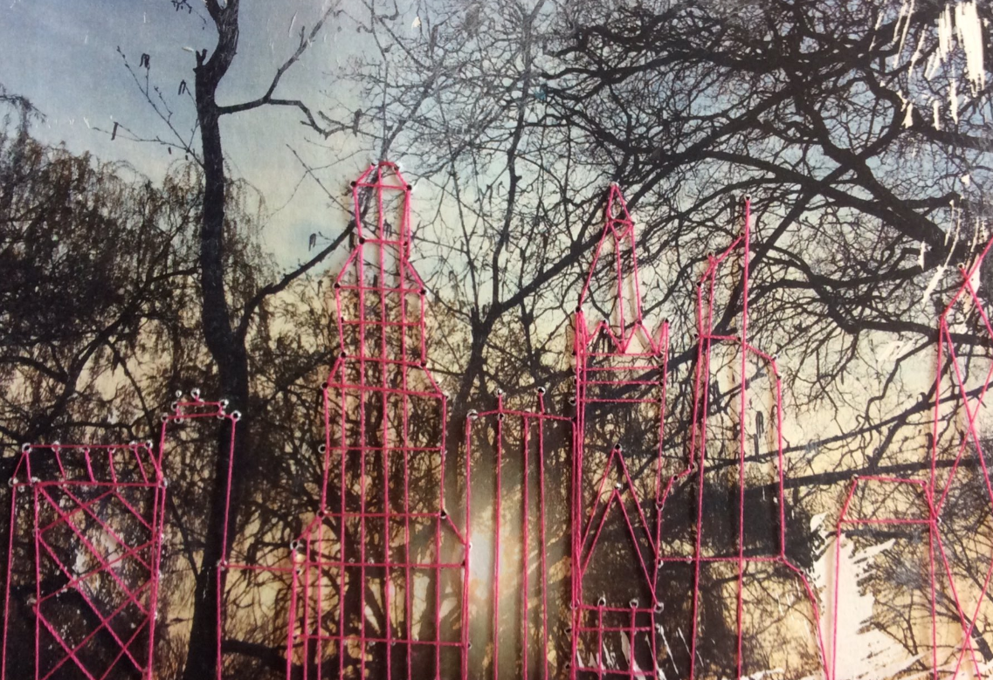
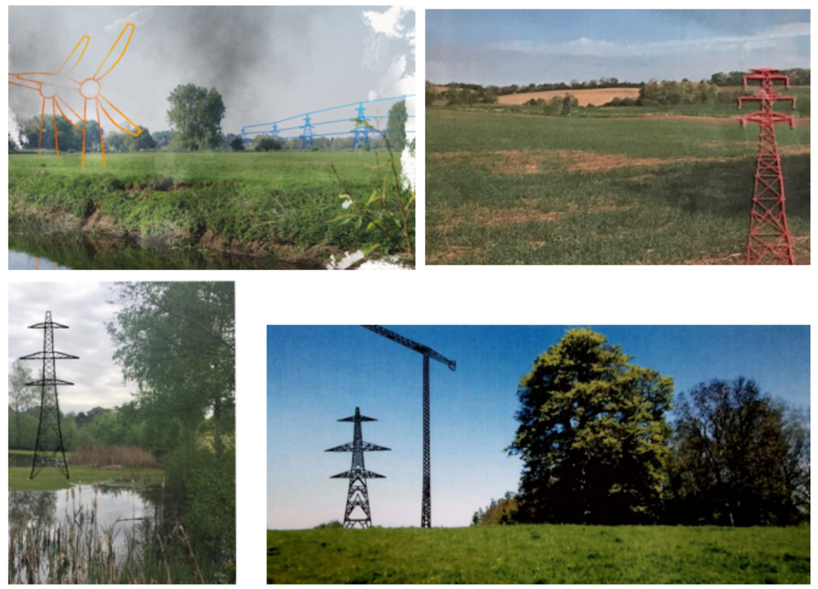
Interventions into the landscape
Task description
Final examples are to the right, so look at these first. You will be adding industrial style imagery to one of your landscape photos (e.g. pylons, cranes... pick something angular in shape because you will stitch it or draw it).
step by step:
Pick your best landscape photograph and print A5.
If you have white acrylic paint you can have a go at creating an image transfer, if not just stick in securely with a glue stick to a piece of sketchbook paper. Image transfer method: Apply the white acrylic paint to sketchpad paper a bit bigger than your image. While it is still wet, place the image face down into the wet paint, press down all over and allow to dry thoroughly. When the application is completely dry, dampen the paper with a wet sponge. Give it a few minutes to allow the water to penetrate the paper pulp. Then rub away, you need to press quite hard. You should be left with an image transferred to the paint (it gives a nice worn effect).
Work out where you want to add an industrial element and then do it as a simple line drawing on the back. If you do not have a needle and thread then just draw the industrial elements on the image with pens. Use reference images to help and a ruler.
Using a pin to make holes where the lines intersect so that you can stitch the image (using a contrasting colour thread works best, as it shows up more). Use the same method as you did when stitching in year 8 (i.e. cellotape on the back, no need to do any knots).
Please present your recent landscape photography alongside your stitched task (I realise some of your have had to draw or do it digitally). Remember to use a range of sizes of photographic images, make the ones that you are most proud of bigger. Think carefully about layout. It can be presented digitally if you wish. It may just fill one sketchbook page or it may go across a double - it depends how you decide to present it. Presentation skills so far have been mixed, for good examples I put some of your Blossfeldt work on the KES art twitter page.
https://twitter.com/KES_Artdept/status/1254740487900221442

