Slide 1
Title: What are the explanations for why we forget?
Key words
Retrieval failure
State dependent
Interference
Learning objectives:
To DEFINE and EXPLAIN retrieval failure as an explanation for forgetting.
To EVALUATE the ‘retrieval’ explanation , with reference to research studies that have investigated context and state dependent forgetting (A02).

Slide 2
Why do we forget?
1. Because the memory has disappeared from the brain.
2. The memory is still stored but, for some reason, it cannot be retrieved.
More applied to forgetting in STM
More applied to forgetting in LTM
Forgetting information from STM can be explained using the theories of trace decay and displacement.
Forgetting from LTM can be explained using the theories of interference and lack of retrieval cues.
Learning objectives:
To DEFINE and EXPLAIN retrieval failure as an explanation for forgetting.
To EVALUATE the ‘retrieval’ explanation , with reference to research studies that have investigated context and state dependent forgetting (A02).

Slide 3
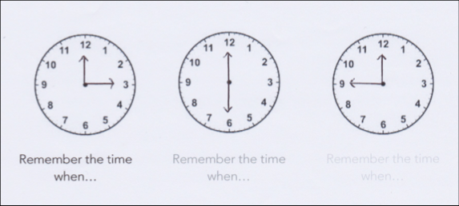
Trace Decay Theory of Forgetting in STM…
Assumes that memories leave a trace in the brain (a trace is some form of physical and/or chemical change).
Trace decay theory states that forgetting occurs as a result of the automatic decay or fading of the memory trace. Trace decay theory focuses on time and the limited duration of short term memory, suggesting STM holds memory for only up to 30 secs before it fades.
Key words
Retrieval failure
State dependent
Interference
Learning objectives:
To DEFINE and EXPLAIN retrieval failure as an explanation for forgetting.
To EVALUATE the ‘retrieval’ explanation , with reference to research studies that have investigated context and state dependent forgetting (A02).

Slide 4
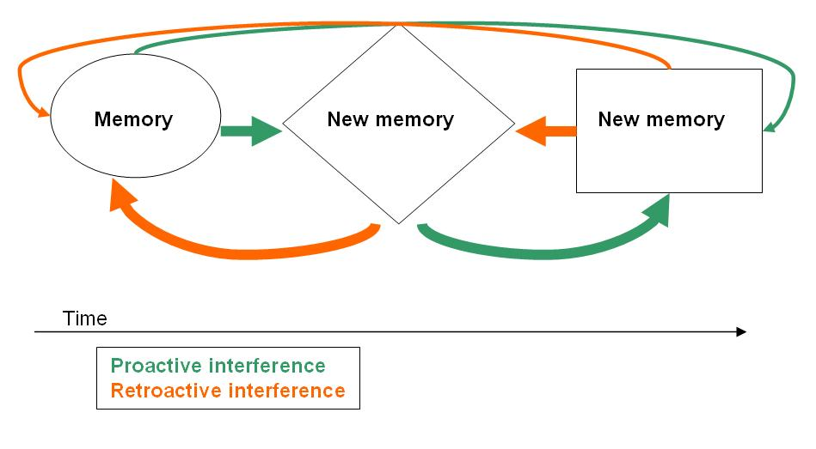
Interference theory of forgetting in LTM…
Memory can be disrupted or interfered with by what we have previously learned or by what we will learn in the future. This idea suggests that information in long term memory may become confused or combined with other information during encoding thus distorting or disrupting memories.
There are two types of interference.
Watch the video.
What are they?
What are the differences?
1. Proactive interference (pro=forward) - you cannot learn a new task because of an old task that had been learnt (old memories disrupt new memories).
2. Retroactive interference (retro=backward) you forget a previously learnt task due to the learning of a new task (new memories disrupt old memories).
Learning objectives:
To DEFINE and EXPLAIN retrieval failure as an explanation for forgetting.
To EVALUATE the ‘retrieval’ explanation , with reference to research studies that have investigated context and state dependent forgetting (A02).

Slide 5
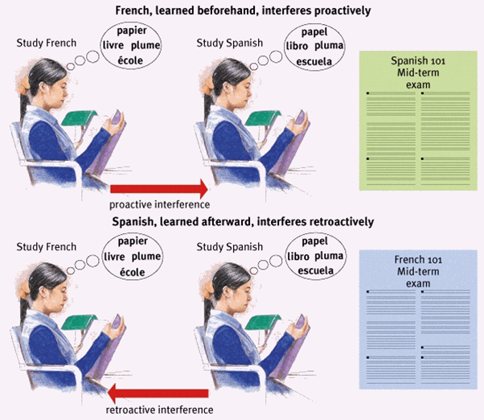
Proactive and retroactive interference are more likely when the memories are similar.
Key words
Retrieval failure
State dependent
Interference
Learning objectives:
To DEFINE and EXPLAIN retrieval failure as an explanation for forgetting.
To EVALUATE the ‘retrieval’ explanation , with reference to research studies that have investigated context and state dependent forgetting (A02).

Slide 6
Interference theory: Evidence …
Read the APFC of ‘Postman (1960)’
In pairs, discuss:
How this supports the theory previously discussed
The strengths and weaknesses of the research.
Learning objectives:
To DEFINE and EXPLAIN retrieval failure as an explanation for forgetting.
To EVALUATE the ‘retrieval’ explanation , with reference to research studies that have investigated context and state dependent forgetting (A02).

Slide 7
Bar graph task
How do you get all the marks for ‘draw a bar graph’ questions?
Title
Label both axis WITH units!
Accuracy of bars drawn with a ruler
Suitable scale
Key words
Retrieval failure
State dependent
Interference
Learning objectives:
To DEFINE and EXPLAIN retrieval failure as an explanation for forgetting.
To EVALUATE the ‘retrieval’ explanation , with reference to research studies that have investigated context and state dependent forgetting (A02).

Slide 8
Bar graph task
1. Work out the average number of words recalled from each condition.
2. Draw a suitable bar graph to represent the data from Postman’s experiment
Participant | Number of paired words recalled (Condition A – control)
1 | 9
2 | 7
3 | 9
4 | 8
5 | 10
6 | 6
7 | 7
Participant | Number of paired words recalled (Condition B – experimental)
1 | 5
2 | 5
3 | 6
4 | 4
5 | 3
6 | 3
7 | 4
Learning objectives:
To DEFINE and EXPLAIN retrieval failure as an explanation for forgetting.
To EVALUATE the ‘retrieval’ explanation , with reference to research studies that have investigated context and state dependent forgetting (A02).

Slide 9
Evaluating interference theory (A02)
Tells us little about the cognitive processes involved in forgetting.
+ Supported by experimental evidence.
- However, the majority of research has been carried out in a laboratory using lists of words, a situation which is likely to occur fairly infrequently in everyday life, and not necessarily reflect real-life behaviour. The majority of the research therefore has low ecological validity, as a result, it may be difficult to generalise the findings to wider settings.
Key words
Retrieval failure
State dependent
Interference
Learning objectives:
To DEFINE and EXPLAIN retrieval failure as an explanation for forgetting.
To EVALUATE the ‘retrieval’ explanation , with reference to research studies that have investigated context and state dependent forgetting (A02).

Slide 10
Use as A02 in essays!
HOWEVER, there is an alternative theory to forgetting in LTM…
… ‘Retrieval failure’
Key words
Retrieval failure
State dependent
Interference
Learning objectives:
To DEFINE and EXPLAIN retrieval failure as an explanation for forgetting.
To EVALUATE the ‘retrieval’ explanation , with reference to research studies that have investigated context and state dependent forgetting (A02).

Slide 11
Retrieval failure of forgetting
Retrieval failure is where the information is in long term memory, but cannot be accessed because retrieval cues are not present.
Experiment…
Try to remember the list of 20 words. You have 3 minutes.
Half of the class to go to the study room with a piece of paper and write down as many as can remember, half to stay here and do the same.
Which group remember more?
Key words
Retrieval failure
State dependent
Interference
Learning objectives:
To DEFINE and EXPLAIN retrieval failure as an explanation for forgetting.
To EVALUATE the ‘retrieval’ explanation , with reference to research studies that have investigated context and state dependent forgetting (A02).
Notes:
Students to do the experiment then analyse what they did through the questions.

Slide 12
Experiment
How many conditions were there?
Which was the experimental condition and which the control?
What was the IV and DV?
What type of experimental design was used?
How could we make this a repeated measures design?
What are a strength and weakness of this design?
Key words
Retrieval failure
State dependent
Interference
Learning objectives:
To DEFINE and EXPLAIN retrieval failure as an explanation for forgetting.
To EVALUATE the ‘retrieval’ explanation , with reference to research studies that have investigated context and state dependent forgetting (A02).

Slide 13
Use the textbook to write answers to the following questions:
What are retrieval cues? And what are the key different types? (including examples).
What research did Tulving (1974) do? – AFPC
What research did Baddley (1975) do? How this corroborate the earlier findings?
What are the strengths and weaknesses of the ‘retrieval cues’ theory of forgetting?
How could you apply the knowledge of ‘retrieval cues’ to improve exam performance in the school?
Key words
Retrieval failure
State dependent
Interference
Learning objectives:
To DEFINE and EXPLAIN retrieval failure as an explanation for forgetting.
To EVALUATE the ‘retrieval’ explanation , with reference to research studies that have investigated context and state dependent forgetting (A02).

Slide 14
What is it like living with a neurological disorder that means you have problems with memory loss? E.g. amnesia or dementia
video
Key words
Retrieval failure
State dependent
Interference
Learning objectives:
To DEFINE and EXPLAIN retrieval failure as an explanation for forgetting.
To EVALUATE the ‘retrieval’ explanation , with reference to research studies that have investigated context and state dependent forgetting (A02).

