Slide 1
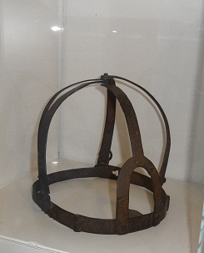
What were Tudor Crimes and Punishments Like? 26/11/2014
Place any homework on my desk
Do you already know anything about this item?
If you know nothing, then what sorts of questions would you ask?
Write down 4 questions you would want to ask about it?

Slide 2
What is the item?
You will be finding out for yourself!
But for now…

Slide 3
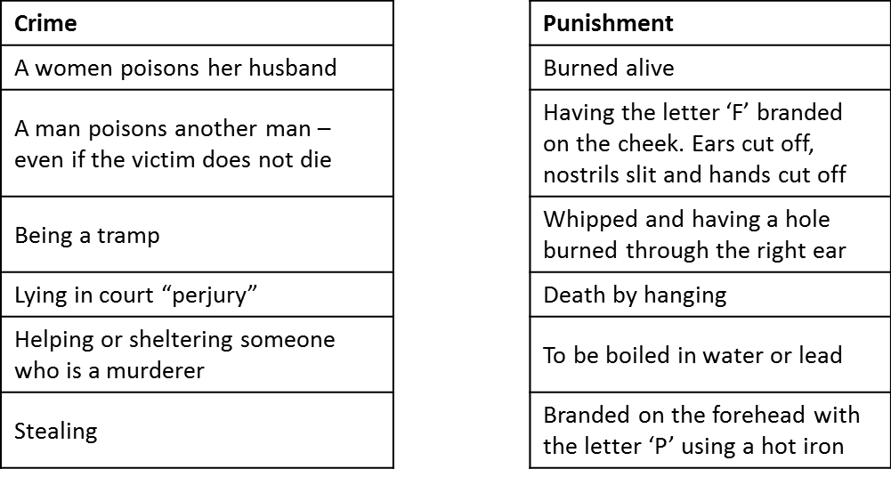
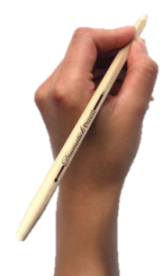
Have a go at matching the crimes to the punishments

Slide 4
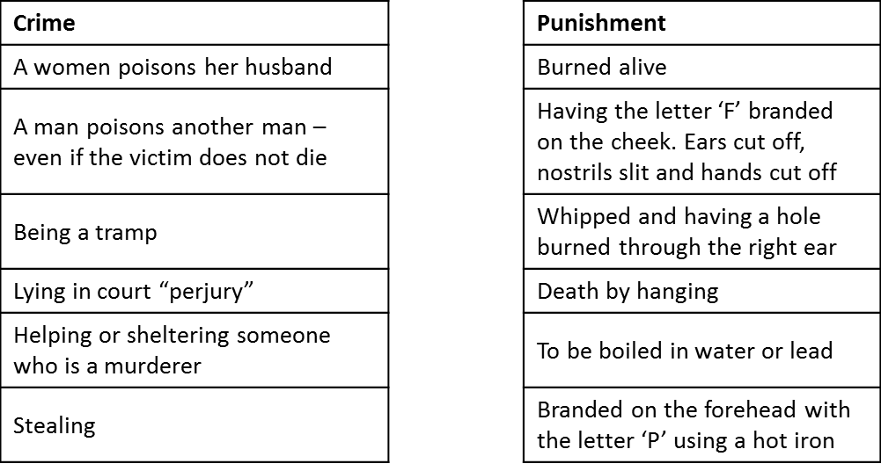
How did you do? Swap with the person next to you

Slide 5
TITLE: What were Tudor crimes & punishments like?
Learning Objectives
Remember you should have written the title and date and underlined them both in your book by now!
5
All: will be able to describe the way the law worked in Tudor England and the different types of crimes that were punished.
6
Most: will be able to explain ways that the law got information using different methods
7
Some: will be able to use source material to analyse Tudor crimes and punishments

Slide 6
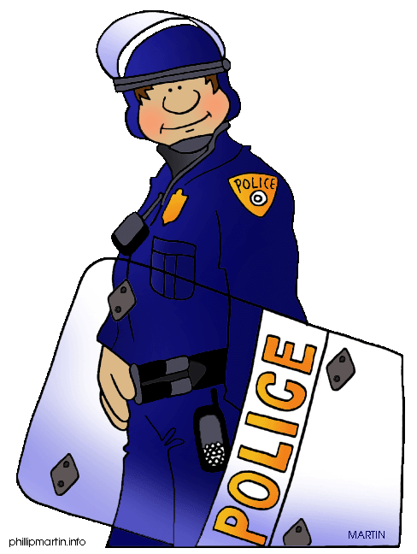
Tudor Policing
There were no police during the Tudor times. However, laws were harsh and wrongdoing was severely punished. In Tudor times the punishments were very, very cruel. People believed if a criminal’s punishment was severe and painful enough, the act would not be repeated and others would deter from crime as well.

Slide 7
You, in pairs are going to be given a punishment, a torture or a policing fact file. You are to make notes on this in the box on your grids.
You are then, in pairs, to draw a picture representing your information on your sugar paper. BUT you can use no more than 6 words on your poster
Now – we are going to create an information market. One person will stay back and explain their poster (punishment, torture, fact file) to the fact finders. The other person will be your fact finder. They must go round to the other market stalls collecting information to fill in their sheet. You will swap half way through and collect information your partner does not have!

Slide 8
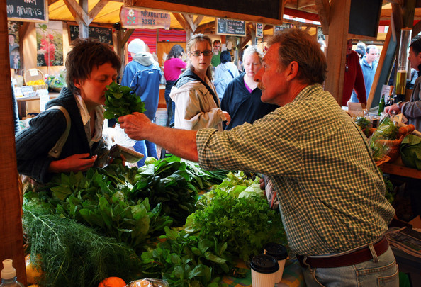
You have ten minutes to sell your information whilst your partner collects yours!
Explain your posters so that visitors to your ‘stall’ go away with as much information as possible!

Slide 9
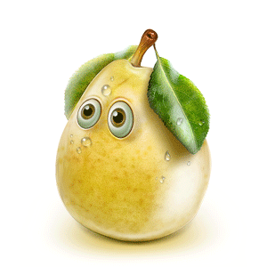
Now, fact finders must discuss with their partners the information they have found so that partners you can fill out your sheets!
This crime was punished by….
Oh, that sounds nasty, how did that work?

Slide 10
How well did you work today?
Choose one of the following question sheets;
Medium
Hard
You have 8 minutes

Slide 11
TITLE: What were Tudor crimes & punishments like?
Learning Objectives
Remember you should have written the title and date and underlined them both in your book by now!
5
All: will be able to describe the way the law worked in Tudor England and the different types of crimes that were punished.
6
Most: will be able to explain ways that the law got information using different methods
7
Some: will be able to use source material to analyse Tudor crimes and punishments

Slide 12
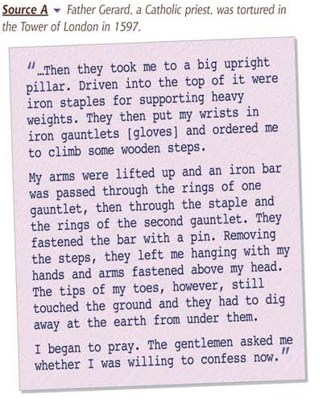
Describe what is happening to Father Gerard
Why did the earth have to be dug away from under his feet?
Looking at the provenance (place of origin) of the source, come up with a reason why he may have been a prisoner
Why was torture a large part of society’s crime and punishment?

Slide 13
Describe what is happening to Father Gerard
Why did the earth have to be dug away from under his feet?
Looking at the provenance (place of origin) of the source, come up with a reason why he may have been a prisoner
Using the source, explain how the law punished different crimes. You must include detail which describes the different ways the law gained information through using different methods.

Slide 14
Crime And
Punishment
In Tudor
times

Slide 15
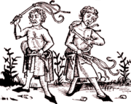
The crime
Begging in the street
The punishment
Flogging

Slide 16
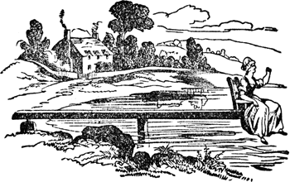
The crime
Witchcraft
The punishment
Ducking stool

Slide 17
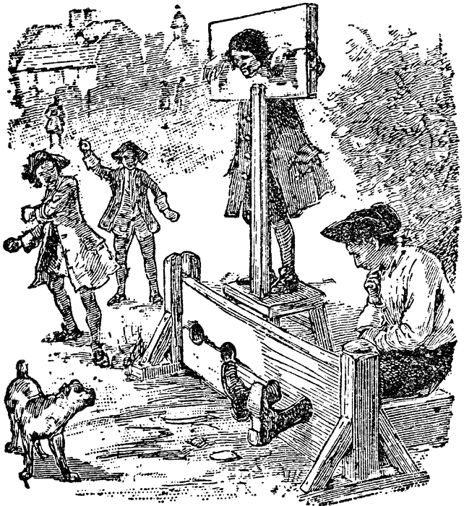
The crime
Selling rotten food
The punishment
Locked into stocks

Slide 18
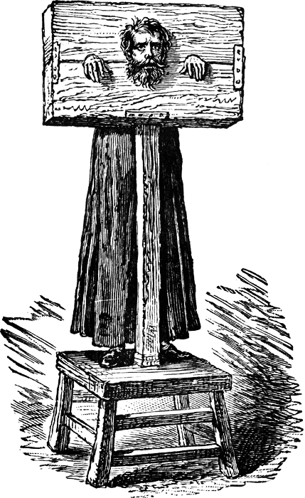
The crime
Being dishonest
The punishment
Locked into the Pillory

Slide 19
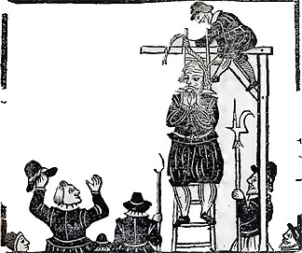
The crime
Stealing and murder
The punishment
Hanging

Slide 20
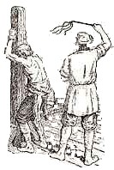
The crime
Robbery
The punishment
Whipping

Slide 21
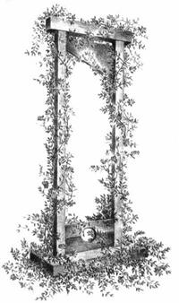
The crime
Speaking out against the monarchy
The punishment
Beheaded

Slide 22
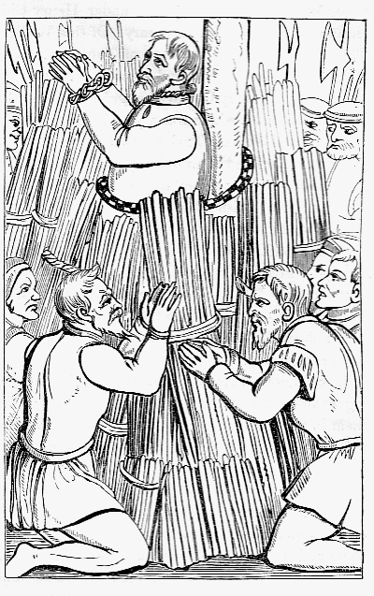
The crime
Speaking out against the church
The punishment
Burnt at the stake

Slide 23
Tudor crime
true or false

Slide 24
If you were found
guilty of robbing,
you would be whipped.

Slide 25
true

Slide 26
If you were dishonest,
you would get a
telling off.

Slide 27
false

Slide 28
If you sold rotten food,
you would be beheaded

Slide 29
false

Slide 30
If people thought you
were a witch, you would
be ducked in water

Slide 31
true

