Slide 1
Title: How does the media influence aggression?
Starter: Media are sources of influence on aggression.
What types of ‘media’ are there?
Key terms
Disinhibition
Cognitive priming
Desensitisation
Learning objectives:
To DESCRIBE and EVALAUTE the effect of the media on aggression, including desensitation, cognitive priming and disinhibition.
To KNOW and EVALUATE research findings in the area.

Slide 2
Interesting TV statistics…
People (particularly children) imitate models that they observe portrayed on TV or in other forms of media (SLT).
Imitation is more likely if the observer identifies with the
model in some way, if the context in which the behaviour is observed is realistic and if the model is rewarded (vicarious reinforcement).
Key terms
Disinhibition
Cognitive priming
Desensitisation
Learning objectives:
To DESCRIBE and EVALAUTE the effect of the media on aggression, including desensitation, cognitive priming and disinhibition.
To KNOW and EVALUATE research findings in the area.

Slide 3
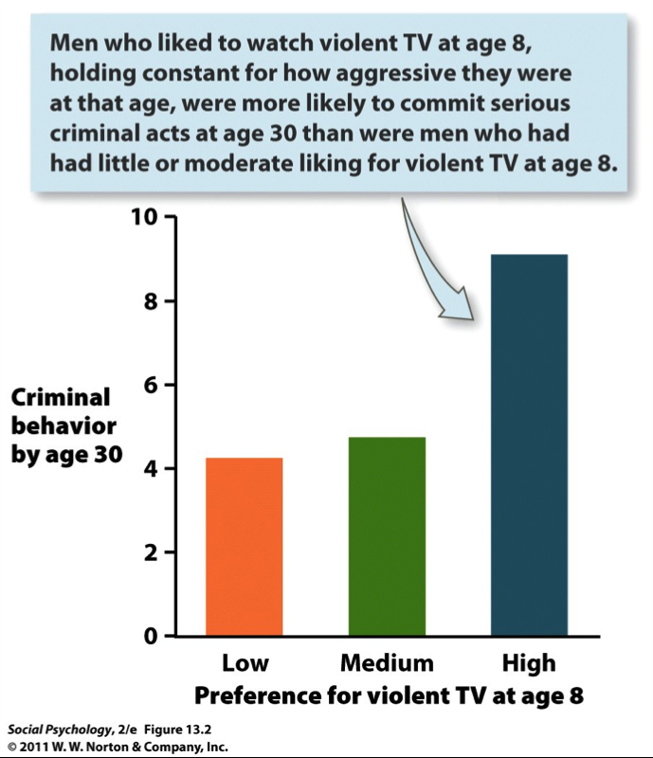
Huesmann and Eron (2003)
Violent TV can lead to enhanced levels of aggression e.g….
Learning objectives:
To DESCRIBE and EVALAUTE the effect of the media on aggression, including desensitation, cognitive priming and disinhibition.
To KNOW and EVALUATE research findings in the area.

Slide 4
Aggression and video games…
An investigation took 70 teenagers and asked them to complete a rating scale questionnaire to assess their hostility, anger and anxiety.
They were then randomly allocated to play either a violent or non-violent video game.
After the game they completed the rating scale again. Scores on the scale before and after playing the game were compared.
Both groups had higher ratings on hostility and anger after playing the games, though the effect was more pronounced for the group playing the game with the violent content.
What can you learn and conclude from this research?
Key terms
Disinhibition
Cognitive priming
Desensitisation
Learning objectives:
To DESCRIBE and EVALAUTE the effect of the media on aggression, including desensitation, cognitive priming and disinhibition.
To KNOW and EVALUATE research findings in the area.

Slide 5
Aggression and video games…
Study shows that:
Video game playing is associated with raised levels of hostility and anger, irrespective of content
Violent content associated with further increase in levels of hostility and anger.
Key terms
Disinhibition
Cognitive priming
Desensitisation
Learning objectives:
To DESCRIBE and EVALAUTE the effect of the media on aggression, including desensitation, cognitive priming and disinhibition.
To KNOW and EVALUATE research findings in the area.

Slide 6
Aggression and video games…
An investigation took 70 teenagers and asked them to complete a rating scale questionnaire to assess their hostility, anger and anxiety.
They were then randomly allocated to play either a violent or non-violent video game.
After the game they completed the rating scale again. Scores on the scale before and after playing the game were compared.
Both groups had higher ratings on hostility and anger after playing the games, though the effect was more pronounced for the group playing the game with the violent content.
Strong research?
Key terms
Disinhibition
Cognitive priming
Desensitisation
Learning objectives:
To DESCRIBE and EVALAUTE the effect of the media on aggression, including desensitation, cognitive priming and disinhibition.
To KNOW and EVALUATE research findings in the area.

Slide 7
Lack of ecological validity - lab studies fail to reflect the social context in which such games are played,
Causal inference cannot really be drawn.
Measurement issues, eg self-report versus behaviour observation
Participants allocated to the violent game may have been people who would not choose such games in real life
Key terms
Disinhibition
Cognitive priming
Desensitisation
Learning objectives:
To DESCRIBE and EVALAUTE the effect of the media on aggression, including desensitisation, cognitive priming and disinhibition.
To KNOW and EVALUATE research findings in the area.

Slide 8
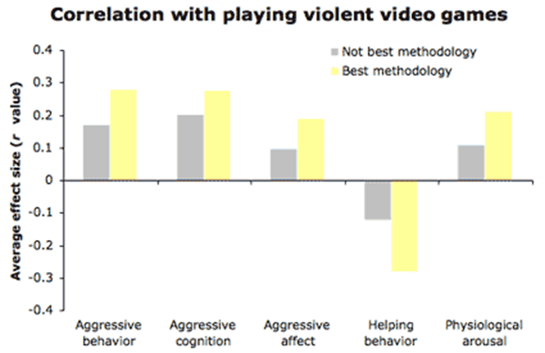
Aggression and video games…
There is some evidence (although it is not clear-cut) that playing violent games fosters aggression in the players (e.g. Anderson et al, 2007 - children who play a violent game deliver stronger punishments to others than control groups).
Key terms
Disinhibition
Cognitive priming
Desensitisation
Learning objectives:
To DESCRIBE and EVALAUTE the effect of the media on aggression, including desensitation, cognitive priming and disinhibition.
To KNOW and EVALUATE research findings in the area.

Slide 9
Read the article
Key terms
Disinhibition
Cognitive priming
Desensitisation
Learning objectives:
To DESCRIBE and EVALAUTE the effect of the media on aggression, including desensitation, cognitive priming and disinhibition.
To KNOW and EVALUATE research findings in the area.

Slide 11
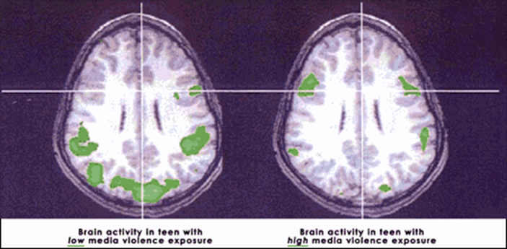
Theoretical Explanations for Media Violence Effects - Card sort
Match each of the terms with the correct explanation and picture….
Key terms
Disinhibition
Cognitive priming
Desensitisation
Learning objectives:
To DESCRIBE and EVALAUTE the effect of the media on aggression, including desensitisation, cognitive priming and disinhibition.
To KNOW and EVALUATE research findings in the area.

Slide 12
Most theorists would now agree that the short term effects of exposure to media violence are mostly due to:
cognitive priming,
arousal processes,
the impact of disinhibition
the immediate modelling of specific behaviors
Long term effects, on the other hand, seem to be due to:
more lasting observational learning of cognitions and behaviors (i.e., imitation of role model behaviors),
desensitization of emotional processes
Key terms
Disinhibition
Cognitive priming
Desensitisation
Learning objectives:
To DESCRIBE and EVALAUTE the effect of the media on aggression, including desensitisation, cognitive priming and disinhibition.
To KNOW and EVALUATE research findings in the area.

