Slide 1
STRATFIED RANDOM SAMPLE
A method of sampling that involves the division of a population into smaller groups known as strata.
In stratified random sampling, the strata are formed based on members' shared attributes or characteristics (e.g. Year Group, gender, etc.)

Slide 2
STRATFIED RANDOM SAMPLE
A random sample from each stratum is taken in a number proportional to the stratum's size when compared to the population.
These subsets of the strata are then pooled to form a random sample.
Let’s see an example to put all of this in context…………………

Slide 3
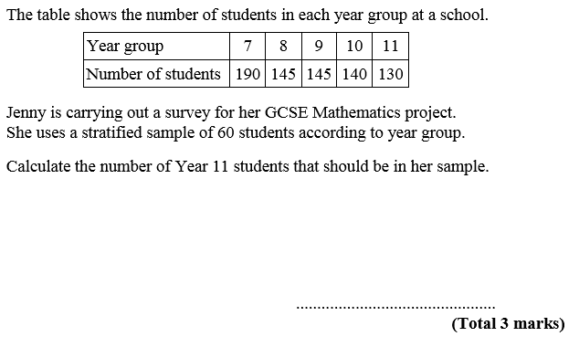
GCSE QUESTION
Σ Number of students = 750
Notes:
Re-cap Epsilon as the notation for sum of.

Slide 4
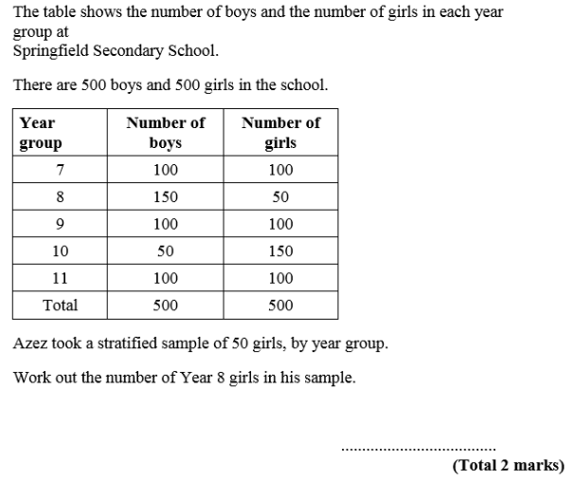
GCSE QUESTION

Slide 5
QUESTIONS
Complete the following worksheet that contains past GCSE questions independently.
Make sure you show all of your workings!

Slide 6
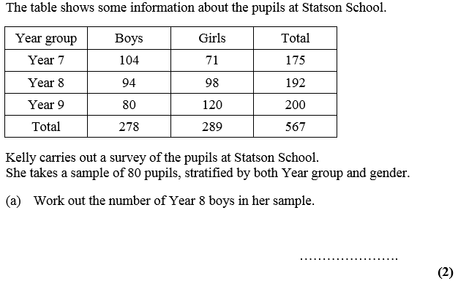
SPOT THE MISTAKES
Year 8 boys = 80 x $\frac{192}{567}$ = 27.0899471
= 28 x $\frac{98}{192}$ = 14.29
14.3
Notes:
Plenary. 3 mistakes.
1st – 27.0899471 has been rounded up, not down.
2nd – Year 8 girls (98) has been selected instead of Year 8 boys (92)
3rd – final answer should be a whole number.

