Slide 1
Knowledge dump...
For 1 minute, write down anything you already know about the Black Death!

Slide 2
Was the Black Death a disaster?
Learning Objectives:
Must be able to name the consequences of the Black Death.
Should be able to decide as a group if the BD was a disaster.
Could start to discuss the significance of the BD.

Slide 3
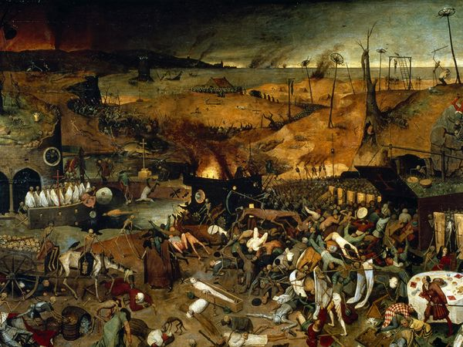
What's Occurring?
Notes:
1 out of every 3 in England died of the Plague. By 1350 1.5 million had died from the Plague in England

Slide 4
In your pairs come up with your own definition for the word ‘plague’

Slide 5
An epidemic disease that causes high mortality…
An epidemic is a widespread occurrence of an infectious disease in a community at a particular time.

Slide 6
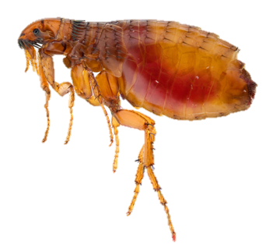
What caused it?
I CAUSED THE PLAGUE! I am a flea from a rat.
It wasn’t my fault, I didn’t realise that sucking the black rat’s blood and then a human would spread the Plague!!!
I’m not a bad flea really ☹
Notes:
If we had more time we would do a story board of how the flea would feel! Stick in your flea

Slide 7
Bubonic Plague
In bubonic plague, the most common form, bacteria infect the lymph system and causes it to become inflamed. (The lymph or lymphatic system is a major component of your body's immune system. The organs within the lymphatic system are the tonsils, adenoids, spleen, and thymus.)
How do you get it? Usually, you get bubonic plague from the bite of an infected flea or rodent. In rare cases, Y. pestis bacteria can enter the body (through an opening in the skin) from a piece of contaminated material used by a person with plague.
What are the symptoms? Bubonic plague affects the lymph nodes (another part of the lymph system). Within three to seven days of exposure to plague bacteria, you will develop flu-like symptoms such as fever, headache, chills, weakness, and swollen, tender lymph glands (called buboes—hence the name bubonic).
Is it contagious? Bubonic plague is rarely spread from person to person.

Slide 8
Septicemic Plague
This form of plague occurs when the bacteria multiply in the blood.
How do you get it? You usually get septicemic plague the same way as bubonic plague—through a flea or rodent bite. You can also get septicemic plague if you have had untreated bubonic or pneumonic plague.
What are the symptoms? Symptoms include fever, chills, weakness, abdominal pain, shock, and bleeding underneath the skin or in other organs. Buboes, however, do not develop.
Is it contagious? Septicemic plague is rarely spread from person to person.

Slide 9
Pneumonic Plague
This is the most serious form of plague and occurs when Y. pestis bacteria infect the lungs and cause pneumonia.
How do you get it? You get primary pneumonic plague when you inhale plague bacteria from an infected person or animal. You usually have to be in direct or close contact with the ill person or animal.
You get secondary pneumonic plague if you have untreated bubonic or septicemic plague that spreads to your lungs.
What are the symptoms? Symptoms usually develop within one to three days after being exposed to airborne droplets containing plague bacteria. Pneumonia begins quickly, with shortness of breath, chest pain, cough, and sometimes bloody or watery sputum. Other symptoms include fever, headache, and weakness.
Is it contagious? Pneumonic plague is contagious. If someone has pneumonic plague and coughs, droplets containing Y. pestis bacteria are released into the air. An uninfected person can then develop pneumonic plague by breathing in those droplets.

Slide 10
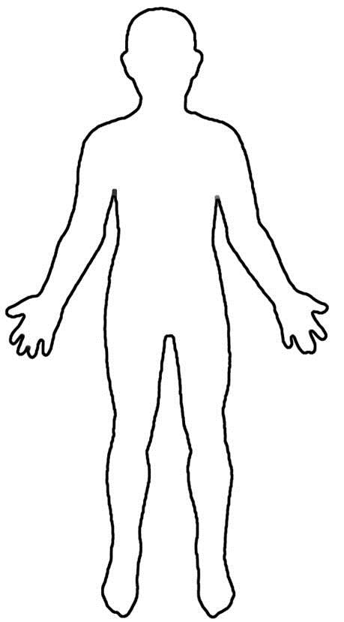
Decorate your Plague Victim!
ILLUSTRATE the symptoms on your Plague victim!
Make sure you remember each symptom!
Notes:
Mini version to stick in books and label – 2 minutes

Slide 11
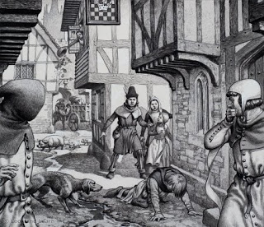
Caption Competition. Fill in one-two sentences that these people might be saying about the Black Death. Success Criteria: each character should be saying something different about the Black Death. You could talk about the symptoms, the cures and what they believed caused it.

Slide 12
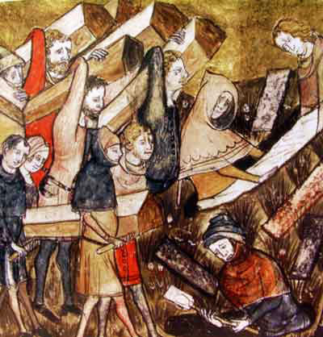
What happened next? Using this image of the Black Death below, predict with your partner four things that could have happened after the Black Death. Success criteria – think about as many different areas of life as possible, there are a couple below to get you started.
We predict that after the Black Death work would be effected because...
We predict that after the Black Death families would be effected because...

Slide 13
Your Task is to answer the Key Question: Was the Black Death a disaster?
In your pairs, you are going to produce a living graph like the one below. You will be given a list of different consequences of the Black Death and for each you have to decide if:
This effect happened immediately after the Black Death or would have happened a while later.
Was this effect a positive or a negative effect and for whom would it have been positive/negative?
Write the different effects onto your Living Graph where you think they fit it.
Positive effects
Extension Task: When your group has completed the Living Graph, decide how significant (important) the Black Death was in England. Did it have a significant effect on the population?
Immediately after the Black Death
A few years after the Black Death
Disaster

Slide 14
The Black Death killed over 1/3 of the people in England. | In some places, peasants stopped doing their labour for the Lord and gave them a low payment instead. Lords did not complain because they wanted to keep the peasants on their manors. | Peasants were able to bargain with the lords to farm more land at lower rents because there was so much unworked land around. | Peasants had more freedom of movement because they could go and work for someone else.
Lords tried to poach peasants from other manors by offering them higher wages. | There were not enough Villeins to farm the land so crops were left to rot in the fields. | Some people believed that god had sent the Black Death as a punishment and turned to the church to pray and make God happy again. | Groups of people such as the Jews were blamed for the Black Death, it was said they had poisoned the wells. In Europe, Jews were murdered in thousands as people tried to prevent the spread of the Black Death.
Families were torn apart by the Black Death. Children were left orphaned, villages had their entire population of young people wiped out and families were often left with just one adult to work and look after the young children. | Lords could not get labourers to work on their land. They were so desperate that they were prepared to pay high wages. | Some people believed that as disease could strike them any day, they should live a wild life. They would drink, throw parties and live carelessly. | Villages were deserted. Some, like Wharram Percy, never recovered.

Slide 15
Plenary – Review your learning:
‘On the one hand, the Black Death was a disaster because...
On the other hand, the Black Death was not a disaster because...’
Were you able to:
Name the consequences of the Black Death?
Decide as a group if the Black Death was a disaster or not?
Discuss the significance of the Black Death with your group members?

