Slide 1
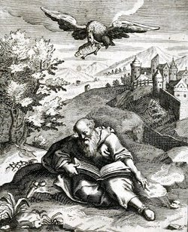
The Death of Aeschylus

Slide 2
Who was Aeschylus?
Aeschylus (ὁ Αἴσχυλος) was an Athenian who lived in the 5th century BC and wrote Greek Tragedies (tragedians were usually referred to simply as ‘Poets’ - οἱ ποιηταί).
The Fifth Century BC was the period when Athenian Democracy and Greek Theatre were at their most dynamic. Our word ‘drama’ is the Greek word for ‘action’ or ‘a play’ - τὸ δρᾶμα.
The century began with the Persian Wars (490BC and 480-479BC). Aeschylus fought in the famous Battle of Marathon in 490BC when the Athenians defeated the Persian invasion sent by King Darius, killing 6,700 Persians while losing only 192 Athenians. Aeschylus’s brother, Cynegeirus, had his hand cut off while fighting over a ship.

Slide 3
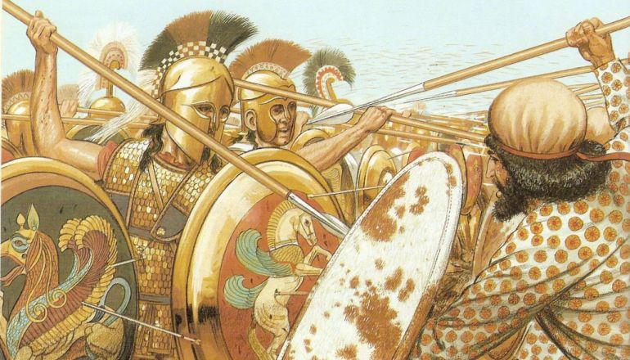
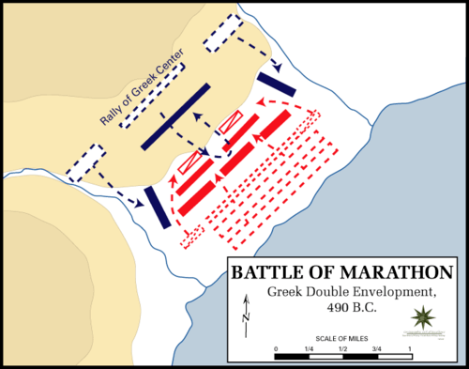
The Battle of Marathon 490BC
Background to the Battle of Marathon The Armchair Historian, 20 minutes
Why is a Marathon called a Marathon? Horrible Histories, 5 minutes

Slide 4
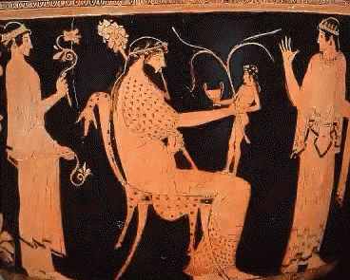
The Festival of Dionysus
Tragedies were written to be performed only once at spring at festivals
dedicated to the god, Dionysus. The birth of Dionysus is shown to the right.
The most famous festival was the Great Dionysia, a competitive event sponsored by wealthy citizens and attended by huge crowds. Three tragedians would be selected to compete and the victor (and his sponsor) were celebrated like Olympic victors.
Aeschylus’s first tragedy was staged in 499BC when he was about 25 Years old, so he was about 34 when he fought at Marathon.
In 484BC Aeschylus won his first victory at the Great Dionysia. He went on to win another twelve times.
One of his victories was for a play that still survives called The Persians, produced in 472BC.
In this play the Athenians watched the tragedy of Xerxes, son of Darius and Great King of Persia.

Slide 5
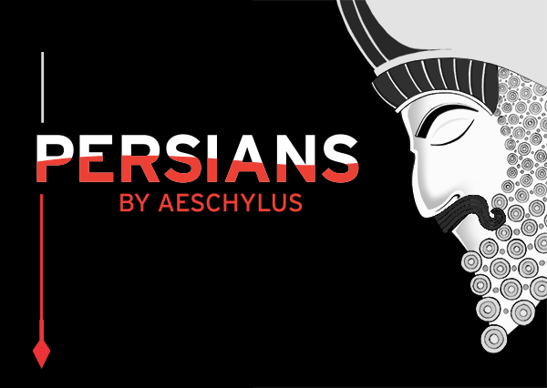
Based on a historical event—the Persians’ defeat by the Greeks in a great naval battle of 480 B.C.— Aeschylus’s tragedy is a gripping story of war’s human toll.
An interview with the director Anne Bogart, 2014:
Of the 32 surviving Greek tragedies, why Persians? Why now?
We chose Persians because it is the very first extant tragedy in the western world. We were interested in excavating theatrical history to learn about the play’s genesis—nothing short of the birth of Greek tragedy—and then share what we’ve learned with audiences.
How are you making this production accessible to a contemporary audience?
Our production will look modern and feel luscious. I imagine that the same elements of Persians that pleased Greek audiences in 472 B.C. will cast a similar spell on our contemporary audiences: song and dance, the magical appearance and disappearance of a ghost, the return of a beloved son.

Slide 6
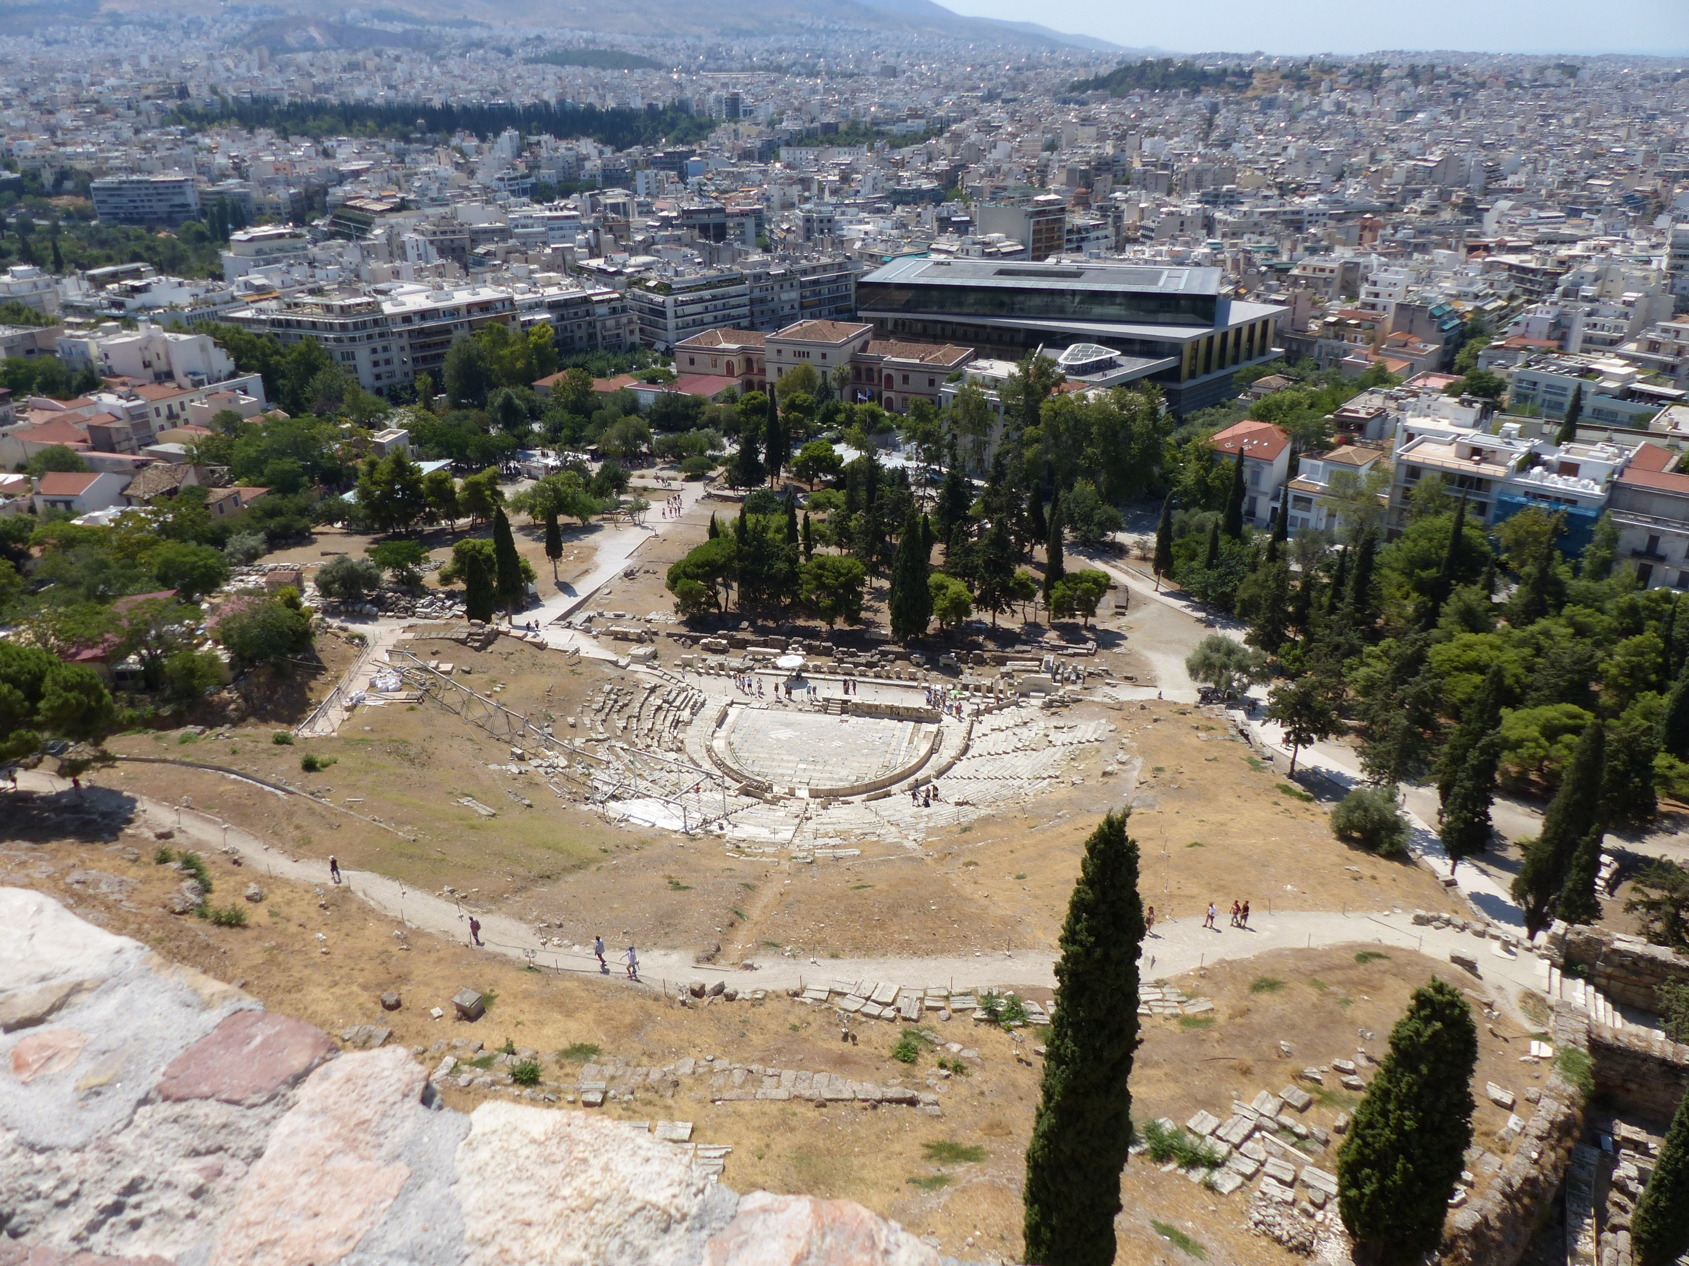
Three Great 5th Century BC Tragedians:
Aeschylus
Sophocles
Euripides
The great 5th century comedian:
Aristophanes
Remains of the Theatre of Dionysus in Athens today.

Slide 7
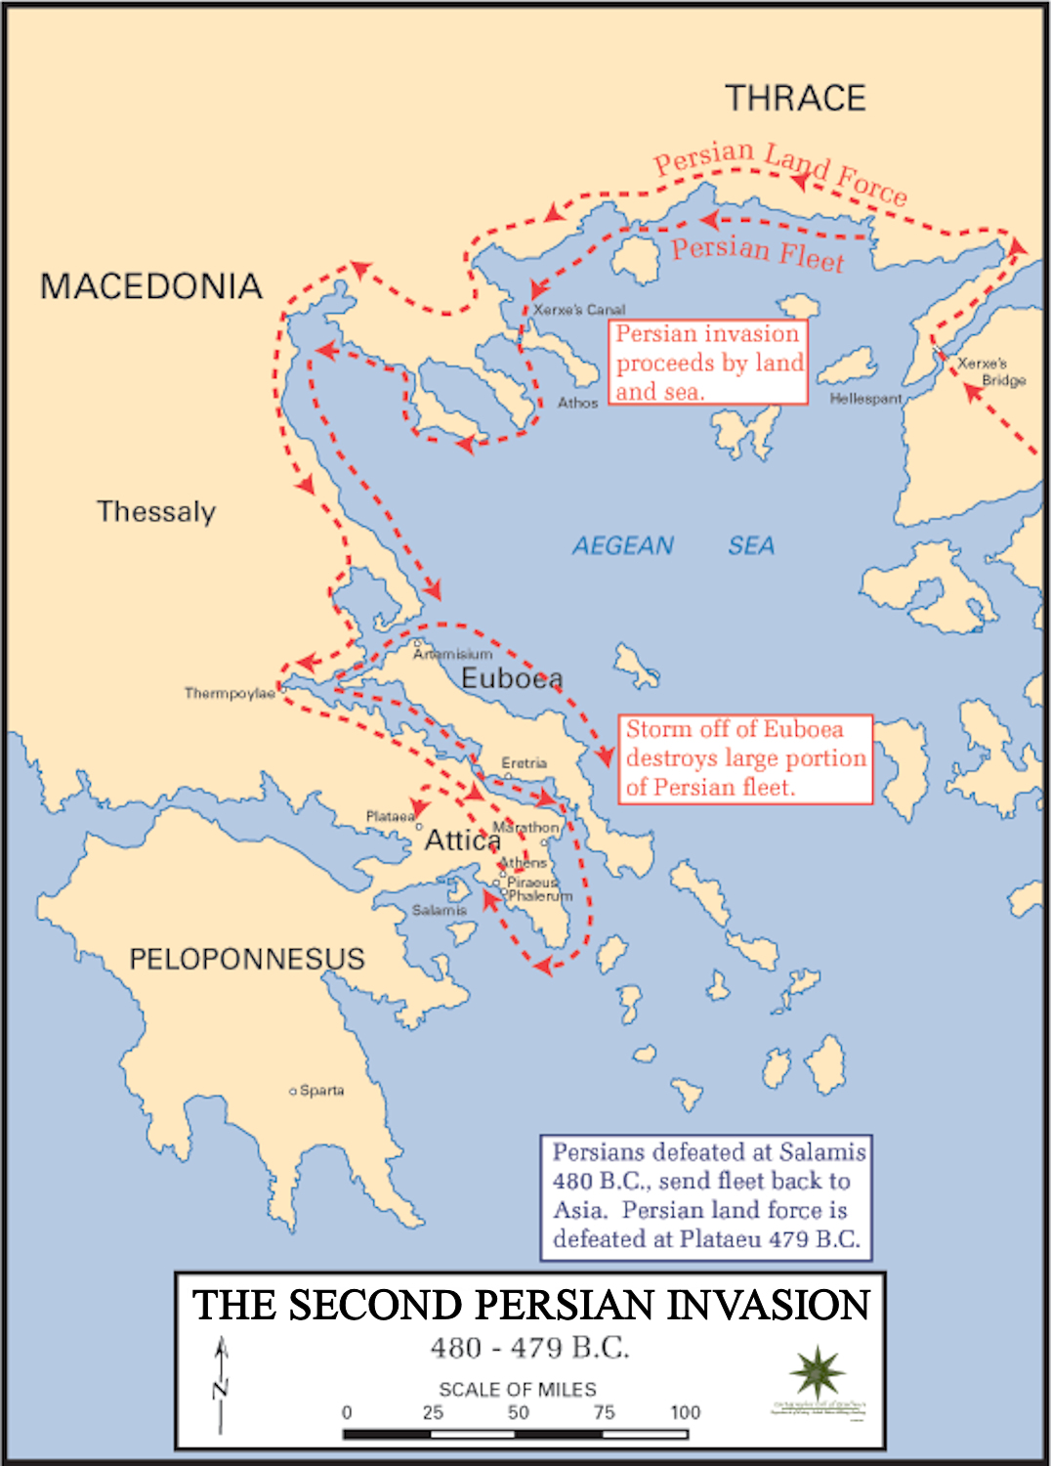
The Second Persian Invasion 480-479BC
Darius was succeeded by his son Xerxes in 486BC.
Aeschylus was in his mid 40s when Xerxes sent a second great expedition to invade Greece, with the prime purpose of destroying the city of Athens.
The historian Herodotus gives us a powerful account of this invasion, emphasising the vast scale of Xerxes’ forces and the super-human preparations he made – like building a bridge across the Hellespont and cutting a canal through the Athos peninsular.
The Greeks faced the Persians in a number of famous key battles we will look at another time (like Thermopylae, famous for The 300) and Salamis, the sea battle which Xerxes watched from his throne,after having sacked the city of Athens, expecting victory….

Slide 8
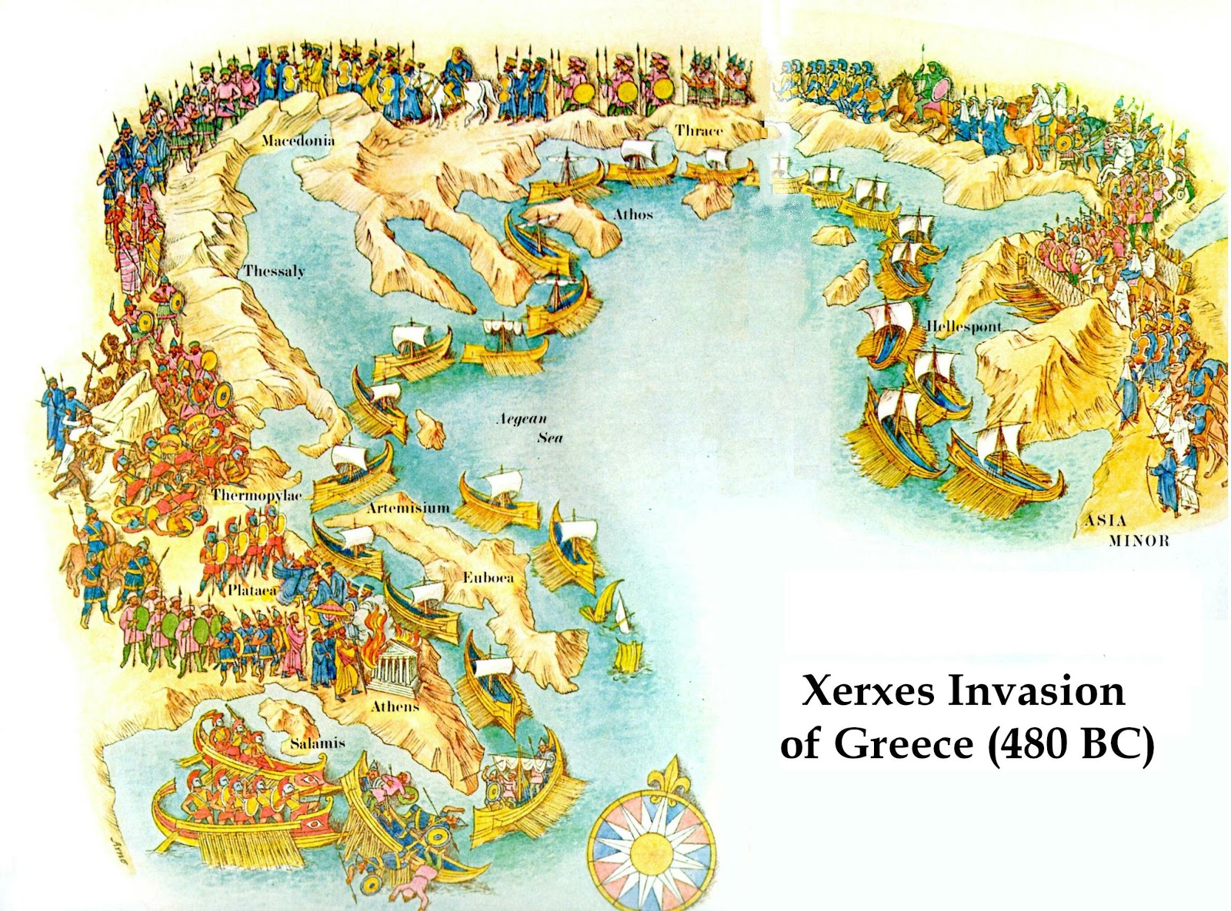

Slide 9
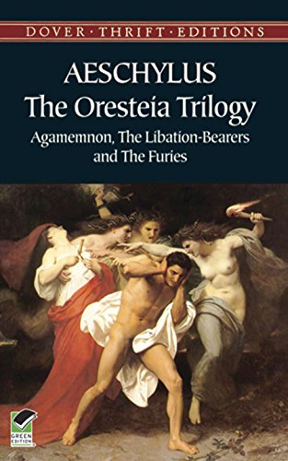
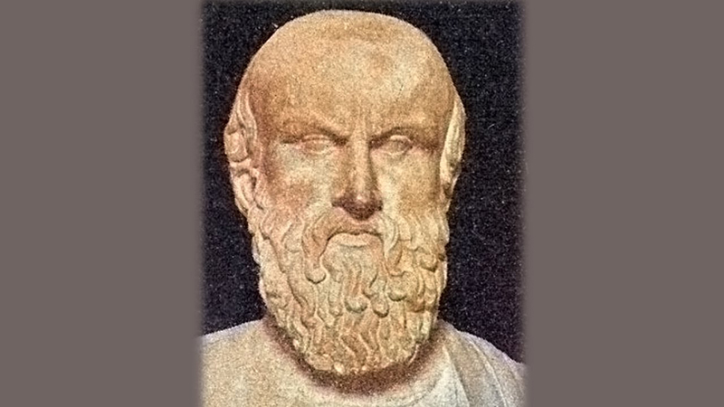
Aeschylus is best known today for a trilogy first performed in 458BC, not long before the author’s death. The first play, Agamemnon, enacts the murder of Agamemnon by his wife Clytaemnestra.
The trilogy is called The Oresteia after Agamemnon’s son, Orestes, a baby at the time of the murder. He grows up in exile but returns as a young man to avenge his father’s death. He kills his own mother but is then hounded by the furies for this terrible deed.
Aeschylus’ fame as a poet led him to the court of the King of Hiero, tyrant of Syracuse in Sicily. It was there that he met the death you are going to read about in the following passage….

Slide 10
Instructions: a) Listen to the recording of part 1 on the next slide. b) Read it out loud yourself in Greek. The passage is then broken down line by line to help with your translation. Write this in your Exercise book after each slide.

Slide 11
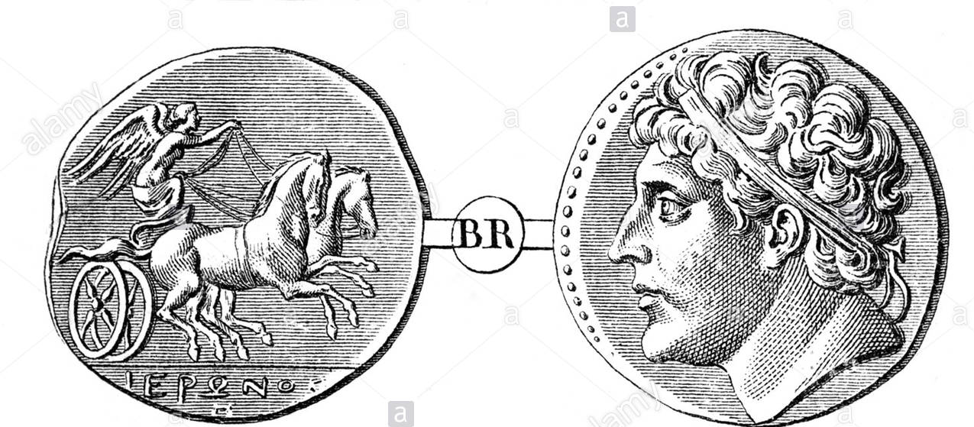
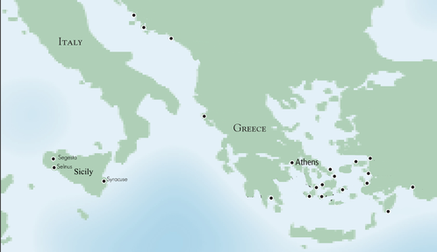
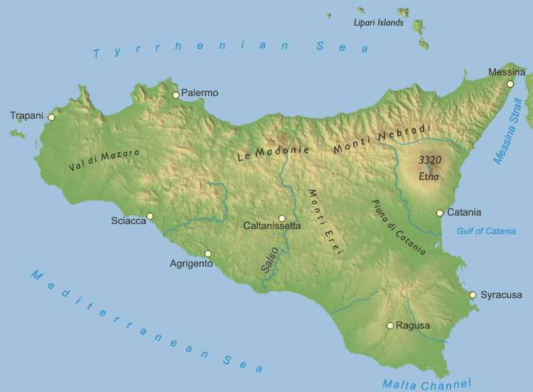
Coin of Hiero I, Tyrant of Syracuse, d.466BC

Slide 12
The Death of Aeschylus Part i)
Vocabulary:
ὁ ποιητής - poet
ἄριστoς, -η, -ον - very good, excellent, the best.
ὁ δε Αἴσχυλος Ἀθηναῖος ἦν, καὶ ποιητὴς ἄριστος·
Identify the verb before you translate.
ὁ δε Αἴσχυλος Ἀθηναῖος ἦν, καὶ ποιητὴς ἄριστος·

Slide 13
The Death of Aeschylus Part i).
Vocabulary:
πολλά - many
δραματά τά – plays
δὶα ταῦτα – on account of this
ἆθλον τό - prize
ἐν τῇ πόλει -in the city
(ἡ πολις = city)
ὁ δε Αἴσχυλος Ἀθηναῖος ἦν, καὶ ποιητὴς ἄριστος·
πολλὰ δράματα ἔγραψεν, καὶ διὰ ταῦτα πολλὰ ἆθλα ἐν τῇ πόλει
ἐδέξατο.
πολλὰ δράματα ἔγραψεν, καὶ διὰ ταῦτα πολλὰ ἆθλα ἐν τῇ πόλει
ἐδέξατο.
δέχομαι
Present:
γράφω
γράφεις
γράφει
γράφομεν
γράφετε
γράφουσι(ν)
Future:
γράψω
γράψεις
γράψει
γράψομεν
γράψετε
γράψουσι(ν
Imperfect:
ἔγραφον
ἔγραφες
ἔγραφε(ν)
ἐγράφομεν
ἐγράφετε
ἔγραφον
Weak Aorist:
ἔγραψα
ἔγραψας
ἔγραψε(ν)
ἐγράψαμεν
ἐγράψατε
ἔγραψαν
Weak Aorist:
ἐδέξαμην ἐδέξω
ἐδέξατο
ἐδέξαμεθα ἐδέξασθε
ἐδέξαντο
ἐδέξατο is the Weak Aorist of δἐχομαι.

Slide 14
The Death of Aeschylus Part i).
Vocabulary:
ἐπεί– when
ὁ γέρων – old man
φλαλακρoς, -α, -ον - bald.
ὁ δε Αἴσχυλος Ἀθηναῖος ἦν, καὶ ποιητὴς ἄριστος·
πολλὰ δράματα ἔγραψεν, καὶ διὰ ταῦτα πολλὰ ἆθλα ἐν τῇ πόλει
ἐδέξατο.
ἐπεὶ δὲ γέρων ἐγένετο, φαλακρὸς ἦν.
ἐπεὶ δὲ γέρων ἐγένετο, φαλακρὸς ἦν.
γίγνομαι
Strong Aorist:
ἐγενoμην ἔγενου
ἐγένετο
ἐγενόμεθα ἐγένεσθε
ἐγένοντο
ἐγενετο is the Strong Aorist of γίγνομαι.

Slide 15
The Death of Aeschylus Part i).
Vocabulary:
τότε δέ – then, and/but then
πλέω, aorist: ἔπλευσα – sail
ὁ δε Αἴσχυλος Ἀθηναῖος ἦν, καὶ ποιητὴς ἄριστος·
πολλὰ δράματα ἔγραψεν, καὶ διὰ ταῦτα πολλὰ ἆθλα ἐν τῇ πόλει
ἐδέξατο.
ἐπεὶ δὲ γέρων ἐγένετο, φαλακρὸς ἦν.
τότε δὲ πρὸς τὴν Σικελίαν ἔπλευσεν.
τότε δὲ πρὸς τὴν Σικελίαν ἔπλευσεν.

Slide 16
The Death of Aeschylus Part i).
Vocabulary:
διότι– because
φιλέω, aorist: ἔφιλησα – like, love
ἡ νῆσος - island
ἐκεῖ - there
πολύν χρόνον - for a long time
μένω, ἔμεινα - stay, remain
ὁ δε Αἴσχυλος Ἀθηναῖος ἦν, καὶ ποιητὴς ἄριστος·
πολλὰ δράματα ἔγραψεν, καὶ διὰ ταῦτα πολλὰ
ἆθλα ἐν τῇ πόλει ἐδέξατο.
ἐπεὶ δὲ γέρων ἐγένετο, φαλακρὸς ἦν.
τότε δὲ πρὸς τὴν Σικελίαν ἔπλευσεν
καὶ διότι ἐφίλει τήν νῆσον, πολύν χρόνον ἐκεῖ ἔμενεν.
καὶ διότι ἐφίλει τήν νῆσον, πολύν χρόνον ἐκεῖ ἔμενεν.
Present: ε-contracted
φιλέ + ω = φιλῶ
φιλεῖς
φιλεῖ
φιλοῦμεν
φιλεῖτε
φιλοῦσι(ν)
Imperfect:
ἐφίλε + ον = ουν
ἐφίλεις
ἔφίλει (ν)
ἐφιλοῦμεν
ἐφιλεῖτε
ἔφίλοῦν
Present:
μένω
μένεις
μένει
μένομεν
μένετε
μένουσι(ν)
Imperfect: Present stem + endings
ἔμενον
ἔμενες
ἔμενε(ν)
ἐμένομεν
ἐμένετε
ἔμενον

Slide 17
Coin of Hiero I, Tyrant of Syracuse, d.466BC
CHECK YOUR TRANSLATION SO FAR

Slide 18
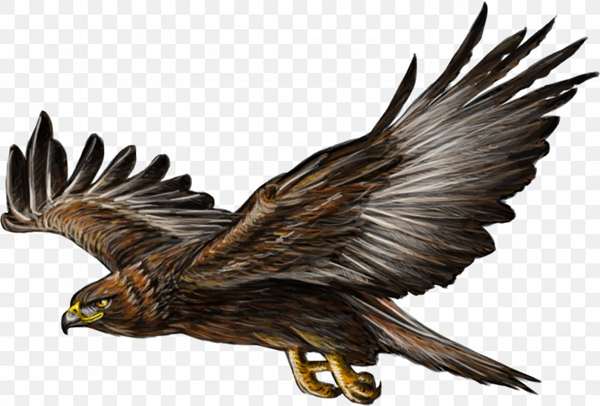
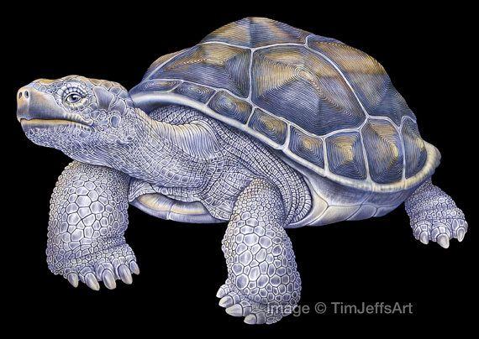
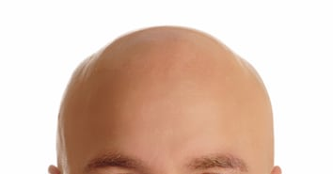
Part 2
ὁ ἀετός
ἡ χελώνη

Slide 19
Vocabulary:
ἐπεί – when (= ubi)
ποτέ – one day (= ōlim)
ἀγρος ὁ - field (= ager)
περιπατέω – go for a walk
οὐρανος ὁ - sky (= caelum)
πετομαι – I fly
ὁ ἀετός
ἐπεὶ δε ποτε ἐν τοῖς άγροῖς περιεπάτει,
ἀετός τις ἐν τῷ οὐρανῷ ἐπέτετο.
Imperfect tense
(the Augment comes after ‘περι-΄)
ἐπεὶ δε ποτε ἐν τοῖς άγροῖς περιεπάτει,
ἀετός τις ἐν τῷ οὐρανῷ ἐπέτετο.
πέτομαι – I fly
Imperfect tense
ἐπέτετο – ‘he/she/it was flying’
ὁ ἀετός – the eagle
ἀετός τις - an eagle

Slide 20
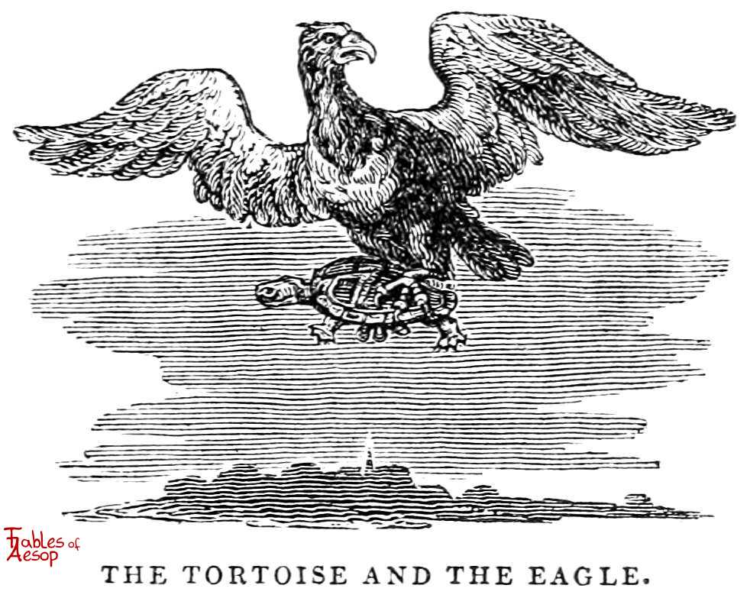
ὁ αἐτος
Vocabulary:
ὀνυξ ὁ – nail, claw, talon
ἐπεὶ δε ποτε ἐν τοῖς άγροῖς περιεπάτει,
ἀετός τις ἐν τῷ οὐρανῷ ἐπέτετο.
ὁ δὲ ἀετός χελώνην ἐν τοῖς ὄνυξιν εἶχεν.
ὁ δὲ ἀετός χελώνην ἐν τοῖς ὄνυξιν εἶχεν.
χελὠνη
Imperfect of ἐχω
(= ‘habēbat’)

Slide 21
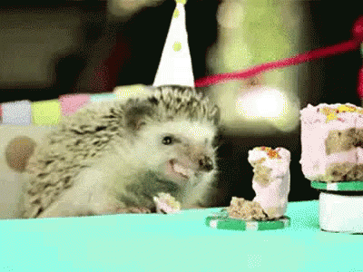
Vocabulary:
γαρ – for (nam, enim)
ἐπεὶ δε ποτε ἐν τοῖς άγροῖς περιεπάτει,
ἀετός τις ἐν τῷ οὐρανῷ ἐπέτετο.
ὁ δὲ ἀετός χελώνην ἐν τοῖς ὄνυξιν εἶχεν.
ἐβούλετο γὰρ τὴν χελώνην ἐσθίειν.
Infinitive
ἐβούλετο γὰρ τὴν χελώνην ἐσθίειν.
βούλομαι
Imperfect:
Same endings as Strong Aorist
ἐβούλoμην
ἔβούλου
ἐβούλετο
ἐβούλόμεθα ἐβούλεσθε
ἐβούλοντο
ἡ χελὠνη
ἐβούλετο is the Imperfect of βούλομαι
ἐβούλετο = volēbat

Slide 22
Vocabulary:
ἀλλά – but
διά + acc. – because of
τὸ δερμα – shell, skin
οἱος τ΄εἰμι – I am able, I can
ἐπεὶ δε ποτε ἐν τοῖς άγροῖς περιεπάτει,
ἀετός τις ἐν τῷ οὐρανῷ ἐπέτετο.
ὁ δὲ ἀετός χελώνην ἐν τοῖς ὄνυξιν εἶχεν.
ἐβούλετο γὰρ τὴν χελώνην ἐσθίειν.
ἀλλὰ διὰ τὸ δέρμα οὐχ οἷος τ΄ἦν.
I was able/I could
LATIN
pot-eram
pot-eras
pot-erat
pot-eramus
pot-eratis
pot-erant
ἀλλὰ διὰ τὸ δέρμα οὐχ οἷος τ΄ἦν.
was able
(literally, ‘was such as to…’)
οἷος τ΄
οἷος , -α, -ον τ΄

Slide 23
αἰσθάνομαι
αἰσθομενος = having perceived
Vocabulary:
ἡ κεφαλή – head
φαλακρός, -ά, -όν - bald
οὖσα - being i.e. ‘that it was’
νoμίζω – think (‘that…’ + acc. + inf)
εἶναι – to be, i.e. ‘that it was’
ὁ λίθος – stone, a stone
ἐπεὶ δε ποτε ἐν τοῖς άγροῖς περιεπάτει,
ἀετός τις ἐν τῷ οὐρανῷ ἐπέτετο.
ὁ δὲ ἀετός χελώνην ἐν τοῖς ὄνυξιν εἶχεν.
ἐβούλετο γὰρ τὴν χελώνην ἐσθίειν. ἀλλὰ διὰ τὸ δέρμα οὐχ οἷος τ΄ἦν.
αἰσθόμενος δὲ τὴν τοῦ Αἴσχυλου κεφαλὴν φαλακρὰν οὖσαν, ἐνόμιζε λίθον εἶναι.
Verbs of knowing and perceiving in Greek are followed by the participle:
e.g. I perceive that he is handsome
= αἰσθάνομαι αὐτον καλον ὄντα.
Verbs of thinking in Greek are followed by the Infinitive:
e.g. I think that he is handsome
= νομίζω αὐτον καλον εἶναι.
Latin does the same:
eum pulchrum esse credo.
Literally: I believe him to be handsome.
αἰσθόμενος δὲ τὴν τοῦ Αἴσχυλου κεφαλὴν φαλακρὰν οὖσαν, ἐνόμιζε λίθον εἶναι.
Participles (in purple). We are going to be covering these properly before the end of term, but they basically mean ‘–ing’ (Present), or ‘having –ed’ (Aorist).

Slide 24
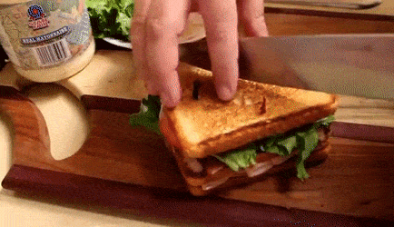
ἐπεὶ δε ποτε ἐν τοῖς άγροῖς περιεπάτει,
ἀετός τις ἐν τῷ οὐρανῷ ἐπέτετο.
ὁ δὲ ἀετός χελώνην ἐν τοῖς ὄνυξιν εἶχεν.
ἐβούλετο γὰρ τὴν χελώνην ἐσθίειν.
ἀλλὰ διὰ τὸ δέρμα οὐχ οἷος τ΄ἦν.
αἰσθόμενος δὲ τὴν τοῦ Αἴσχυλου κεφαλὴν φαλακρὰν οὖσαν, ἐνόμιζε λίθον εἶναι.
κατέβαλεν οὖν τὴν χελώνην ἐπὶ τὴν τοῦ ποιητοῦ κεφαλήν, βουλόμενος συντρίβειν
τὸ δέρμα.
Vocabulary:
καταβαλλω – drop, throw down
ἐπι + acc./gen/dat. – on
συντρίβω – smash
τὸ δέρμα – shell, skin
ἡ τοῦ ποιητου κεφαλη
βούλομαι
βουλόμενος = wanting
κατέβαλεν οὖν τὴν χελώνην ἐπὶ τὴν τοῦ ποιητοῦ κεφαλήν, βουλόμενος συντρίβειν
τὸ δέρμα.
ἡ χελώνη

Slide 25
Vocabulary:
πίπτω, ἔπεσον – fall
ἀποκτείνω – kill
ἐπεὶ δε ποτε ἐν τοῖς άγροῖς περιεπάτει,
ἀετός τις ἐν τῷ οὐρανῷ ἐπέτετο.
ὁ δὲ ἀετός χελώνην ἐν τοῖς ὄνυξιν εἶχεν.
ἐβούλετο γὰρ τὴν χελώνην ἐσθίειν.
ἀλλὰ διὰ τὸ δέρμα οὐχ οἷος τ΄ἦν.
αἰσθόμενος δὲ τὴν τοῦ Αἴσχυλου κεφαλὴν φαλακρὰν οὖσαν, ἐνόμιζε λίθον εἶναι.
κατέβαλεν οὖν τὴν χελώνην ἐπὶ τὴν τοῦ ποιητοῦ κεφαλήν, βουλόμενος συντρίβειν
τὸ δέρμα. ἡ δὲ χελώνη πεσοῦσα ἀπέκτεινε τὸν Αἴσχυλον.
ἡ χελὠνη
ἡ δὲ χελώνη πεσοῦσα ἀπέκτεινε τὸν Αἴσχυλον.
Aorist participle of πίπτω, ἔπεσον: having fallen

Slide 26
Part 2
ὁ αἐτος
ἡ χελὠνη

Slide 27
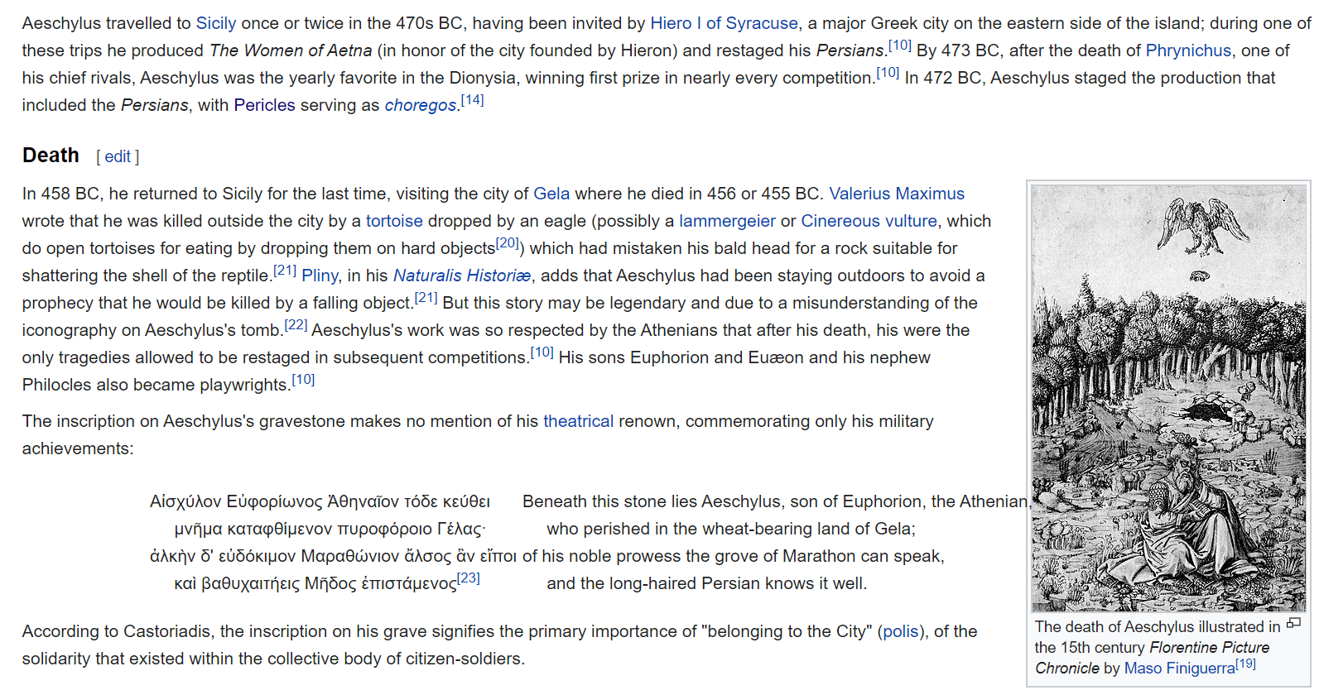
Wikipedia reports Aeschylus epitaph:

Slide 28
Dramatic Irony

