Slide 2
2
5
4
7
3
6
1

Slide 3
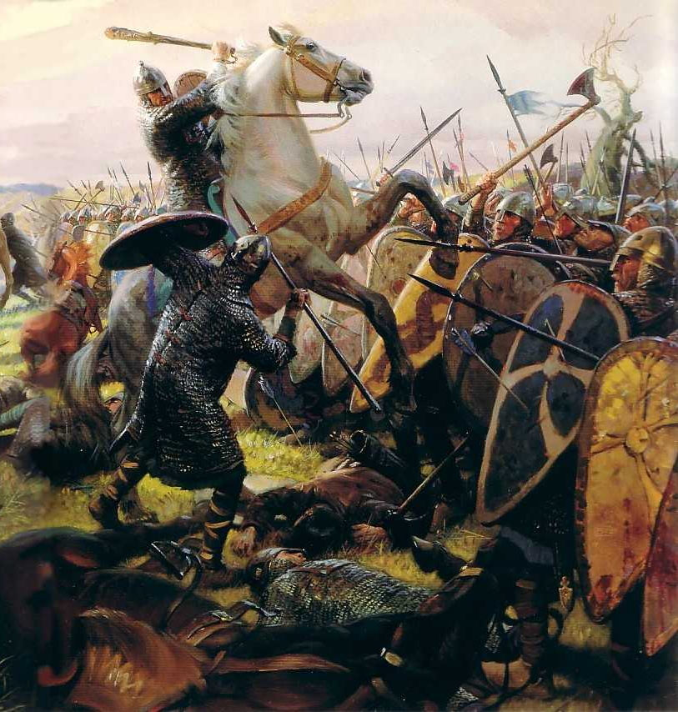
The Battle of Hastings
Learning Objectives:
Recall which contender for the throne was killed at the Battle of Stamford Bridge.
Examine the Bayeux Tapestry.
Interpret the events of the Battle of Hastings.

Slide 4
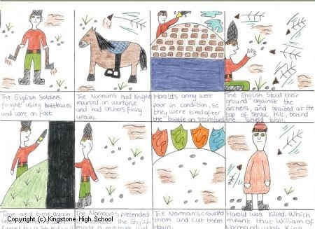
Comic strip!
Task:
Using the information we have learnt today and the information on the sheets to help you, create a comic strip!
Notes:
Conqueror

Slide 5
And Finally!
With the same people you worked in a group with to examine the section of the Bayeux tapestry, think of a freeze-frame to explain what it shows!

