Slide 1
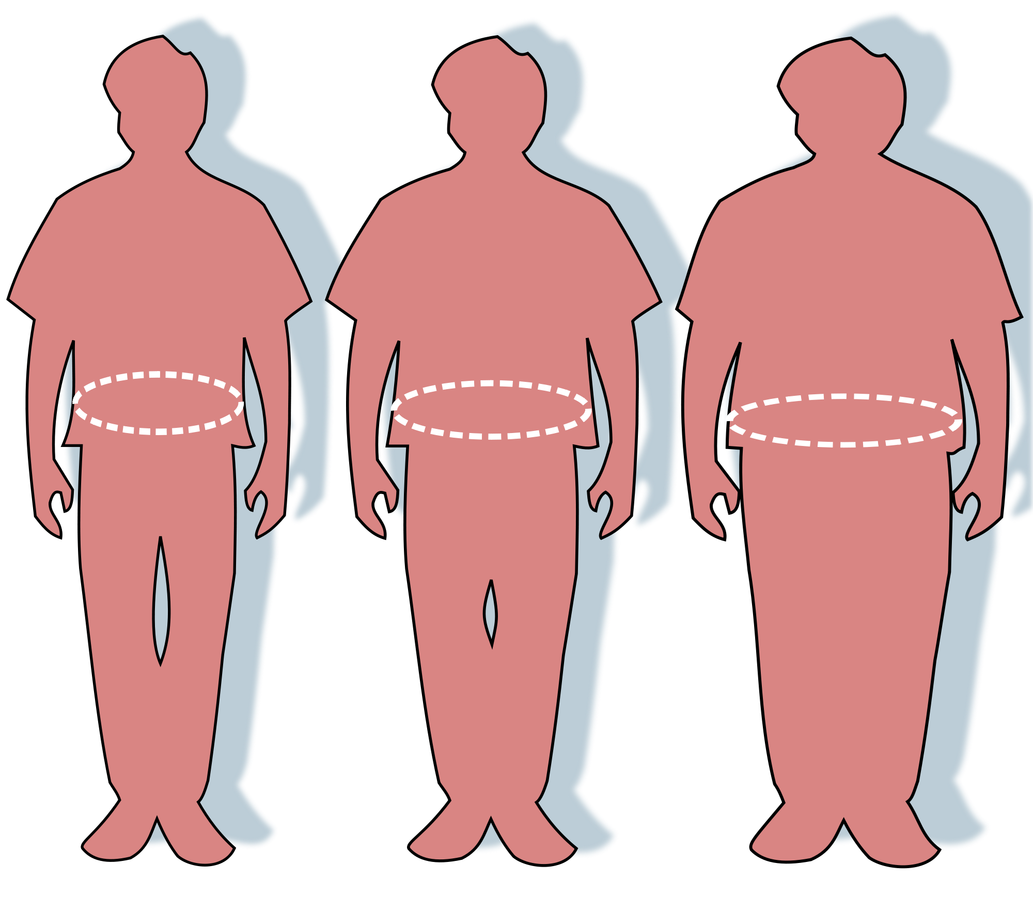
The relationship between
socio-economic status and health and the different policy solutions
Ciara Farrelly EPQ

Slide 2
What have I been researching?
Why did I choose this topic?
My research
The link between socioeconomic status and health
Policies to be implemented
Reflection
Do people of lower incomes have generally worse health?
Why do lower income groups tend to have higher risk of obesity, heart disease and lower life expectancies?
What can be done about these health inequalities?

Slide 3
‘The Spirit Level’ by Richard Wilkinson
Why did I choose this topic?
My research
The link between socioeconomic status and health
Policies to be implemented
Reflection
Consequences of inequality
Reduced education
Decreased trust
Higher rates of crime
Higher rates of drug use
Increased health problems
such as greater risk of obesity
Increased anxiety and stress

Slide 4
Initial ideas for my project
Why did I choose this topic?
My research
The link between socioeconomic status and health
Policies to be implemented
Reflection
Focus on health
Include mental health
Just focus on UK
Is there a link between social class and health in the United Kingdom?

Slide 5
Initial problems during research
Why did I choose this topic?
My research
The link between socioeconomic status and health
Policies to be implemented
Reflection
Is there a link between social class and health in the United Kingdom?
Problems faced immediately:
Decisions made
Sources to use: research reports, library books, media (newspaper articles, web reports)
Narrow down to specific health factors
Obesity, risk of heart disease, life expectancy, mental health
Need to define health
Need to define social class
Define social class as socio-economic status based on income

Slide 6
Focus on policies
Why did I choose this topic?
My research
The link between socioeconomic status and health
Policies to be implemented
Reflection
What should be done by the government?
Updated project title: The link between socioeconomic status and health and the different policy solutions

Slide 7
Overall problems faced during research
Why did I choose this topic?
My research
The link between socioeconomic status and health
Policies to be implemented
Reflection
Using mental health as a factor
2) Sources
3) Comparing studies with different definitions of socio-economic status

Slide 8
Obesity in lower socioeconomic groups
Why did I choose this topic?
My research
The link between socioeconomic status and health
Policies to be implemented
Reflection

Slide 9
Obesity in lower socioeconomic groups
Why did I choose this topic?
My research
The link between socioeconomic status and health
Policies to be implemented
Reflection
Psychological reasons
Financial reasons
Lack of education

Slide 10
Greater risk of heart disease in lower socioeconomic groups
Why did I choose this topic?
My research
The link between socioeconomic status and health
Policies to be implemented
Reflection
Food choice - eating more potentially harmful foods such as milk, butter, cheese
Increased smokers in lower classes due to social acceptance

Slide 11
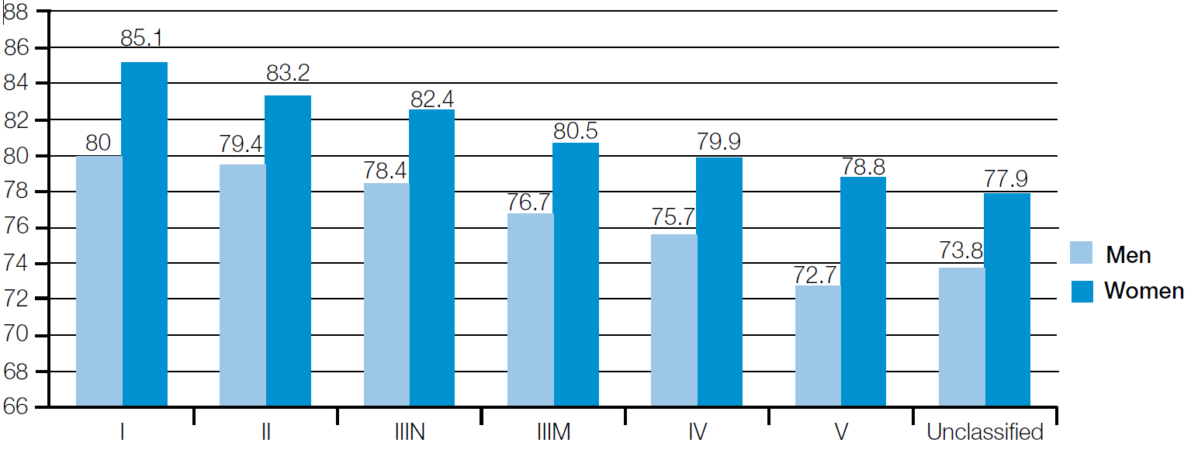
Reduced life expectancy in lower socio-economic groups
Why did I choose this topic?
My research
The link between socioeconomic status and health
Policies to be implemented
Reflection
Life expectancy
Social Grade
Note: defined by income in the project

Slide 12
Why is there a difference in life expectancies in different socioeconomic groups?
Why did I choose this topic?
My research
The link between socioeconomic status and health
Policies to be implemented
Reflection
Behaviouralist model
Materialist model
Psychosocial model
Life course model

Slide 13
Policies to be implemented
Why did I choose this topic?
My research
The link between socioeconomic status and health
Policies to be implemented
Reflection
Behavioural economics
Reducing Unemployment
Directly improve health of lower socio-economic groups
Policies to reduce health inequalities
Decrease inequality
Fiscal measures
Information provision
Fiscal measures

Slide 14
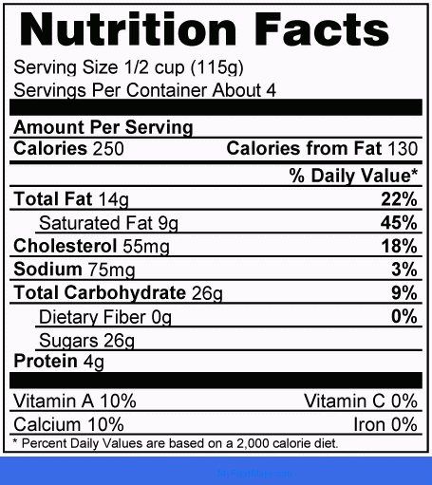
Policy 1: Provision of Information
Why did I choose this topic?
My research
The link between socioeconomic status and health
Policies to be implemented
Reflection
Display nutritional information
Colour coded packages
Programmes in school
The Internet
Media, Posters

Slide 15
Policy 2: Fiscal Measures
Why did I choose this topic?
My research
The link between socioeconomic status and health
Policies to be implemented
Reflection
Taxing unhealthy foods
Subsidising healthy foods
Tax revenue collected to re-injected back into the economy

Slide 16
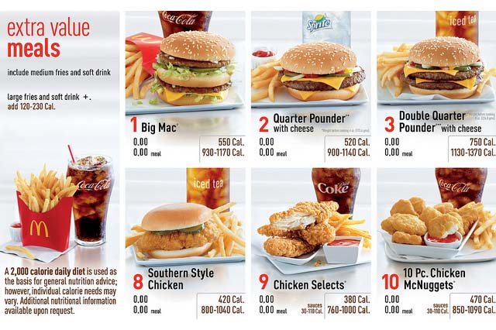
Policy 3: Behavioural Economics
Why did I choose this topic?
My research
The link between socioeconomic status and health
Policies to be implemented
Reflection
Attempt to change people’s incentives at the present moment
Posting calories on fast food menus e.g. Starbucks, McDonalds
Stopping unhealthy food being in reach
iPhone apps

Slide 17
Reducing Inequality: Fiscal Measures
Why did I choose this topic?
My research
The link between socioeconomic status and health
Policies to be implemented
Reflection
Taxation
Progressive Income Tax, Increase Personal Allowance, Raise NIC thresholds

Slide 18
Reducing Inequality: Fiscal Measures:
Why did I choose this topic?
My research
The link between socioeconomic status and health
Policies to be implemented
Reflection
Large welfare state - increase benefits
Target low income areas with spending
Benefits in kind - those free to use at point of consumption e.g. NHS
Government spending and taxation must be evaluated jointly.

Slide 19
Reducing Inequality: Reducing unemployment
Why did I choose this topic?
My research
The link between socioeconomic status and health
Policies to be implemented
Reflection
Different types of unemployment need different policies
Cyclical
Frictional
Real Wage Unemployment

Slide 20
Reflection
Why did I choose this topic?
My research
The link between socioeconomic status and health
Policies to be implemented
Reflection
Things I have learnt:
Independent study techniques
How to overcome problems
To properly reference
To select only crucial, relevant information
The importance of planning and structuring

Slide 21
Reflection
Why did I choose this topic?
My research
The link between socioeconomic status and health
Policies to be implemented
Reflection
Problems
Mental health would have been interesting to include
Hard to keep definition of socio-economic status consistent
Sources limited to UK sources
Some sources used may contain bias as they were from the media
Hard to find relevant information in library books

