Slide 1
Journal Project
Jose Naranja turns ordinary notebooks into highly detailed works of art. The artist uses watercolors, stamps, writing, elements of photography and drawings to turn each notebook into a one of a kind masterpiece.
Jose has worked as an aeronautic engineer for many years but eventually decided to quit and devote his life to art and travels. The artist developed his passion for notebook art in 2005 when he discovered Moleskine pocket journals. As hard as it may be to believe, Jose is a self-taught artist, but his skills are remarkable. So far the artist has filled in 12 notebooks and recently has begun binding his own, to make his art even more personal.

Slide 2
What is the project for?
To collate a book/journal of images, reflections and thoughts about this strange time we are living in at the moment.
To take creative risks and not worry about being wrong or right. To explore media in a creative way.
To use things around us as inspiration and tools to work with.
To explore possible themes that might lead to work in year 10.
To focus on developing skilled drawings and attention to detail.
To use writing/words and quotes as part of your work.

Slide 3
STRETCH AND CHALLENGE:
USE MORE THAN ONE MEDIA PER PAGE.
USE ANALYTICAL/ANNOTATION SKILLS ON AT LEAST EVERY OTHER PAGE.
THINK ABOUT LITERACY AND WRITING SKILLS TO HELP BUILD YOUR “VISUAL STORY” .
TRY AND WORK ON A REALLY DETAILED PIECE OF WORK EVERY WEEK – THAT IS A 2-3 HOUR PIECE OF WORK.
USE VARIATIONS OF DRAWING TECHNIQUES: I.E. CROSSHATCHING, CONTINUOUS LINE, POINTILLISM, MARK MAKING, BLENDING ETC.

Slide 4
Each Day/Page will have a theme
Each page will have a theme (there are 20 to start with) . You can dip into this when you want.
You can add more pages of course, you can think of your own themes or use ideas from the “extras” page.

Slide 5
https://www.demilked.com/amazing-notebook-art-jose-naranja/?fbclid=IwAR0SBIdANQvcXIajs_kGaQAT2lrfWrMdSvW48c1txEa_QeaO9-DRwISyG6A
The link above takes you to the article and images about the artist who created it.
Titles are a good way of drawing in the viewer
Annotate or write a note about the things you have drawn
Add small images and boxes

Slide 6
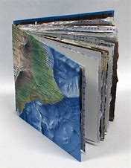
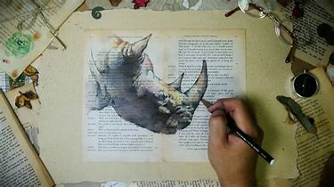
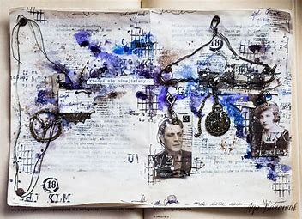
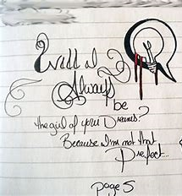
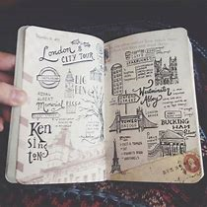
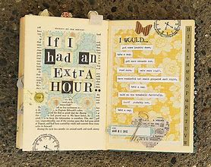
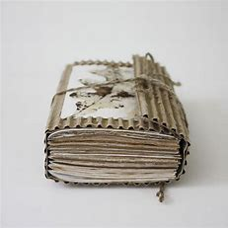
I don’t have a sketchbook Miss……….
https://www.accessart.org.uk/sketchbooks-an-online-course-for-children-families-parents-teachers/?fbclid=IwAR0eXgOhXUnmJdtsLP-0-SaSrYINphDO0pQP2KlcHuOGrEHLQMQpDJc2IYk

Slide 7
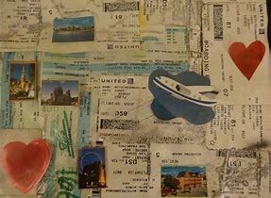
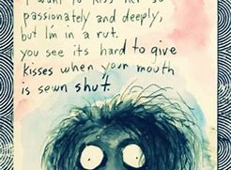
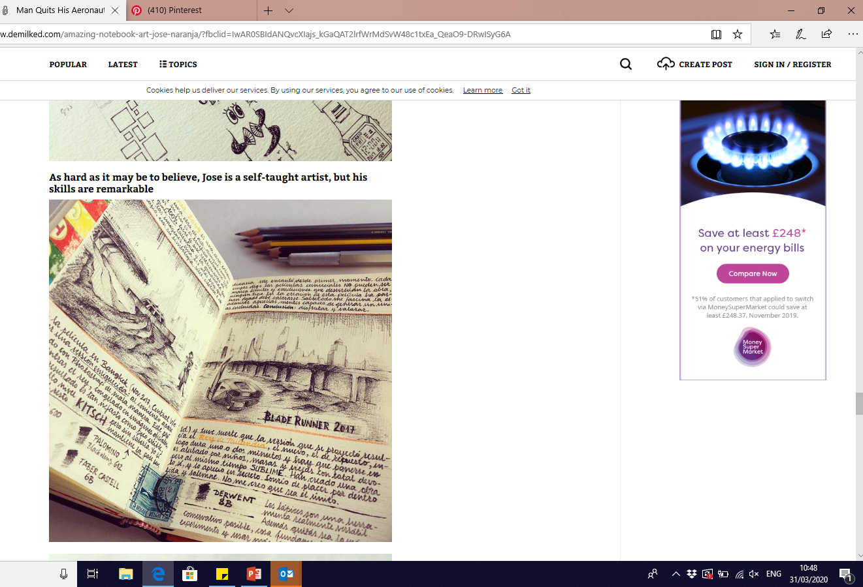
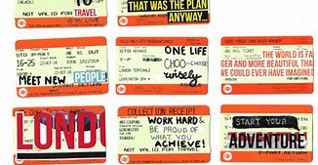
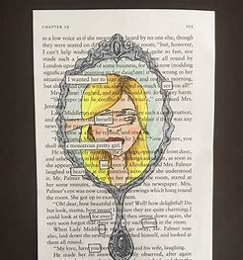
Extra ideas:
Paint with coffee
Collage
Paint on different surfaces
Stick things in
Write poems
Add quotes
Write stories

Slide 8
Front Cover:
Produce a front cover for your journal
Include your name
Relate it to our current situation.

Slide 9
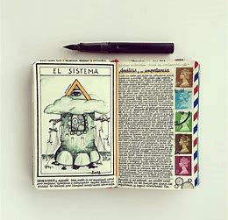
Page layout ideas:
Double page spread
Various size boxes with small snippets/drawings in
Then a space for some writing
Whole page pieces

Slide 10
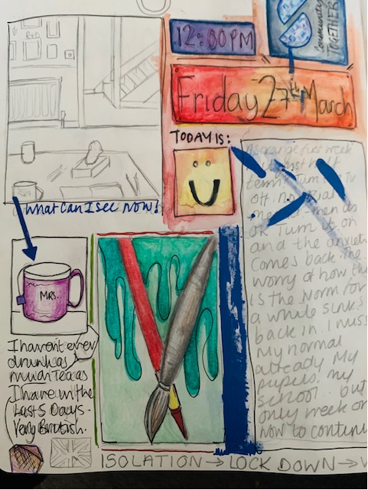
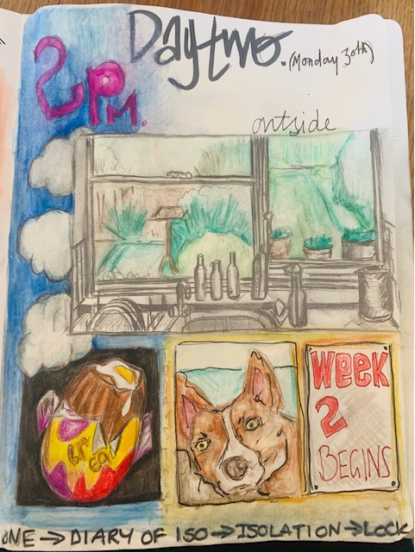
Day 1 ( page 1 )
Day 2 ( page 2 )
A view of somewhere inside
A view of outside
I am logging the date and time I do my page entry
A diary extract about the week so far
Close up of an object in the house
Something positive
What's Inside
What's Outside

Slide 11
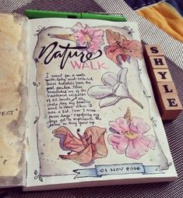
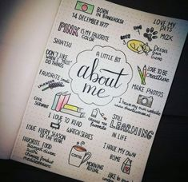
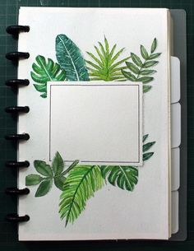
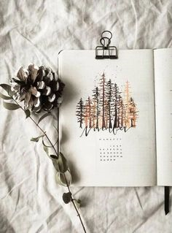
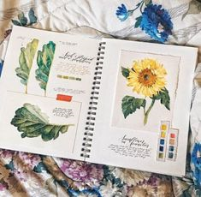
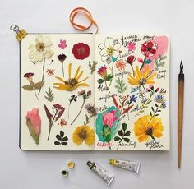
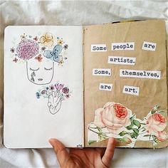
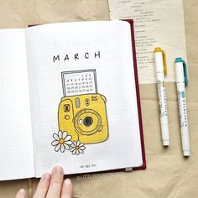
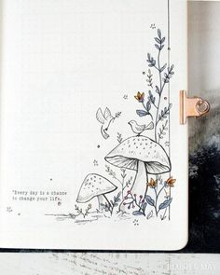
Inspiration Ideas:
L
A
Y
O
U
T
S

Slide 12
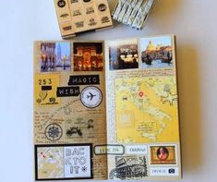
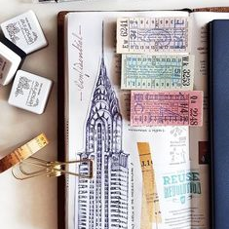
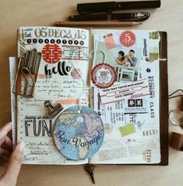
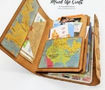
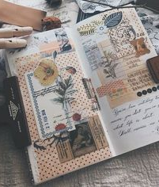
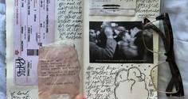
Add things to your journal:
Draw on other things to stick in:
Receipts
Tickets
Scrap paper
Envelopes
postcards
Stick things in – find some memories and relate them to the theme

Slide 13
More of his work:
Add little sketches/cartoons
Create pages where there is just one detailed drawing

Slide 14
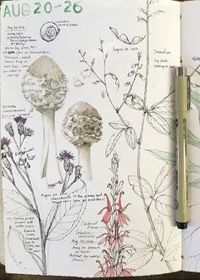
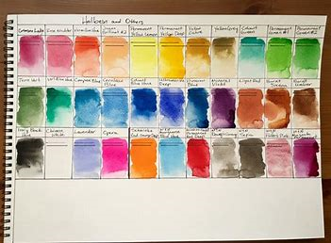
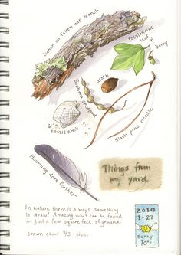
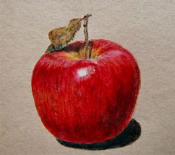
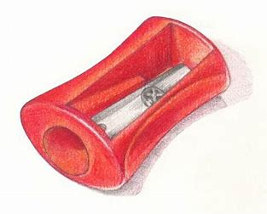
Day 3 ( page 3 )
Day 4 ( page 4 )
Try and draw from real life if doing a drawing of something you can see.
Colour – colour and mood, or a specific colour in objects
Nature

Slide 15
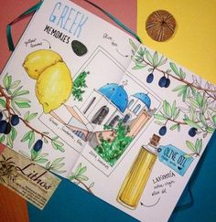
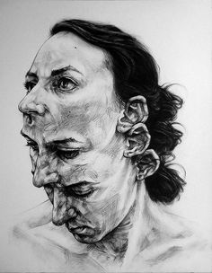
Day 5 (page 5)
Day 6 (page 6)
Travel – favourite place or dream travel destination
Mood/Feelings and Emotions

Slide 16
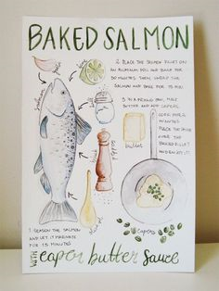
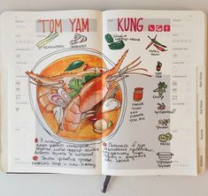
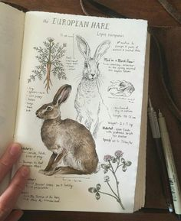
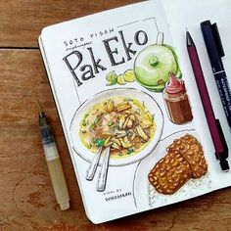
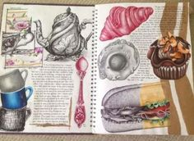
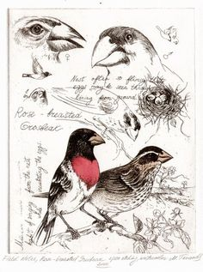
Day 8 (page 8)
Day 7 (page 7)
Animals – pets or favourite animals
Food

Slide 17
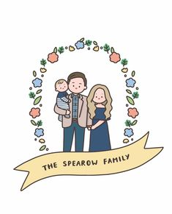
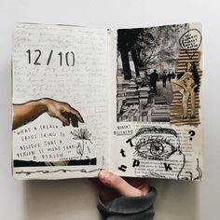
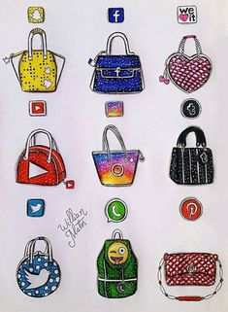
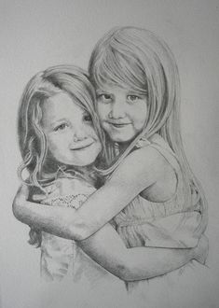
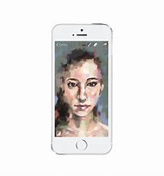
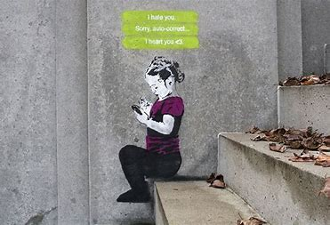
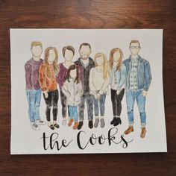
Day 9 (page 9)
Day 10 (page 10)
Family- portraits, or captures of their activities
Social Media

Slide 18
Day 11 (page 11)
Day 12 (page 12)
A piece of work or entry about how you are communicating, who with? How ?
Try to capture the world in isolation.
What are you missing ? Friends ? Hobbies ? School ?
What are you missing?
Communication

Slide 19
Day 15 (page 15)
Day 16 (page 16)
Your personal dream.
Dream career ?
A dream you have had or nightmare you have had.
A representation of a dream or nightmare .
Dreams
Nightmares

Slide 20
Day 17 (page 17)
Day 18 (page 18)
Things you love about School.
Things you love about your home.
Subjects
Something you can depict that you have learnt about.
School
Home

Slide 21
Day 19 (page 19)
Day 20 (page 20)
The news so far.
The news today.
Worldwide news.
What have we learnt about ourselves and life in Lockdown.
Rainbows are being used as a symbol of hope in the current situation – produce a piece of work around the theme.
The News
Hope/Rainbow

Slide 22
Day 21 (page 21)
Day 22 (page 22)
Produce a page about your favourite artist.
Copy a piece of their work.
Produce your own pieces of work based on the artist you choose for page 21.
Artist – favourite
Artist – inspiration

Slide 23
Day 23 (page 23)
Day 24 (page 24)
Best day of Lockdown
What did you do today?

Slide 24
Day 25 (page 25)
Day 26 (page 26)
Favourite book
Favourite film

Slide 25
Day 27 (page 27)
Day 28 (page 28)
Remember you can be creative with your page layouts so doesn’t have to be one thing…
Favourite character/Celebrity/sports person
Favourite TV series

Slide 26
Day 29 (page 29)
Day 30 (page 30)
Long drawing of a scene or place that you’d live to visit.
First thing you are going to do after lockdown

