Slide 1
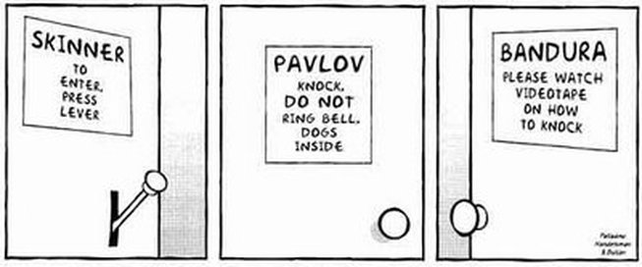
Title: Social psychological theories of aggression: Social Learning Theory (SLT)
Learning objectives:
To DESCRIBE and EVALAUTE SLT of aggression including: observation, punishment, modelling and vicarious reinforcement.
To KNOW and EVALAUTE research supporting SLT including ‘Bobo doll study’.

Slide 2
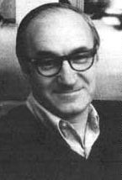
Albert Bandura…
Aggression learnt from the environment.
People NOT born aggressive (biological).
Learning objectives:
To DESCRIBE and EVALAUTE SLT of aggression including: observation, punishment, modelling and vicarious reinforcement.
To KNOW and EVALAUTE research supporting SLT including ‘Bobo doll study’.

Slide 3
How do children learn aggression through SLT?
REMEMBER: Use the correct key words e.g. role models, vicarious learning etc.
Children observe ‘role models’ and imitate their behaviour.
Characteristics and status of ‘role model’ likely to affect probability of imitating behaviour (identification).
Also learn whether others are rewarded or punished for aggressive behaviour by observing (vicarious reinforcement). If others are rewarded more likely to imitate the behaviour themselves.
Learning objectives:
To DESCRIBE and EVALAUTE SLT of aggression including: observation, punishment, modelling and vicarious reinforcement.
To KNOW and EVALAUTE research supporting SLT including ‘Bobo doll study’.

Slide 4
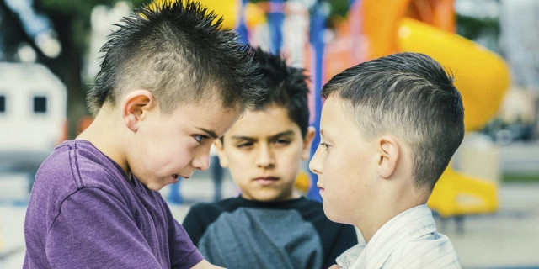
Example…
Child overserves a bully demand money from another student in the playground.
Observes that the behaviour is rewarded (gets the money).
Likely to imitate the behaviour himself.
Learning objectives:
To DESCRIBE and EVALAUTE SLT of aggression including: observation, punishment, modelling and vicarious reinforcement.
To KNOW and EVALAUTE research supporting SLT including ‘Bobo doll study’.

Slide 5
Behaviour is not automatically modelled. There are mediating cognitive processes which determine whether behavior is imitated…..
Attention: the person must first pay attention to the model. The model’s behavior must be noticeable.
Retention: the behavior noticed must memorable to the observer. E.g. emotional.
Motor reproduction: must have the ability to replicate the behavior that the model has just demonstrated. E.g. might need to be big and strong.
Motivation: learners must want to demonstrate what they have learned.
Since these four conditions vary among individuals, different people will reproduce the same behaviour differently (Explain individual differences).
Learning objectives:
To DESCRIBE and EVALAUTE SLT of aggression including: observation, punishment, modelling and vicarious reinforcement.
To KNOW and EVALAUTE research supporting SLT including ‘Bobo doll study’.

Slide 6
SLT suggests that although a strong influence on why people behave aggressively, does not necessarily happen exclusively.
Likely interacts with operant and classical conditioning, as well as underlying biological factors.
Learning objectives:
To DESCRIBE and EVALAUTE SLT of aggression including: observation, punishment, modelling and vicarious reinforcement.
To KNOW and EVALAUTE research supporting SLT including ‘Bobo doll study’.

Slide 7
Bandura’s (1961) ‘Bobo doll’ experiment
Evidence?
Aggression topic
Key Study
Watch video and remind yourselves:
What Bandura did? (procedures)
What he found?
Why the findings are important? (potential practical applications).

Slide 8
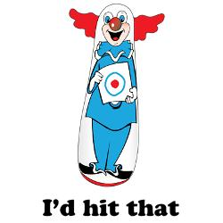
3 – 5 year old children split into two conditions:
Group one watch an adult model behave aggressively to the life-sized ‘bobo doll’ e.g. kicking it, striking it with a hammer, verbally abusing it etc.
Group two watch an adult behave passively towards the bobo doll.
Children made to feel frustrated (by being placed in room with attractive toys they were not allowed to play with), then taken to the room with the bobo doll, which they were allowed to play with.
Children exposed to aggression models reproduced a good deal of the aggressive behaviour they saw. The children exposed to passive behaviour did not exhibit any aggressive behaviour.
A follow up study found that children who saw the model being rewarded for aggression, imitated even more behaviour, and children who saw an aggressive model being punished imitated less aggressive behaviour (evidence for vicarious learning).
Exam success
“Detailed description of the procedures and findings of Bandura’s Bobo doll studies, without reference to the theory, cannot move beyond rudimentary.”
Learning objectives:
To DESCRIBE and EVALAUTE SLT of aggression including: observation, punishment, modelling and vicarious reinforcement.
To KNOW and EVALAUTE research supporting SLT including ‘Bobo doll study’.

Slide 9
Problems with ‘bobo doll study’ … (A02)
Low ecological validity (doll, not person). – so generalizability of findings? Although a follow-up study using real clowns produced the same results…!
Potential demand characteristics (children knew what was expected of them)
Ethical issues
X
X
Exam success
“Answers presenting only extended methodological analysis of Bandura’s Bobo doll studies are unlikely to move beyond basic for AO2”.
X
Learning objectives:
To DESCRIBE and EVALAUTE SLT of aggression including: observation, punishment, modelling and vicarious reinforcement.
To KNOW and EVALAUTE research supporting SLT including ‘Bobo doll study’.

Slide 10
Task
SO…. Do these evaluations therefore mean this study is strong support for the theory? Or weak support?
Read through the hand out and use it to create elaborated evaluative linking paragraphs for at least two methodological evaluations of the Bobo study.
Learning objectives:
To DESCRIBE and EVALAUTE SLT of aggression including: observation, punishment, modelling and vicarious reinforcement.
To KNOW and EVALAUTE research supporting SLT including ‘Bobo doll study’.
Notes:
Handout 60

Slide 11
Overall evaluation of SL theory
Does explain cultural differences in levels of aggression. (Aggression levels differ across the world. In some cultures aggression in adults is hidden from children – levels therefore lower).
‘Vicarious learning’ can explain aggression from a learning perspective without a need for ‘direct reinforcement’.
Can explain individual differences in aggression (dependent on upbringing situations).
Not a great deal of evidence with adults. Does Bandura’s work generalize to adults?
explains some forms of aggression better than others, eg cannot easily explain impulsive aggressive behaviours
Exam success
“Comparison with alternative explanations, such as the role of genetics or evolutionary approaches, may earn AO2/AO3 credit if used effectively. Simple description of alternatives will not earn marks.
X
X
Learning objectives:
To DESCRIBE and EVALAUTE SLT of aggression including: observation, punishment, modelling and vicarious reinforcement.
To KNOW and EVALAUTE research supporting SLT including ‘Bobo doll study’.

Slide 12
Issues, debates and approaches?
Could use ‘ethical issues’ with research into SLT as already discussed (hard to test the theory empirically due to ethical difficulties).
Could use ‘nature vs nurture’.
SLT strongly emphasises imitation, vicarious learning, and the influence of role models to explain aggressive behaviour. This is clearly very much a ‘nurture’ explanation. It therefore ignores the established importance of biological (e.g. brain neurotransmitters), genetic and evolutionary (e.g. sex differences in jealousy) factors in aggressive behaviour, for which there is some compelling empirical evidence. It is likely aggressive behaviour is more fully explained through a combination of ‘nature’ and ‘nature’ factors, such as the diathesis-stress model.
Could use ‘cultural differences and biases’. E.g. Ethnocentrism of Bobo doll study. Difficult to generalise the results to explain aggressive behaviour in other cultures
Learning objectives:
To DESCRIBE and EVALAUTE SLT of aggression including: observation, punishment, modelling and vicarious reinforcement.
To KNOW and EVALAUTE research supporting SLT including ‘Bobo doll study’.

Slide 13
Practical research task
Read through the handout and complete the activities to apply what you have learnt to research methods.
Learning objectives:
To DESCRIBE and EVALAUTE SLT of aggression including: observation, punishment, modelling and vicarious reinforcement.
To KNOW and EVALAUTE research supporting SLT including ‘Bobo doll study’.

Slide 14
Home learning
1. Watch the crash course psychology video at: https://www.youtube.com/watch?v=128Ts5r9NRE (and on moodle).
2. Answer the following question:
Describe and evaluate the social learning theory of human aggression. [16 marks]
Learning objectives:
To DESCRIBE and EVALAUTE SLT of aggression including: observation, punishment, modelling and vicarious reinforcement.
To KNOW and EVALAUTE research supporting SLT including ‘Bobo doll study’.
Notes:
Mark scheme sample paper

Slide 15
4 – 5 pm After-school ‘stretch and support’ on Mondays
From next week will be running an after school session every Monday for individual help with essays, AS retakes help, revision, getting an A* (whatever you want really….)
Only two people per week. First come first served.
These will become general revision sessions, and open to all, nearer Easter.
Learning objectives:
To DESCRIBE and EVALAUTE SLT of aggression including: observation, punishment, modelling and vicarious reinforcement.
To KNOW and EVALAUTE research supporting SLT including ‘Bobo doll study’.

