Slide 1
Starter: With a peer – explain each of these genetic evaluation points
Methodological problems (sample, measuring aggression, Self reports v observations)
Gender differences
Multiple genes – 5-HTT also influences serotonin.
IDA / Implications
Caspi

Slide 2
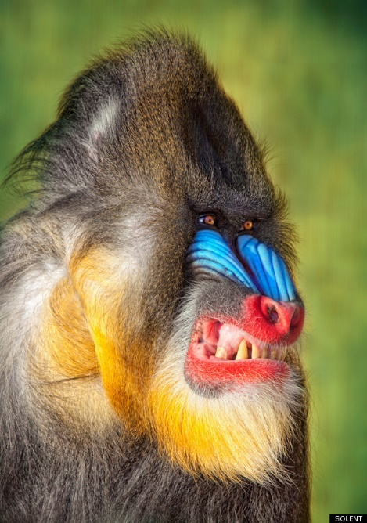
The ethological explanation of aggression
Describe ethological explanations of aggression (AO1).
Evaluate ethological explanations of aggression (AO3).
Literacy key terms: ethology, adaptive, naturally selected, ritualistic display, appeasement display, sign stimulus, innate releasing mechanism (IRM), fixed action pattern (FAP).

Slide 3
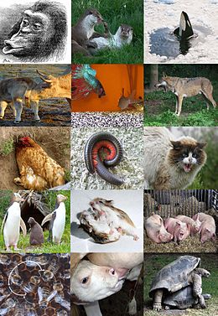
What is ethology?
Scientific study of animals (including humans) in their natural habitat.
Animals have innate behavioural responses to specific situations.
An example of an innate behaviour that is found in all species is aggression
https://www.youtube.com/watch?v=fKVYAqtKBVI
Ethologists study behaviour in animals and extrapolate to human behaviour. Aim to understand innate behaviours of animals in their natural environment.
Lorenz studied animals (fish, insects) and applied his findings to human behaviour.

Slide 4
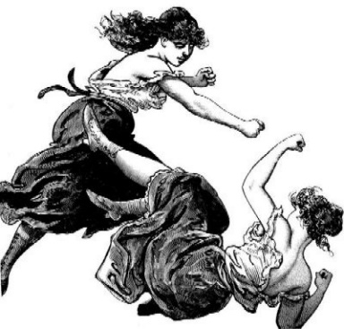
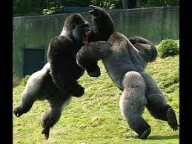
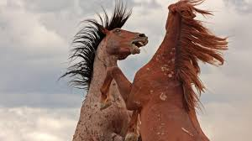
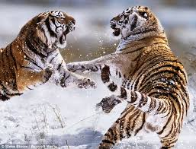
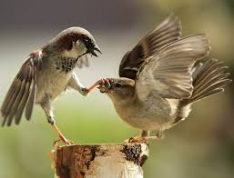
Lorenz defines aggression as:
“the fighting instinct in beast and man which is directed against members of the same species”

Slide 5
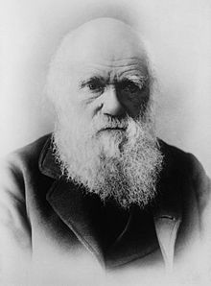
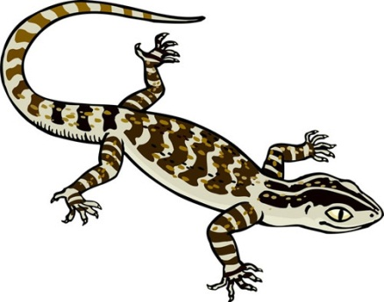
Adaptive
“Any characteristic that enhances an individuals survival and reproduction, and is thus likely to be naturally selected”
How may aggression be adaptive?

Slide 6
Adaptive
“Any characteristic that enhances an individuals survival and reproduction, and is thus likely to be naturally selected”
Ethological explanations state that aggression is adaptive.
Aggression is needed to establish territory – species will spread out over a larger areas reducing demand on resources.
Aggression allows access to mates and status. For example Male chimpanzees use aggression to establish hierarchy's just like humans.

Slide 7
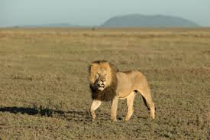
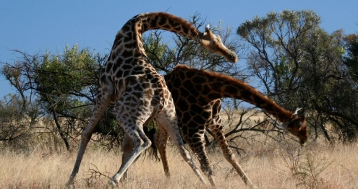
Adaptive functions of aggression
THE LOSER AND THE SPECIES IN GENERAL
It is adaptive because it allows a species to survive. This is because the animal that was defeated is rarely killed, instead it is forced to establish a new territory elsewhere and find new food sources, mates etc. This means that the existing pack of animals is not threatened by starvation, the species spreads across a greater area and the competition is reduced.
VICTOR
For the animal that won the fight, the pack is there for immediate mating, ensuring the strong aggressive gene is passed. This increased reproductive success ensures aggression is naturally selected.

Slide 8
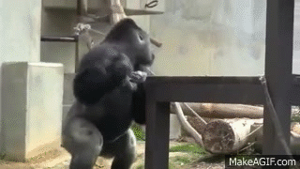
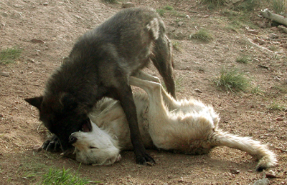
Ritualistic aggression - Lorenz
Lorenz observed that little physical harm came to animals during encounters.
Often animals display non-physical aggressive actions such as baring teeth or showing claws. This behaviours is ritualistic and follows a set pattern. The aim of each animal is to display strength and intimidate (ritualistic displays).
If one animal feels the other is stronger it will show signs of submission such as rolling over and showing a vulnerable spot such as the belly or throat (appeasement displays).
This behaviour is adaptive because if every encounter ended in death a species would quickly be wiped out.

Slide 9
Quick check
What is meant by ethology?
How did Lorenz view aggression?
Why is aggression adaptive? Give two reasons.
Describe the purpose of ritualistic displays.
Describe the purpose of appeasement displays.

Slide 10
Starter
What is meant by ethology?
Scientific study of animals (including humans) in their natural habitat.
How did Lorenz view aggression?
A fighting instinct which is directed against members of the same species.
Why is aggression adaptive? Give two reasons.
Loser is forced to move to new territory – spreads species and reduces chance of starvation,
Victor has access to resources and mates.
Describe the purpose of ritualistic displays.
The aim of each animal is to display strength and intimidate – avoid actual aggression.
Describe the purpose of appeasement displays.
If one animal feels the other is stronger it will show signs of submission such as rolling over and showing a vulnerable spot – deters victor from killing them.

Slide 11
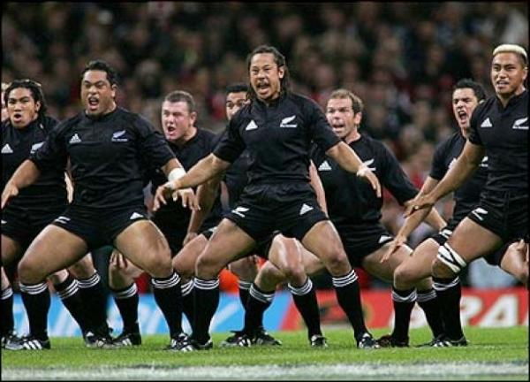
AO2/AO3 Human application: The Haka is a traditional Maori dance. What is the intention of the All Blacks in performing this before a rugby match? What is this an example of?
https://www.youtube.com/watch?v=yiKFYTFJ_kw

Slide 12
IRM’s and FAP’s
Members of the same species share innate releasing mechanisms (IRM’s) i.e. a built-in physiological processes.
Innate releasing mechanism is a biological structure/process in the brain which activates a fixed repesonse.
They are triggered by a sign stimulus.
Once triggered, the IRM then ‘releases’ a specific behaviour – known as a fixed action patterns (FAPs).
Therefore, animals are inherently inclined to perform certain behaviours in response to certain situations.
Notes:
PRINT

Slide 13
Fixed Action Patterns’s
Once triggered, the IRM then ‘releases’ a specific behaviour – known as a fixed action patterns (FAPs).
FAP have 6 main features (you do need to know these);
Stereotyped, unchangeable behaviours.
Universal (found in all species)
Unaffected by learning (same regardless of experience)
Ballistic - once triggered the behaviour cant be altered and is inevitable
Single –purpose, occurs in that one situation
A response to a sign/trigger.
Therefore, animals are inherently inclined to perform certain behaviours in response to certain situations.
Notes:
PRINT

Slide 14
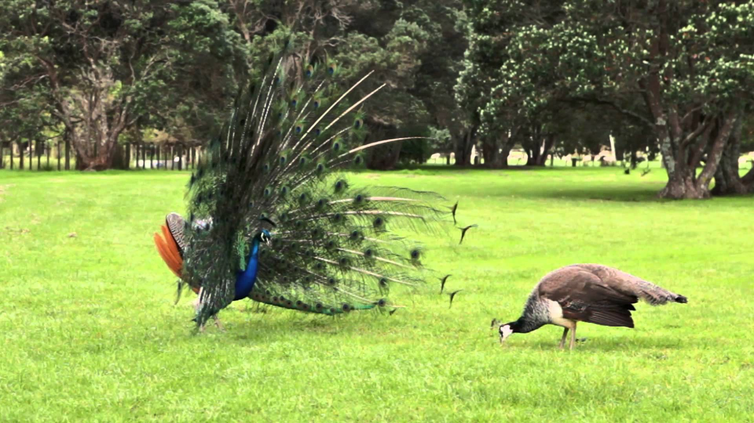
FAPs: A series or sequence of acts that occur behaviourally in animals
A mating dance may be used as an example. Many species of birds engage in a specific series of elaborate movements, usually by a brightly coloured male.
How well they perform the "dance" is then used by females of the species to judge their fitness as a potential mate.
The sign stimulus is typically the presence of the female.
Notes:
Examples
https://www.youtube.com/watch?v=7dx2CUMtZ-0

Slide 15
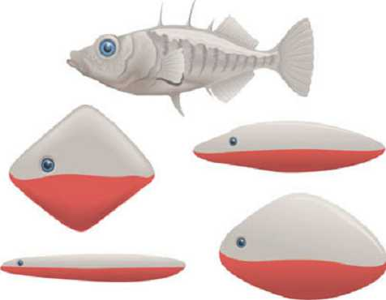
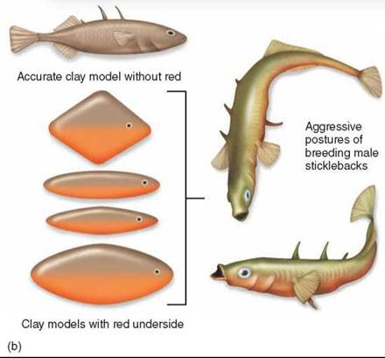
Aggression: red-bellied stickleback fish
Another example of fixed action patterns is the red-bellied stickleback. The male turns a bright red colour during the breeding season and are naturally aggressive towards other male red-bellied sticklebacks (FAPs)
However anything that is red, or has the appearance of being red, will bring about this FAP. Once the FAP has been initiated it will run until completion
The sign stimulus is not the presence of another male, but the sight of another red underbelly.
Notes:
https://www.youtube.com/watch?v=ZfcGZCGdGVE

Slide 16
Aggression: red-bellied stickleback fish

Slide 17
Why do they occur?
FAPS occur in response to a sign stimulus and are produced by a neural network known as the innate releasing mechanism
Sign stimulus
The essential feature of a stimulus, which is necessary to elicit a response (eg, provoke aggression)
Notes:
Sign stimulus
Sign stimulus IRM FAP

Slide 18
Sign stimulus triggers ...
IRM produces …
FAPs

Slide 19
During breeding season the bill of adult herring gulls turn a bright yellow with a red spot at the tip.
When a herring gull chick sees this colourful bill it pecks at it. In response to the pecking the adult regurgitates food for the chick.
Note down the five characteristics of FAPs according to Lea (1984)
What is the sign stimulus?
What is the FAP?
How can these ethological ideas be applied to human behaviour?

Slide 20
Quick check
Use the following to give an ethological explanation of aggression (6 marks).
Ritualistic
IRM
Innate
Adaptive
Sign stimulus
Red-bellied stickleback fish
FAPs
Extrapolate

Slide 21
Outline the Ethology approach to explaining aggression. (6 marks)
Ethology is the scientific study of animals which aims to identify innate aggressive behaviours and extrapolate these to understand humans. The aggressive behaviour is adaptive as the victor gains access to resources and mates. Furthermore, it disperses the species to reduce competition and ensure resources aren’t depleted. The ethology approach also suggest we have innate ritualistic displays of aggression, which rarely reach the point of being physical aggression; this prevent extinction of a species but still establishes dominance and hierarchies.
As aggression has evolved, we have developed innate mechanisms (IRM’s) and fixed action plans (FAP’s) which can trigger aggressive behaviours. IRM’s are built-in physiological processes which respond to the sign stimulus. These then trigger an FAP, which are specific behaviours. For example, the red-bellied male stickleback fish turn red during breeding season. The sign stimulus is another red-bellied male, which stimulates aggressive behaviour. An FAP is then triggered where the male will proceed to push and attack the other male out of its territory until it appeases.

Slide 22
Outline research into the ethological explanation of aggression (4 marks)
Tinbergen conducted….
Aim
IV DV
Findings
Conclusion

Slide 23
Homework – going further
Research the Gombe chimpanzee war.
Write down the five interesting facts to share with your classmates.

Slide 24
AO3 - Evaluating the Ethological Explanation
1. Face validity – evident in animals / Amygdala in humans and animals / MAOA gene in humans / innate ability to recognise anger (facial expression)
2. Research against ritualistic aggression
3. Method – cant generalise animals to humans
4. Fixed Action Patterns aren’t so fixed
5. Can’t explain cultural differences

Slide 25
https://www.youtube.com/watch?v=a7XuXi3mqYM
1. Killing of conspecifics is not rare
How can we use this behaviour to evaluate ethological explanations of aggression? Does it support or criticise which element of the ethological explanation.

Slide 26
1. Killing of conspecifics is not rare - evidence against ritualistic
According to the ethological approach it is rare for an animal to kill its own species because it has innate inhibitors to prevent it. Therefore it should only happen due to accident; however male lions and male chimpanzees kill more systematically (lions – cubs; chimps – members of another group).
For example Goodall (2010) observed chimpanzees in Tanzania and witnessed a “4 year war” where one group of chimpanzees systematically murdered chimpanzees from another group. The murders would often involve pinning a chimpanzee down and bit and hitting it even thought it was displaying submissive signals and appeasement. These observations contradict the idea that ritualistic behaviours prevent the death of conspecifics.
Thus casting doubt on the claim that aggression may be ritualistic rather than real and that ritualistic behaviours prevent the death of conspecifics.
Notes:
Brutal attacks of chimps – tearing arms off each other

Slide 27
2. Ethologist explanation has face validity
Supported by biological explanations of aggression
IRM in humans may be amygdala and activation of certain areas of the limbic systems triggers aggression.
Furthermore certain genes MAOA support the notion that we have innate basis for aggression.
These explanations support the idea that aggression is genetically determined and inherited, suggesting aggression maybe an innate adaptive response in humans.

Slide 28
3. Unjustified generalisation to humans – weakness of animal research
Humans are far more complex than animals.
Lorenz and Tinbergen studied lower animals such as fish and insects rather than mammals and made generalisations to human aggressive behaviours and warfare.
However warfare is not an impulsive and individual response rather a complex and collective decision. In addition, humans will commit extreme acts of aggression such as murder and war that were not observed in their animal studies.
Therefore Lorenz, and other ethological explanations that try to apply the innate response of animal aggression to whole populations, countries and cultures is too simplistic and reductionist and maybe only able to explain reactive aggression.
There are numerous other factors involved in aggression and by attempting to extrapolate these findings, the validity of the explanation is questioned.

Slide 29
FAP are not fixed
FAP and innate responses are not fixed or unchangeable but can be influenced by our environment and learning.
For example FAP are usually consist of a variety of aggressive behaviours which can vary from one animal to the next. This questions the extent to which the are universal and ballistic, in animals, let alone humans.
Therefore fixed action patterns are more flexible then previously described.
Consequently many ethologists prefer to use the term model action pattern.
** Furthermore, in humans, our environment changes so rapidly that FAPs are no long adaptive to modern times. The ability to adapt behaviour to different circumstances is far more beneficial (adaptive) than having a FAP. Therefore because human behaviour is less predictable, the benefits of FAP is no longer applicable and lacks temporal validity.

Slide 30
Cultural differences
Ethological approach struggles to explain variations of aggression geographically.
Nisbett found that there was a north-south divide in the number of homicide levels in America. Homicide was more common by white Americans living in the southern states.
This was because of a culture that had been learnt, a ‘honour culture’. This was supported in Nisbett’s lab experiment where after insulting different White northern or southern males, southern males responded more aggressively.
Suggests that aggression maybe learnt/socialised, rather than being innate – therefore SLT may be better at explaining geographical differences.

Slide 31
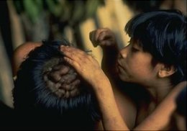
Optional extra – Benefits of ritualistic aggression behaviours
Anthropological evidence suggests that ritualised aggression can be seen in humans to prevent physical aggression
The Yanomamo of South America use chest pounding and club fighting to settle conflicts (Chagnon, 1992) – article
Hoebel (1967) found that Inuit eskimos use song duels to settle grudges and disputes
This suggests that even in aggressive cultures rituals may be used to prevent injury or death

Slide 32
Wider Research
https://www.psychologytoday.com/gb/blog/animal-emotions/201511/the-evolution-and-ethology-terrorism-we-are-unique

