Slide 1
2 Historical vs Personal significance

Slide 2
What does it mean to say that something is HISTORICALLY SIGNIFICANT?
What does it mean to say that something is PERSONALLY SIGNIFICANT?

Slide 3
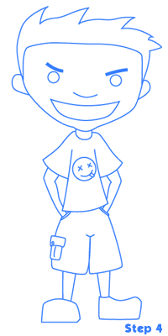
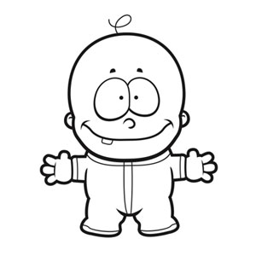
My Personal History Your job:
Double page spread.
Draw a timeline from the day of your birth up until today.
Fill in at least 10 important events on your timeline and illustrate it.
You have this lesson and next to get it done.
If you want to bring in copies of photos and pictures from newspapers/magazines to stick in, you can.

