Slide 1
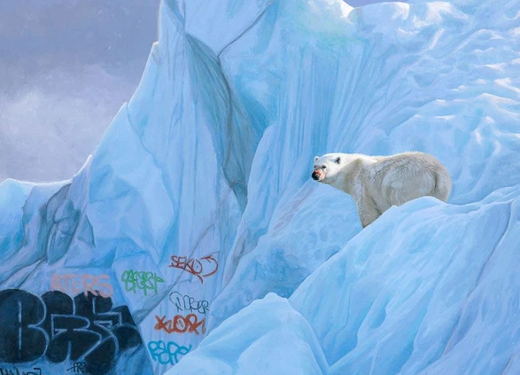
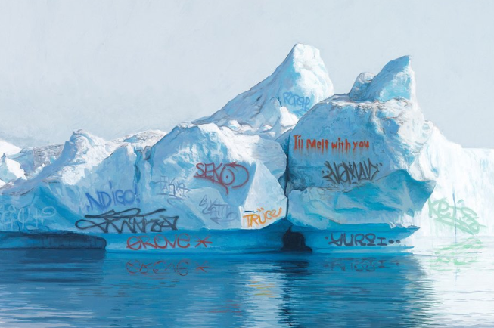
Task description Start by looking at the work of Josh Keyes.... https://www.joshkeyes.net/ (we will be creating responses to his work in the coming weeks). Pick a piece of his that depicts the addition of graffiti. Then complete full written analysis of the piece using the usual sheet attached. You can type this and stick it in or hand write it onto a new left hand side of a double page of your sketchbook.. Don't forget to include a title/heading and images of his work.

Slide 2
Writing about art work
Start by introducing who the artist is, what style (genre) of work they produce/d, their influences /motivations and the date the artwork was produced.
Content
What is the piece of work about? Is there a story/meaning? Try to think about bigger issues such as politics, culture, religion, event in history, art movements. What is the artist communicating to the viewer?
Was the subject observed, (did the artist sit and look at the object while drawing?) or from imagination?
Is the image realistic, distorted (changed), abstracted or simplified?
Is there a meaning behind the piece of work? What is the artist saying to the viewer /audience?
Form
What do you look at first and why? (This is the main focus point of the composition).
Describe the colours and tone used in the piece. Are there any strong areas of shadow or light?
What mood / feeling does this create?
Describe the composition. How does this exaggerate the feeling/ mood of the piece?
Process
What materials, tools and techniques has the artist used? What texture, mood does this create?
Mood
What is the mood of the piece of work? (Use appropriate adjectives).
How does the artist show this? (look at use of colour, composition, content).
Does it look like any other artist work you have seen?
Personal Response
What does the work make you feel or think of and why?
How does this relate to your own work?
Consider; colours used, theme, items/objects, mood/feeling.
How could you create an artistic response to this work?
How can you develop this further?
USE YOUR EXISTING GLOSSARY SHEET AND OTHER SHEET ON HOW TO ANNOTATE YOUR OWN ARTWORK.

