Slide 1
Skills

Slide 2
Skills
AO1
Own knowledge
Germany
Stuarts
AO2
Source Skills
Germany
AO3
Historical Interpretations
Stuarts

Slide 3
AQA: Essay Technique for AO1 & AO3
Essay Questions (AO1)
Interpretations (AO3)

Slide 4
AQA: Essay Technique for AO1 & AO3
AO1: Question Analysis
AO3: Text Analysis
AO3: Planning (Synthesis)
AO3: Writing

Slide 5
AO1
AQA: Essay Technique for AO1
i. Question Analysis
(a) Focus
(b) Adjectival Qualifiers

Slide 6
AO1
Conceptual Focus
Questions which require a primary focus on
Give Reasons
Two essential question concepts
EXPLANATION
Questions which require a primary focus on
Weigh up
EVALUATION

Slide 7
AO1
AQA: Essay Technique for AO1
Cause
Reasons
Explain
Questions which require a primary focus on
Two essential types of question
EXPLANATION
Success v Failure
Change v Continuity
Similarity v Difference
Questions which require a primary focus on
EVALUATION

Slide 8
AO1
AQA: Essay Technique for AO1
Question analysis:
‘There were continual tensions between King and Parliament about fundamental issues between 1603-1640’.
Assess the validity of this view.
Topic focus
Conceptual focus
Chronological focus
Adjectival Qualifiers

Slide 9
AO1
AQA: Essay Technique for AO1
Question analysis:
‘Disagreements over finance were the main reason for tensions between the Monarch and Parliament in the years 1603-1629’.
Assess the validity of this view.
Topic focus
Conceptual focus
Chronological focus
Adjectival Qualifiers

Slide 10
AO1
AQA: Essay Technique for AO1
Question analysis:
‘The power of Parliament grew consistently in the period 1603-1640’
Assess the validity of this view.
Topic focus
Conceptual focus
Chronological focus
Adjectival Qualifiers

Slide 11
AO1
AQA: Essay Technique for AO1
Question analysis:
To what extent did the character of Charles I cause irresolvable problems between the Crown and Parliament in the period 1625-1640?
Topic focus
Conceptual focus
Chronological focus
Adjectival Qualifiers

Slide 12
AQA: Essay Technique for AO1 & AO3
AO1: Question Analysis
AO3: Text Analysis
AO3: Planning (Synthesis)
AO3: Writing

Slide 13
AO3

Slide 14
AO3
AQA: Essay Technique for AO3
ii. Text Analysis

Slide 15
AO3
AQA: Essay Technique for AO3
Read the question – what is the issue you should focus on?

Slide 16
AO3
AQA: Essay Technique for AO3
Read Extract A, what is it’s main argument?
Summarise the main argument in one or two sentences, in total less than 25 words.

Slide 17
AO3
AQA: Essay Technique for AO3
i. Comprehension
Read Extract B, what is it’s main argument?
Summarise the main argument in one or two sentences, in total less than 25 words.

Slide 18
AO3
AQA: Essay Technique for AO3
i. Comprehension
Highlight the adjectival qualifiers in Extract A.
Highlight the adjectival qualifiers in Extract B.

Slide 19
AO3
AQA: Essay Technique for AO3
ii. Comparison
Having read Extracts A and B, what is the main difference between the two arguments?
Summarise the main difference in one sentences, in total less than 25 words.

Slide 20
AO3
AQA: Essay Technique for AO3
ii. Comparison
Having read Extracts A and B, what is the main difference between the two arguments?
Summarise the main difference in one sentences, in total less than 25 words.

Slide 21
AO3
AQA: Essay Technique for AO3
ii. Comparison
Having read Extracts A and B, what are the similarities between the two arguments?
List the similarities in the form of bullet points.

Slide 22
AO3
AQA: Essay Technique for AO3
iii. Analysis
Read Extract A:
Highlight the main argument in one colour, the details in another, and the counter argument in a third colour.

Slide 24
AO3
AQA: Essay Technique for AO3
iii. Analysis
Read Extract B:
Highlight the main argument in one colour, the details in another, and the counter argument in a third colour.

Slide 25
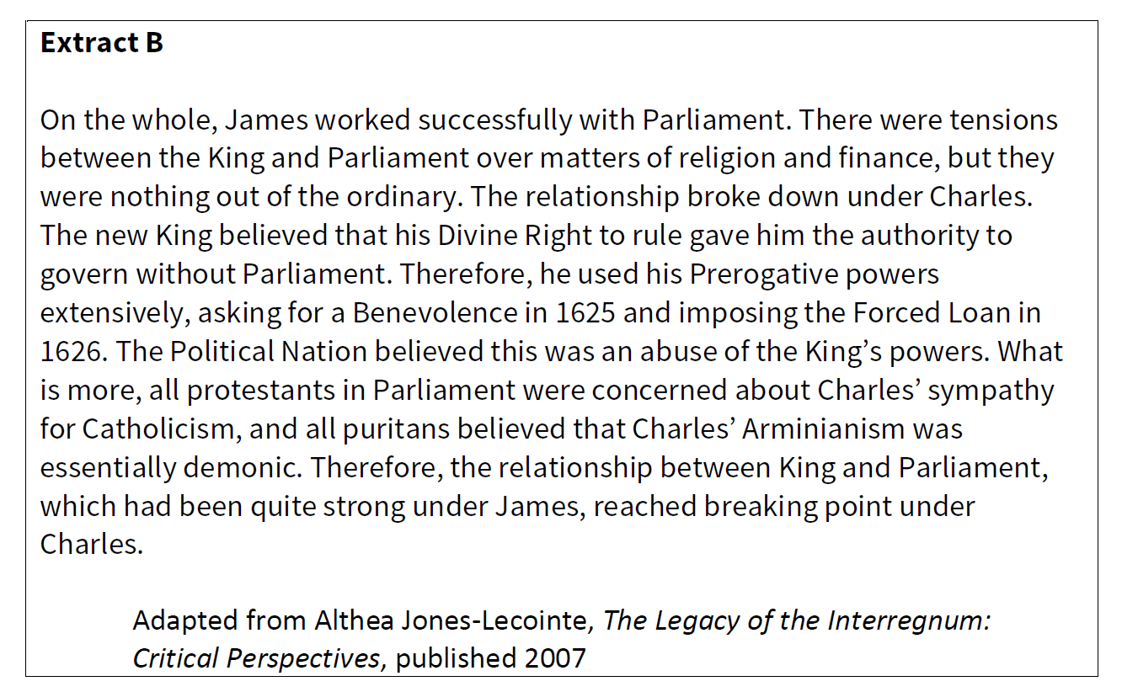

Slide 26
AQA: Essay Technique for AO1 & AO3
AO1: Question Analysis
AO3: Text Analysis
AO3: Planning
AO3: Writing

Slide 27
AO3
AQA: Essay Technique for AO3
iii. Planning

Slide 28
AO3
AQA: Essay Technique for AO3
iv. Synthesis
Make a table and add own knowledge to support and challenge the argument of Extract A
Support Challenge

Slide 29
AO3
AQA: Essay Technique for AO3
Factor/Aspect
Factor/Aspect
How convincing the arguments in these Extracts are in relation to the extent to Stuart Kings were able to work with Parliament in the period 1603-1629?
‘The relationship between King and Parliament transformed in the years after 1625-1645’
Assess the validity of this view.
Factor/Aspect
Factor/Aspect

Slide 30
AQA: Essay Technique for AO1 & AO3
AO1: Question Analysis
AO3: Text Analysis
AO3: Planning
AO3: Writing

Slide 31
AO3
AQA: Essay Technique for AO3
iv. Writing
(a) Introduction

Slide 32
AO3
AQA: Essay Technique for AO3
iv. Writing
(b) Judgement

Slide 33
AO3
AQA: Essay Technique for AO3
v. Evaluation
Which extract do you find more convincing as an interpretation the extent to Stuart Kings were able to work with Parliament in the period 1603-1629?
Begin with a clear answer
Back this up with evidence from both sides
End with a supported judgement
Make sure to quote the Extracts

Slide 34
End

