Slide 1
The Treaty of Trianon
And its consequences

Slide 2
Quick History of Hungary
896 - Magyars migrate onto the Danube Basin
1000 - King Stephen I crowned as first King of Hungary
1222 - Golden Bull established the right of the nobility to resist monarch
1301 - House of Árpád, which had ruled since 896, was eliminated
1458 - Matthias Corvinus becomes king until 1490
1526 - Battle of Mohács won by Suleiman II
1570 - Treaty of Speyer
1635 - First university in Hungary - Jesuit Trnava University, Trnava, Slovakia
1699 - Ottomans expelled by Leopold I (HRE)

Slide 3
The Beginning of Autonomy
1703-11 - Ferenc Rákóczi II, Prince of Transylvania attempts an uprising against Habsburg rule
1711 - Treaty of Szatmár restored the old Hungarian constitution
1848 - Hungarian War of Independence
1849 - Austrian and Russian forces destroy Hungarian forces
1867 - Compromise of 1867 established dual monarchy
1914 - Archduke Franz Ferdinand shot, starting World War One
1918 - World War One ends and Austria-Hungary collapses
1920 - Treaty of Trianon

Slide 4
What is the Treaty of Trianon?
On the 4th June 1920, the lands of the Kingdom of Hungary was separated into 7 nations. Hungary’s territory had stayed the same for more than 200 years. It all changed after Trianon.
Hungary lost 63.5% of its population, 71.4% of its territory and 3,300,000 (⅓) Hungarians were separated from Hungary, despite Woodrow Wilson’s policy of self-determination.
Hungary lost access to the sea, its railway system was mutilated and one people were divided, sparking anger and loss for years.

Slide 5
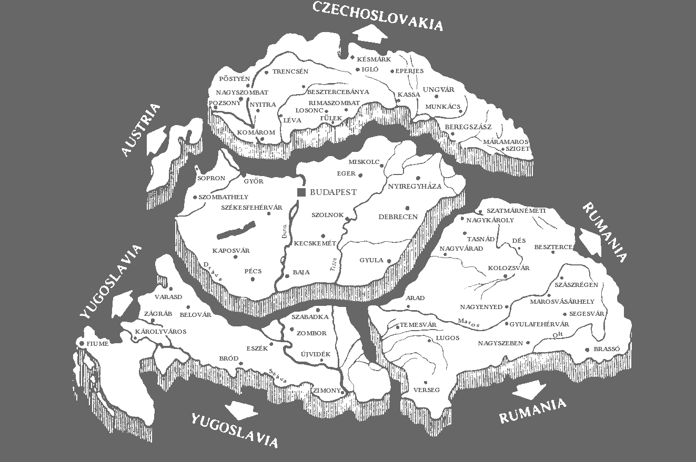

Slide 6
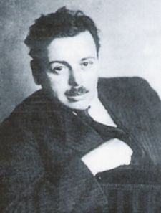
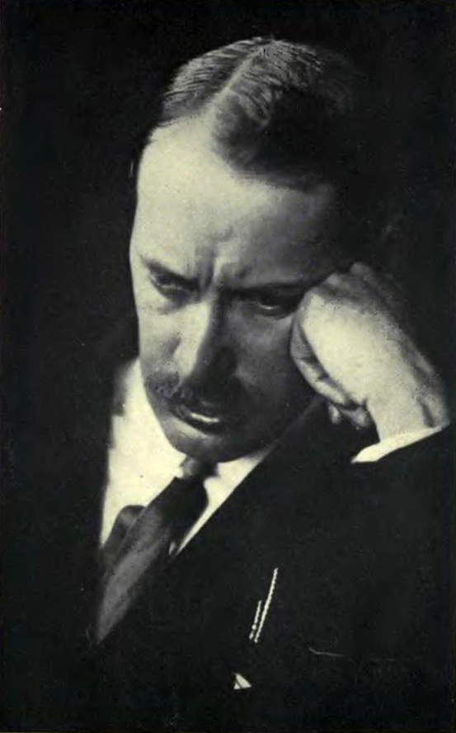
Why Hungary?
France sought security against the USSR, so gave Romania, Czechoslovakia and Yugoslavia whatever they wanted.
Large segments of annexed Hungary held vital west-east railways. In Western Europe, only Germany had a more extended railway network.
When Károlyi saw that the Entente gave all of Transylvania to Romania, he gave up and Béla Kun’s communist government took control and invaded Slovakia.
Hungarian prime minister Count István Tisza did not support the war and Mihály Károlyi, an opposition leader was in contact with the Entente.
⅓ of Hungarians were unjustly separated from their homeland.
Hungary’s neighbours occupied further than Trianon’s borders. Hungary was paralysed being limited to 35,000 soldiers, so could only watch Romania march into Budapest.

Slide 7
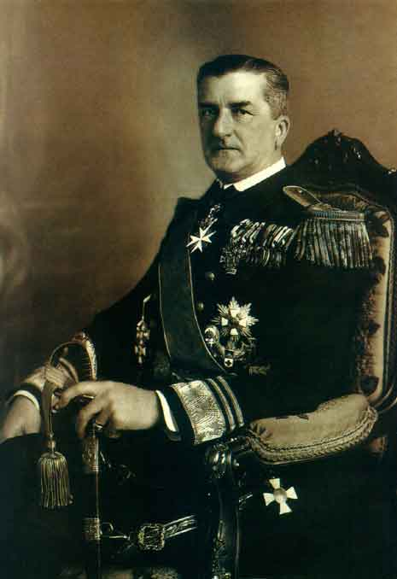
Admiral Miklós Horthy
In the 1920 elections, the Christian National Union Party (Keresztény Nemzeti Egyesülés Pártja) and the National Smallholders’ and Farmers’ Party (Országos Kisgazda- és Földműves Párt) won 94% of mandates for the new Kingdom of Hungary.
Both parties supported the restoration of a king and compromised on Horthy. Horthy banned communist parties and the Arrow Cross Party. During his nearly 25 year reign, Hungary became an authoritarian democracy. Horthy had the right to appoint a prime minister, reject legislation and dissolve the National Assembly indefinitely.
In October 1932, Gyula Gömbös was appointed prime minister. Gömbös wanted to achieve a “self-sustaining” authoritarian state, with revision of Trianon by “peaceful means”. Gömbös was openly anti-semitic and started to follow in Mussolini’s footsteps, aligning Hungary with the axis.

Slide 8
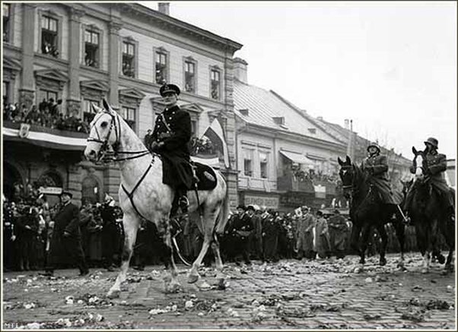
Alignment with Fascism
Gömbös wanted to gain an ally in Hitler, welcoming him as chancellor and he was the first leader to visit Hitler. Germany thus became Hungary’s largest export partner.
Hungary then went against Hitler, permitting 140,000 Polish soldiers and civilians to take refuge in Hungary. Hungary had not yet officially aligned with the axis despite territorial gains.
This changed in November 1940 when Hungary signed the Tripartite Pact officially ending its “neutrality”.

Slide 9
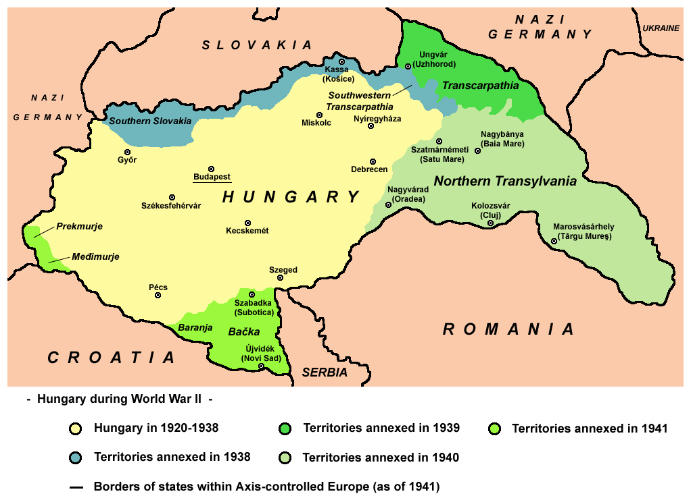
Regaining Lost Land
The First Vienna Award which returned 11,927 km² of Hungarian majority (86.5%) Slovakian borderland.
Hungary then invaded Carpathian Ruthenia (12,171 km²) which was majority Rusyn (61%) with Hungarian minority (12.7%).
Thousands of civilians killed and expelled during the Hungarian invasion of Yugoslavia.
After 9 months of military occupation, Hungary incorporated 11,475 km² of mixed South Slavic (40%) and Hungarian (37%) land
The Second Vienna Award returned 43,104 km² of ethnically mixed (Hungarian (53.6%) & Romanian (39.9%)) Romanian territory

Slide 10
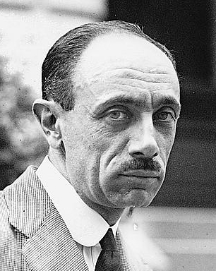
“We have violated our word—out of cowardice. . . . The nation feels that we have cast aside its honor. We have stood on the side of the villains. . . We shall be body snatchers! The most despicable of people. I did not hold you back. I am guilty.”
Prime Minister Pál Teleki

Slide 11
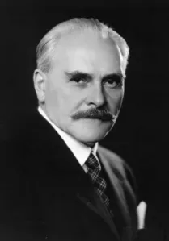
Brutality and Peace?
Hungary began to limit the amount Jews who could work in one industry. On 27-28 August 1941, 23,600 deported Hungarian Jews were executed under order of the German SS.
In January 1942, the Hungarian Army killed 3,800 Serbian and Jewish partisans.
In 1944, 825,007 Jews lived in Hungary. After the German invasion, Jews living outside of Budapest were forced into ghettos. Over 56 days, 437,402 Jews were sent to concentration camps, mostly to Auschwitz-Birkenau. 40% of Jews in Auschwitz were Hungarian. 564,507 Hungarian Jews died.
In the following years, anti-Nazi intellectuals and figures and attempted to create a “Third Road” between capitalism and communism.
Kállay contacted Allied powers attempting to negotiate a peace albeit they never agreed. Kállay refused to negotiate with the USSR.
Hitler noticed this and ordered an invasion of Hungary in March 1944. A pro-German prime minister was appointed and 3,000 opposition figures were arrested.

Slide 12
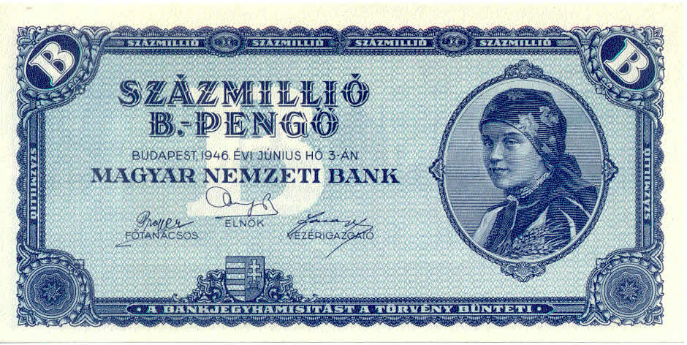
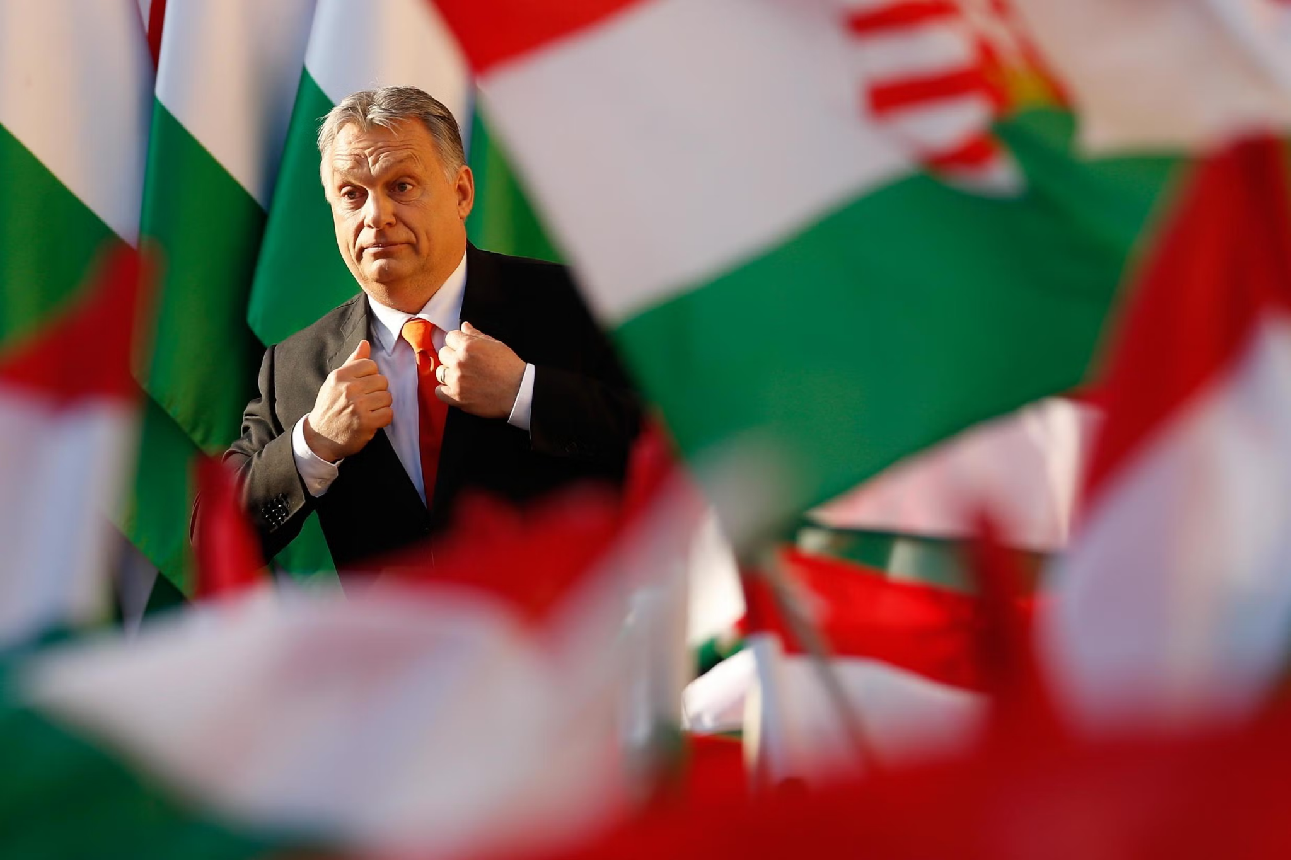
“Trianon Syndrome”
Hungary suffered major inflation after WW2. The largest banknote ever was the 100 quintillion pengő. The inflation rate reached 41.9 quadrillion percent in July 1946.
“Trianon Syndrome” was heavily suppressed during the communist takeover and rule of Hungary but began to reemerge after independence in 1990.
Arguments about Trianon split Hungary to this day. 67% of Hungarians believe that parts of neighbouring countries belong to Hungary and 25% do not.
Since 2010, 4th June is dedicated to the Day of National Unity which commemorates the signing of Trianon.
Orbán has poured vast amounts of money into Hungarian speaking areas and has extended voting rights to Hungarian speakers in surrounding nations

Slide 13
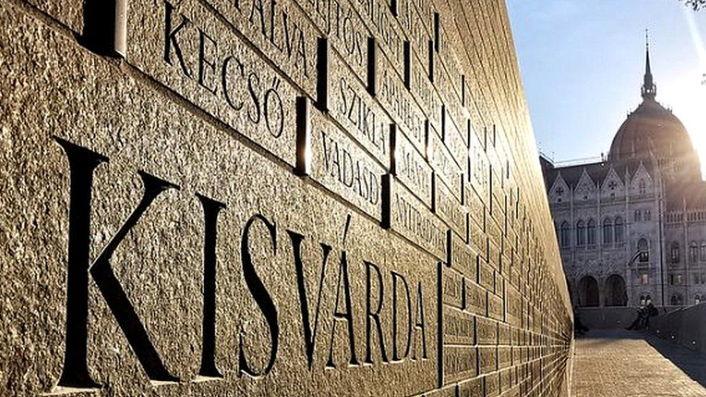
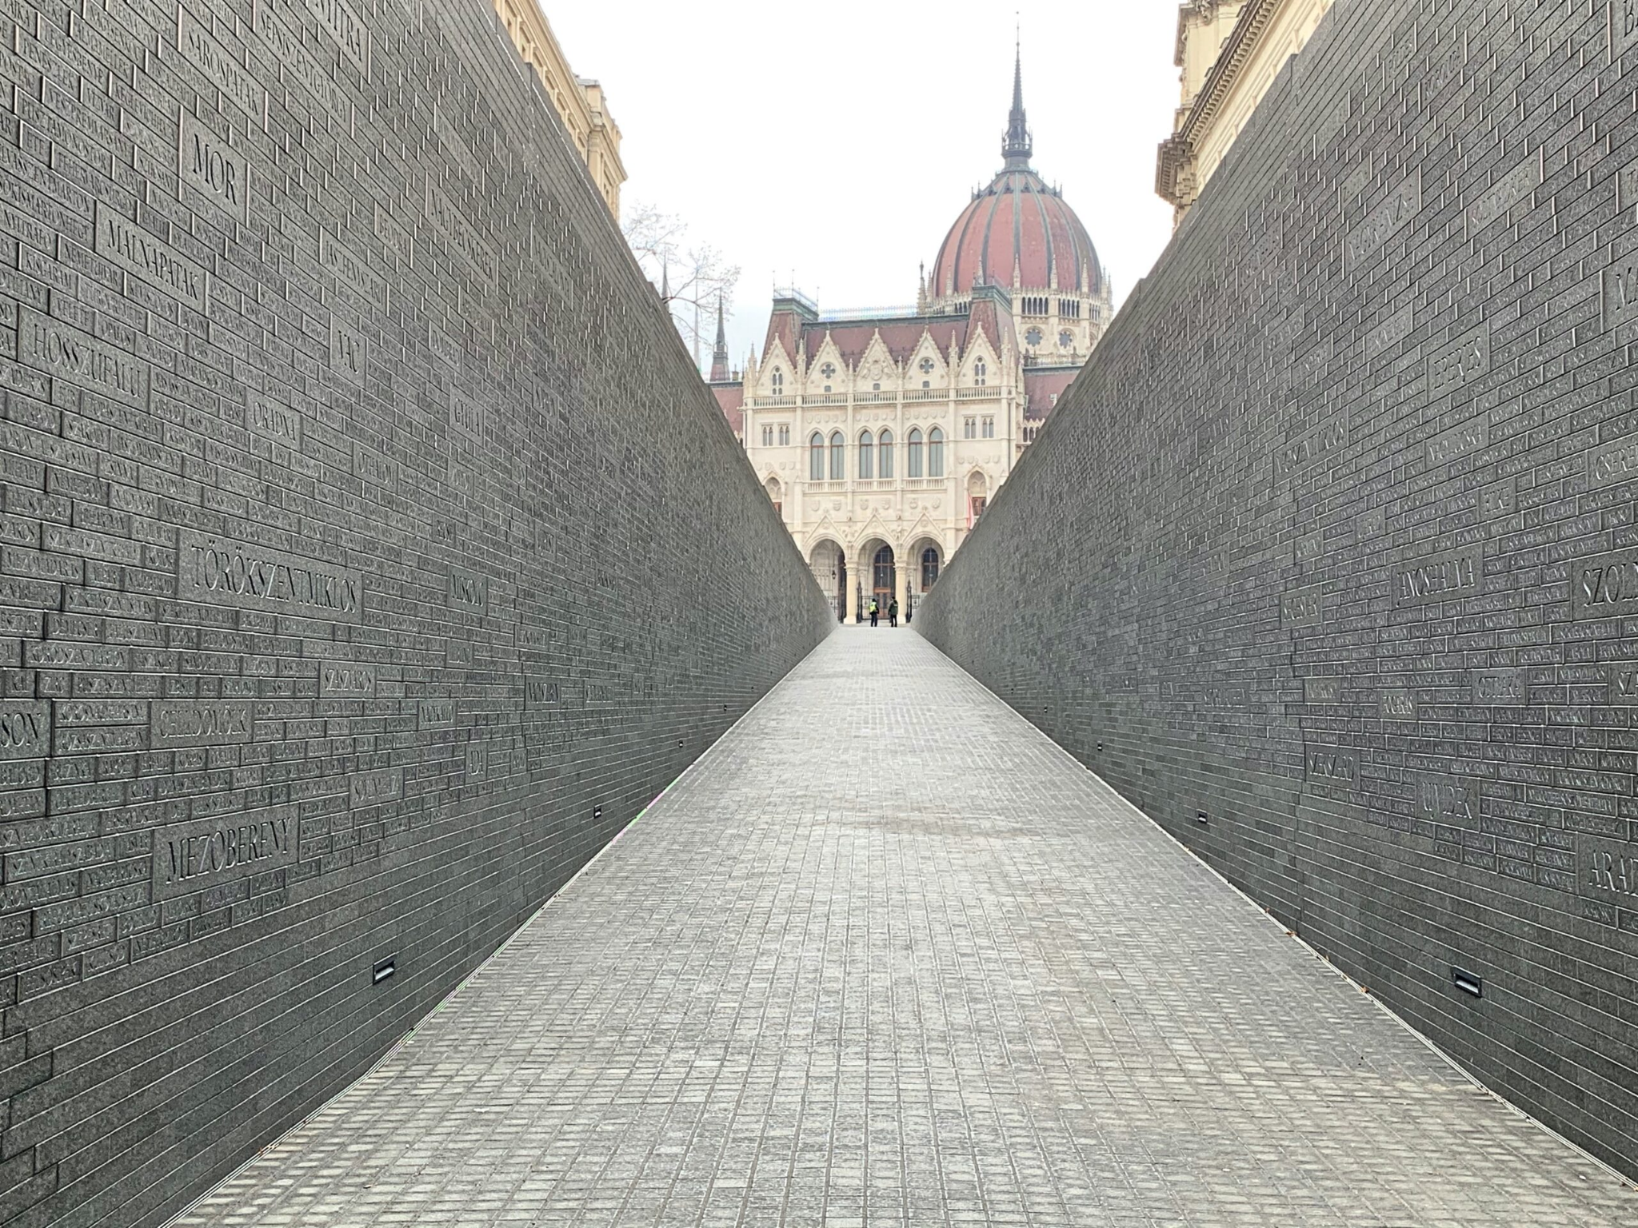
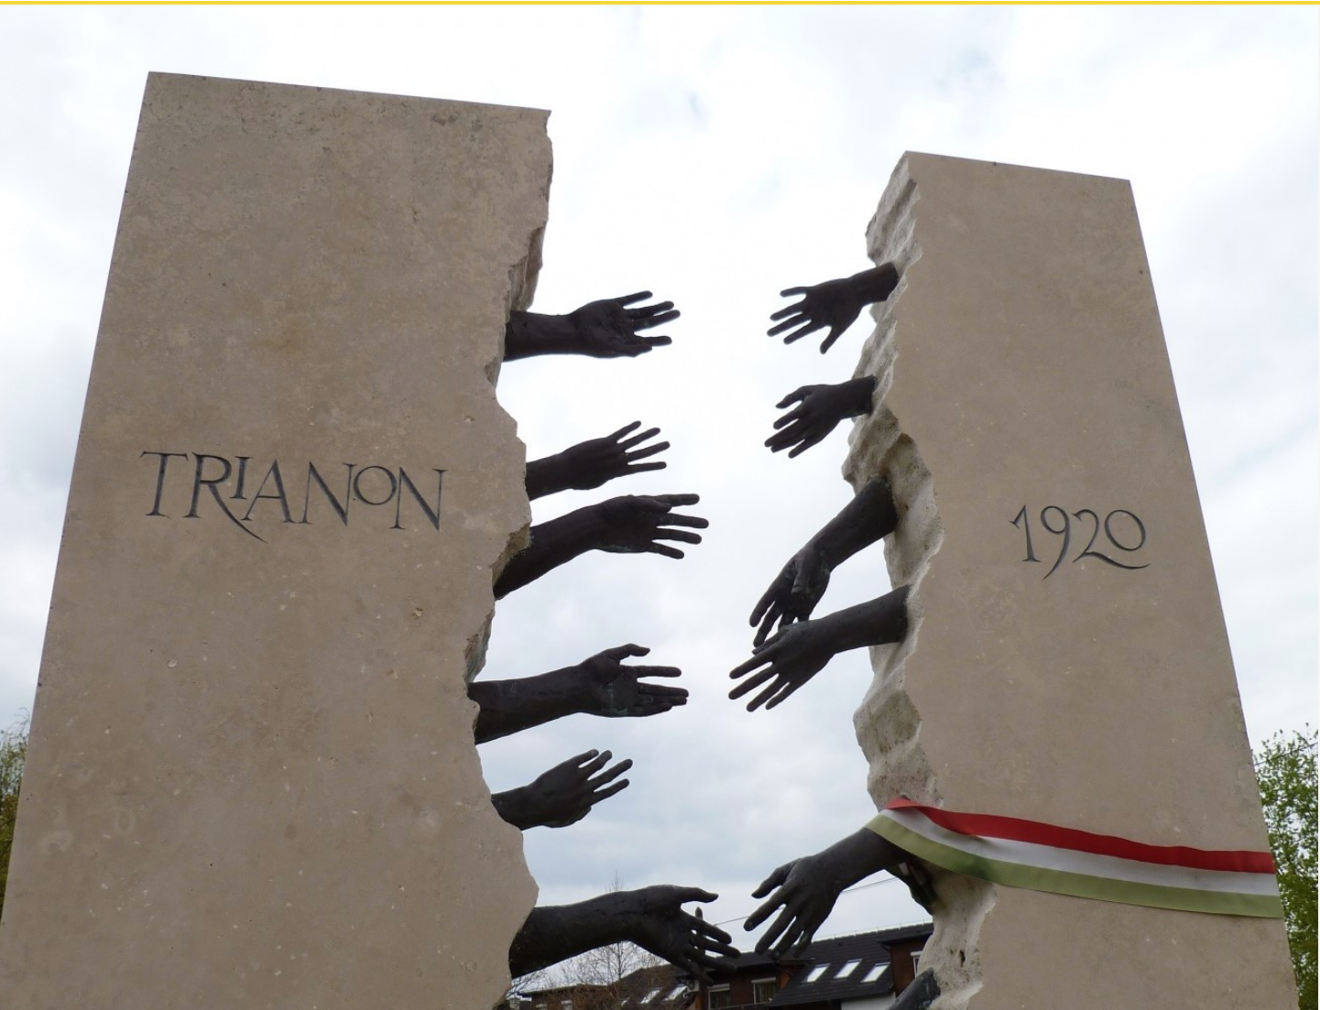
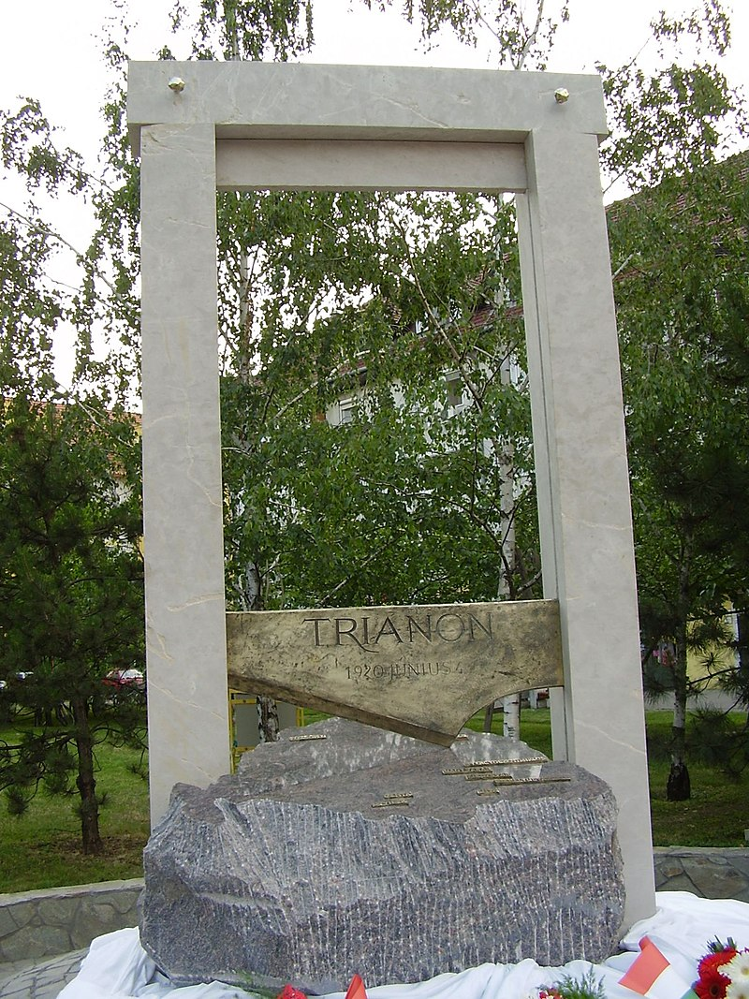
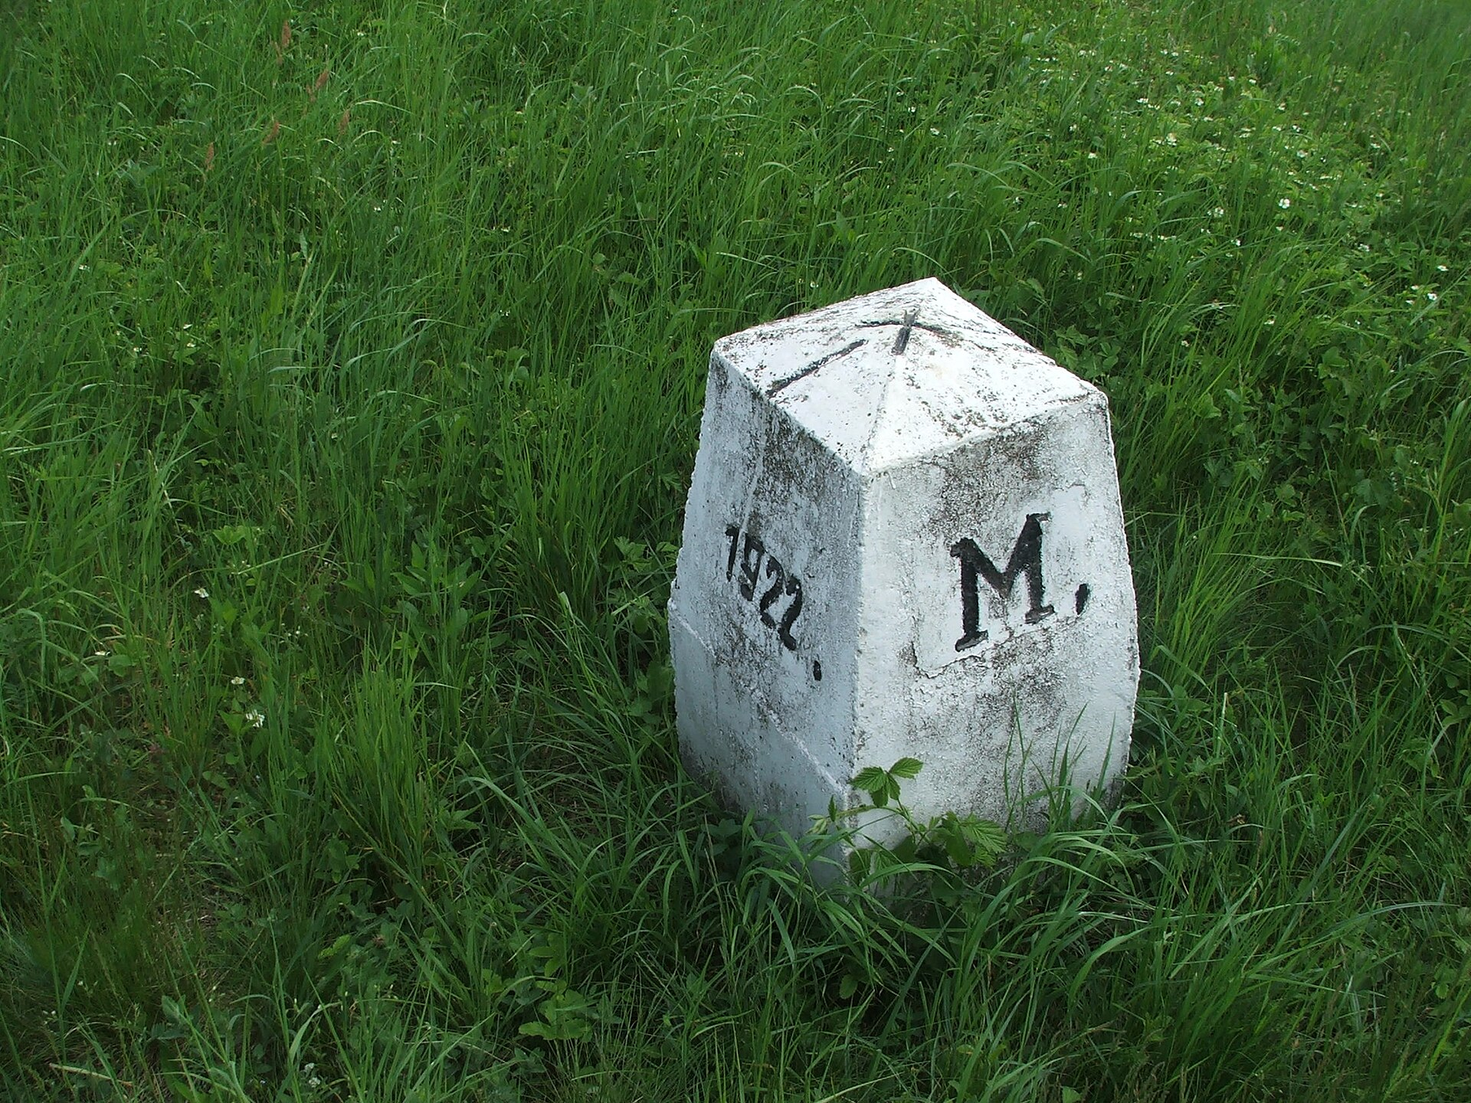
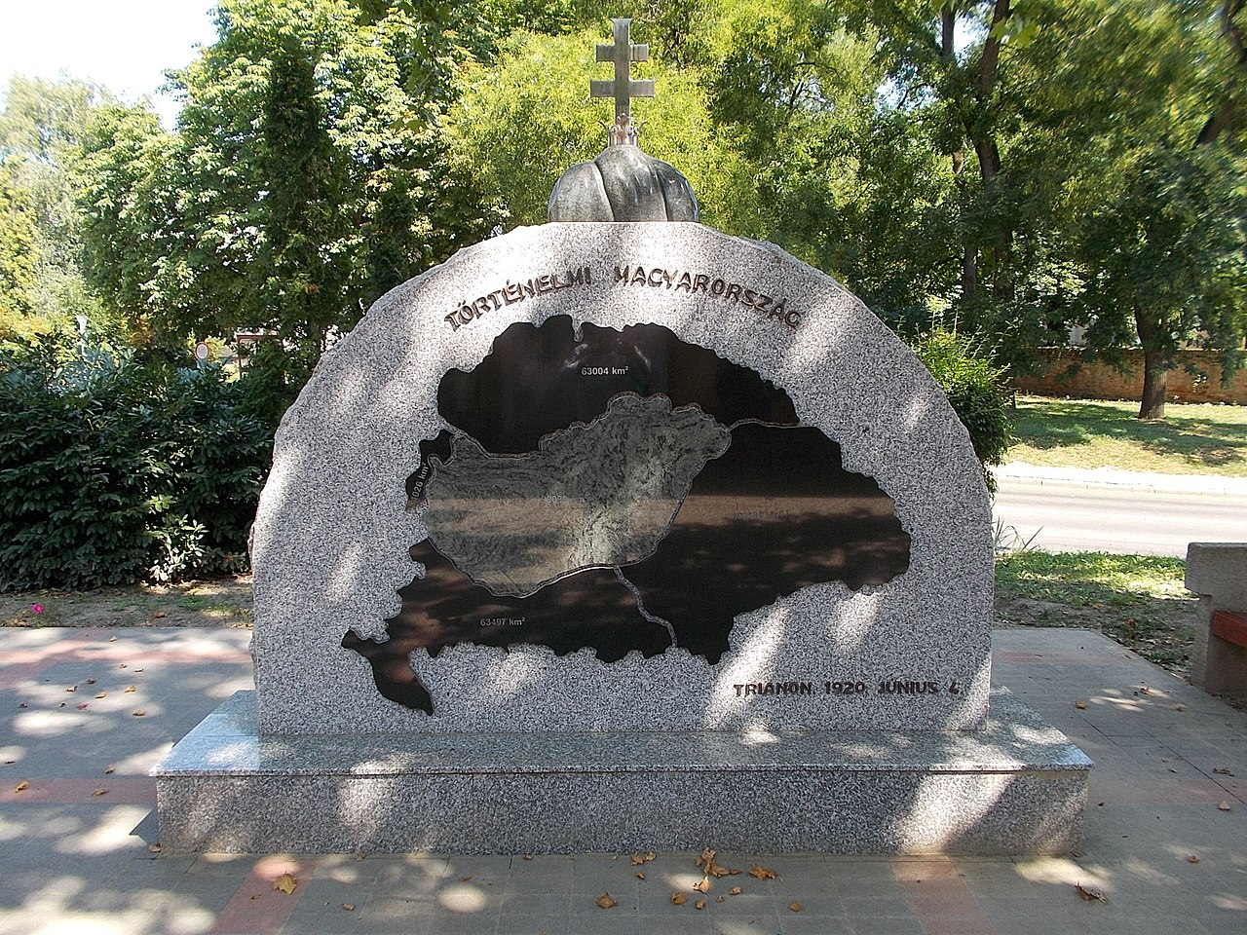

Slide 14
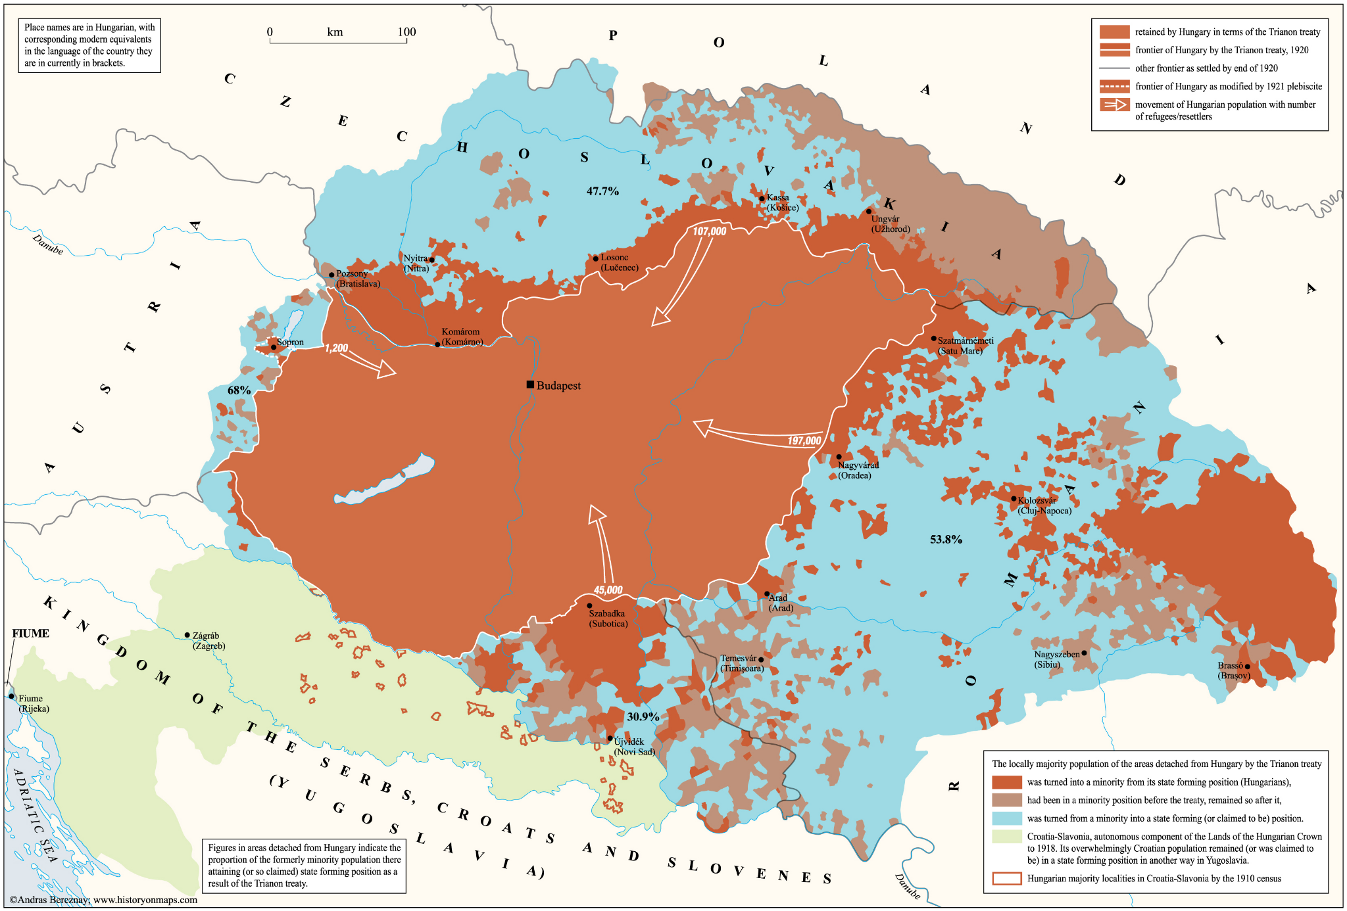

Slide 15
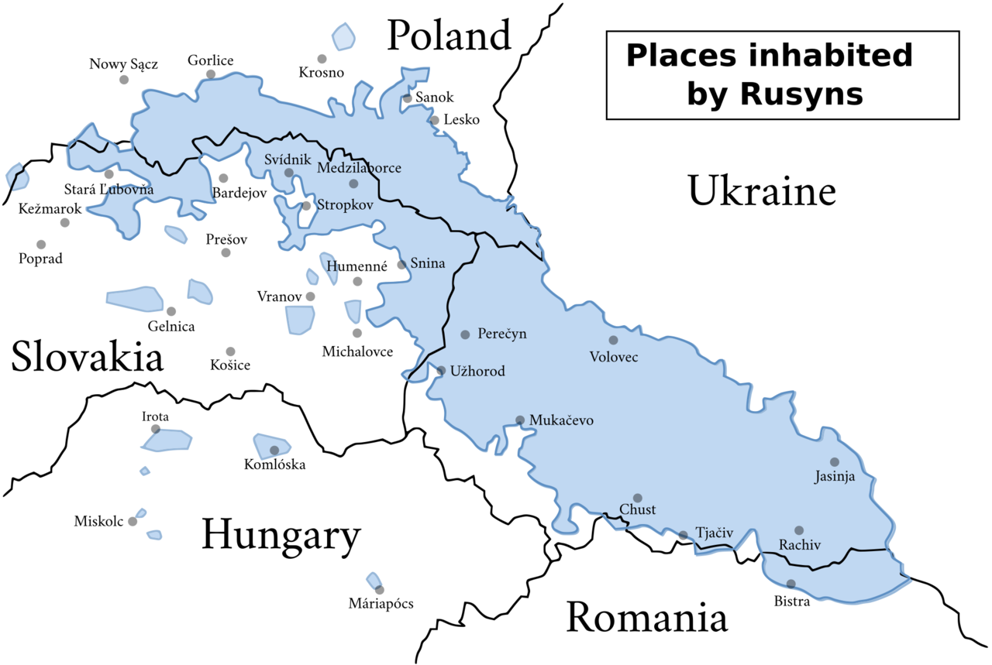
Carpathian Ruthenia
Carpathian Ruthenia is a region of Ukraine inhabited by the Rusyn people, a separate linguistic and ethnic group that was interdependent with Hungary for almost 1,000 years.
After WW2, the Rusyns were separated between Slovakia, Ukraine and Poland, being deported, abused and Russified. In 1947, 150,000 Rusyns and were forced from Poland into Ukraine with only half returning in the 1960s.
After the breakup of the USSR in 1990, 78% of Rusyns voted for autonomy but the Ukrainian government denied them and still to this day do not recognise the Rusyns as a separate ethnic group, saying the Rusyns are only acting in the “interests of the Russian Empire”.

Slide 16
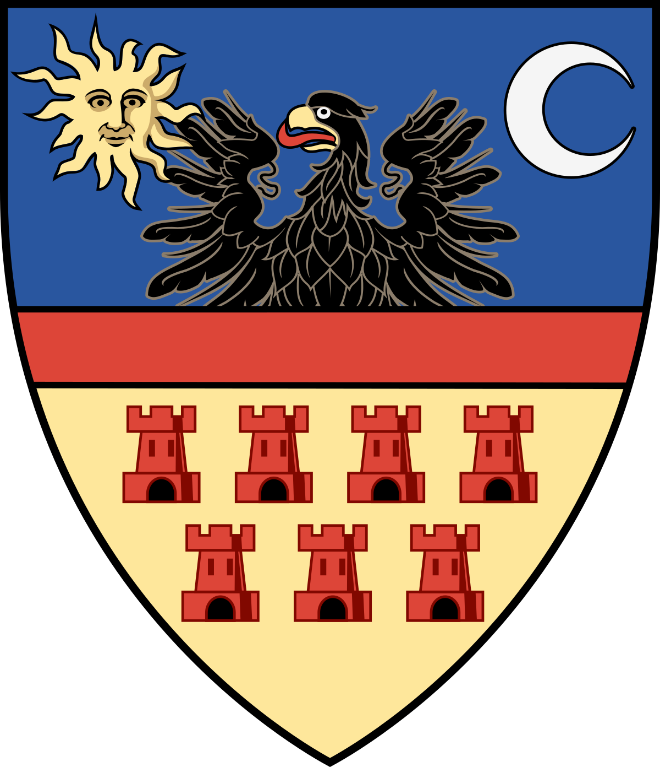
Romania
Romania celebrates Trianon as it “recognised” the unification of Transylvania and Romania who had been separate since Dacia. It also marks a freedom from the “prison of nations”.
The Romanian argument for Transylvania is “backed up” by Woodrow Wilson’s self-determination principle, despite Wilson, Lloyd George and Nitti protesting against Trianon.
“Romania sees the new political-territorial chessboard of Central Europe as part of a process carried out by the peoples and legitimized by the Great Powers, while Hungary sees only the legitimation and only the 1920 moment, completely neglecting the role of the peoples.”
- Ioan-Aurel Pop, President of the Romanian Academy

Slide 17
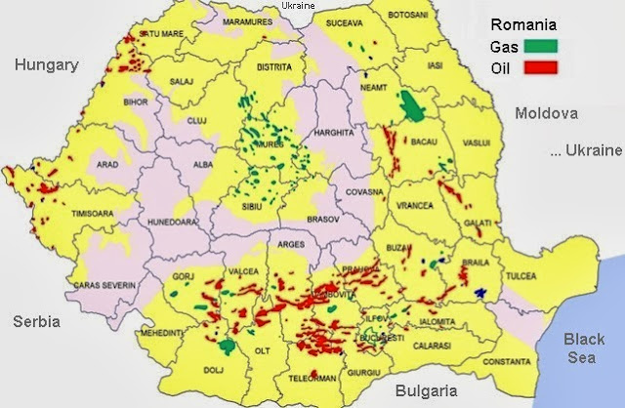
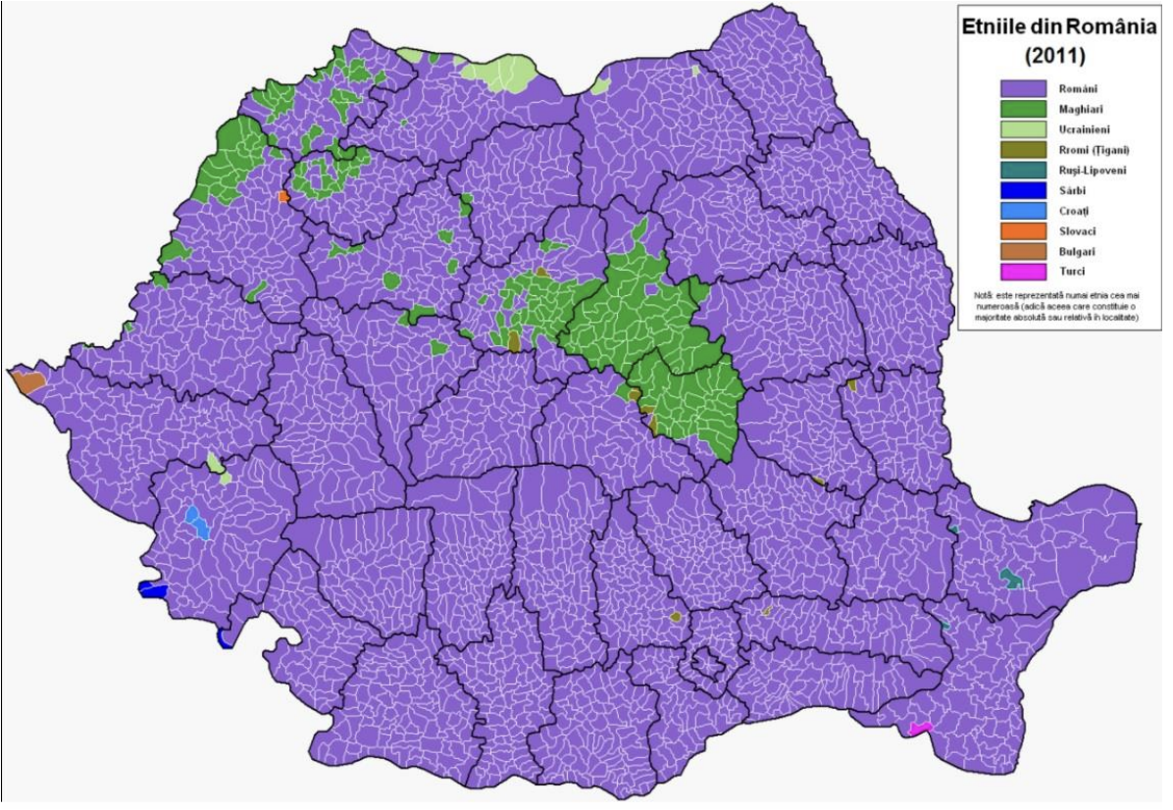
Székely Land
The Treaty of Trianon exacerbated tensions between Romania and Hungary due to the ethnic enclave of Székely Land.
The Second Vienna Award returned Székely Land to Hungary but after WW2 ended, Romania kept it. Székely Land received levels of autonomy between 1952 and 1968.
When Ceaușescu came to power, Székeys suffered due to Romanianisation. In 1990, Târgu Mureș the capital of Székely Land witnessed violent clashes between ethnic Hungarians and Romanians.

Slide 18
Displacement of Hungarians
Vojvodina - Serbia
In 1944, partisans massecred 40,000 Hungarian civilians. Since the end of WW2, the Hungarian population has steadily declined due to low birth rates and emigration.
By the Yugoslav Wars of the 1990s, Hungarians felt threatened by conflict with Croatia, leading to many leaving, causing areas to be resettled by Serbian refugees.
Hungarians have fallen from 16.9% (1991) to 14.28% (2002), and are hoping to create an autonomous area in Northern Vojvodina.
Satu Mare and Székely Land - Romania
When Nicolae Ceaușescu came to power in 1965, minority privileges were lost, mass resettlement of Romanians into Transylvania took place and Hungarian intellectuals were forced out of Transylvania.
The Hungarian population fell from 25.5% in 1920 to 19.6% in 2002. In Cluj Napoca, it has fallen from 81.6% in 1910 to 13.9% in 2021.
Hungarian cities fell due to migration from rural to urban areas with urbanisation

Slide 19
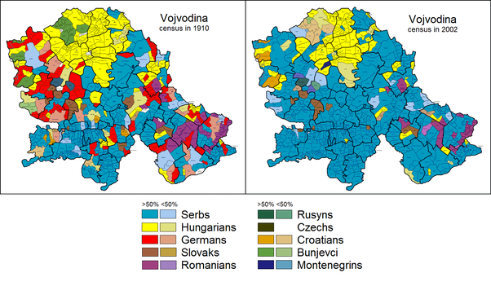
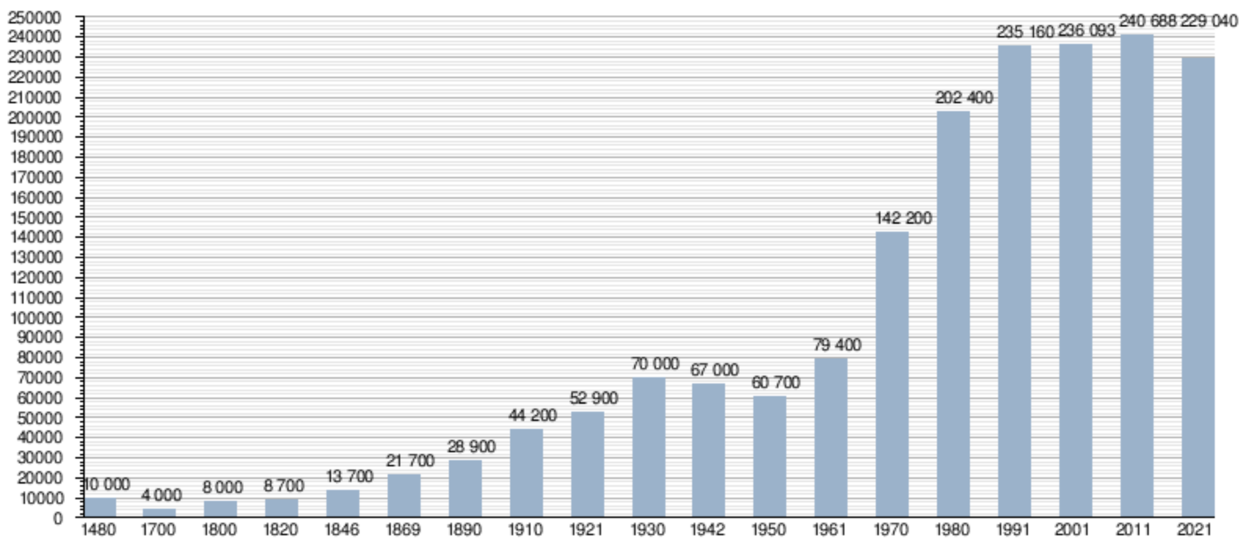
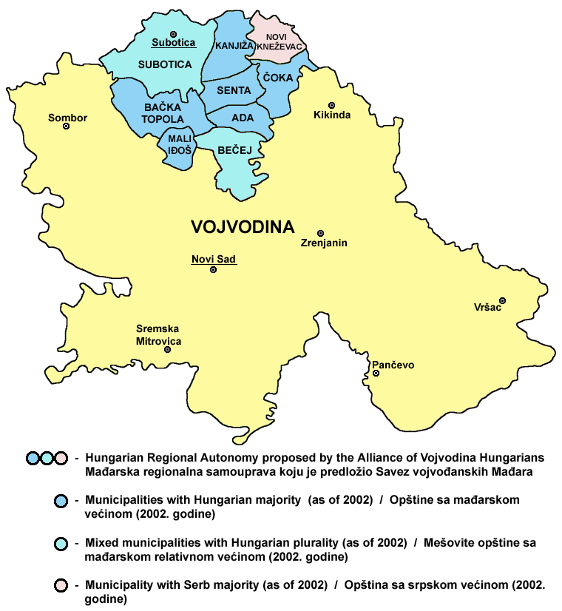
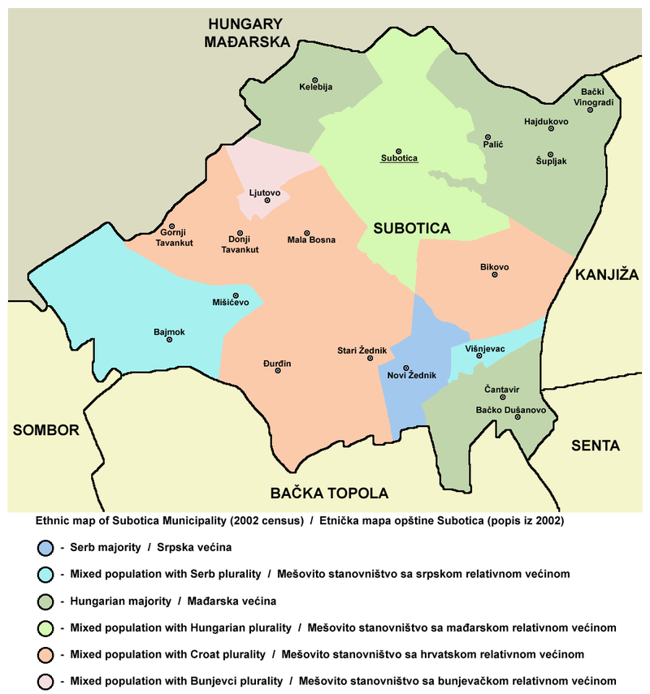
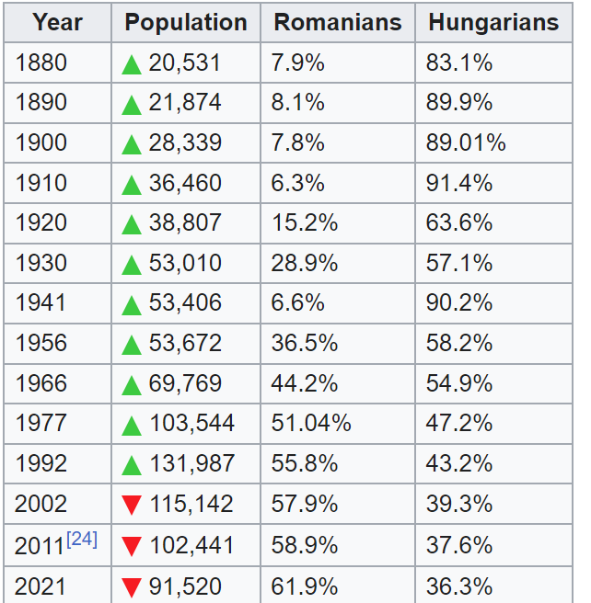
1910 - 75.4%
2011 - 2.65%
1910 - 58.75%
1931 - 41.38%
1953 - 50.6%
1971 - 48.49%
1991 - 39.6%
2011 - 32.66%

Slide 20
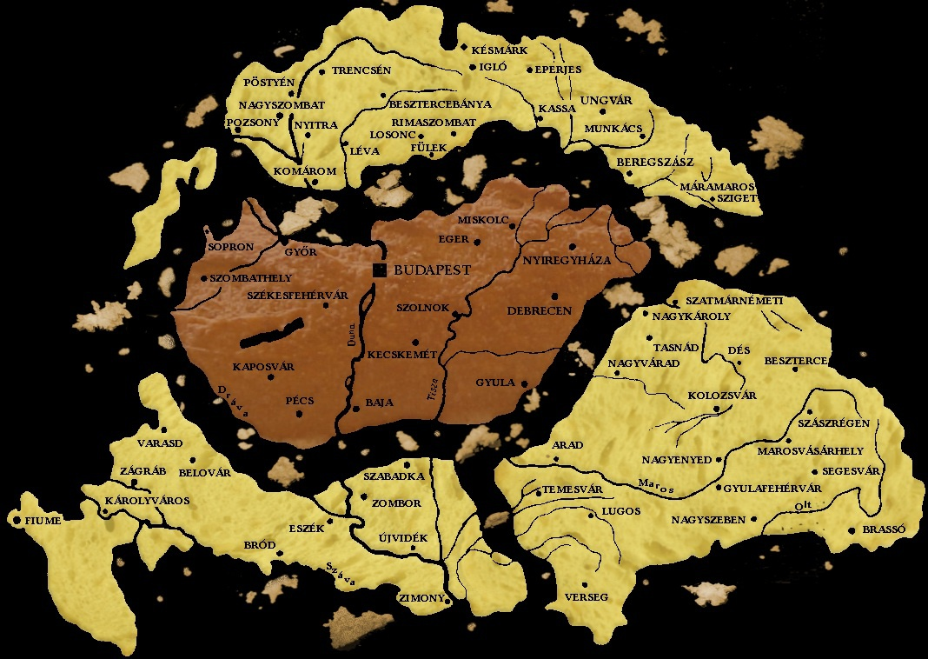
“The victors hated Hungary for her proud defence. The adherents of Socialism do not love her because she had to resist, under more than difficult conditions, internal and external Bolshevism. The international financiers hate her because of the violences committed against the Jews. So Hungary suffers all the injustices without defence, all the miseries without help, and all the intrigues without resistance.”
— Francesco Saverio Nitti, Prime Minister of Italy (1919-20) - Peaceless Europe

