Slide 1
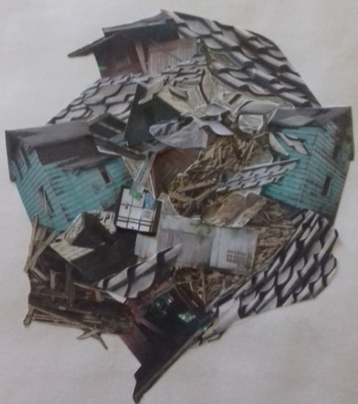
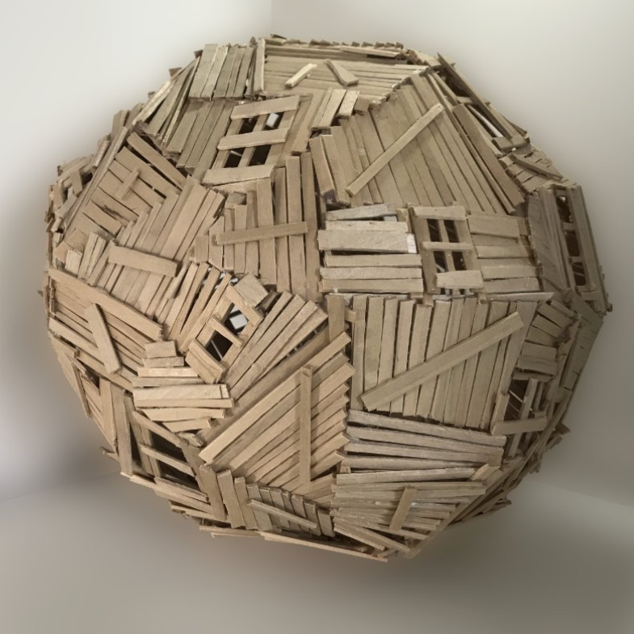
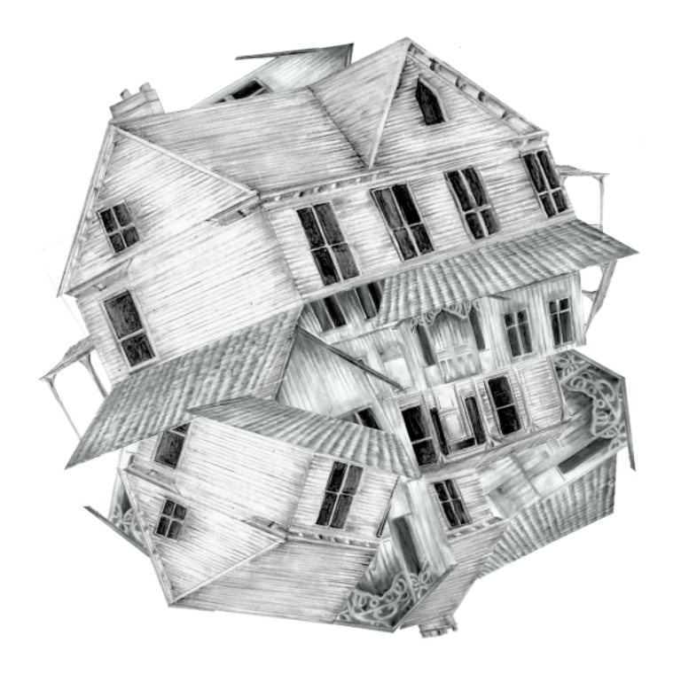
Seth Clark response
Task description
For your task today I would like you to start creating a response to the work of Seth Clark. This will take some careful planning on your part, his work is meticulous in style. I am giving a lot of lesson time to work on this, so take your time to make a great piece. If you need feedback part way through, just send me a progress shot, so that I can offer guidance. Below I have set out ways of approaching the task, however, you may have your own idea entirely, which is absolutely fine. His work is very intricate and obviously takes more than 5hrs, which is what I am giving you. So equally, be reasonable in your aims.
You could:
minimum expectation -create a flat 2D collage by hand out of broken up segments of buildings. To do this I would source and print lots of buildings off first, cut up lots of sections and then plan how you are going to stick them together (e.g. some of his are done in a circle, others still have a house like structure).
or
slightly more advanced- do the above but digitally, if you feel confident using the lasso tool and digital programs.
or
advanced - do your own drawings/paintings of fragments of buildings and collage them together.
or
very advanced -really go to town and create a sculpture?!
Make sure you make visual links with his style, for example his collages are often mounted onto plain white backgrounds. Size wise it depends on the size of the cut pieces, so I will leave that up to you.
Time frame: you are to spend a minimum of 5 hours on this, which is about 6 lessons.
Right hand side student examples (from top left anticlockwise): hand cut collage, 3D mode, digital collage and drawing.

