Slide 1
What happens when a King dies or
loses his throne?

Slide 2
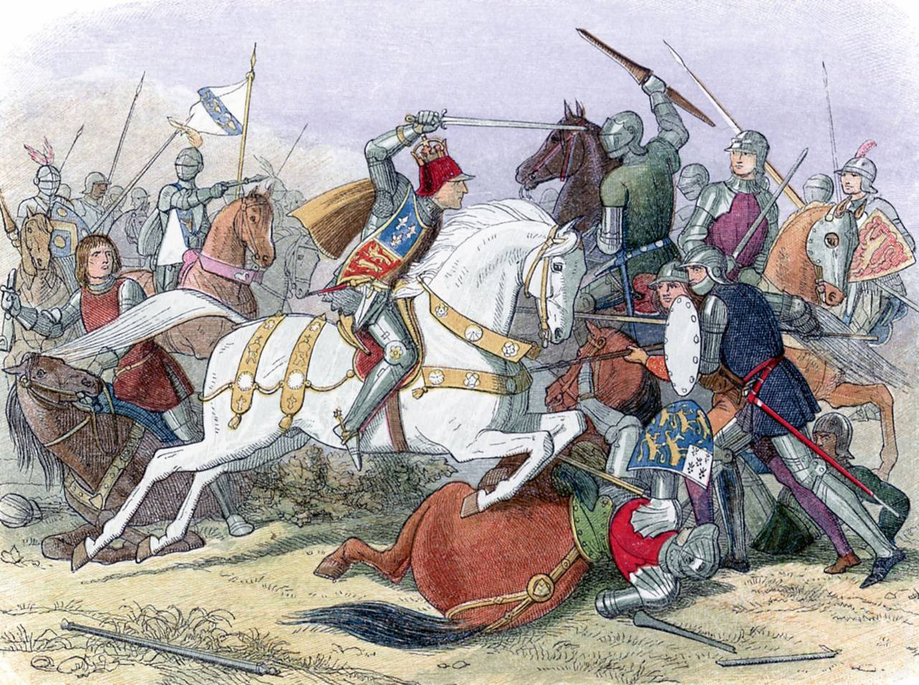
Enquiry Question: Why did Henry VII triumph at Bosworth?

Slide 3
Learning Objectives
To explain why Henry triumphed at the Battle of Bosworth
To evaluate the relative importance of factors that led to Henry’s victory

Slide 4
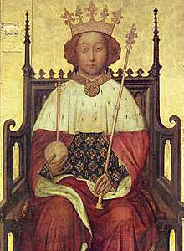
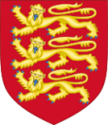
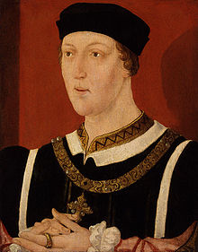
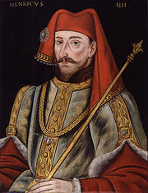
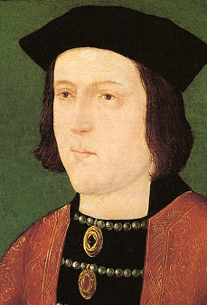
Richard II
(Boy King in Peasants Revolt)
Lost his throne to his Cousin Henry IV in September 1399
Henry VI
(Grandson of Henry IV)
Rumoured to be mad, his Kingdom was frequently ran by regents
(people put in charge in Kings absence)
Became King 1422
Henry IV
Henry “Bolingbroke” (he was born there)
First Lancaster King of England.
Edward IV
Became King in 1460. Led an uprising against the King and took the throne.
First York King of England
Did you know? Shakespeare’s play Richard II is about Richard losing the throne to Henry Bolingbroke.

Slide 5
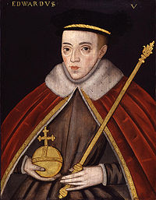
Henry VI
Edward IV
Henry VI took the throne back from Edward IV in 1470
Edward IV won the throne back in 1471
Edward IV dies in 1483 and is replaced by his son, Edward V.
Edward V
Edward is King at age 12, but was never crowned.....

Slide 6
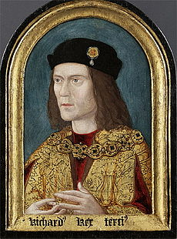
Edward V
Edward V on travelling to be crowned King is met by his regent and uncle Richard.
His fathers marriage is declared invalid and Edward V and his brother are declared illegitimate.....
What does this mean in terms of being King?
Richard III
Locked Edward V and his brother in the tower of London. The two princes disappeared.....
Richard becomes King Richard III in 1483.
Did you know? Shakespeare’s wrote a play about this as well !
Richard III was a hunchback or had a curved spine.
Richard III body was found in 2012, buried under a car park in Grey friars Leicester.

Slide 7
The White Rose of York
The Red Rose of Lancaster.
Both branches of the Plantagenet family but considered separate dynasties.
Dynasty = a bloodline or line of rulers.
Gold: With York and Lancaster fighting for the Throne of England what or who do you think could bring these families back together?
Silver: What exactly do you think happened to Prince Edward V and his brother in the Tower of London?
Bronze: Which family was the most powerful and why?

Slide 8
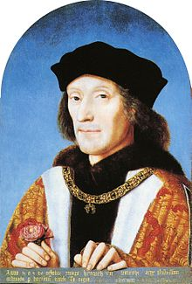
Henry VII
Last surviving Lancaster male.
Held a very slight claim to the throne based around his mother.
(She was a cousin of Henry VI)
Henry VIII got support from the York forces to raise and army and try to take the throne from Richard III.
How did Henry VII a Lancaster get support from York to remove a York King ??
Richard III was very unpopular. Henry VII had agreed to marry Elizabeth of York ( technically his cousin) if crowned King. Elizabeth of York was sister to Edward V ( the Prince in the Tower) making Elizabeth technically the rightful heir to the throne !

Slide 9
1485. Lancaster meets York at the Battle of Bosworth Field.
What do you think the outcome will be?
Notes:
Study the top trumps cards in pairs

Slide 10
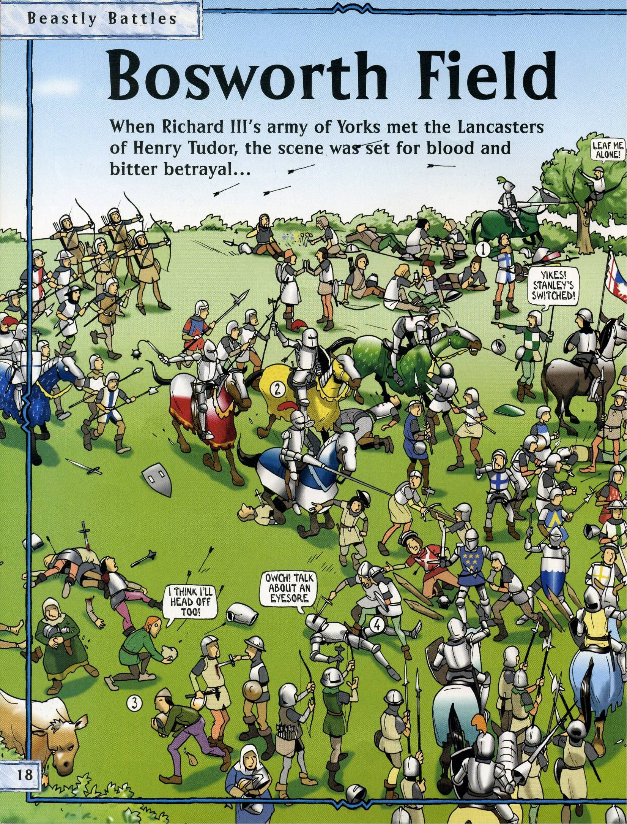

Slide 11
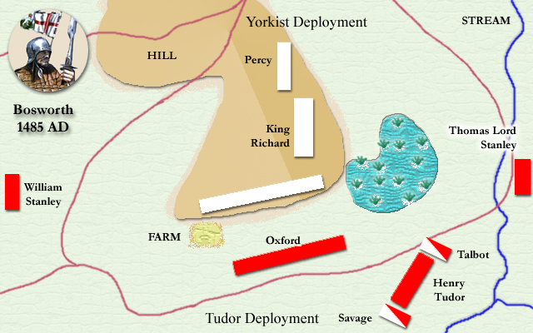
What do you already know about
the Battle of Bosworth?

Slide 12
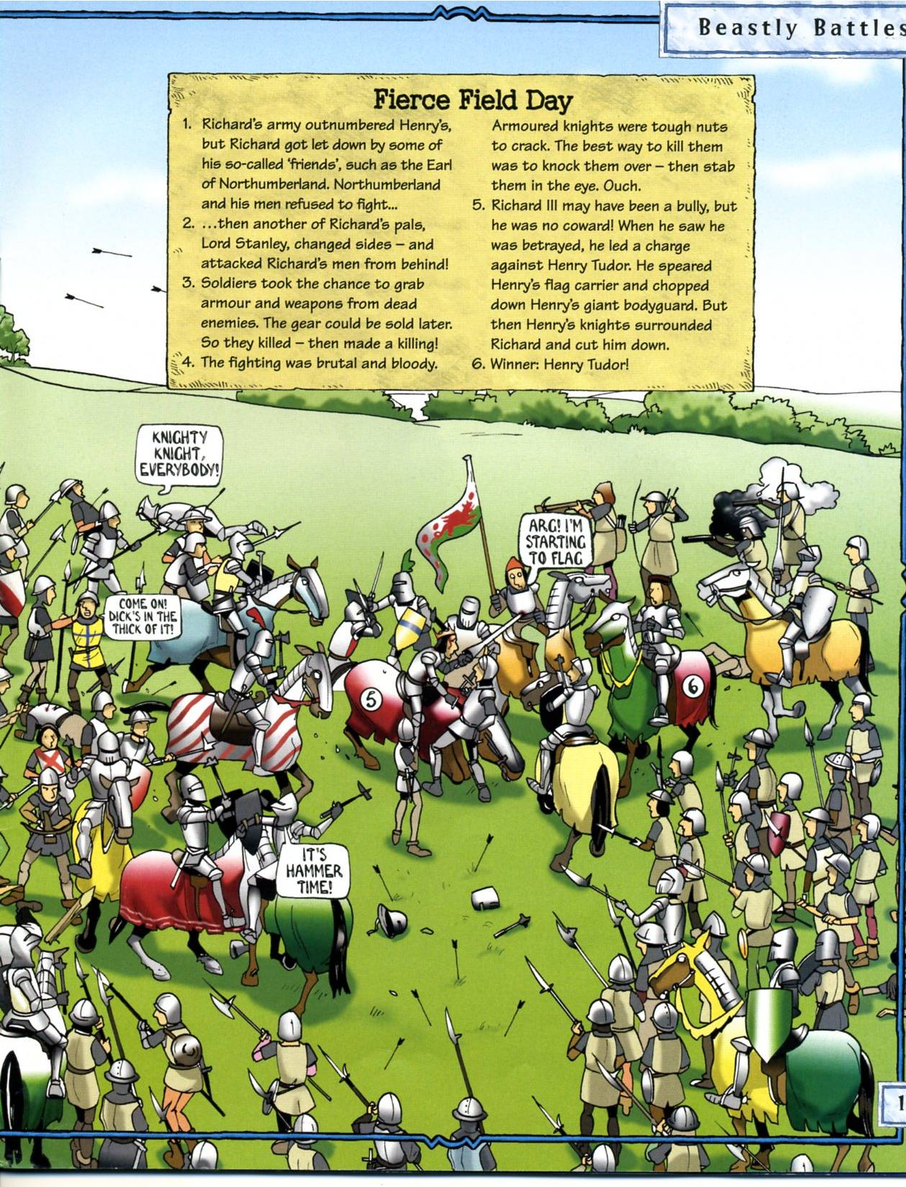

Slide 13
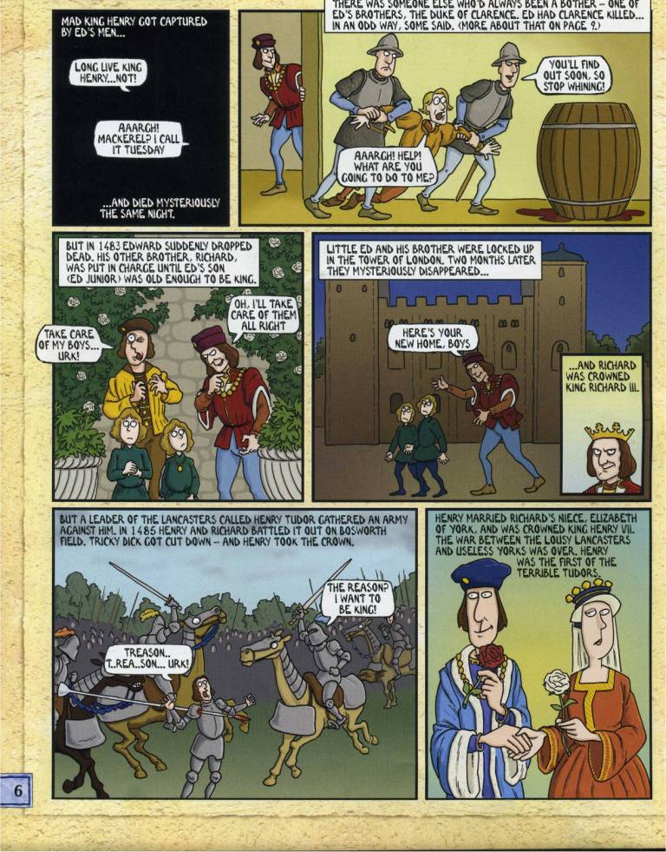

Slide 14
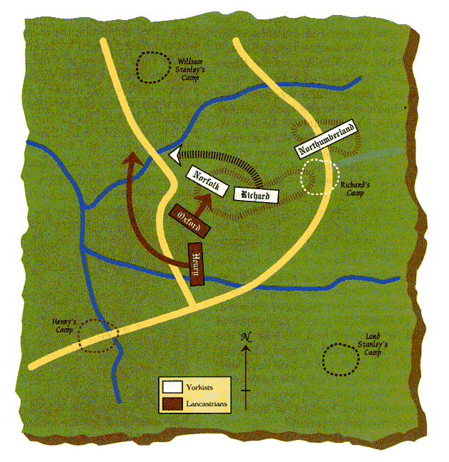

Slide 15
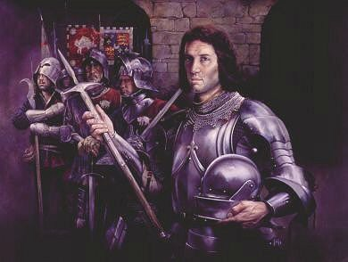
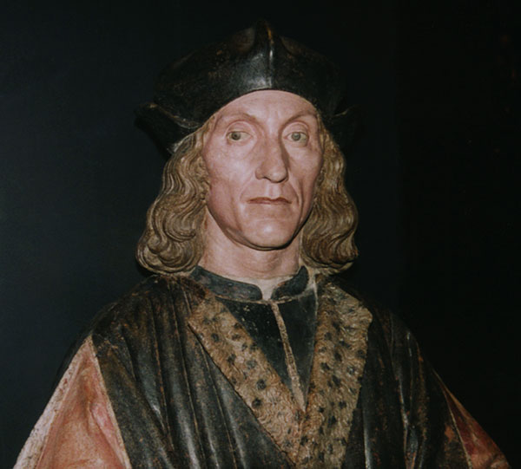
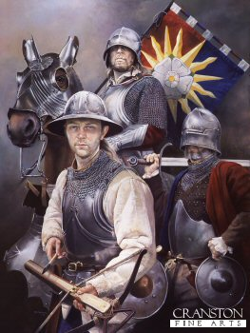
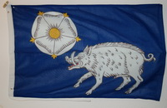
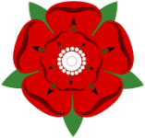
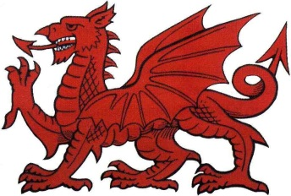
In 1485 there was a huge battle between two armies in a field at Bosworth, near Leicester. On its flags one army showed the White Boar and White Rose of the York family, which was the symbol of King Richard III. The other army’s flags showed the symbols of the Red Dragon and the Red Rose of the Lancaster family. At the head of this family was Henry Tudor.

Slide 16
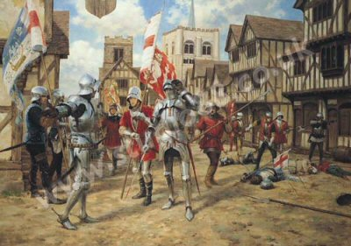
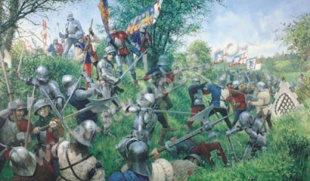
House of Lancaster (Tudor)
House of York (Richard III)
This battle was to end the War of the Roses which had been going on for 30 years! The House of York (Richard III’s family) and The House of Lancaster (Henry Tudor’s family) had been fighting for 30 years to decide which family was going to rule England as Kings and Queens.

Slide 17
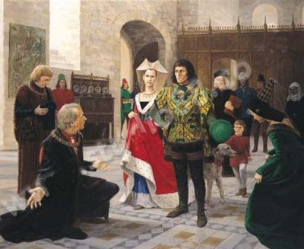
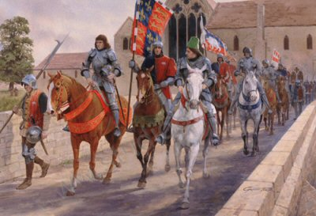
Richard III was worried because he did not know how many other armies he would get to help him fight Henry Tudor
On 21 August 1485, Richard III rode out of Leicester to meet Henry Tudor’s army at the Field of Bosworth. Richard had 6000 men in his army with promise of another 3000 men from another Lord.

Slide 18
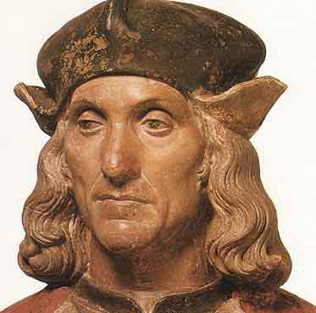
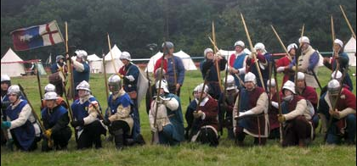
Henry Tudor, leading the House of Lancaster Army, only had 5000 soldiers and knights in all. Richard III seemed to have 4000 more men than Henry.
First the Longbow men shot their arrows across the field at the opposing army.

Slide 19
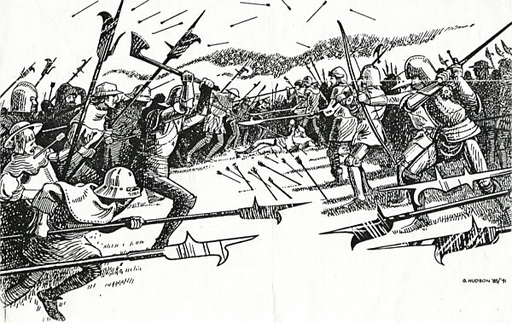
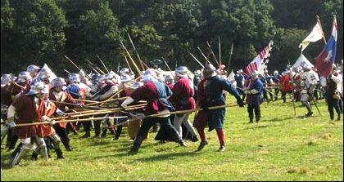
Then the Halberdiers and Pikemen of each army charged at each other, thrusting their long sharp, spiked and bladed weapons at each other.

Slide 20
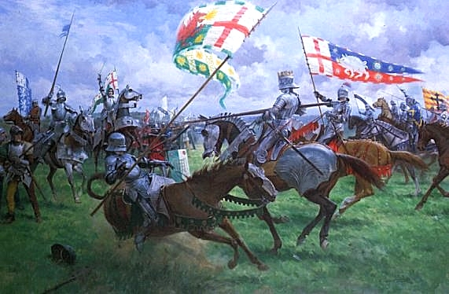
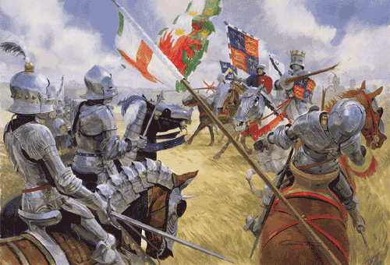
Then, finally, the knights in their shining armour, sitting on their armoured horses, charged at each other with their lances ready to push their enemy off his horse and hopefully kill him
During the battle Richard III became impatient and and charged at Henry Tudor himself. He hoped to kill Henry, but instead Richard was pushed off his own horse by Henry’s knights.

Slide 21
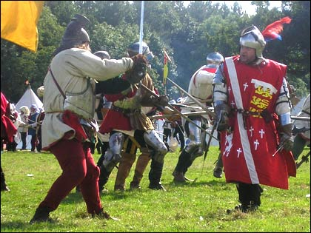
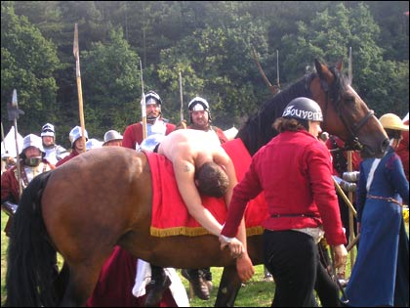
Richard III, off his horse, fought with his sword bravely, but he was soon surrounded by Henry’s knights, and they killed him.
The Battle was over, Richard III was dead. His body was taken back to Leicester on his horse.
Henry Tudor and the House of Lancaster had won the War of the Roses.

Slide 22
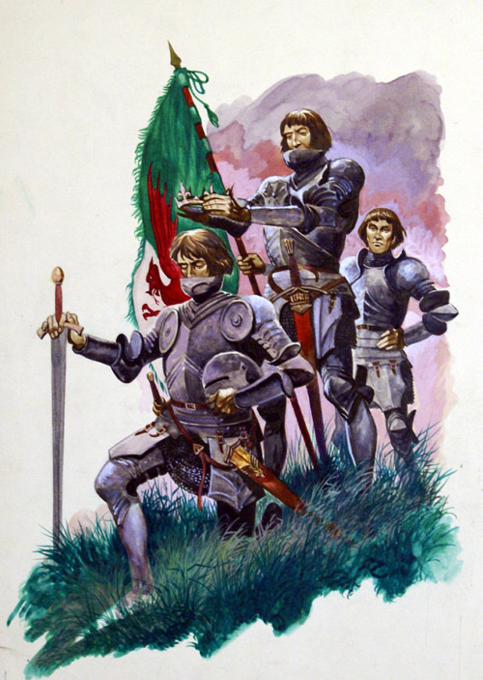
One of Henry’s knights found Richard’s crown lying on the grass under a thorn bush near where Richard had been killed in the battle.
The knight picked up the crown and placed it on Henry’s head shouting, “Hail, the new King of England!”
All Henry’s knights and soldiers cheered.

Slide 23
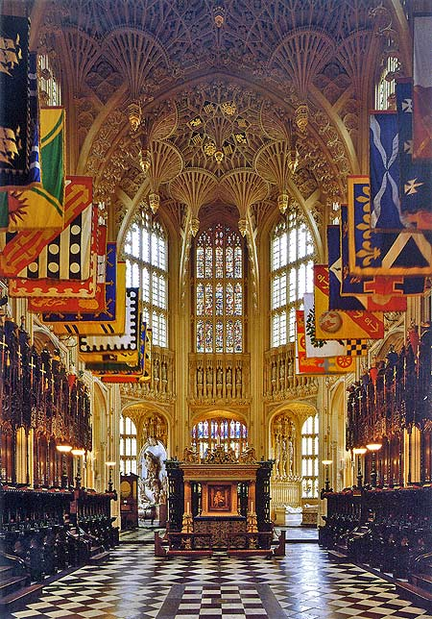
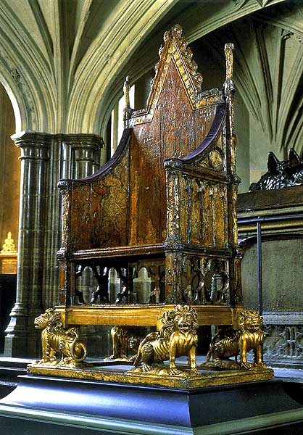
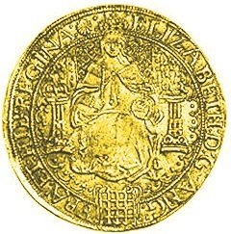
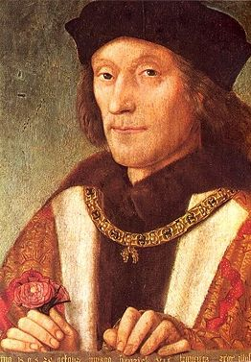
In 1485 Henry Tudor was properly crowned Henry Tudor King of England (Henry VII) at Westminster Abbey in London.
You can see here the Throne that he sat on for his crowning, and a Gold Coin that was made to show he was now the new King of England. All new coins would now have Henry’s image on them.

Slide 24
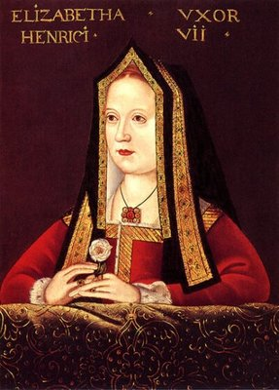
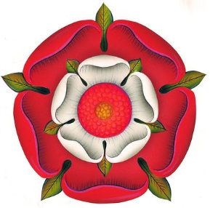
The House of York
The House of Tudor
After Henry Tudor was crowned as King Henry VII he married Elizabeth of York, Richard III’s niece. Henry now brought together the houses of York and Lancaster (Tudor) into a peaceful time, with no more warring between them.
This started the reign of the Tudor family as Kings and Queens of England for over the next 100 years.
The new Tudor Rose

Slide 25
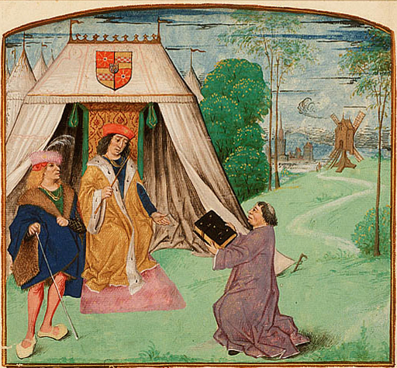
Eye Witness Interpretation
Jean Molinet – a French poet and chronicle writer. He wrote a chronicle from 1474 to 1504 which was published in 1828.
In his chronicle he said that a Welshman struck the death-blow with a big sword whilst Richard’s horse was stuck.

Slide 26
Eye Witness Interpretation
Guto’r Glyn
A Welsh poet and a soldier who fought on the Yorkist side during the War of the Roses.
During the Battle of Bosworth he praised Welsh Lancastrian Rhys ap Thomas for killing Richard III, writing that he “killed the boar, shaved his head”

Slide 27
Why did Henry VII triumph at Bosworth?
Strengths and Weaknesses
YOUR TASK:
Read the statements and decide if they are a strength or weakness for Richard III or Henry VII.
Add each statement to the corresponding column of the table below.
Richard III |  | Henry VII
Strengths | Weaknesses | Strengths | Weaknesses

Slide 28
Beacon network in place to warn of Tudor’s invasion | Due to ‘Bucks’ rebellion, he knew he had to plan his second invasion with great political, military and diplomatic care | Able warrior | Spent huge amounts of money commissioning a fleet in Southampton
Had Lord Stanley’s son (Lord Strange) as hostage | Tudor went through Wales unopposed | Reinforced his position | His promise to marry Elizibeth of York won support from disaffected Royal Servants in England |
Placed himself in Nottingham Castle, putting himself centrally in England | Tudor had agents frequently crossing the Channel to assess and build his level of public support | No Great Magnate had fully declared for him- No guarantee of support | Some of his men defected to Tudor (Rhys ap Thomas and Lord Stanley)
Forced to flee from Brittany | Alienated much of the Nobility due to usurptions, Mystery over the Princes and various rumours | Had a large army (10,000-15,000 | Tudor’s mother, Margarat Beaufort, was in a strong position to influence her opinions as she was married to the powerful Noble Lord Stanley
Already repelled Henry’s invasion in 1483 | Charles VIII of France lent him 60,000 francs and Philibert de Chandee gave him 1,800 merceneries | Inexperienced in battle and English politics | Support base in Brittany and France was small
Started the Battle of Bosworth in a marsh | Small army of about 5,000 men | Started the Battle on Higher Ground (Ambien Hill) | Rhys ap Thomas brought additional 1800-2000 men, Sir Richard Corbet brought 800 men whilst Sir Gilbert Talbot brought 500 men

Slide 29
Henry VII’s claim
Mother was cousin to a former King.
Current King Richard III was hated by the people.
Made a deal to marry Elizabeth of York.
Elizabeth of York was the sister of Edward V.
This made her the rightful heir to the throne.
Henry VII’s claim
Mother was cousin to a former King.
Current King Richard III was hated by the people.
Made a deal to marry Elizabeth of York.
Elizabeth of York was the sister of Edward V.
This made her the rightful heir to the throne.

Slide 30
Plantagenet: Former ruling family of England
House of Lancaster : A cadet branch or offshoot of the Plantagenet's based in Lancaster
House of York: A cadet of offshoot of the Plantagenet's based in Lancaster
Dynasty: A bloodline of kings or rulers
Regent: Someone who rules in place of the King if he's not able to rule himself
Roman Numerals: Numbers used to show a King or Queen with the same name as one held before. IV= 4th V = 5th VI =6th VII = 7th
Illegitimate: The son or daughter is not considered King or Queen.
Heir: Next in line for the throne
Plantagenet: Former ruling family of England
House of Lancaster : A cadet branch or offshoot of the Plantagenet's based in Lancaster
House of York: A cadet of offshoot of the Plantagenet's based in Lancaster
Dynasty: A bloodline of kings or rulers
Regent: Someone who rules in place of the King if he's not able to rule himself
Roman Numerals: Numbers used to show a King or Queen with the same name as one held before. IV= 4th V = 5th VI =6th VII = 7th
Illegitimate: The son or daughter is not considered King or Queen.
Heir: Next in line for the throne

