Slide 1
GCSE Latin Grammar Review

Slide 2
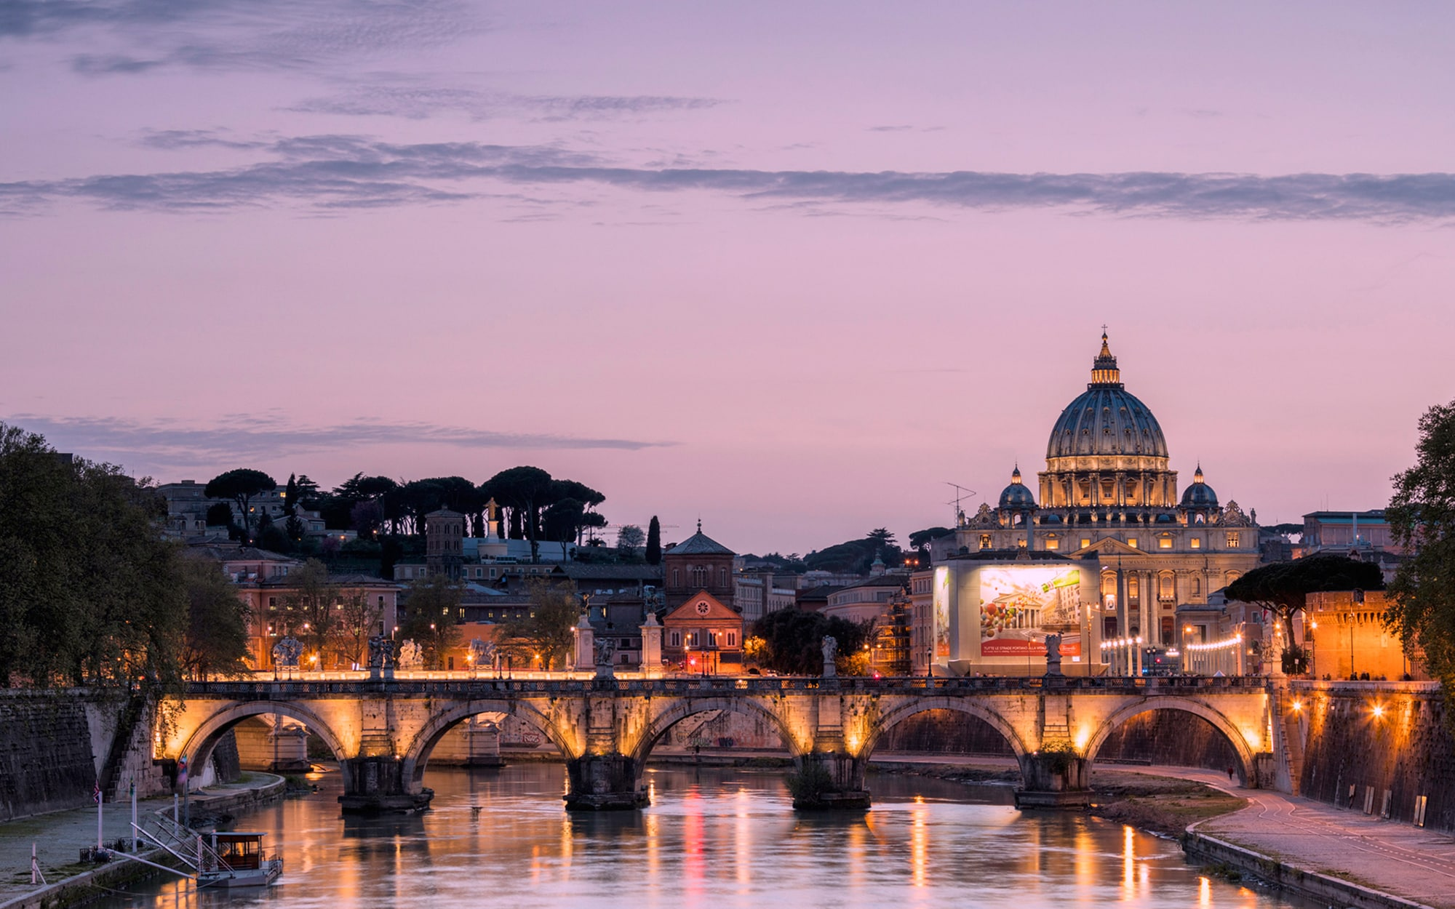
Grammar Review
Reviewing Grammar regularly is the best way to deepen your understanding of how Latin works.
Use this Presentation, several times if needed, to go back over all the GCSE Latin Forms (Accidence)
Wait for each animation to finish before you click.

Slide 3
Please ignore this slide first time around.
VERBS
NOUNS
ADJECTIVES
PARTICIPLES
INDICATIVES
Click on a Part of Speech to revise what you want. You can return to this menu with the blue button at the top right of each slide.
SUBJUNCTIVES
PRONOUNS
IMPERATIVES
GERUNDS
INFINITIVES
PASSIVES

Slide 4
Nouns
Year 9-13
Nouns can be singular or plural, as in English. In Latin, however, they also have gender (m, f or n) and case.
The First Declension
Feminine
The Second Declension
Masculine
The Third Declension
Masculine/Feminine
The Fourth Declension
Masculine (except manus + domus - f)
Nominative
mēns-a
mēns-ae
serv-us
serv-ī
rēx
rēg-ēs
man-us
man-ūs
Vocative
mēns-a
mēns-ae
serv-e
serv-ī
rēx
rēg-ēs
man-us
man-ūs
Accusative
mēns-am
mēns-ās
serv-um
serv-ōs
rēg-em
rēg-ēs
man-um
man-ūs
Genitive
mēns-ae
mēns-ārum
serv-ī
serv-ōrum
rēg-is
rēg-um
man-ūs
man-uum
Dative
mēns-ae
mēns-īs
serv-ō
serv-īs
rēg-ī
rēg-ibus
man-uī
man-ibus
Ablative
mēns-ā
mēns-īs
serv-ō
serv-īs
rēg-e
rēg-ibus
man-ū
man-ibus
mēnsa, -ae (f) - table
servus, -ī (m) - slave
rēx, rēgis (m) - king
manus, manūs (f) - hand
The Second Declension
Neuter
The Third Declension
Neuter
The Fifth Declension
Feminine (except diēs m)
Nominative
SUBJECT – Go!
bell-um
bell-a
caput
capit-a
r-ēs
r-ēs
Vocative
Addressing someone, - O,
bell-um
bell-a
caput
capit-a
r-ēs
r-ēs
Accusative
OBJECT – Stop!
bell-um
bell-a
caput
capit-a
r-em
r-ēs
Genitive
‘
OF
bell-ī
bell-ōrum
capit-is
capit-um
r-eī
r-ērum
Dative
TO FOR
bell-ō
bell-īs
capit-ī
capit-ibus
r-eī
r-ēbus
Ablative
BY WITH FROM
bell-ō
bell-īs
capitl-e
capit-ibus
r-ē
r-ēbus
bellum, -ī (n) - war
caput, capitis (n) – head
rēs, reī (f) - thing

Slide 5
Adjectives
Year 9-13
2-1-2 adjectives are so-called because they go:
like ‘servus’ (2nd) when agreeing with a masculine noun/pronoun
like ‘mēnsa’ (1st) in when agreeing with something feminine
like ‘bellum’ (2nd) when neuter.
2-1-2 Adjectives
servus
mēnsa
bellum
Singular
Plural
Masculine
Feminine
Neuter
Masculine
Feminine
Neuter
SUBJECT – Go!
Nominative
bon-us
bon-um
bonus
bon-a
bon-ī
bon-ae
bon-a
Addressing someone, - O,
Vocative
bon-e
bon-a
bon-um
bon-ī
bon-ae
bon-a
OBJECT – Stop!
Accusative
bon-um
bon-am
bon-um
bon-ōs
bon-ās
bon-a
‘
OF
Genitive
bon-ī
bon-ae
bon-ī
bon-ōrum
bon-ārum
bon-ōrum
TO FOR
Dative
bon-ō
bon-ae
bon-ō
bon-īs
bon-īs
bon-īs
BY WITH FROM
Ablative
bon-ō
bon-ā
bon-ō
bon-īs
bon-īs
bon-īs
bonus, -a, -um - good
Agreement: Adjectives usually come after the noun/ pronoun they describe and must ‘agree’ in:
number
(sg. or pl.)
gender
(m,f,n)
case
(n,v,a,g,d,a)
e.g. rēx = nom. m. sg.
‘rēx bonus’

Slide 6
Adjectives
Year 9-13
3rd Declension adjectives are so-called because they go:
like ‘rēx’ (3rd) when agreeing with a masculine or feminine noun/pronoun.
like ‘caput’ (3rd) in when agreeing with something neuter.
Two differences:
the Ablative Singular ends in -ī, not in –e.
There is usually an ‘i’ before the gen. pl. ending and the n.pl. n/v/a.
3rd Declension Adjectives
Singular
Plural
Masculine
Feminine
Neuter
Masculine
Feminine
Neuter
SUBJECT – Go!
Nominative
ingēns
ingēns
ingent-ēs
ingent-ia
Addressing someone, - O,
Vocative
ingēns
ingēns
ingent-ēs
ingent-ia
OBJECT – Stop!
Accusative
ingent-em
ingēns
ingent-ēs
ingent-ia
ingēns, ingentis
- huge
‘
OF
Genitive
ingent-is
ingent-ium
TO FOR
Dative
ingent-ī
ingent-ibus
BY WITH FROM
Ablative
ingent-ī
ingent-ibus
Nominative
tristis
triste
trist-ēs
trist-ia
Adjectives like ‘tristis, -e’
There is a very common type of 3rd Declension adjective which is different in two small respects:
it has no stem change.
The neuter singular n/v/a ends in -e.
Vocative
tristis
triste
trist-ēs
trist-ia
tristis, -e
- sad
Accusative
trist-em
triste
trist-ēs
trist-ia
Genitive
trist-is
trist-ium
Dative
trist-ī
trist-ibus
Ablative
trist-ī
trist-ibus

Slide 7
Verbs: Indicative Active: Present, Future and Imperfect
Year 9-13
Indicative verbs forms have a Person (1st, 2nd or 3rd, Singular or Plural) and Tense. They can be Active or Passive Latin Verbs come in groups or Conjugations, with slight differences in how they are formed.
The First Conjugation
Present, Future, Imperfect
The Second Conjugation
Present, Future, Imperfect
Present
Future - will
Imperfect – was/were
Present
Future - will
Imperfect – was/were
I
am-ō
amā-bō
amā-bam
mone-ō
monē-bo
monē-bam
You
amā-s
amā-bis
amā-bās
monē-s
monē-bis
monē-bās
He/she/it
amā-t
amā-bit
amā-bat
mone-t
monē-bit
monē-bat
We
amā-mus
amā-bimus
amā-bamus
monē-mus
monē-bimus
monē-bāmus
You
amā-tis
amā-bitis
amā-batis
monē-tis
monē-bitis
monē-bātis
They
amā-nt
amā-bunt
amā-bant
mone-nt
monē-bunt
monē-bant
amō,, amāre, amāvī, amātus - love
moneō, monēre, monuī, monītus - warn, advise
The Third Conjugation
Present, Sneaky Future, Imperfect
The 3½ Conjugation
Present
The Fourth Conjugation
Present, Sneaky Future, Imperfect
Present
Sneaky Future - will
Imperfect – was/were
Present
Present
Sneaky Future - will
Imperfect – was/were
I
reg-ō
reg-am
reg-ē-bam
capi-ō
audi-ō
audi-am
audi-ē-bam
You
reg-is
reg-es
reg-ē-bās
capi-s
Future and Imperfect tenses are the same as for the 4th Conjugation
audī-s
audi-ēs
audi-ē-bās
He/she/it
reg-it
reg-et
reg-ē-bat
capi-t
audi-t
audi-et
audi-ē-bat
We
reg-imus
reg-ēmus
reg-ē-bāmus
capi-mus
audī-mus
audi-ēmus
audi-ē-bāmus
You
reg-itis
reg-ētis
reg-ē-bātis
capi-tis
audī-tis
audi-ētis
audi-ē-bātis
They
reg-unt
reg-ent
reg-ē-bant
capi-unt
audi-unt
audi-ent
audi-ē-bant
regō, regere, rēxī, rectus - rule
capiō, capere, cēpī, captus - take, capture
audiō, audīre, audīvī, audītus - hear, listen

Slide 8
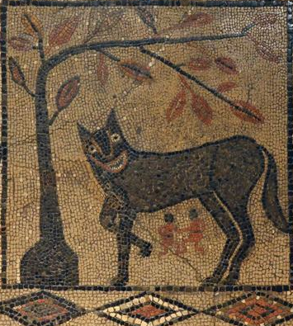
Passive: Present, Future and Imperfect
To change from Active to Passive for any of these three tenses, simply switch the ending from Active to Passive:
I
-ō
-r
You
-s
-ris
He/she/it
-t
-tur
-mus
-mur
We
-tis
-minī
You
-nt
-ntur
They
Romulus and Remus are being fed by the wolf

Slide 9
ACTIVE
PASSIVE
servī Iūlium portant.
Iūlius ā servīs portātur.
servī sacculōs portant.
sacculī ā servīs portantur.

Slide 10
Verbs: Indicative Passive: Present, Future and Imperfect
Year 9-11
The First Conjugation
Present, Future, Imperfect
The Second Conjugation
Present, Future, Imperfect
Present
Future - will
Imperfect – was/were
Present
Future - will
Imperfect – was/were
I
am-or
amā-bor
amā-bar
mone-or
monē-bor
monē-bar
You
amā-ris
amā-beris
amā-bāris
monē-ris
monē-beris
monē-bāris
He/she/it
amā-tur
amā-bitur
amā-bātur
mone-tur
monē-bitur
monē-bātur
We
amā-mur
amā-bimur
amā-bāmur
monē-mur
monē-bimur
monē-bāmur
You
amā-minī
amā-biminī
amā-bāminī
monē-minī
monē-biminī
monē-bāminī
They
amā-ntur
amā-buntur
amā-bantur
mone-ntur
monē-buntur
monē-bantur
amō,, amāre, amāvī, amātus - love
moneō, monēre, monuī, monītus - warn, advise
The Third Conjugation
Present, Sneaky Future, Imperfect
The 3½ Conjugation
Present
The Fourth Conjugation
Present, Sneaky Future, Imperfect
Present
Sneaky Future - will
Imperfect – was/were
Present
Present
Sneaky Future - will
Imperfect – was/were
I
reg-or
reg-ar
reg-ē-bar
capi-or
audi-or
audi-ar
audi-ē-bar
You
reg-eris
reg-ēris
reg-ē-bāris
cap-eris
Future and Imperfect tenses are the same as for the 4th Conjugation
audī-ris
audi-ēris
audi-ē-bāris
He/she/it
reg-itur
reg-ētur
reg-ē-bātur
capi-tur
audī-tur
audi-ētur
audi-ē-bātur
We
reg-imur
reg-ēmur
reg-ē-bāmur
capi-mur
audī-mur
audi-ēmur
audi-ē-bāmur
You
reg-iminī
reg-ēminī
reg-ē-bāminī
capi-minī
audī-minī
audi-ēminī
audi-ē-bāminī
They
reg-untur
reg-entur
reg-ē-bantur
capi-untur
audi-untur
audi-entur
audi-ē-bantur
regō, regere, rēxī, rectus - rule
capiō, capere, cēpī, captus - take, capture
audiō, audīre, audīvī, audītus - hear, listen

Slide 11
Verbs: Indicative Active: Perfect and Pluperfect
These are much simpler than the forms you have just studied.
Once you know the Perfect Active stem, you add the same sets of endings for each of the three tenses, so it makes no difference which Conjugation the verbs belongs to.
The Perfect Active stem is taken from the Third Principal Part.
These are very predictable for the 1st Conjugation,
and quite predictable for the 2nd and 4th Conjugation
– but always need to be learned for each verb, especially those in the 3rd and 3 ½ Conjugation.
Perfect Stems:
Perfect
I …. -ed
Pluperfect
I had …
Principal Parts,
First
Principal Part
Second
Principal Part
Third
Principal Part
-ī
-eram
-istī
-erās
The 1st Conjugation
am-ō
am-āre
amāv-ī
-it
-erat
The 2nd Conjugation
mone-ō
mon-ēre
monu-ī
The 3rd Conjugation
reg-ō
reg-ere
rēx-ī
-imus
-erāmus
The 3½ Conjugation
capi-ō
cap-ere
cēp-ī
-istis
-erātis
The 4th Conjugation
audi-ō
aud-īre
audīv-ī
-ērunt
-erant

Slide 12
Verbs: Indicative Active: Perfect and Pluperfect
Year 9-11
These are totally regular, with no difference between the Conjugations, apart from identifying the Perfect Stem.
The First Conjugation
Present, Future, Imperfect
The Second Conjugation
Present, Future, Imperfect
Perfect
Future Perfect – will have
Pluperfect - had
Perfect
Future Perfect – will have
Pluperfect – had
I
amāv-ī
amāv-erō
amāv-eram
monu-ī
monu-erō
monu-eram
You
amāv-istī
amāv-eris
amāv-erās
monu-istī
monu-eris
monu-erās
He/she/it
amāv-it
amāv-erit
amāv-erat
monu-it
monu-erit
monu-erat
We
amāv-imus
amāv-erimus
amāv-erāmus
monu-imus
monu-erimus
monu-erāmus
You
amāv-istis
amāv-eritis
amāv-erātis
monu-istis
monē-eritis
monu-erātis
They
amāv-ērunt
amāv-erint
amāv-erant
monu-ērunt
monu-erint
monu-erant
amō,, amāre, amāvī, amātus - love
moneō, monēre, monuī, monītus - warn, advise
The Third Conjugation
Present, Sneaky Future, Imperfect
The 3½ Conjugation
Present
The Fourth Conjugation
Present, Sneaky Future, Imperfect
Perfect
Future Perfect – will have
Pluperfect – had
Perfectt
Perfect
Future Perfect - will have
Pluperfect – had
I
rēx-ī
rēx-erō
rēx-eram
cēp-ī
audīv-ī
audīv-erō
audīv-eram
You
rēx-istī
rēx-eris
rēx-erās
cēp-istī
Perfect
and Pluperfect tenses are the same for all verbs, even irregular ones.
audīv-istī
audīv-eris
audīv-erās
He/she/it
rēx-it
rēx-erit
rēx-erat
cēp-it
audīv-it
audīv-erit
audīv-erat
We
rēx-imus
rēx-erimus
rēx-erāmus
cēp-imus
audīv-imus
audīv-erimus
audīv-erāmus
You
rēx-istis
rēx-eritis
rēx-erātis
cēp-istis
audīv-istis
audi-eritis
audi-erātis
They
rēx-ērunt
rēx-erint
rēx-erant
cēp-ērunt
audīv-ērunt
audīv-erint
audīv-erant
regō, regere, rēxī, rectus - rule
capiō, capere, cēpī, captus - take, capture
audiō, audīre, audīvī, audītus - hear, listen

Slide 13
Verbs: Indicative Passive: Perfect and Pluperfect
Take the P.P.P. (The Perfect Passive Participle, 4th Principal Part).
Make it agree (with the subject of the sentence). (e.g. She was loved = amata est.)
Add some ‘sum’ (Present or Imperfect).
This converts the Participle from a 2-1-2 adjective (‘loved’) into a verb (‘was loved’).
P.P.P.
Perfect
I was …. -ed
Pluperfect
I had been …
Principal Parts,
First
Principal Part
Second
Principal Part
Third
Principal Part
Fourth
Principal Part
sum
eram
es
erās
The 1st Conjugation
am-ō
am-āre
amāv-ī
amātus, -a, -um
est
erat
The 2nd Conjugation
mone-ō
mon-ēre
monu-ī
monītus, -a, -um
The 3rd Conjugation
reg-ō
reg-ere
rēx-ī
rēctus, -a, -um
sumus
erāmus
The 3½ Conjugation
capi-ō
cap-ere
cēp-ī
captus, -a, -um
estis
erātis
The 4th Conjugation
audi-ō
aud-īre
audīv-ī
audītus, -a, -um
sunt
erant

Slide 14
Verbs: Indicative Passive: Perfect and Pluperfect
Year 9-11
Again, there is no difference between the Conjugations, once you’ve identified the Perfect Passive Participle.
The First Conjugation
Present, Future, Imperfect
The Second Conjugation
Present, Future, Imperfect
Perfect
The
–us, -a, -um
endings are to agree with a
m, f or n subject.
In the plural forms these will be
–i, -ae or –a.
Pluperfect – had been
Perfect
Pluperfect – had been
I
amātus, -a, -um sum
amātus, -a, -um eram
monītus, -a, -um sum
monītus, -a, -um eram
You
amātus, -a, -um es
amātus, -a, -um eras
monītus, -a, -um es
monītus, -a, -um eram
He/she/it
amātus, -a, -um est
amātus, -a, -um erat
monītus, -a, -um est
monītus, -a, -um eram
We
amātī, -ae, -a sumus
amātī, -ae, -a erāmus
monītī, -ae, -a sumus
monītī, -ae, -a erāmus
You
amātī, -ae, -a estis
amātī, -ae, -a erātis
monītī, -ae, -a estis
monītī, -ae, -a erātis
They
amātī, -ae, -a sunt
amātī, -ae, -a erant
monītī, -ae, -a sunt
monītī, -ae, -a erant
amō,, amāre, amāvī, amātus - love
moneō, monēre, monuī, monītus - warn, advise
The Third Conjugation
Present, Sneaky Future, Imperfect
The 3½ Conjugation
Present
The Fourth Conjugation
Present, Sneaky Future, Imperfect
Perfect
Pluperfect – had been
Perfectt
Perfect
Pluperfect – had been
I
rēctus, -a, -um sum
rēctus, -a, -um eram
captus,-a, -um sum
audītus, -a, -um sum
audītus, -a, -um eram
You
rēctus, -a, -um es
rēctus, -a, -um erās
captus, -a, -um es
audītus, -a, -um es
audītus, -a, -um erās
He/she/it
rēctus, -a, -um est
rēctus, -a, -um erat
captus, -a, -um est
audītus, -a, -um est
audītus, -a, -um erat
We
rēctī, -ae, -a sumus
rēctī, -ae, -a erāmus
captī, -ae, -a sumus
audītī, -ae, -a sumus
audītī, -ae, -a erāmus
You
rēctī, -ae, -a estis
rēctī, -ae, -a erātis
captī, -ae, -a estis
audītī, -ae, -a estis
audītī, -ae, -a erātis
They
rēctī, -ae, -a sunt
rēctī, -ae, -a erant
captī, -ae, -a sunt
audītī, -ae, -a sunt
audītī, -ae, -a erant
regō, regere, rēxī, rectus - rule
capiō, capere, cēpī, captus - take, capture
audiō, audīre, audīvī, audītus - hear, listen

Slide 15
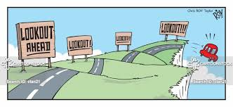
Verbs: IMPERATIVES
Imperatives are brief command words and only exist in the Present tense in Latin, but can be Active or Passive.
The Passive Imperatives looks like the Infinitive in the Singular and like the You (pl) form in the Plural.
Imperatives,
Active Singular
Active Plural
Meaning:
Passive Singular
Passive Singular
Meaning
The 1st Conjugation
am-ā!
am-āte!
Love!
amāre!
amāminī!
Be loved!
The 2nd Conjugation
monē!
mon-ēte!
Advise!
monēre!
monēminī!
Be warned!
The 3rd Conjugation
rege!
reg-ite!
Rule!
regere!
regiminī!
Be ruled!
The 3½ Conjugation
cape!
cap-ite!
Take!
capere!
capiminī!
Be captured!
The 4th Conjugation
audī!
aud-īte!
Listen!
audīre!
audīminī!
Be heard!

Slide 16
Verbs: SIX INFINITIVES
SIX
Principal Parts,
1st
amō – I love
2nd
amāre – to love
3rd
amāv-ī – I loved
4th
amātus – loved
The Present Active Infinitive (‘to love’) is the 2nd Principal Part.
However, there are SIX different Infinitives in Latin: Present, Future and Perfect; Active and Passive:
Future and Perfect Infinitives are used in
Indirect Statements
(the Acc/Inf construction)
Table of Infinitives
ACTIVE
PASSIVE
Change the –e to an –i, but the 3rd and 3½ have short stems.
Present
amāre
to love
amārī
to be loved
Active: insert –ūr- into the PPP:
to form the Future Participle, then add ‘esse’
Future
amātūrus, -a, -um esse
to be about to love
The Future Passive Infinitive is new to A-level. It is formed from the Supine (4th Principal Part ending in ‘-um’ (which does not agree) and the passive infinitive ‘iri’)
Perfect
amāv-isse
to have loved
amātus, -a, -um esse
to have been loved
The Six Infinitives
Present
Future
Perfect
The 1st Conjugation
amāre
amārī
amātūrus, -a, -um esse
amāvisse
amātus -a, -um esse
The 2nd Conjugation
monēre
monērī
monitūrus, -a, -um esse
monuisse
monītus -a, -um esse
The 3rd Conjugation
regere
regī
rēctūrus, -a, -um esse
rēxisse
rēctus -a, -um esse
The 3½ Conjugation
capere
capī
captūrus, -a, -um esse
cēpisse
captus -a, -um esse
The 4th Conjugation
audīre
audīrī
audītūrus, -a, -um esse
audīvisse
audītus -a, -um esse

Slide 17
Verbs: Participles
Principal Parts,
1st
amō – I love
2nd
amāre – to love
3rd
amāv-ī – I loved
4th
amātus – loved
Participles are adjectives formed from verbs. They come in three different tenses: Present, Future and Perfect.
There is no Passive form of the Present or Future participle in Latin, so they are always Active.
Perfect Passive Participles, as their name suggests, are always Passive …
Table of Participles
ACTIVE
PASSIVE
Present
amāns, amantis
loving
Deponents only
Active: insert –ūr- into the PPP:
to form the Future Participle. This word cannot be translated by a single word into English.
amātūrus, -a, -um esse
‘about to love’
Future
Deponent Verbs, however, since they are always Active in meaning, have Active Perfect Participles.
Perfect
Deponents
only
[conātus]
[‘having tried’]
amātus, -a, -um
‘loved’
Participles
Perfect
Present
Future
Deponents only
Perfect
The 1st Conjugation
amāns, amantis
loving
amātūrus, -a, -um
about to love
conatus, -a, -um
having tried
amātus -a, -um
(having been) loved
The 2nd Conjugation
monēns, -entis
warning
monitūrus, -a, -um
about to warn
ausus, -a, -um
having dared
monītus -a, -um
(having been) warned
The 3rd Conjugation
regēns, -entis
ruling
rēctūrus, -a, -um
about to rule
locutus, -a, -um
having spoken
rēctus -a, -um
(having been) ruled
The 3½ Conjugation
capiēns, -ientis
taking
captūrus, -a, -um
about to take
ingressus, -a, -um
having entered
captus -a, -um
(having been) captured
The 4th Conjugation
audiēns, -intis
hearing
audītūrus, -a, -um
about to hear
ortus, -a, -um
having arisen
audītus -a, -um
(having been) heard

Slide 18
Participles: The Present Participle
Year 9-13
The Present Participle goes like a 3rd Declension adjective.
A participle is simply an adjective formed from a verb.
The Present participle is translated as ‘…-ing’ – e.g. ‘listening’ etc.
One differences:
the Ablative Singular in an Ablative Absolute ends in -e, not in –ī!
The Present Participle
rēx
Singular
caput
Plural
Masculine
Feminine
Neuter
Masculine
Feminine
Neuter
amāns, amantis
‘loving’
SUBJECT – Go!
Nominative
amāns
amāns
amant-ēs
amant-ia
monēns, monentis
-‘warning’, ‘advising’
Addressing someone, - O,
Vocative
amāns
amāns
amant-ēs
amant-ia
OBJECT – Stop!
Accusative
amant-em
amāns
amant-ēs
amant-ia
regēns, regentis
‘ruling’
‘
OF
Genitive
amant-is
amant-ium
capiēns, -ntis
‘taking’
TO FOR
Dative
amant-ī
amant-ibus
audiēns, -ntis
‘hearing’
‘listening’
BY WITH FROM
Ablative
amant-e
amant-ibus

Slide 19
Verbs: Subjunctive: The Imperfect Subjunctive
Year 10-13
To form the Imperfect Subjunctive add the normal person endings to the Infinitive.
The Imperfect Subjunctive
All Conjugations: Active
The Imperfect Subjunctive
is formed by adding the normal endings to the Infinitive.
I
amāre-m
monēre-m
regere-m
capere-m
audīre-m
You
amārē-s
monērē-s
regerē-s
caperē-s
audīrē-s
He/she/it
amāre-t
monēre-t
regere-t
capere-t
audīre-t
We
amārē-mus
monērē-mus
regerē-mus
caperē-mus
audīrē-mus
You
amārē-tis
monērē-tis
regerē-tis
caperē-tis
audīrē-tis
They
amāre-nt
monēre-nt
regere-nt
capere-nt
audīre-nt
This rule applies even to the verbs with irregular infinitives:
The Imerfect Subjunctive
All Conjugations: Passive
I
amāre-r
monēre-r
regere-r
capere-r
audīre-r
esse – m
(be)
velle – m
(want)
You
amārē-ris
monērē-ris
regerē-ris
caperē-ris
audīrē-ris
posse – m
(be able)
nōlle – m
(not want/refuse)
He/she/it
amārē-tur
monērē-tur
regerē-tur
caperē-tur
audīrē-tur
We
amārē-mur
monērē-mur
regerē-mur
caperē-mur
audīrē-mur
ferre – m
(bring, carry, bear)
malle – m
(prefer)
You
amārē-minī
monērē-minī
regerē-minī
caperē-minī
audīrē-minī
They
amāre-ntur
monēre-ntur
regere-ntur
capere-ntur
audīre-ntur
īre – m
(go)

Slide 20
Verbs: Subjunctive: The Pluperfect Subjunctive
Year 10-13
To form the Perfect Active Subjunctive add the normal endings to the Perfect Infinitive.
The Pluperfect Subjunctive Active
is formed by adding the normal endings to the Perfect Infinitive.
The Pluperfect Subjunctive
All Conjugations: Active
I
amāvisse-m
monuisse-m
rēxisse-m
cēpisse-m
audīvisse-m
You
amāvissē-s
monuissē-s
rēxissē-s
cēpissē-s
audīvissē-s
The Perfect Infinitive (‘to have loved’) is formed by adding –isse to the Perfect Stem
(i.e. 3rd Principal Part + -sse)
e.g. amāvisse.
He/she/it
amāvisse-t
monuisse-t
rēxisse-t
cēpisse-t
audīvisse-t
We
amāvissē-mus
monuissē-mus
rēxissē-mus
cēpissē-mus
audīvissē-mus
You
amāvissē-tis
monuissē-tis
rēxissē-tis
cēpissē-tis
audīvissē-tis
They
amāvisse-nt
monuisse-nt
rēxisse-nt
cēpisse-nt
audīvisse-nt
To form the Pluperfect Passive Subjunctive, take the PPP, make it agree and add the Imperfect Subjunctive of sum (essem, esses, esset, essemus, essetis, essent).
The Pluperfect Subjunctive
All Conjugations: Passive
I
amātus, -a, -um a essem
monītus, -a, -um essem
rēctus, -a, -um essem
captus, -a, -um essem
audītus, -a, -um a essem
You
amātus, -a, -um a essēs
monītus, -a, -um essēs
For all Perfect Passives:
Take the PPP
Make it agree
Add some ‘sum’
rēctus, -a, -um essēs
captus, -a, -um essēs
audītus, -a, -um a essēs
He/she/it
amātus, -a, -um a esset
monītus, -a, -um esset
rēctus, -a, -um esset
captus, -a, -um esset
audītus, -a, -um a esset
We
amātī, -ae, -a essēmus
monītī, -ae, -a essēmus
rēctī, -ae, -a essēmus
captī, -ae, -a essēmus
audītī, -ae, -a essēmus
You
amātī, -ae, -a a essētis
monītī, -ae, -a a essētis
rēctī, -ae, -a a essētis
captī, -ae, -a a essētis
audītī, -ae, -a a essētis
They
amātī, -ae, -a a essent
monītī, -ae, -a a essent
rēctī, -ae, -a a essent
captī, -ae, -a a essent
audītī, -ae, -a a essent

Slide 21
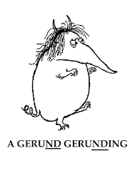
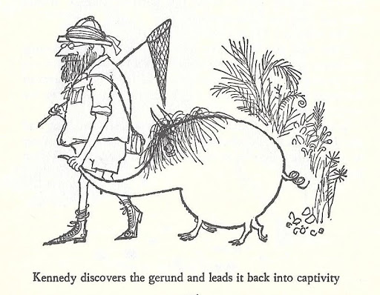
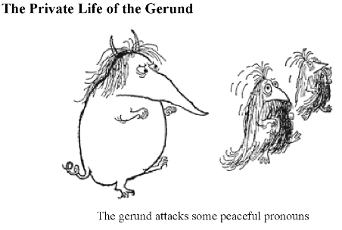
Verbs: GERUNDS/GERUNDIVES
Recognisable by the –nd- before their endings, a Gerund is a verbal noun. It goes like ‘bellum’. A Gerundive is a verbal adjective that follows the normal 2-1-2 pattern.
ad + gerund/gerundive expresses purpose.

Slide 22
Pronouns 1
Year 9-13
Pronouns are words that stand in place of a noun, like ‘he’, ‘who, ‘this (one)’ or ‘that (one)’.
The key pronouns to learn are: Personal Pronouns, the Reflexive Pronoun plus is, ea, id;
the Relative Pronoun, qui, quae, quod and demonstratives like hic, haec, hoc and ille, illa, illud.
Watch out – they don’t have a Vocative form and their Genitive and Dative singulars are odd.
ipse, ipsa, ipsum
him/her/itself/themselves
3rd Person (reflexive)
e.g. The President herself was in charge of foreign policy.
Singular
1st Person
I, me
2nd Person - you
Singular
e.g.
he saw himself in the mirror
Masculine
Feminine
Neuter
Nominative
ego
tū
SUBJECT – Go!
ipse
ips-a
ip-sum
Accusative
mē
tē
sē
OBJECT – Stop!
ips-um
ips-am
ips-um
‘
OF
Genitive
meī* (better to use
meus, a, -um
tuī* (better to use
tuus, a, -um
suī* (better to use
suus, a, -um
Dative
mihī
tibī
sibī
ips-ius
ips-ius
ips-ius
TO FOR
Ablative
mē
tē
sē
ips-ī
ips-ī
ips-ī
BY WITH FROM
ips-ō
ips-ā
ips-īs
3rd Person (reflexive)
Plural
Plural
1st Person
We, us
2nd Person
you (pl)
e.g.
they saw themselves …
The Plural is the same as the singular
Masculine
Feminine
Neuter
Nominative
nōs
vōs
ips-ī
ips-ae
ips-a
This Pronoun is typical in following a totally regular 2-1-2 form in the Plural
Accusative
nōs
vōs
sē
ips-ōs
ips-ās
ips-a
Genitive
nostrī (use noster, nostra, nostrum
vestrī – use vester, vestra, vestrum
suī* (better to use
suus, a, -um
ips-ōrum
ips-ārum
ips-ōrum
Dative
nōbīs
vōbīs
sibī
ips-īs
ips-īs
ips-īs
Ablative
nōbīs
vōbīs
sē
ips-īs
ips-īs
ips-īs

Slide 23
Pronouns 2
The Interrogative Pronoun Who? Which? is the same as qui, quae, quod, except in the Nom sg. and Acc sg (n).
Pronouns are words that stand in place of a noun, like ‘he’, ‘who, ‘this (one)’ or ‘that (one)’.
The key pronouns to learn are: Personal Pronouns, the Reflexive Pronoun plus is, ea, id;
the Relative Pronoun, qui, quae, quod and demonstratives like hic, haec, hoc and ille, illa, illud.
Watch out – they don’t have a Vocative form and their Genitive and Dative singulars are odd.
Year 9-13
Masculine
Feminine
Neuter
Nominative
quis?
quid?
Singular
Plural
Accusative
quid?
is, ea, id
he/she/it/they;
‘that’ (man/woman/one)
Masculine
Feminine
Neuter
Masculine
Feminine
Neuter
SUBJECT – Go!
Nominative
is
e-a
id
e-ī
e-ae
e-a
OBJECT – Stop!
Accusative
e-um
e-am
id
e-ōs
e-ās
e-a
is, ea, id
he/she/it/they;
‘that’ (man etc.)
‘
OF
Genitive
eius
eius
eius
e-ōrum
e-ārum
e-ōrum
TO FOR
Dative
e-ī
e-ī
e-ī
e-īs
e-īs
e-īs
BY WITH FROM
Ablative
e-ō
e-ā
e-ō
e-īs
e-īs
e-īs
Masculine
Feminine
Neuter
Masculine
Feminine
Neuter
qui, quae, quod
Nominative
quī
quae
quod
qu-ī
qu-ae
quae
quī, quae, quod
- who, which
The Relative Pronoun
So-called because it relates or refers back to a noun /pronoun already mentioned,
e.g. ‘the woman who….’
= femina quae ….
Accusative
‘whom’
qu-ōs
qu-em
qu-am
quod
qu-ās
qu-ae
‘whose’
qu-ārum
Genitive
cuius
cuius
cuius
qu-ōrum
qu-ōrum
Dative
cu-ī
cu-ī
cu-ī
qu-ibus
qu-ibus
qu-ibus
The Dat/Abl plural can also be quīs.
Ablative
qu-ō
qu-ā
qu-ō
qu-ibus
qu-ibus
qu-ibus

Slide 24
Pronouns 3
Year 9-13
Pronouns are words that stand in place of a noun, like ‘he’, ‘who, ‘this (one)’ or ‘that (one)’.
The key pronouns to learn are: Personal Pronouns, the Reflexive Pronoun plus is, ea, id;
the Relative Pronoun, qui, quae, quod and demonstratives like hic, haec, hoc and ille, illa, illud.
Watch out – they don’t have a Vocative form and their Genitive and Dative singulars are odd.
This and That – hic and ille
Demonstrative Pronouns
Singular
Plural
Masculine
Feminine
Neuter
Masculine
Feminine
Neuter
SUBJECT – Go!
Nominative
hic
haec
hoc
h-ī
h-ae
haec
OBJECT – Stop!
Accusative
hunc
hanc
hoc
h-ōs
h-ās
haec
hic, haec, hoc
- this
‘
OF
Genitive
huius
huius
huius
h-ōrum
h-ārum
h-ōrum
TO FOR
Dative
huic
huic
huic
h-īs
h-īs
h-īs
BY WITH FROM
Ablative
hōc
hāc
hōc
h-īs
h-īs
h-īs
Masculine
Feminine
Neuter
Masculine
Feminine
Neuter
Nominative
ille
illa
illud
ill-ī
ill-ae
ill-a
Accusative
ill-um
ill-am
illud
ill-ōs
ill-ās
ill-a
ille, illa, illud
- that
Genitive
illius
illius
illius
ill-ōrum
ill-ārum
ill-ōrum
Dative
ill-ī
ill-ī
ill-ī
ill-īs
ill-īs
ill-īs
Ablative
ill-ō
ill-ā
ill-ō
ill-īs
ill-īs
ill-īs

Slide 25
VERBS
NOUNS
ADJECTIVES
PARTICIPLES
INDICATIVES
Now go back if you want to review anything.
SUBJUNCTIVES
PRONOUNS
IMPERATIVES
GERUNDS
INFINITIVES
PASSIVES

