Slide 1
This double and next week one single lesson:
You MUST show that you have the ability to further develop and refine your ideas (AO3):
Create three sample swatches of what materials you could use to create your final piece (these can be quite small, they could be in parts of your composition designs or cut out bits on photos).
A mini version of your final piece using the materials you intend to use (A5 or A4).
To gain higher marks you could create mini versions of each possible design.
H/W – to complete the above and take the photos, or print the images you will need for your final piece (to the right scale) ready to work from. Due: Monday!
Wednesday lesson you will be drawing out your final piece or prepping backgrounds.

Slide 2
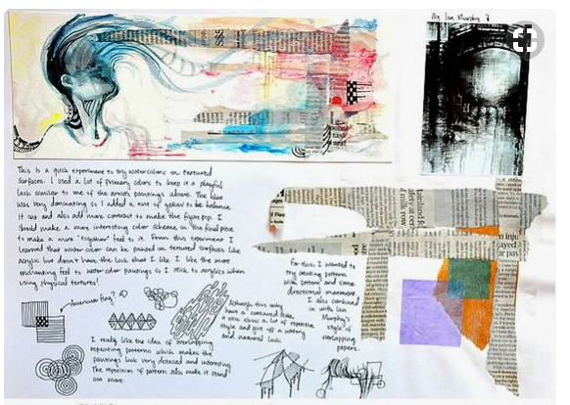
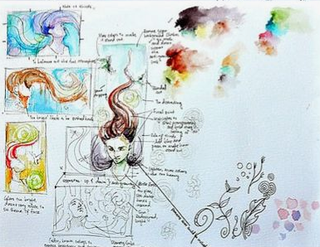
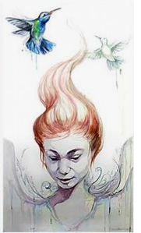
Final design ideas with experiments with materials
Example 1
Mini practice final pieces

Slide 3
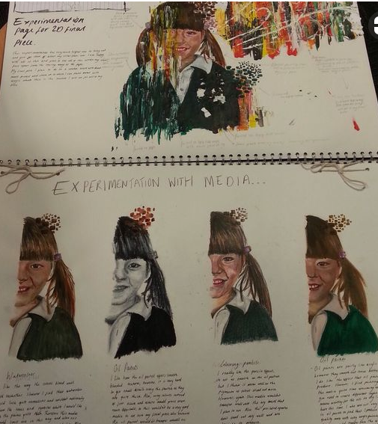
Example 2

Slide 4
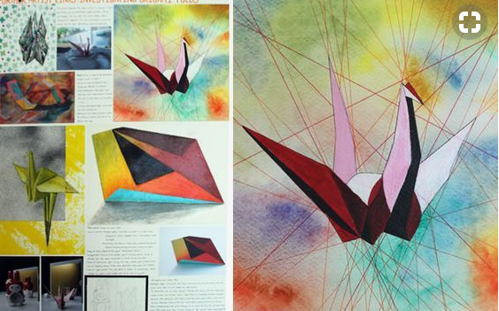
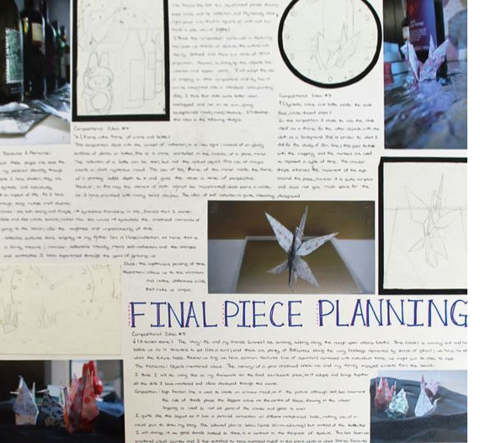
Possible final piece designs and new photos to help planning
Example 3

Slide 5
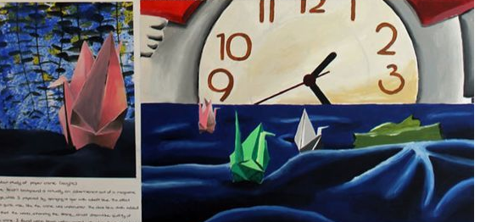
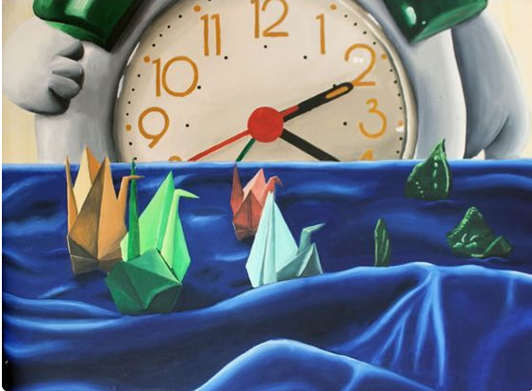
Mini practice final piece
Experiment with materials
Actual final piece. Notice how the composition and design have been further refined.

Slide 6
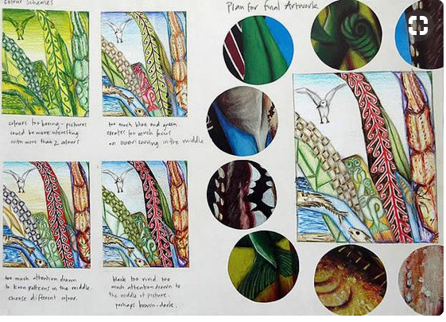
Example 4
Mini practice final piece designs x4
Decided final piece plan.
Samples of possible materials to use

