Slide 1
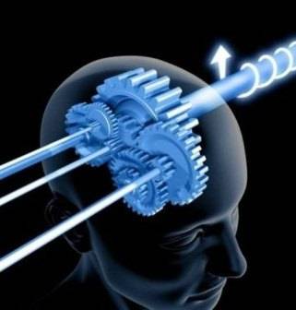
Title: What is memory? And how good is yours?!
In psychology, memory is the process in which information is encoded, stored, and retrieved.
Memories are thought to have a physical basis in the brain, but not before about two and a half.
Starter: What’s your earliest memory? Have a think for a couple of minutes about some detail e.g. Where were you? Who with? Why? How old were you? Smell? Sound? What could you see? Etc.
Learning objectives:
To be able to DEFINE sensory, short-term and long-term memory.
To KNOW there are different types of long-term memory.
To UNDERSTAND that memory can be considered ‘ reconstructive’.

Slide 2
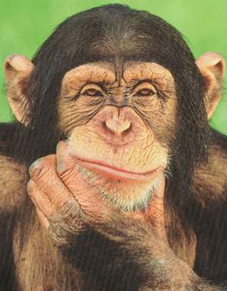
Have a think.....
What would life be like with no memory?
So how good do you think your memory is on a scale of 1 – 10?

Slide 3
How good is your memory? Memory test 1…
Look at the objects in the tray. Feel free to pick them up if you want. You have 2 mins.
Task: Write down as many of the objects as you can……..
Keywords
Semantic memory
Procedural memory
Recall
Sensory memory
Learning objectives:
To be able to DEFINE sensory, short-term and long-term memory.
To KNOW there are different types of long-term memory.
To UNDERSTAND that memory can be considered ‘ reconstructive’.

Slide 4
Memory test 2…
You are going to be shown a series of pictures….
Keywords
Semantic memory
Procedural memory
Recall
Sensory memory
Learning objectives:
To be able to DEFINE sensory, short-term and long-term memory.
To KNOW there are different types of long-term memory.
To UNDERSTAND that memory can be considered ‘ reconstructive’.

Slide 5
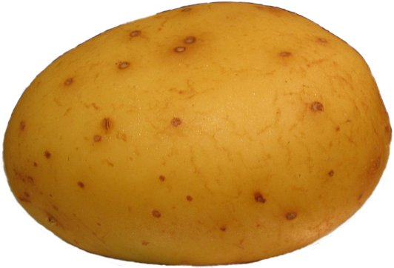
Potato

Slide 6
Grass

Slide 7
Blue Car

Slide 8
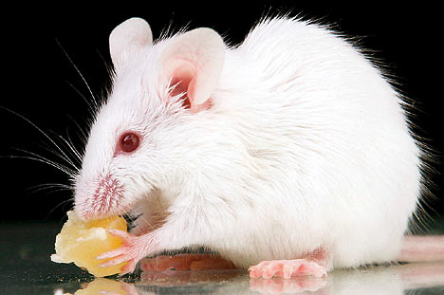
Mouse

Slide 9
Radiator

Slide 10
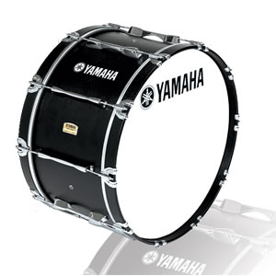
Drum

Slide 11
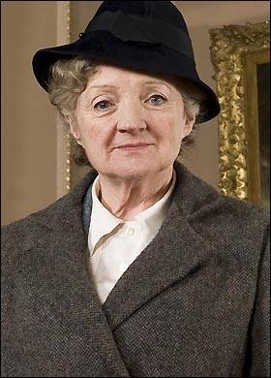
Miss Marple

Slide 12
Dinosaur

Slide 13
Baby

Slide 14
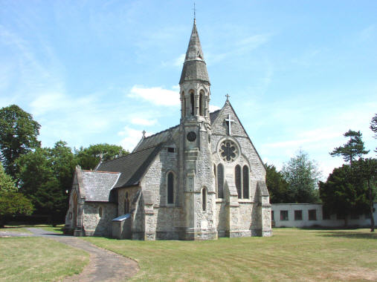
Church

Slide 15
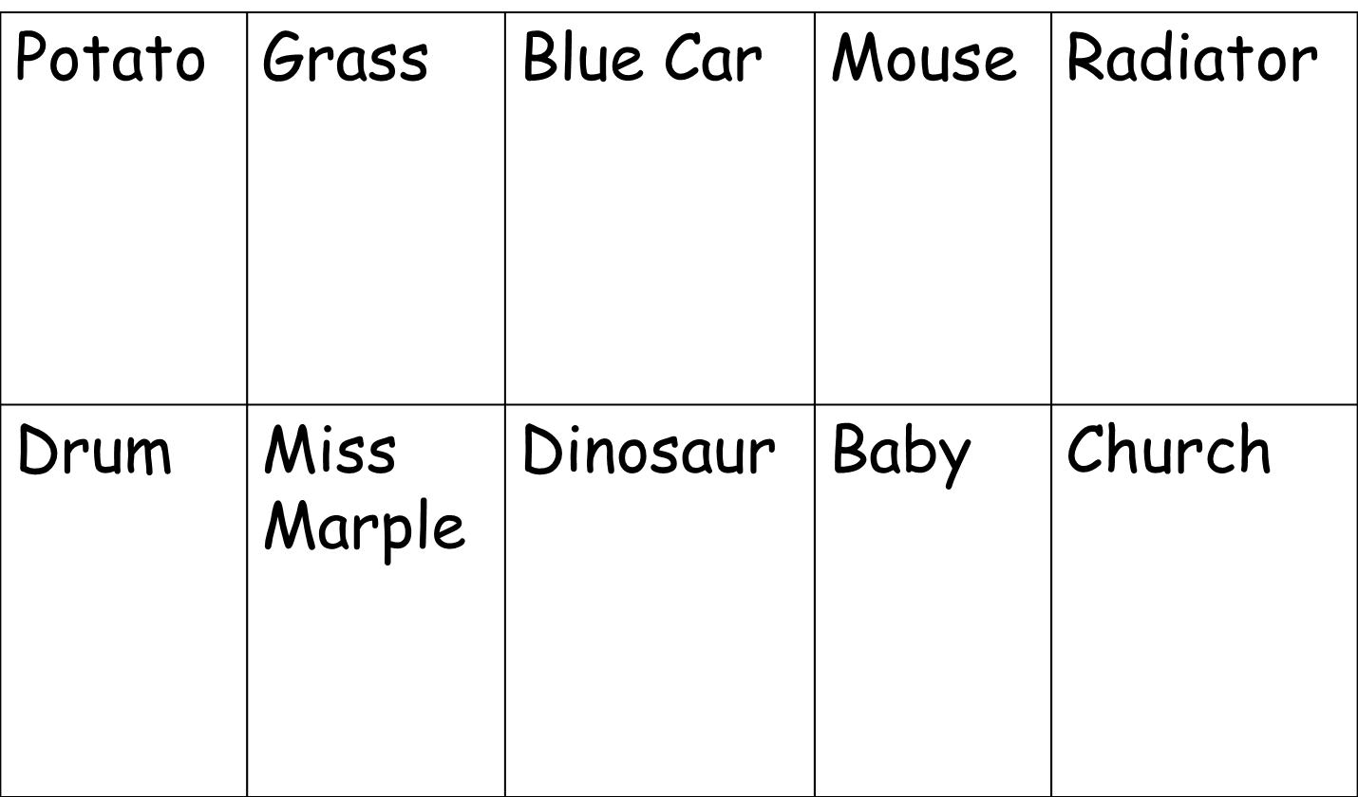
Task: Write down as many of the pictures as you can……..
How did you do in comparison to the first task?
Why do you think this was?
Were there any strategies you used to try to help you remember?

Slide 16
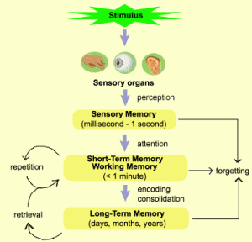
There are three types of memory…
Sensory memory (SM)
Short-term (a.k.a working) memory (STM)
Long-term memory (LTM)
Learning objectives:
To be able to DEFINE sensory, short-term and long-term memory.
To KNOW there are different types of long-term memory.
To UNDERSTAND that memory can be considered ‘ reconstructive’.

Slide 17
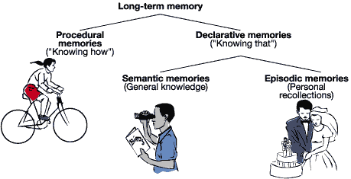
LTM can be broken down further into different types…
‘Implicit’ (unconscious memory type)
Both ‘explicit’ (conscious memory types)
Learning objectives:
To be able to DEFINE sensory, short-term and long-term memory.
To KNOW there are different types of long-term memory.
To UNDERSTAND that memory can be considered ‘ reconstructive’.

Slide 18
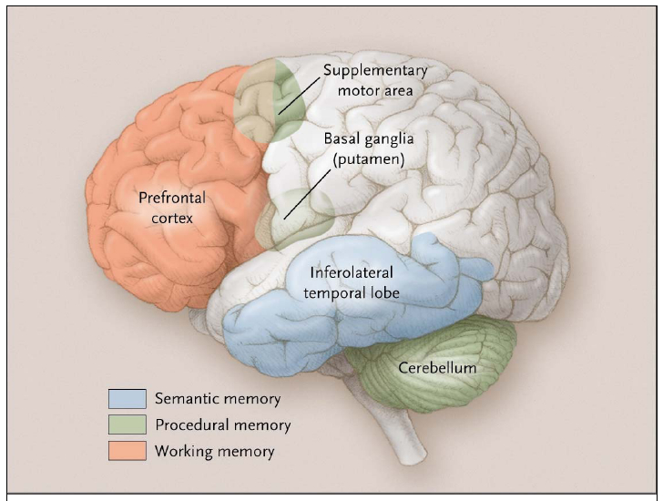
Keywords
Semantic memory
Procedural memory
Recall
Sensory memory
Learning objectives:
To be able to DEFINE sensory, short-term and long-term memory.
To KNOW there are different types of long-term memory.
To UNDERSTAND that memory can be considered ‘ reconstructive’.

Slide 19
What happens to memory over time?
Over time memory degrades. I have now removed two items from the tray.
Can you remember which ones?
Keywords
Semantic memory
Procedural memory
Recall
Sensory memory
Learning objectives:
To be able to DEFINE sensory, short-term and long-term memory.
To KNOW there are different types of long-term memory.
To UNDERSTAND that memory can be considered ‘ reconstructive’.

Slide 20
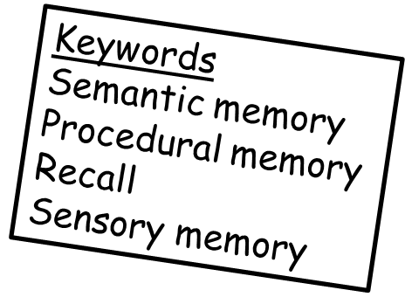
A key factor about the ‘nature’ of memory…
1. Read the story ‘War of Ghosts’ that you have been given.
2. Three of you are going to leave the room without the story, then come in one by one and retell it to the best of your ability.
3. The rest of the class are going to listen carefully and make note of any changes from the original the person inadvertently makes.
…..is that it is often distorted by things like a reordering of events in our minds, our own cultural expectations and times.
The findings from Bartlett’s original experiment using this story were that the story tended to become more succinct with the British participants cultural expectations, and that the overall length and order of the story tended to become muddled.
Learning objectives:
To be able to DEFINE sensory, short-term and long-term memory.
To KNOW there are different types of long-term memory.
To UNDERSTAND that memory can be considered ‘ reconstructive’.

Slide 21
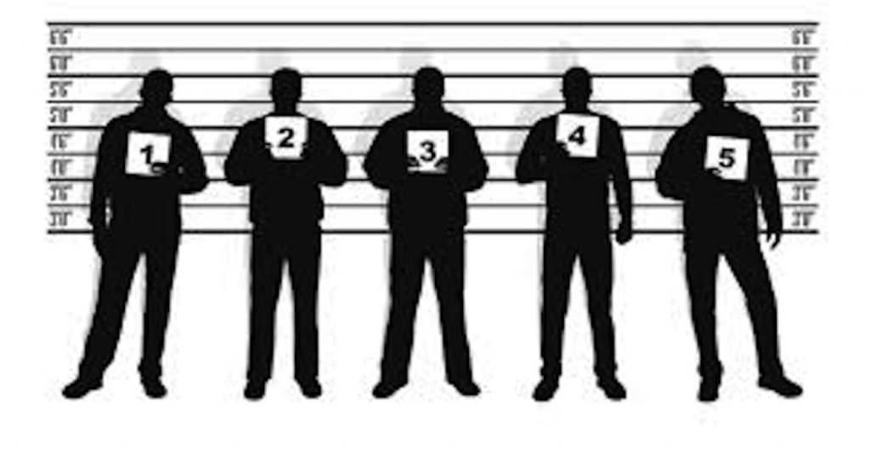
A final key factor about the ‘nature’ of memory…
Memory is ‘reconstructive’!
It is a not a perfect replication of what the person has actually seen, heard etc.
What key areas might this be problematic for in real life?
Keywords
Semantic memory
Procedural memory
Recall
Sensory memory
Learning objectives:
To be able to DEFINE sensory, short-term and long-term memory.
To KNOW there are different types of long-term memory.
To UNDERSTAND that memory can be considered ‘ reconstructive’.

Slide 22
Home Learning
Making the best use of your memory is a very important factor in exam success.
You can maximise learning and revision techniques if you know the way your brain learns best.
Task:
Complete the questionnaire to find out which type of learner you are.
Then use the internet to research what type of learning strategies are best for your type of learning preference.
Homework guidelines psychology:
If essays and past exam questions are set, a formal date will be given when these are to be given in to be marked (usually at least a week will be given).
Tasks (such as this) that require you to read/watch and make notes, or worksheet based tasks will be checked in half-termly folder checks. If they are not present you will need to attend catch up until they are.
Some home learning will not be checked (such as merely listening to a podcast). It is expected that you do this, you will be behind if you do not.
Learning objectives:
To be able to DEFINE sensory, short-term and long-term memory.
To KNOW there are different types of long-term memory.
To UNDERSTAND that memory can be considered ‘ reconstructive’.

