Slide 1
Title: What is the role of the father in development?
Starter: In pairs, one person read on article, one read the other. Summarise your article to your partner
Learning objectives:
To UNDERSTAND how the role of fathers changes by culture and over time.
To EXPLAIN the factors that affect relationships between fathers and infants.
To OUTLINE and EVALUATE research into the role of fathers.

Slide 2
What have traditional views on the ‘role of the father’ been?
Minor role.
Women ‘should’ stay home with children, man goes out to work.
Father is more of a ‘play mate’ for children, ‘nurturing’ done by mothers who demonstrate more ‘sensitive responsiveness’.
Learning objectives:
To UNDERSTAND how the role of fathers changes by culture and over time.
To EXPLAIN the factors that affect relationships between fathers and infants.
To OUTLINE and EVALUATE research into the role of fathers.

Slide 3
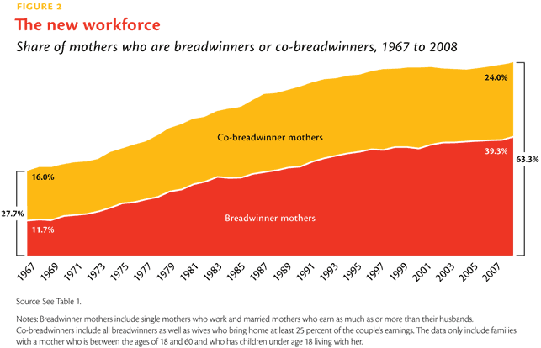
Changes in society mean that more and more men involved in child care.
Father’s demonstrate ‘sensitive responsiveness’ when spend time with infant, and assume main caregiver role.
Role of father also drastically determined by culture. For example, Aka tribe (nomadic African tribe) child rearing equal, and no gender roles.
Learning objectives:
To UNDERSTAND how the role of fathers changes by culture and over time.
To EXPLAIN the factors that affect relationships between fathers and infants.
To OUTLINE and EVALUATE research into the role of fathers.

Slide 4
Several factors affect the relationship between fathers and children…
Type of attachment with own parents
Marital intimacy
Supportive co-parenting
Learning objectives:
To UNDERSTAND how the role of fathers changes by culture and over time.
To EXPLAIN the factors that affect relationships between fathers and infants.
To OUTLINE and EVALUATE research into the role of fathers.

Slide 5
What does a secure attachment with your father lead to?
Better peer relationships.
Less behavioural problems, less aggressive and less criminality later in life (especially boys).
Do better academically.
Less likely to become a single mother, and more likely to delay first pregnancy.
HOWEVER, much of the research into these factors are conducted in deprived areas, as these are areas more likely to have absent fathers. Therefore could be the result of poverty factors, rather than father explicitly.
Learning objectives:
To UNDERSTAND how the role of fathers changes by culture and over time.
To EXPLAIN the factors that affect relationships between fathers and infants.
To OUTLINE and EVALUATE research into the role of fathers.

Slide 6
Watch the documentary about research into fathers and infants.
Make appropriate notes.
To be finished for homework.
Learning objectives:
To UNDERSTAND how the role of fathers changes by culture and over time.
To EXPLAIN the factors that affect relationships between fathers and infants.
To OUTLINE and EVALUATE research into the role of fathers.
Notes:
https://vimeo.com/94644039 http://www.documentarytube.com/videos/biology-of-dads

