Slide 1
Important watching Massolit – MAOA Gene
https://www.massolit.io/courses/aggression/the-maoa-gene

Slide 2
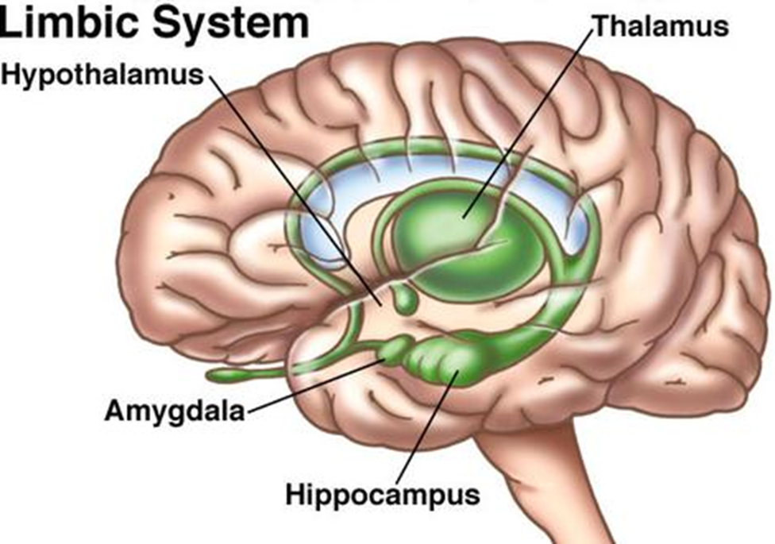
Starter : Outline the role of the limbic system in aggression (4 marks) – 4 minutes

Slide 3
Outline the role of the limbic system in aggression (4 marks)
The limbic system is comprised of the hippocampus, amygdala, thalamus and hypothalamus
The hippocampus retains memories of situations and encounters, enabling the person to respond and react appropriately. Damage to this means that encounters cannot be put into context as they do not remember how the situations played out in the past, and so there is an aggressive response since the individual cannot be sure that they are safe.
The amygdala is the part of the brain responsible for reactions to stimuli. It assesses the environment and gives an appropriate response. When the amygdala is stimulated, an aggressive response is given. Therefore an overactive amygdala causes aggression.

Slide 4
Biological Explanation – Genetic factors in aggression
Literacy Objective:
MAOA gene
Learning Objectives:
To describe research into genetic factors and explain the role of the MAOA gene (AO1)
To evaluate research into genetic factors (AO3)

Slide 5
Biological explanations of aggression
Neural and hormonal
Genetic
The limbic system *
(Amygdala, hippocampus)
Serotonin *
Testosterone*
Research on genetic factors
MAOA gene *
* You can be directly questioned on these
Notes:
Print

Slide 6
Task
Download a QR code reader app- it is free!
Go around the room and find the questions
Answer each question
The first pair to get all of the questions and answers wins

Slide 13
Thinking/ starter questions
1.In terms of genetic make-up what is the difference between monozygotic and dizygotic twins?
2.When studying aggression in twins, what are researchers looking for in order to come to a conclusion?
3.Is there any research in support for twin studies?
4.Explain how adoption studies work.
5.Have adoption studies supported or challenged the role of genetics in human aggression?

Slide 14
Background Biological Approach - Genes
Central to genetic explanations are concordance rates - A measure of similarity (usually expressed as a percentage) between two individuals or sets of individuals on a given trait.
If the concordance rate is high between family members, this would suggest a biological basis for aggression. As Mz twins share the exact same genes, they should show higher concordance rates (i.e. 100%) than DZ twin or siblings. The biological approach therefore likes to use twin studies to look and compare the concordance rate of aggression to see if it is caused by genes.
Adoption studies are also useful as if there is a similarity between a biological parent and their child who has been adopted we can assume it is due to biological factors.

Slide 15
AO1 - Twin studies
MZ= identical twins who share 100% of their genes
DZ= non-identical who share 50% of their genes
(what would this imply about aggression being genetic)
Coccaro et al used twin research to investigate into aggression.
They used a sample of adult male MZ and DZ twins (IV). They compared them in acts if direct physical assault (DV).
Findings - concordance rates of 50% in MZ twins and 19% for DZ twins for aggressive behaviour (direct physical assault)
For verbal aggression 28% Mz and 7% Dz.
This suggests…..
The higher concordance rates between MZ twins suggests that there are genetic /predisposing factors in aggression.

Slide 16
AO1 Adoption studies
Similarities between aggressive behaviour in adopted children and their biological parents suggests that genetics are influencing the behaviour.
Rhee and Waldman carried out meta-analysis of adoption studies and direct aggressive and anti social behaviour. They found genetic influence accounted for 41% of aggressive behaviour. Suggesting that….
There are genetic predisposing factors in aggression

Slide 17
The ‘warrior gene’
Notes:
https://www.youtube.com/watch?v=jRIOgdz_AIM

Slide 18
Wider research
Does Dr. Fallon, a leading neurobiologist at the University of California think that violence and aggression are genetic?
Make notes to back up your answer.
https://www.ted.com/talks/jim_fallon_exploring_the_mind_of_a_killer/transcript?language=en
http://brainposts.blogspot.co.uk/2010/08/neuroscience-of-murder-and-aggression.html#!/2010/08/neuroscience-of-murder-and-aggression.html
Recap on the findings of Dr.Fallon!

Slide 19
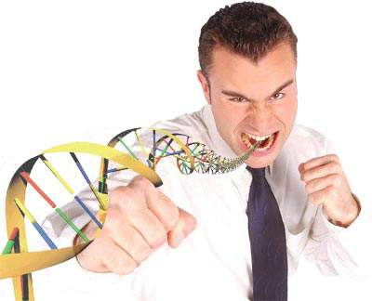
Can a gene influence the level of aggression?
MAOA’s role is to breakdown neurotransmitters after the nerve impulse has been transmitted, so that they can be recycled or excreted. MAOA especially targets serontonin. Therefore what might happen if the gene regulating MAOA is dysfunctional?
A gene responsible for producing the enzyme MAOA has been associated with aggressive behaviour

Slide 20
MAOA is responsible for
Breaking down (recycling) serotonin
Low levels of serotonin is associated with impulsive and aggressive behaviour
What do we know about serotonin and aggression?

Slide 21
The Warrior gene AO1
Research has suggested that there is a ‘warrior gene’ that leads to low MAOA.
The MAOA gene controls the production of Monoamine oxidase A enzyme which helps to break down neurotransmitters such as serotonin and noradrenaline. Low activity of this enzyme causes an imbalance in serotonin and other transmitters, in turn causing increased levels of aggression.
Research
Brunner studied 5 generations of a Dutch family
Many male members demonstrated violent and aggressive behaviour. This included acts of arson and rape.
These men were found to have had abnormally low levels of MAOA and a defect in the gene.
This suggests….

Slide 22
MAOA-L is common in populations where there has been a history of warfare (2/3rds)
Contrastingly, in Western cultures only 1/3 have this variation of the gene
Notes:
https://www.youtube.com/watch?v=jRIOgdz_AIM

Slide 23
Progress check
What is MAOA and what is it responsible for in the brain?
What research suggests there is a link between MAOA and aggression?
What is the ‘warrior gene’?
Outline the role of MAOA in aggression (4 marks)
Outline the role of genetic factors in aggression ( 6marks)

Slide 24
Outline the role of MAOA in aggression (4 marks)
The MAOA gene controls the production of Monoamine oxidase A enzyme which helps to break down neurotransmitters such as serotonin and noradrenaline. Low activity of this enzyme causes an imbalance in serotonin and other transmitters, in turn causing increased levels of aggression.
Brunner looked at a Dutch family over 5 generations and found that many expressed violent and aggressive behaviour. After studying their DNA, he found these men had abnormally low levels of MAOA and a defect in the gene.
It is a sex-linked gene on the X chromosome, meaning men are more likely to have the gene than women, and so consequently will be more aggressive.

Slide 25
Evaluating Genetic Explanations
1. Support in being able to explain gender differences
2. Too simplistic – other genes 5HTT
3. Caspi – gene and environment interaction
4. Methodological problems
5. IDA - implications a
Important note: Some of these evaluations can be used again for SLT and environmental explanations! So make sure you are happy with them now and you can flip them across and make comparisons for level 4 paragraphs

Slide 26
Gender differences

Slide 27
Evaluating Gender Differences
A strength of the MAOA gene is that it can explain gender differences found in aggression.
MAOA gene is a sex-linked gene on the X chromosome. Women have two X chromosomes whereas men only have one. Therefore when men inherit an X- linked gene from their mothers they are more likely to be affected unlike women (women have the second X chromosome so it prevents the expression of the abnormal version). This could therefore explain why men show more aggressive behaviour.
This can explain gender differences found in society and in Bandura’s bobo doll study…… (explain here what Bandura found about gender differences)

Slide 28
MAOA gene is too Simplistic – Other genes such as the 5-HTT are involved
Measuring aggression using partner violence 5 HTT gene that also leads to higher levels of aggression. The two genes work together increased likelihood of partner violence (aggression).
Difficult to isolate certain genes – hundreds of different possibilities of how genes interact that could cause aggression.
Therefore genetic research has low predictability; this questions its value. Furthermore if there is a gene involved there are limited applications – ethically we can’t manipulate genes and should be tell people they might have violent genes?

Slide 31
Caspi Gene-environment interaction AO3 or AO1
Low MAOA gene activity only appears to be associated with aggression when combined with early traumatic events
Caspi
Aim:
Method:
Results:
Conclusion:
Stretch and Challenge:
What is the diathesis-stress model?
What does this suggest?
It is difficult to isolate genetic and environmental factors. Usually it is an interaction of the two and it would make more sense to study the interaction of these two factors. In the real world, for humans, our complex social interactions means it would be more valid and useful to study the relationships between nature and nurture.

Slide 32
Evaluation of Genetic Factors
IDA Points
** What are the implications of the genetic explanation? Do we have free will according to this explanation or is it biologically deterministic? Should we be held accountable for our actions if it is the result of our genes? What are the implications for our legal system?
Can we change genes? Eugenics?
Ethical Issues? Labelling – what are the implications we we label people with the warrior gene? Undesirable?
Biologically reductionist

Slide 33
Methods and measuring aggression
However also the methods used to understand aggression can also influence findings.
Observations such as Bandura tend to demonstrate environmental factors play a big role in aggression. Whereas self report methods highlight the importance of genes in aggression. Are we actually measuring the causes of aggression accurately, as there tend to be inconsistencies depending on methods. Therefore can’t establish the cause of aggression until we are objectively and accurately measuring it.
Higher concordance rates in MZ twins may be due to identity confusion – nurture not nature. This is because they are treated as one and therefore they have similar environments compared to DZ.

Slide 34
Unrepresentative sample

Slide 35
A weakness of the research into the genetic factors of aggression is that the sample is sometimes unrepresentative. For example, participants are mainly convicted criminals and doesn’t represent those repeat offenders who haven’t been convicted. Furthermore those being convicted may have committed a single act of violence and not necessarily have had a lifetime of aggression. Therefore by using these individuals as sample we aren’t getting an accurate representation of aggression and this can explain the low/little evidence found in heritability/ genetic causes.

