Slide 1
Try to solve the ‘social influence’ key word anagrams Comfy Intro Rad Zombi Cheating Fits Occults For Loon
How can the minority influence social change?
Learning objectives:
To be able to DEFINE ‘social change’ and give examples.
To UNDERSTAND how minority can bring about social change.
To KNOW and EVALUATE research into social change (including Moscovici 1969)
Notes:
Conformity
Zimbardo
Agentic shift
Locus of control

Slide 2
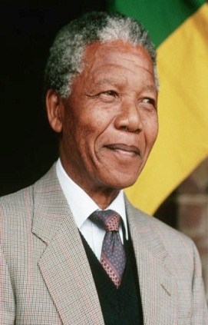
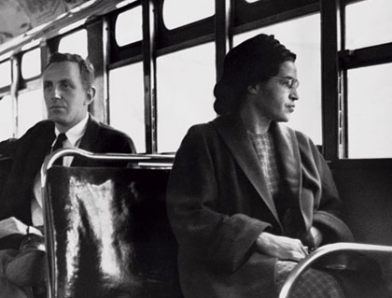
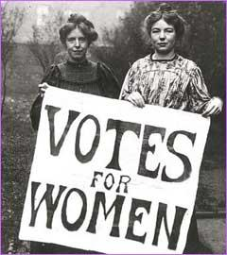
We have looked at majority influence (conformity), but sometimes the ‘minority’ can also have an influence on society – and at times cause social change.
Social change occurs when a society as a whole adopts a new belief or way of behaving which then becomes the accepted ‘norm’.
Who are each of the people? And what examples of real life social change did they bring about?
Learning objectives:
To be able to DEFINE ‘social change’ and give examples.
To UNDERSTAND how minority can bring about social change.
To KNOW and EVALUATE research into social change (including Moscovici 1969)

Slide 3
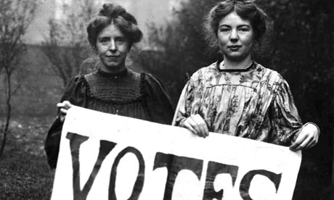
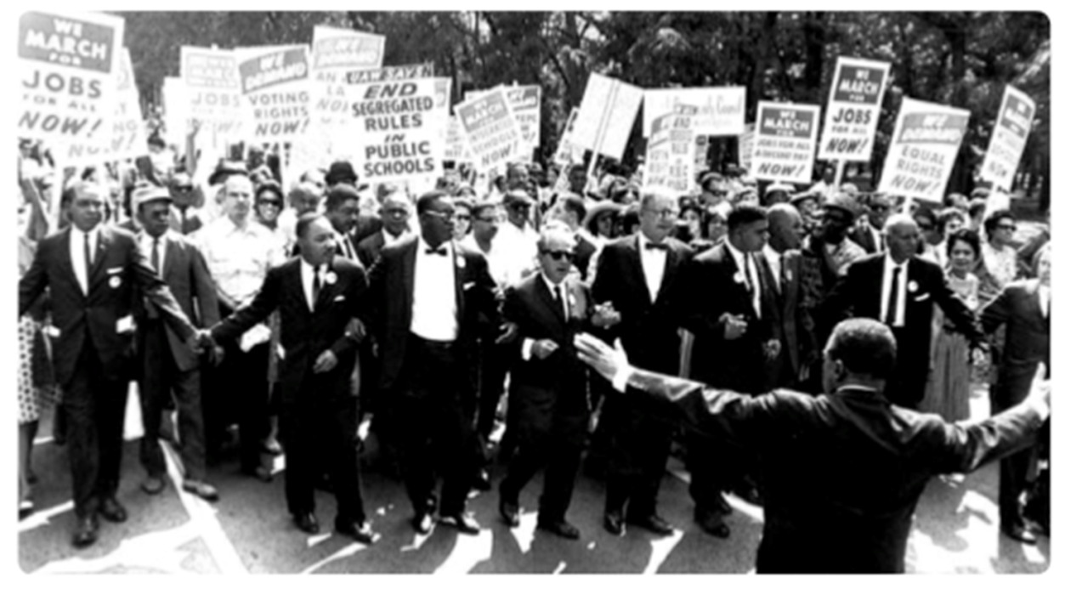
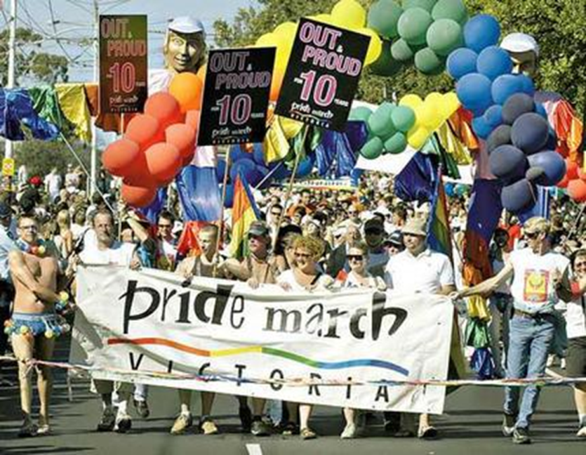
Historically, there have been many examples of social change: the Suffragette movement, Civil Rights movement, etc.
The term ‘minority influence’ refers to a form of social influence that is attributed to exposure to a consistent minority position in a group.
Minority influence is generally felt only after a period of time, and tends to produce private acceptance of the views expressed by the minority.
Learning objectives:
To be able to DEFINE ‘social change’ and give examples.
To UNDERSTAND how minority can bring about social change.
To KNOW and EVALUATE research into social change (including Moscovici 1969)

Slide 4
Moscovici et al (1969)
Wanted to show that majority influence was not the only way in which groups exerted pressure on individuals: could be the minority.
His explanation of minority influence is: if an individual is exposed to a persuasive argument under certain conditions, they may change their own views to match those of the minority.
He called this a ‘conversion’ and said it was a prerequisite for social change.
Learning objectives:
To be able to DEFINE ‘social change’ and give examples.
To UNDERSTAND how minority can bring about social change.
To KNOW and EVALUATE research into social change (including Moscovici 1969)

Slide 5
Moscovici et al (1969) – procedure…
In a laboratory experiment, groups of 6 female ppts (2 confederates – ‘the minority group’) shown 36 blue slides of differing shades
Learning objectives:
To be able to DEFINE ‘social change’ and give examples.
To UNDERSTAND how minority can bring about social change.
To KNOW and EVALUATE research into social change (including Moscovici 1969)

Slide 6
Moscovici et al (1969) – procedure…
How could these terms be used to evaluate Moscovici’s study?
Condition 1 – confederates identified all 36 slides as green
Condition 2 – confederates identified slides as green in 24 slides and blue in 12 slides.
Moscovici said this showed the importance of presenting a consistent argument in minorities having an influence on the majority.
In real life, such as civil rights movements, Moscovici argues that if minorities are consistent in their beliefs over time, it makes their views more influential, as it gives the impression that the minority are convinced they are right and shows to others that they have the skills with which to challenge the beliefs and attitudes of the majority.
“Green”
10% of participants changed their view.
Low
ecological
validity
36/36
Unrepresentative sample
“Green”
“Blue”
No participants changed their view.
24/36
12/36
Learning objectives:
To be able to DEFINE ‘social change’ and give examples.
To UNDERSTAND how minority can bring about social change.
To KNOW and EVALUATE research into social change (including Moscovici 1969)

Slide 7
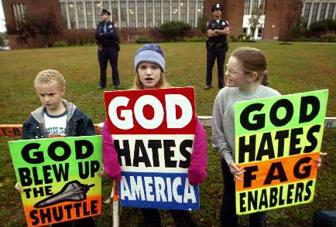
In addition to ‘consistent’, research has shown that for a minority to be successful in bringing about social change they also need to be:
Flexible
Non-dogmatic
and
E.g. not Westboro
Baptist Church…
Learning objectives:
To be able to DEFINE ‘social change’ and give examples.
To UNDERSTAND how minority can bring about social change.
To KNOW and EVALUATE research into social change (including Moscovici 1969)

Slide 8
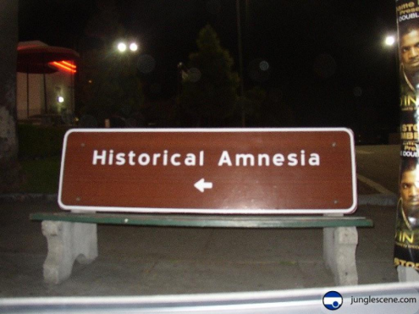
The minority gradually turns into the majority Through social crypto-amnesia and the snowball effect….
:
People beginning to change their minds when they see others adopting changing the minority viewpoint. Exponential growth of view swing.
The source of the minority view is often forgotten when the view becomes the majority ‘norm’. E.g. distance themselves from historically belonging to a racist, sexist society etc.
Learning objectives:
To be able to DEFINE ‘social change’ and give examples.
To UNDERSTAND how minority can bring about social change.
To KNOW and EVALUATE research into social change (including Moscovici 1969)

Slide 9
The minority gradually turns into the majority Through social crypto-amnesia and the snowball effect….
:
People beginning to change their minds when they see others adopting changing the minority viewpoint. Exponential growth of view swing.
The source of the minority view is often forgotten when the view becomes the majority ‘norm’. E.g. distance themselves from historically belonging to a racist, sexist society etc.
Learning objectives:
To be able to DEFINE ‘social change’ and give examples.
To UNDERSTAND how minority can bring about social change.
To KNOW and EVALUATE research into social change (including Moscovici 1969)

Slide 10
Explain how social influence research helps us to understand social change. (6 marks)
AO1 = 6 marks
There are various ways in which social influence research can help explain social change and there is a wide range of possible answers here. However, social change refers to the change that occurs in a society and not at the individual level.
Minorities bring about social change by being consistent, flexible and non-dogmatic. Through social crypto-amnesia and the snowball effect, gradually the minority turns into the majority.
Detailed descriptions of studies (eg Moscovici) are only relevant if they are used effectively to show how they have helped our understanding.
Research can refer to either theory or study.
6 marks: Accurate and reasonably detailed answer that demonstrates sound knowledge and understanding of how social influence research helps our understanding of social change. There is appropriate selection of material to address the question.
5 - 4 marks: Less detailed but generally accurate answer that demonstrates relevant knowledge and understanding. There is some evidence of selection of material to address the question.
3 - 2 marks: Basic answer that demonstrates some relevant knowledge and understanding but lacks detail and may be muddled. There is little evidence of selection of material to address the question.
Learning objectives:
To be able to DEFINE ‘social change’ and give examples.
To UNDERSTAND how minority can bring about social change.
To KNOW and EVALUATE research into social change (including Moscovici 1969)

Slide 11
Revision!
In groups you are going to make one the following:
A revision video of the ‘social influence’ topic.
A massive mind-map of social influence.
A revision presentation to deliver to the class including powerpoint or prezi etc.
Learning objectives:
To be able to DEFINE ‘social change’ and give examples.
To UNDERSTAND how minority can bring about social change.
To KNOW and EVALUATE research into social change (including Moscovici 1969)

