Slide 1
Lesson Objective:
Enquiry: Was Henry VIII a man or a monster?
Reasoning
&
Reflection

Slide 2
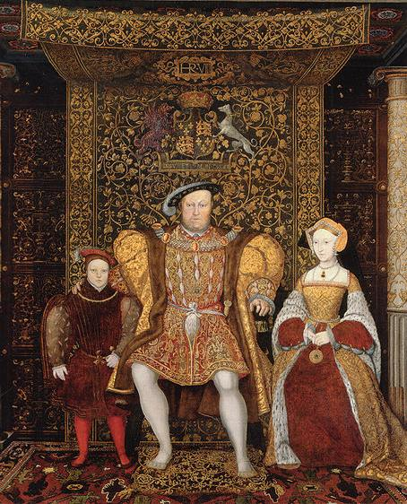
Learning Outcomes:
Complete the source investigation and describe if Henry was good or bad.
Decide if Henry was a man or a monster and explain this using the sources to support your answer.
Evaluate Henry VIII’s personality and question the reliability of the sources based on their origin or nature. (who wrote them/what are they)
A3
A2
A1

Slide 3
Was Henry VIII a man or a monster?
Starter:
In the backs of your books write down as many things as you can about Henry VIII. You have 2 min only!!

Slide 4
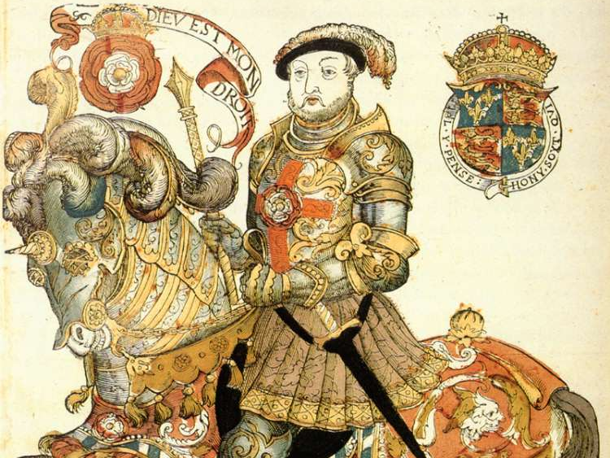
Source No
DESCRIBE + EXPLAIN:
What can you learn from the source about Henry VIII?
Who wrote it? / Said it?
Who were they?
Can you trust it? YOU MUST EXPLAIN WHY!
I can learn that Henry was a horrible man. The source says he was ‘cruel’ and had “many people” killed.
The Earl of Bedford, 1534
I think I can trust the source because it was written during the Tudor period and the Earl knew Henry and helped him run the country.
Task:
Enquiry question: Was Henry a man or a monster?
You are going to investigate different sources to try and answer the enquiry question.
Look at the example provided then use the sources around the room to complete your source investigation table.

Slide 5
Discussion:
Was Henry a good or a bad king?
What is your interpretation of Henry’s personality?
How do you think people in Tudor England felt about their king?
Which sources support each other?
Which source do you think is the most accurate?
Why are these sources significant?
LO2: Please put one tick in the top right-hand corner of your book if
you think you have successfully completed the source investigation and
can describe if Henry was good or bad using the sources.

Slide 6
Task:
In your books answer the following question:
Was Henry VIII a man or a monster?
LO3: Please put one tick in the bottom right-hand corner of your book if
you think you have in your answer question the reliability of the sources

Slide 7
What level am I?
A3:
I can describe who Henry VIII was and if he was good or a bad
You write in full sentences
A2:
You describe who Henry was and explain if he was a good or a bad king using the sources to back up your points.
You write in full sentences paragraph your work and have a introduction and conclusion.
A1:
You can evaluate Henry VIII’s personality and question the reliability of the sources based on what they are or who wrote them.
You write in full sentences paragraph your work and have a introduction and conclusion.
Reflection: Self Assessment
Look over your essay: On your post it note write down:
The level you would give yourself
A target- what could you improve / what you didn’t understand
What did you enjoy? / What did you do well?

Slide 8
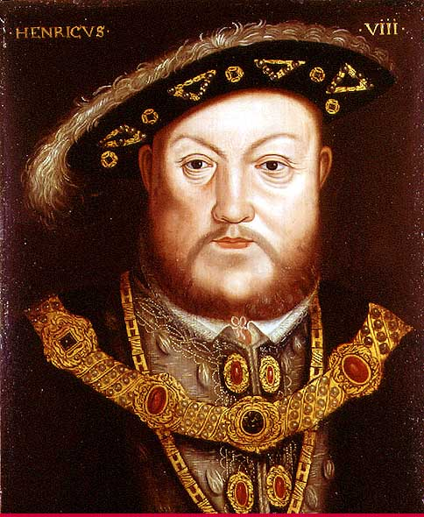
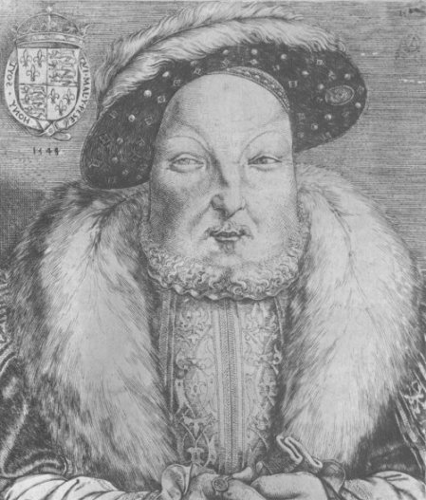
Man:
Monster:
Summary:
Time to vote:
Based on what you have learnt was Henry a man or a monster?

Slide 9
