Slide 1
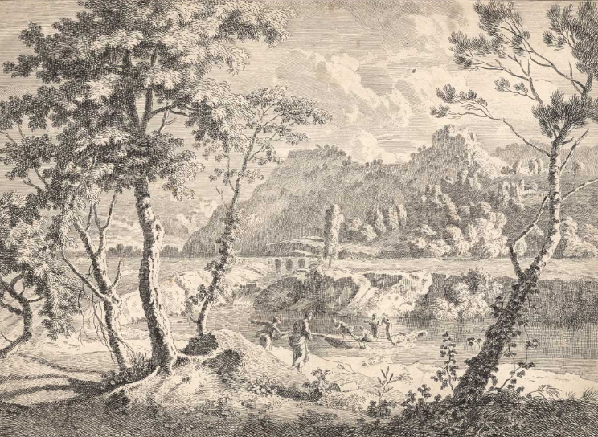
Etching prints
Johannes Glauber's etching, “Landscape with a River, a Boat with Four Men”, c.1680

Slide 2
Lesson objective: to be able to produce a set of crisp etching prints.
Skill objective: to apply and remove the correct amount of ink to your plate and to use the correct method of dampening your paper.
Lesson Outcome: at least one practice print, possibly the print over your Chinese landscape to respond to Yang Yongliang.
Extension: biro additions of industrial elements to second photocopy.

Slide 3
Step by step
1. put gloves on!
2. using a bit of cardboard smear a thin layer of etching ink over the acetate.
3. push the ink into the grooves (in different directions) using a kidney or the bit of cardboard.
4. remove the ink in circular motions using a bit of cloth until the ink just remains in the grooves/scratches.
5. with clean hands dampen a piece of cartridge, drain off excess water and blot.
6. put through printing press – only once!

