Slide 1
Title: Why do we conform and go along with other people?
Paper 1: Social Influence

Slide 2
Many of our everyday decisions and behaviours are influenced by social pressures to conform to the opinions and behaviours of others.
Learning objectives:
To KNOW the differences between types of conformity: ‘internalisation’, ‘identification’ and ‘compliance’ and UNDERSTAND the explanations for these (ISI & NSI).
To DESCRIBE and EVALUATE research into types of conformity (Asch and Sherif).

Slide 3
Conformity
What is conformity?
(A.K.A ‘majority influence’)
“ Tendency for people to adopt the behaviour, attitudes and values of other members of a reference group, as a result of real or imagined pressure from that group to do so”
Zimbardo et al (1995)
We tend to ‘conform’ and change our own opinion when a certain course of action is favoured by the majority…
Or when something is more socially acceptable.
Learning objectives:
To KNOW the differences between types of conformity: ‘internalisation’, ‘identification’ and ‘compliance’ and UNDERSTAND the explanations for these (ISI & NSI).
To DESCRIBE and EVALUATE research into types of conformity (Asch and Sherif).

Slide 4
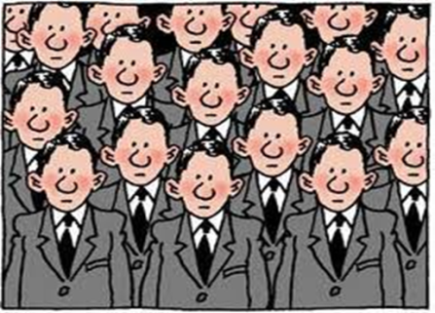
There are 3 ways in which people conform to the opinions and behaviors of others….
These three are differing levels of conformity.
Compliance
Identification
Internalisation
Shallowest Level
Deepest Level
Learning objectives:
To KNOW the differences between types of conformity: ‘internalisation’, ‘identification’ and ‘compliance’ and UNDERSTAND the explanations for these (ISI & NSI).
To DESCRIBE and EVALUATE research into types of conformity (Asch and Sherif).

Slide 5
There are 3 ways in which people conform to the opinions and behaviors of others….
Compliance - Superficial agreement with the group.
Going along with the group publicly, because we don’t want to be rejected, but holding a different view privately. This means that the conformed behaviour or opinion stops as soon as the group pressure stops.
Identification- Moderately conforming to the group because we value it.
Prepared to change opinions and behaviours because we identify with the group and want to be part of it. This may mean we publically change our behaviours and opinions to achieve our goal, even if we do not privately agree with everything the group stand for.
Internalisation – Deeply conforming with the group because we accept its norms.
Agreeing with a group both publically and privately. This form of conformity is therefore permanent, and continues even in the absence of the group, because attitudes have been internalised
Learning objectives:
To KNOW the differences between types of conformity: ‘internalisation’, ‘identification’ and ‘compliance’ and UNDERSTAND the explanations for these (ISI & NSI).
To DESCRIBE and EVALUATE research into types of conformity (Asch and Sherif).

Slide 6
We conform to the ‘norms’ of the group, as we do not want to be ‘the odd one out’ and rejected by the group. We seek social approval, and this is one way to gain it. NSI is therefore an emotional process rather than a cognitive process.
It is more likely to occur with people you know (as you seek their approval more) and/or in situations where you need social support.
Either we conform due to: Normative Social Influence (NSI) – The need to be liked.
More likely to lead to: COMPLIANCE.
The ‘two process’ theory explains WHY people conform.
In situations where you are unsure whether your behaviours and opinions are right or wrong you go along with the group because you assume they are ‘right’, and you too want to be ‘right’. NSI is therefore a cognitive process, and is more likely to occur in new situations, and with people you don’t know, as you’re unsure as to what the ‘right’ way to act or think is.
Or we conform due to: Informational Social Influence (ISI) – The need to be ‘right’
More likely to lead to: INTERNALISATION.
Learning objectives:
To KNOW the differences between types of conformity: ‘internalisation’, ‘identification’ and ‘compliance’ and UNDERSTAND the explanations for these (ISI & NSI).
To DESCRIBE and EVALUATE research into types of conformity (Asch and Sherif).

Slide 7
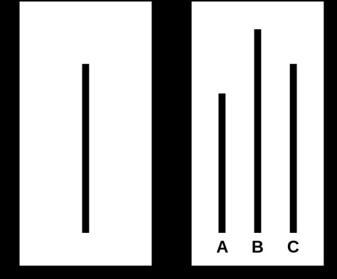
Evidence for NSI…..
Asch (1952)– In the ‘line experiment’, found that many ppts went along with the confederate group majority. After interviewing them to ask why they did this, he found that for most it was just because they did not want to be the only one giving a different answer, and feared disproval from the group. This is illustrated by the fact that in a variation of the experiment where ppts were asked to write down their answer instead, conformity fell dramatically.
Evidence for ISI…..
Lucas et al (2006) – asked students to give answers to maths problems on a scale of difficulty. There was greater conformity to the wrong answers of others on the hard problems, than the easy ones. This was especially marked among the students who doubted their mathematical ability (and therefore were less likely to know if they were ‘right’).
Learning objectives:
To KNOW the differences between types of conformity: ‘internalisation’, ‘identification’ and ‘compliance’ and UNDERSTAND the explanations for these (ISI & NSI).
To DESCRIBE and EVALUATE research into types of conformity (Asch and Sherif).

Slide 8
Evaluation of Asch research…
Ecological validity?
Not a realistic task or setting (laboratory study). Therefore lacks ecological validity. This means difficult to generalise findings to different settings, as it might just be that particular setting/task that yielded the behaviours found.
Also possible that participants knew what they were really being tested for, and acted according. It is therefore possible that demand characteristics contributed to the findings.
HOWEVER, subsequent research (Mori and Arai (2010) that has minimised this issue, by using a more realistic task in a more realistic setting has found similar results.
Ethical?
Population validity?
Era dependent?
Learning objectives:
To KNOW the differences between types of conformity: ‘internalisation’, ‘identification’ and ‘compliance’ and UNDERSTAND the explanations for these (ISI & NSI).
To DESCRIBE and EVALUATE research into types of conformity (Asch and Sherif).

Slide 9
Evaluation of Asch research…
Ecological validity?
Ethical?
Population validity?
Era dependent?
Asch’s experiment has been criticised for being a “child of it’s time”. This is because Perrin and Spencer (1980) replicated Asch’s experiment and found very little conformity. It was suggested that this was because the 1950s (when Asch’s original research was carried out) was a time of unusually high conformity culturally in the US due to historical reasons. By the 1980s this cultural conformity had decreased.
Learning objectives:
To KNOW the differences between types of conformity: ‘internalisation’, ‘identification’ and ‘compliance’ and UNDERSTAND the explanations for these (ISI & NSI).
To DESCRIBE and EVALUATE research into types of conformity (Asch and Sherif).

Slide 10
Evaluation of Asch research…
Ecological validity?
Ethical?
Population validity?
Original study had a biased sample - only US males. Therefore it is difficult to generalise the results across cultures (backed up by research which shows cultural differences between collectivist and individualist cultures). It also difficult to generalise the results to women, as it possible that their differing socialisation and genetics may lead to differing results (backed up by research demonstrating women are more conformist).
Era dependent?
Learning objectives:
To KNOW the differences between types of conformity: ‘internalisation’, ‘identification’ and ‘compliance’ and UNDERSTAND the explanations for these (ISI & NSI).
To DESCRIBE and EVALUATE research into types of conformity (Asch and Sherif).

Slide 11
Evaluation of Asch research…
Ethical?
Ecological validity?
Deceived participants (unethical).
However, could be argued that this was acceptable as the knowledge gained has valuable implications to society.
Ppts were also offered a proper debrief after, and the option to have their results removed. This minimises the issues surrounding deception.
Population validity?
Era dependent?
Learning objectives:
To KNOW the differences between types of conformity: ‘internalisation’, ‘identification’ and ‘compliance’ and UNDERSTAND the explanations for these (ISI & NSI).
To DESCRIBE and EVALUATE research into types of conformity (Asch and Sherif).

Slide 12
Evaluation of Asch research…
Finally, two-thirds of participants did NOT conform!!!!!!
Do Asch’s results therefore actually show that the majority of people resist conformity?! Is 37% actually a significant percentage?
Learning objectives:
To KNOW the differences between types of conformity: ‘internalisation’, ‘identification’ and ‘compliance’ and UNDERSTAND the explanations for these (ISI & NSI).
To DESCRIBE and EVALUATE research into types of conformity (Asch and Sherif).

Slide 13
Evaluation of ‘two process’ theory (A02)….
‘Two process’ idea suggest that conformity in a situation is either due to NSI or ISI. However, more likely that in most situations both are happening at the same time to some degree.
Research shows that NSI does not affect everyone’s behaviour in the same way (individual differences).
People who have a greater need to be liked are more likely to conform due to NSI.
Asch also found that some groups of people (for example students) are less likely to conform than others.
Some research has also suggested that women have also been found to comply more than men. However, this has criticised as it likely that women were merely less confident in the laboratory experiment tasks used.
Bond and Smith (1998) conducted a meta-analysis of conformity studies and found that individualistic cultures showed lower rates of conformity than collectivist cultures.
Berns (2005) used MRI scans to confirm that the part of the brain responsible for judgements when engaged in a conformity task
Learning objectives:
To KNOW the differences between types of conformity: ‘internalisation’, ‘identification’ and ‘compliance’ and UNDERSTAND the explanations for these (ISI & NSI).
To DESCRIBE and EVALUATE research into types of conformity (Asch and Sherif).

Slide 14
Home Learning
1. Listen to the ‘mind changer’s podcast at:
http://www.bbc.co.uk/programmes/p00f8mzr (or on the moodle)
This looks at Solomon Asch’s classic social psychological research, his findings and whether the research is likely to be valid today.
2. Watch the video at:
http://www.wimp.com/conformityvideo/
Make appropriate key notes from the video.
Learning objectives:
To KNOW the differences between types of conformity: ‘internalisation’, ‘identification’ and ‘compliance’ and UNDERSTAND the explanations for these (ISI & NSI).
To DESCRIBE and EVALUATE research into types of conformity (Asch and Sherif).

