Slide 1
Were the Tudors masters of torture?
Why do people commit crimes?
Notes:
At the start of the lessons student to copy the Learning objective into their books. Either: I will learn… or I will develop/be able to
Key words as part of the objective: express, evaluate, organise, define, solve, write, plan, apply, produce, select, reflect on, implement, compile, incorporate, construct, explain, practise, draw, identify, classify, decide, list calculate, present, assemble, describe, conclude
Starter: Think about how are you going to engage the students that they can do independently that look back on the previous lesson or look forward

Slide 2
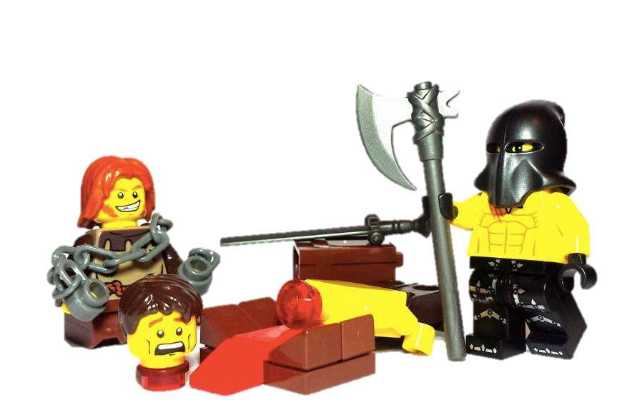
Were the Tudors masters of torture?
Learning objectives:
To investigate the different crimes committed during the Tudor Period.
To assess the different types of punishment given.
To analyse source material to suggest how Tudor punishments differ to modern punishments.
Conclude whether the Tudors were masters of torture!
[A study of Crime and Punishment in Tudor England].

Slide 3
No organised police force!
During Tudor Stuart times there was no organised police force.
Each village had an organised militia where men from the village would protect it from outside invaders.
However law were harsh and wrongdoing was severely punished. To deter people from committing crime, the punishments were very cruel.
People believed if a criminal’s punishment was severe and painful enough, the act would not be repeated and it would put other people off the committing crime as well. Torture was used as a way of gaining information.

Slide 4
Justices of the Peace
Each village had a Justice of the Peace to sort out any problems. If you were a Justice of the Peace you would have the power to:
Stop riots, using the militia
Look after the building of roads, bridges, jails and poor houses
Decide how much local people should be paid
Report people who didn’t go to church
Be in charge of whipping beggars
Check on the local alehouses

Slide 5
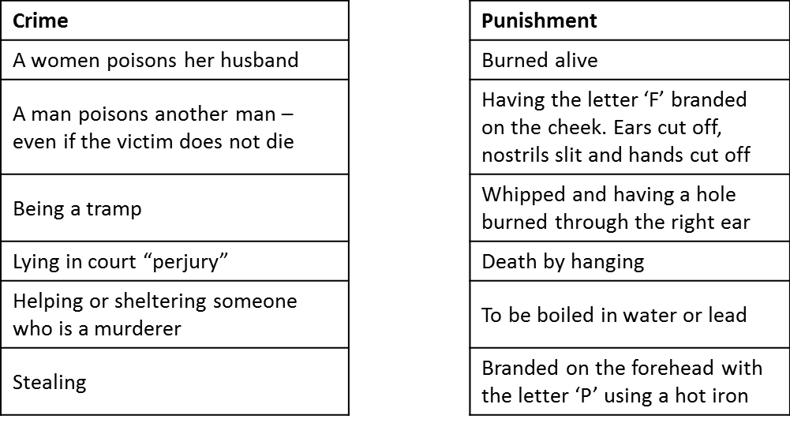
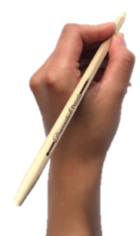
Have a go at matching the crimes to the punishments
2:00
1:59
1:58
1:57
1:56
1:55
1:54
1:53
1:52
1:51
1:50
1:49
1:48
1:47
1:46
1:45
1:44
1:43
1:42
1:41
1:40
1:39
1:38
1:37
1:36
1:35
1:34
1:33
1:32
1:31
1:30
1:29
1:28
1:27
1:26
1:25
1:24
1:23
1:22
1:21
1:20
1:19
1:18
1:17
1:16
1:15
1:14
1:13
1:12
1:11
1:10
1:09
1:08
1:07
1:06
1:05
1:04
1:03
1:02
1:01
1:00
0:59
0:58
0:57
0:56
0:55
0:54
0:53
0:52
0:51
0:50
0:49
0:48
0:47
0:46
0:45
0:44
0:43
0:42
0:41
0:40
0:39
0:38
0:37
0:36
0:35
0:34
0:33
0:32
0:31
0:30
0:29
0:28
0:27
0:26
0:25
0:24
0:23
0:22
0:21
0:20
0:19
0:18
0:17
0:16
0:15
0:14
0:13
0:12
0:11
0:10
0:09
0:08
0:07
0:06
0:05
0:04
0:03
0:02
0:01
End
2:00

Slide 6
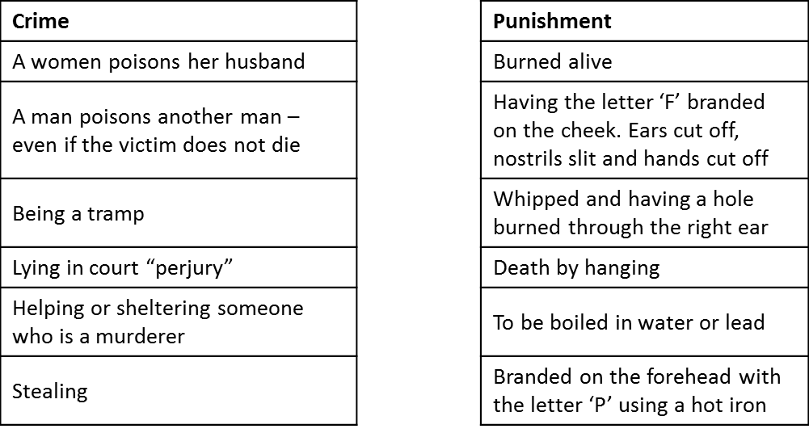
How did you do? Swap with the person next to you

Slide 8
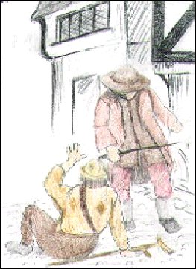
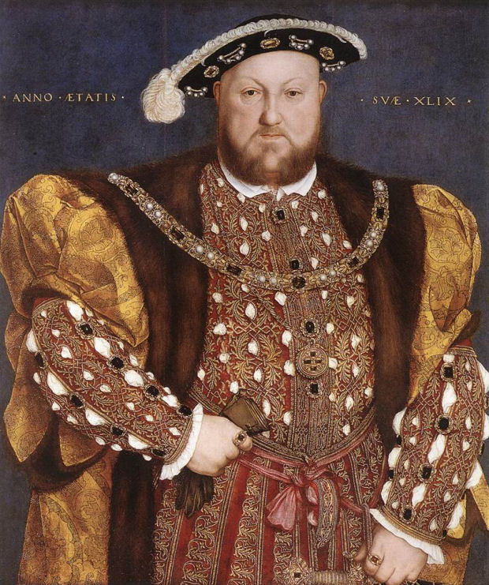
Tudor Punishment varied according to class
Tudor England was split into classes consisting of royalty, nobles and the second classes, traders, peasants or worse, vagrants!

Slide 9
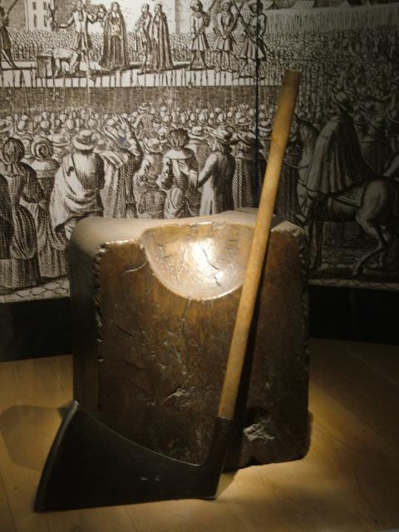
Punishment as form of Entertainment
Execution by beheading The punishment of death by the axe was the most common form of execution.
The punishment of beheading was held in public and witnessed by many people.
The heads of Tudor traitors were placed on stakes and displayed in public places such as the London Bridge.

Slide 10
Most towns had a ducking chair to punish women who were "scolds".
The chair was kept near a pond or river and was hung on a see-saw. The woman was tied into the chair, dipped into the water and pulled out again.
If people thought that a woman was a witch she would be tied up in a sack and thrown into the water.
If she floated it meant she was guilty!
Other people could be burned at the stake.

Slide 11
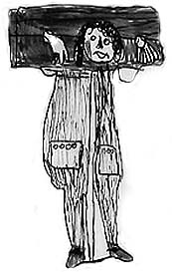
Branding with hot irons Hot irons were used to burn letters onto the skin of offenders hand, arm or cheek. A murderer would be branded with the letter 'M', vagrants with the letter 'V', and thieves with the letter "T".
The pillory (standing) The pillory was a T shaped block of wood with holes for the hands in the crossbar of the T. The person being punished would have to stand in the device in the middle of the market to be ridiculed by passersby.

Slide 12
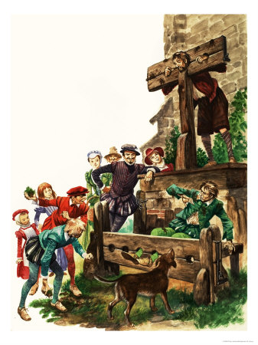
The stocks (sitting) Stocks were used in the same way as the pillory, except that with stocks, the feet were bound. The stocks were a block of wood with two holes for your feet to go in. Local people threw rubbish and rotten eggs at people in the stocks.

Slide 13
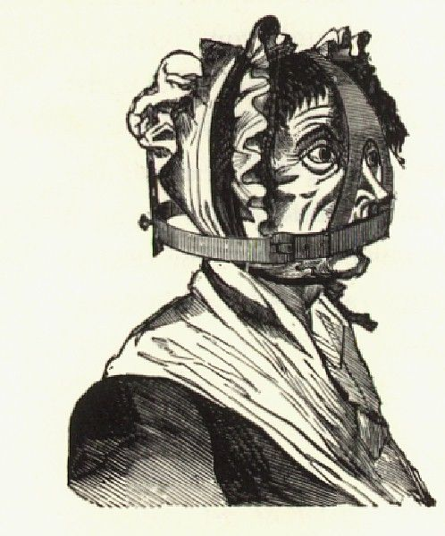
The Brank, (the gossip's bridle)
The brank was a punishment enacted on women who gossiped or spoke too freely.
It was a large iron framework placed on the head of the offender, forming a type of cage.
There was a metal strip on the brank that fit into the mouth and was either sharpened to a point or covered with spikes so that any movement of the tongue was certain to cause severe injuries to the mouth.

Slide 14
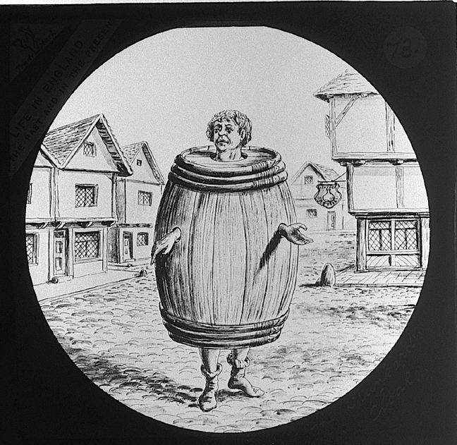
The Drunkard's Cloak This was a punishment for public drunkenness. The drunk was forced to don a barrel and wander through town while the villagers jeer at him. Holes were cut in the barrel for the person's hands and head, causing it to become like a heavy, awkward shirt.

Slide 15
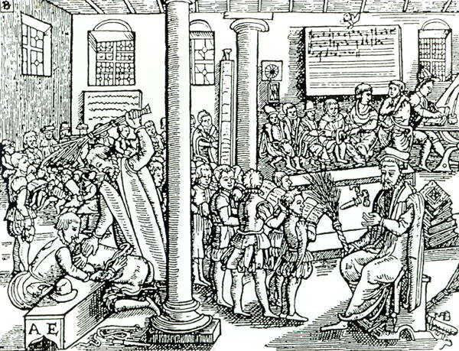
Lesser punishments for committing crimes included:
Whipping (flogging) Many towns had a whipping post. The victim was chained to the post, stripped to the waist and whipped. You could be whipped for stealing a loaf of bread!

Slide 16
You, in pairs are going to be given a punishment, a torture or a policing fact file. You are to make notes on this in the box on your grids.
Now – we are going to create an information market. One person will stay back and explain their poster (punishment, torture, fact file) to the fact finders. The other person will be your fact finder. They must go round to the other market stalls collecting information to fill in their sheet. You will swap half way through and collect information your partner does not have!

Slide 17
You have ten minutes to sell your information whilst your partner collects yours!
Explain your posters so that visitors to your ‘stall’ go away with as much information as possible!
5 minutes
5 minutes
Notes:
This ‘sand timer’ will start on a mouse click anywhere on the slide. The ‘sand’ will drain from the top section to the lower section and when completed will show the word ‘End’.
To change the timings of this timer, you need to enter the animation settings, and change the timings for the Isosceles Triangles. There will be 2 that need changing (to the same amount) – one animates the top triangle emptying, whilst the other animates the bottom triangle filling.
When you change the timings these have to entered as a number of seconds.

Slide 18
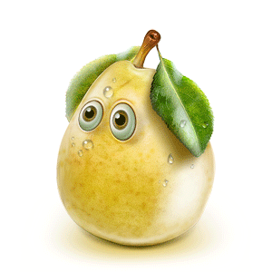
Now, fact finders must discuss with their partners the information they have found so that partners you can fill out your sheets!
This crime was punished by….
Oh, that sounds nasty, how did that work?
4 minutes
End
Notes:
This ‘sand timer’ will start on a mouse click anywhere on the slide. The ‘sand’ will drain from the top section to the lower section and when completed will show the word ‘End’.
To change the timings of this timer, you need to enter the animation settings, and change the timings for the Isosceles Triangles. There will be 2 that need changing (to the same amount) – one animates the top triangle emptying, whilst the other animates the bottom triangle filling.
When you change the timings these have to entered as a number of seconds.

Slide 19
Were the Tudors masters of torture?
Plenary:
P.E.E.L paragraph – Were the Tudors masters of torture?
P – Punishments and torture used during the Tudor period included …
E – Evidence to support this is…
E – This meant that…
L – This shows that the Tudors were/were not masters of torture because…
Notes:
At the start of the lessons student to copy the Learning objective into their books. Either: I will learn… or I will develop/be able to
Key words as part of the objective: express, evaluate, organise, define, solve, write, plan, apply, produce, select, reflect on, implement, compile, incorporate, construct, explain, practise, draw, identify, classify, decide, list calculate, present, assemble, describe, conclude
Starter: Think about how are you going to engage the students that they can do independently that look back on the previous lesson or look forward

Slide 20
Were the Tudors masters of torture?
Plenary:
P.E.E.L paragraph – Were the Tudors masters of torture?
P – Punishments and torture used during the Tudor period included …
E – Evidence to support this is…
E – This meant that…
L – This shows that the Tudors were/were not masters of torture because…
5 minutes
End
Notes:
At the start of the lessons student to copy the Learning objective into their books. Either: I will learn… or I will develop/be able to
Key words as part of the objective: express, evaluate, organise, define, solve, write, plan, apply, produce, select, reflect on, implement, compile, incorporate, construct, explain, practise, draw, identify, classify, decide, list calculate, present, assemble, describe, conclude
Starter: Think about how are you going to engage the students that they can do independently that look back on the previous lesson or look forward

Slide 21
Tudor crime
true or false

Slide 22
If you were found
guilty of robbing,
you would be whipped.

Slide 23
true

Slide 24
If you sold rotten food,
you would be beheaded

Slide 25
false

Slide 26
If people thought you
were a witch, you would
be ducked in water

Slide 27
true

