Slide 1
Recap.. MWB quick check..
What is the limbic system comprised of?
Describe the limbic systems role in aggression
What role does serotonin play in aggression?

Slide 2
Neural and hormonal influences
L.O - To outline and evaluate hormonal influences in aggression
Literacy Objective:
Limbic system
Serotonin
testosterone

Slide 3
Biological explanations of aggression
Neural and hormonal
Genetic
The limbic system *
(Amygdala, hippocampus)
Serotonin *
Testosterone*
Research on genetic factors
MAOA gene *
* You can be directly questioned on these
Notes:
Print

Slide 4
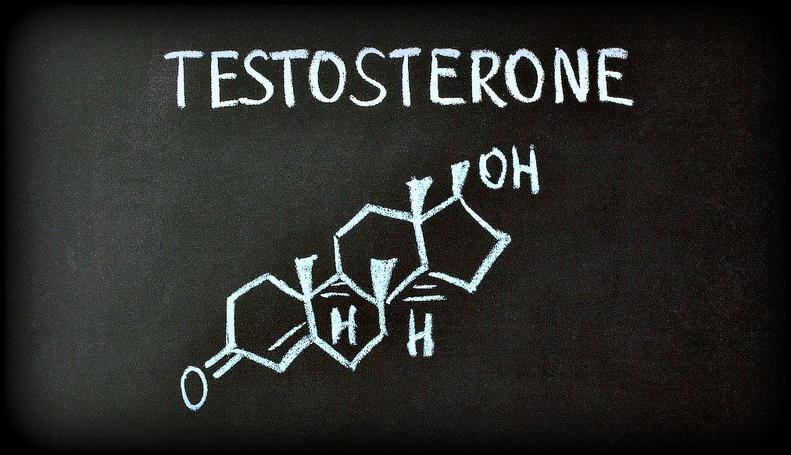
Hormonal influences
Hormones are chemical messengers that are secreted directly into the blood, which carries them to organs and tissues of the body to exert their functions. There are many types of hormones that act on different aspects of bodily functions and processes.

Slide 5
Testosterone AO1
Testosterone is linked with aggressive behaviour. Observations have generally found males are more violent then females. Therefore, different levels of testosterone can be considered a cause.
Also testosterone is highest ages (21-35), this is when we see increased male on male aggression.
Testosterone is know for developing masculine features, but it also has a role in regulating aggression by its influence on certain areas of the brain.
Research has shown a positive correlation in testosterone levels and aggressive behaviours in 60 male offenders in UK security hospitals.
Castration leads to a decrease in aggression in most animals

Slide 6
Evaluation - FAMDA
Neural Explanations | Hormonal Explanations
AO3 – Other brain structures | AO3- Biosocial model (Alternative) optional
AO3 – Drugs and serotonin | Ao3 – Gender Bias (Research / debate)
AO3 – Raleigh monkeys | AO3 – Dual hormone explanation (Alternative)
AO3 – Correlation and Causation | AO3 – Correlation and Causation (Debate)
AO3 – Implication? Can we be held accountable? | AO3 – Implication? Can we be held accountable? (Applications)
AO3 **Comparison – Hormonal can explain the different levels of aggression found in Bandura’s study. Despite having the same experience and modelling boys still behaved more aggressively than girls. This can’t be explained by the limbic or SLT. However varying levels of testosterone can explain this variation between genders.
Can we compare neural and hormonal?
Consider the gender differences found in Bandura’s study?

Slide 7
Evaluating Hormonal Influences
Support for testosterone – however an alternative model
Biosocial model (BMoS) aims to explain the link with testosterone and aggression. Testosterone levels change throughout the day and after a change in status. Josephs et al look at testosterone levels both before and after a change in status.
Method - levels of testosterone were measured before and after males completed a competitive game. In which all the males lost. They were then offered the chance to challenge their competitor again (aggressive task) or take part in an unrelated task (non-aggressive). 77% of males whose testosterone had increased after losing the task were more likely to challenge again (the aggressive task). Whereas only 23% of males who testosterone decreased after the task chose to challenge the competitor again.
Summary - Only those with an increase in testosterone levels after the competition chose to re-challenge. Those who saw a reduction in testosterone chose an alternative activity.
What does this suggest? Is it just testosterone?

Slide 8
Level 4 - Gender bias
Although it can explain why boys are more aggressive than girls, in studies such as Bandura’s SLT study with a Bobo doll…..
Eisenegger criticises explanations for being too simplistic and beta bias (ignoring differences between the genders).
For example, testosterone has been found to make women act ‘nicer’ rather than more aggressively depending on the situation.
It has also been suggested that rather than testosterone directly increasing aggression, it can promote other behaviours, such as status seeking behaviour.
Therefore different forms and more subtle versions of aggression that the biological explanation is not considering.
Correlational findings are too simplistic. Also questions what is ‘aggression’ – does research consider the different forms>

Slide 9
Wider research – can explain individual differences Dual Hormone explanation
Research into other hormones such as cortisol, have shown to also have an influence on aggression.
Research has suggested a dual hormone hypothesis – which might explain inconsistencies in findings.
Aggression is only seen when testosterone is high and cortisol is low. Cortisol is a hormone involved in the stress response.
When cortisol is high testosterone blocked.
Therefore the hormonal explanation is more complex than previously thought and there are other hormones involved in aggression.

Slide 10
IDA
Although the relationship between hormones and aggression can be tested using animals, this has limited application to humans due to complexity of human behaviour. Due to obvious ethical issues we can not induce aggressive behaviour in humans and although we can’t deny there is a link, and research has identified correlations, we cannot assume cause and effect. Therefore the biological is reductionist and in trying to reduce aggressive behaviour due to hormones and we must consider the wider social influences.
Research- types of aggression (violent, verbal) – generalised?
Implications for biological explanations – labelling, accountability.

Slide 11
Taboo
Coccaro
Limbic system
Serotonin
Raleigh
Testosterone
Correlation
Amygdala
Berman
Orbital frontal Cortex
Paroxetine
Inhibition
Tryptophan

Slide 12
Essay questions
Discuss the role of testosterone in causing aggression
Discuss the hormonal and neural explanations of aggression (remember for this question to combine AO3 points that overlap)

