Slide 1
Sampling
The method of choosing a smaller, representative group of respondents with which to conduct research instead of the whole population.
Census
Population
A survey of everyone in the country.
Sample
The total number of people who could be included in a particular survey
Notes:
Ask questions like … why are the points the same distance apart? How steep is the line? Where does it cut the y axis?

Slide 2
Task One: Sampling V Census
Describe the advantages of using a census rather than a sample.
2. Describe the disadvantages of using a census rather than a sample
3. A large school has 1800 pupils. The head teacher wants to find out how far the pupils have to travel to school.
What is the population he could use?
Would you use a census or a sample?
Explain why you would give this advice.
Notes:
Ask questions like … why are the points the same distance apart? How steep is the line? Where does it cut the y axis?

Slide 3
Keywords
systematic
stratified
random
cluster
quota
convenience
Self selecting

Slide 4
Sampling
There are three main factors when we think about what sample we are going to take.
What size of sample can you expect to take, given limited time, money and resources?
How is the sample to be collected to avoid bias?
How is the data going to be collected to avoid bias?
Notes:
Alaska

Slide 5
Sample Size
How big?
The sample size needs to be considered as part of the data collection process.
A large sample will cost more time, money and effort but may be more representative and may produce better results.
For a small population, 5-10% is a large enough sample size.
For a larger population of size n, we take a sample of size √n. E.g. Population of size 400, sample size 20.

Slide 6
Random Sampling
What do we mean by a random sample?
How could we create a random sample?
Notes:
Alaska

Slide 7
Using a random number table
In a class there are 30 pupils. The teacher decides to take a random sample of 5 pupils to estimate the mean height of the pupils in the class. Select a random sample of 5 pupils from the list.
Notes:
Alaska

Slide 8
Using a random number table
We can now use a random number table like:
3 4 5 4 7 3 0 7 7 1 4 0 2 6 0 5 8 8 8 5 6 6 4 5 5 7 6 0 2 7 8 2 7 6 1 5
Notes:
Alaska

Slide 9
Sampling Question
Notes:
Alaska

Slide 10
Systematic Sampling
What do we mean by systematic sampling?
How could we create a systematic sample?
Notes:
Alaska

Slide 11
Systematic Sampling
We will look at the same class as before. What would we do if we wanted a systematic sample of 6 people?
Notes:
Alaska

Slide 12
Systematic Sampling Questions
Notes:
Alaska

Slide 13
Convenience Sampling
is quick to organise
there is no need to order or number the sample frame
you work with what is available to you at the time
. . . can lead to an enormous problem of bias

Slide 14
Quota Sampling
This is probably the easiest method to use in the real world.
Companies use screening questions at the start of any survey issued to make sure they can quickly identify their target audience.
E.g. Do you use sun care products?
No? End of survey… Yes? Answer the following …

Slide 15
Cluster Sampling
Cluster is another word for group and we use this method when the population can be put into or naturally falls into groups.
Within each cluster there must be a good mix of the different elements of the population with the numbers in each cluster spread out as equally as possible..
This means that any one cluster can be selected at random and the population of that cluster used as the sample set.

Slide 16
Stratified Sampling
A method of sampling that involves the division of a population into smaller groups known as strata.
In stratified random sampling, the strata are formed based on members' shared attributes or characteristics (e.g. Year Group, gender, etc.)
A random sample from each stratum is taken in a number proportional to the stratum's size when compared to the population.

Slide 17
The class consists of 20 girls and 10 boys, 30 pupils altogether.
We want a sample of size 5.
Girls = 5 x $\frac{20}{30}= \frac{100}{30}$ = 3.333 we round this down to 3.
Boys = 5 x $\frac{10}{30}= \frac{50}{30}$ = 1.6667 we round this up to 2.

Slide 18
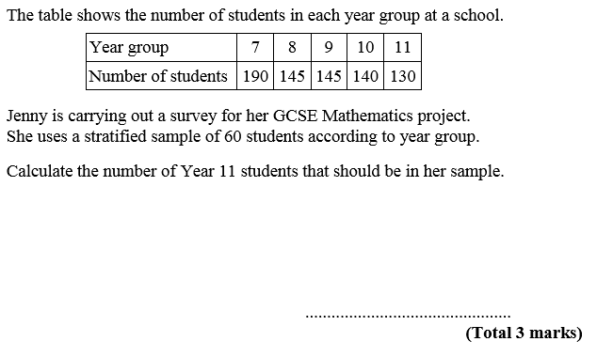
Stratified Sampling
Notes:
Re-cap Epsilon as the notation for sum of.

Slide 19
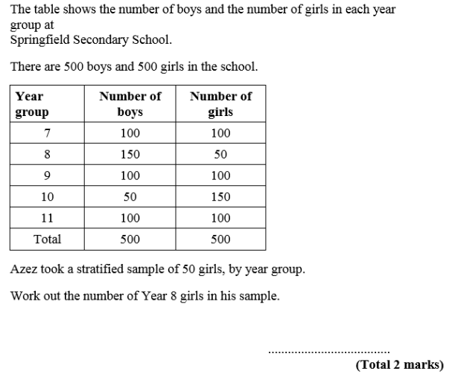
Stratified Sampling

Slide 20
Stratified Sampling
Σ Number of students = 750
Year 11 = 60 x $\frac{130}{750}$
we round this down to 10
$=$ 10.4
10
Notes:
Re-cap Epsilon as the notation for sum of.

Slide 21
Stratified Sampling
5
Year 8 Girls = 50 x $\frac{50}{500}$
$=$ 5

Slide 22
Cluster vs Stratified Sampling
We group together members of the population with similar characteristics (age, gender,..).
We need a variety of characteristics in every cluster.

