Slide 1
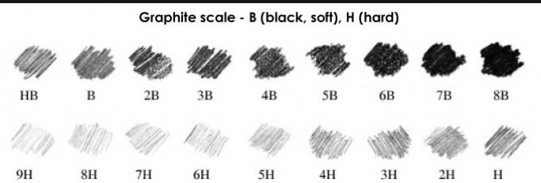
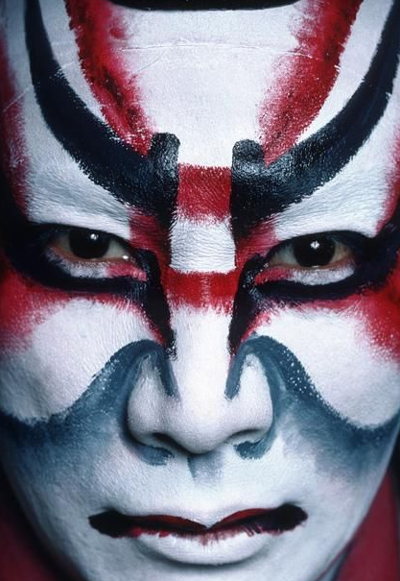
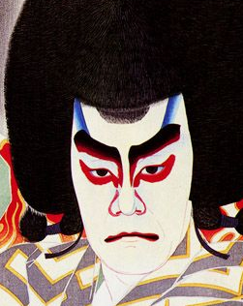
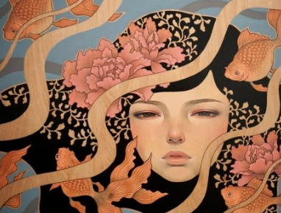
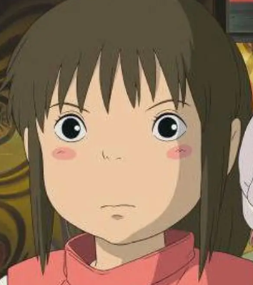
Year 8 Portraiture
Techniques (keywords are underlined) – we will cover definitions in lessons
Drawing faces in proportion……………………………………………………………………………………………………………………………………………………………………………………………………............
Tonal shading to show form ………………………………………………………………………………………………………………………………………………………………………………………………………………
Marks to convey textural details ……………………………………………………………………………………………………………………………………………………………………………………………………………....
Creating stylised portrait compositions…………………………………………………………………………………………………………………………………………………………………………………...
Monoprint ……………………………………………………………………………………………………………………………………………………………………………………………………………............................
Intaglio reduction print made in response to Yakusha-e style of Kabuki theatre imagery. ……………………………………………………………………………………………………………………………..
……………………………………………………………………………………………………………………………………………………………………………………………………………………………………………………………………..
Creating pattern using symbolism………………………………………………………………………………………………………………………………………………………………………………………………… ..
Notan papercut and collage ………………………………………………………………………………………………………………………………………………………………………………………… …………………..
Watercolour painting
Research into portraiture and the purpose of it.
Overview
You will begin this project by exploring why humans are driven to create portraits of people and what the visual language used conveys about a person. This exploration should link to and help to inform your ‘self portrait challenge’ homework project, for which you will also be expected to do further research.
The practical element of the project with begin with developing your recording from observation, in particular your gridded drawing skills and use of tonal shading and textural marks in the form of a portrait study. You will then look at how you can move from realism to stylised drawing of facial features in the form of Manga drawings. You will build your understanding of Japanese portraiture by looking at historical and contemporary approaches. You will learn intaglio reduction printing methods using your own designs that show an understanding of Japanese symbolism before developing the prints into Notan paper collages to be used in your final portrait piece. The final portrait will also need to showcase careful compositional planning and portrait rendering.
Artists
Pattern
‘Wagara’ refers to traditional Japanese patterns. One of the features is that most wagara have ordered pattern and use natural thing as a motif.
Wagara was originally designed in Heian period (approximately a thousand years ago).
Audrey Kawasaki 1982-
Painting
Hayao Miyazaki (from Studio Ghibli)
1941 - Still from animated film
Kabuki Theatre face paint
Photograph
Natori Shunsen 1886-1960
Print
Wider research
Visit the Ashmolean Museum in Oxford, it has a great array of Japanese artefacts.
Visit the National Portrait Gallery in London.
Watch Howl’s Moving Castle (U) and Spirited Away (PG), both by Studio Ghibli.

Slide 2
A01 understanding artists’ work
1 2 3 4 5

