Slide 1
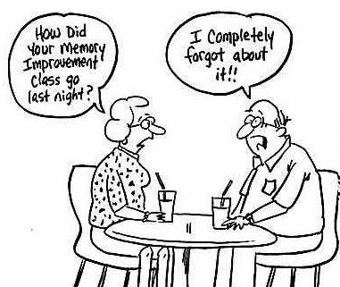
Title: What are the differences between the three types of LTM?
Researcher | Study
Baddeley (1966) | Investigated the SR by flashing 3X4 grid of letters to participants and asking them to recall a row.
Bahrick et al. (1975) | Investigated the duration of LTM by showing participants a yearbook of school colleagues up to 48 years after they had left and asking them to recall names.
Sperling (1960) | Investigated semantic encoding in the LTM store.
Clive Wearing Case study | Virus damaged STM and LTM stores, but left his procedural memory intact.
Starter: Match each study to the correct description
Learning objectives:
To KNOW the differences episodic, semantic and procedural types of LTM.
To UNDERSTAND Tulving’s (1989) and Hassibis et al. (2007) research into LTM and to EVALUATE this research and the practical applications of it.

Slide 2
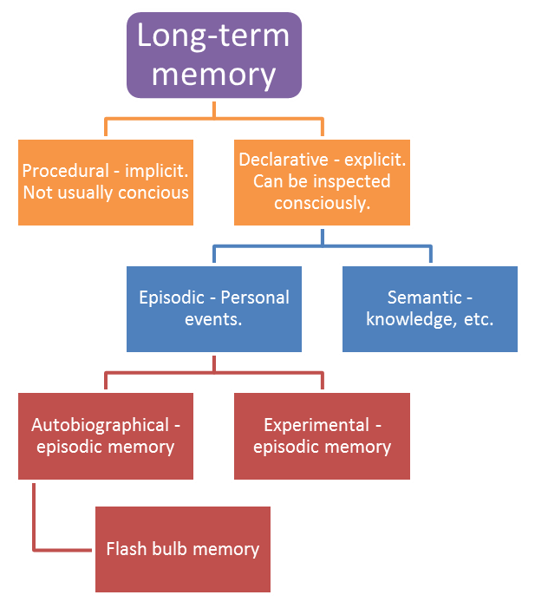
The MSM and WMM model suggest that LTM is unitary.
However, research suggests there are a number of different types of LTM.
Learning objectives:
To KNOW the differences episodic, semantic and procedural types of LTM.
To UNDERSTAND Tulving’s (1989) and Hassibis et al. (2007) research into LTM and to EVALUATE this research and the practical applications of it.

Slide 3
Task
Use the coloured paper, and the textbook to help you create an A3 ANNOTATED diagram of the different types of LTM.
Your diagram must include the following in some way:
A diagram of how LTM memory is broken down into explicit and implicit memories (and their subdivision types).
An explanation of what episodic, semantic and procedural memories are (possibly with picture if you’re artistic…)
Details of research evidence supporting the existence of different types of LTM (Tulving and Hassibis et al.)
Evaluative comments about a) the quality of the research, b) the idea that LTM can be broken down into different types.
Learning objectives:
To KNOW the differences episodic, semantic and procedural types of LTM.
To UNDERSTAND Tulving’s (1989) and Hassibis et al. (2007) research into LTM and to EVALUATE this research and the practical applications of it.

