Slide 1
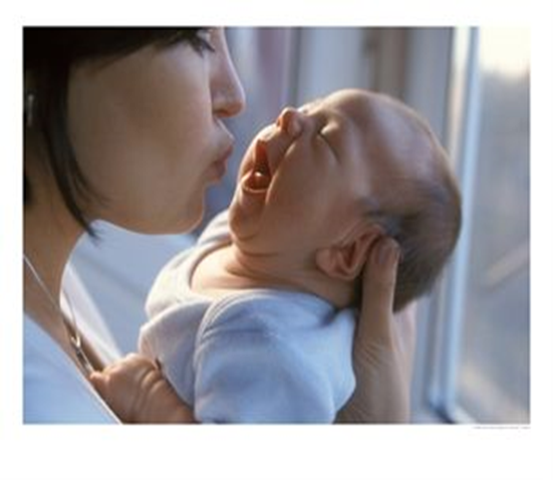
What is an ‘attachment’? And how do caregivers and infants interact?
Developmental psychology – the study of changes that take place as people develop from infancy.
Starter: How are these two photos linked in psychological terms?

Slide 2
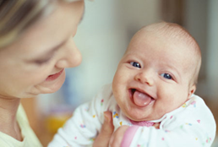
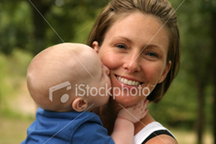
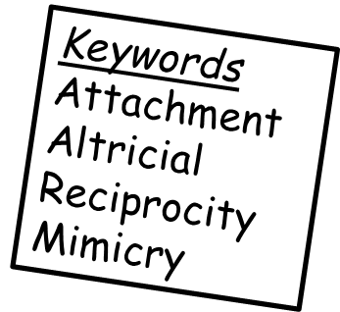
What is an attachment?
Babies demonstrate attachment behaviours from around 6 months of age.
You can tell a baby has formed an attachment through the demonstration of two key behaviours:
Separation anxiety – distress when separated from the attachment figure, even to another known person.
Stranger distress – fear of unknown new people.
“Attachment is an emotional bond between two people. It is a two-way process that endures over time, and develops in set stages within a fairly set timescale. It leads to certain behaviours such as clinging and proximity-seeking, and serves the function of protecting an infant.”
Learning objectives:
To DEFINE attachment, and features of caregiver-infant interactions
To UNDERSTAND why attachments develop, and Schaffer’s key stages.
TO OUTLINE and EVALUATE research in caregiver-infant interactions.

Slide 3
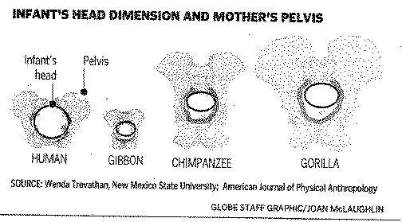
Why?
Humans are altricial animals (as opposed to precocial e.g. horses).
Means they are born very early in development, (as a result consequence of bipedalism) and cannot survive without protection and nurturing for significant periods of time.
Learning objectives:
To DEFINE attachment, and features of caregiver-infant interactions
To UNDERSTAND why attachments develop, and Schaffer’s key stages.
TO OUTLINE and EVALUATE research in caregiver-infant interactions.

Slide 4
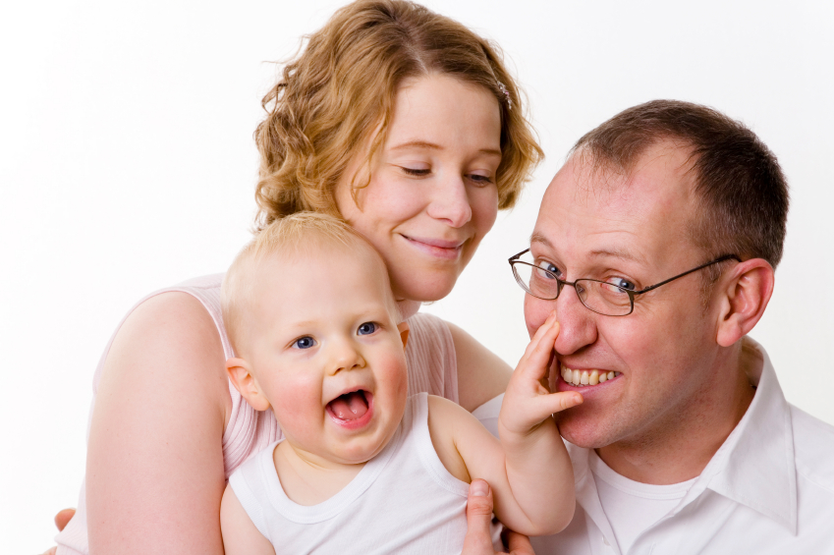
Who do we form attachments with? T-P-S
Are infants attached to just one person? ?
Who would you expect that person to be? ?
Can infants have multiple attachments? ?
Do they behave differently towards different people?
Learning objectives:
To DEFINE attachment, and features of caregiver-infant interactions
To UNDERSTAND why attachments develop, and Schaffer’s key stages.
TO OUTLINE and EVALUATE research in caregiver-infant interactions.

Slide 5
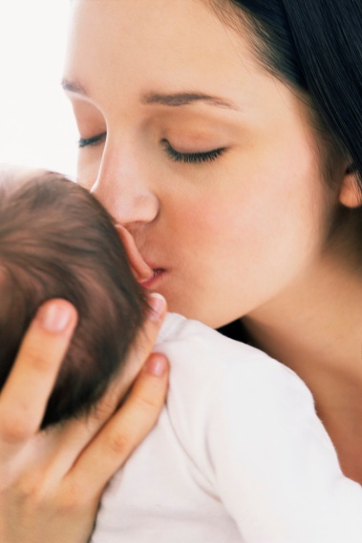
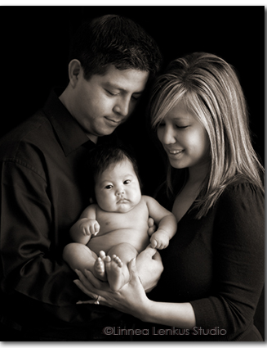
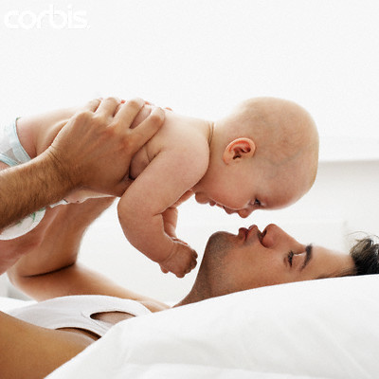
Who do we form attachments with?
30% mother and another (often father)
65% mother only
Can have multiple attachments
Not necessarily the person who fed, changed, washed or spent most time with us….
3% father only
Learning objectives:
To DEFINE attachment, and features of caregiver-infant interactions
To UNDERSTAND why attachments develop, and Schaffer’s key stages.
TO OUTLINE and EVALUATE research in caregiver-infant interactions.

Slide 6
How do attachment form?
Attachments are NOT present at birth.
T-P-S
What things might help a care-giver and child to form a strong attachment?
What things might hinder an attachment forming?
Keywords
Attachment
Altricial
Reciprocity
Mimicry
Learning objectives:
To DEFINE attachment, and features of caregiver-infant interactions
To UNDERSTAND why attachments develop, and Schaffer’s key stages.
TO OUTLINE and EVALUATE research in caregiver-infant interactions.

Slide 7
How do attachment form?
Interactions between a carer and an infant serve to develop and maintain an attachment. Infants cannot talk, but they can communicate to caregivers in several ways which help develop proximity, and eventually an attachment:
Caregiverese (originally ‘motherese’) – A type of high-pitched, slow, soft verbal interaction with infants.
Bodily contact – Infants interact physically with caregiver e.g. clasping fingers, arms around neck etc.
Interactional synchrony - adults and babies respond to each other in a turn-taking, rhythmic style to sustain communication.
Reciprocity - interaction flows both ways between adult and infant.
Mimicry – Infants mimic (copy) the adult’s facial expressions.
Sensitive responsiveness – caregiver adults attend particularly sensitively to infant’s communications. E.g. be aware of needs, and meet them quickly and sufficiently.
Learning objectives:
To DEFINE attachment, and features of caregiver-infant interactions
To UNDERSTAND why attachments develop, and Schaffer’s key stages.
TO OUTLINE and EVALUATE research in caregiver-infant interactions.

Slide 8
Evidence for caregiver-infant interactions?
Watch the video about Tronick (1975) research into communication between infants and caregivers.
What did he do?
What did he find?
Keywords
Attachment
Altricial
Reciprocity
Mimicry
Learning objectives:
To DEFINE attachment, and features of caregiver-infant interactions
To UNDERSTAND why attachments develop, and Schaffer’s key stages.
TO OUTLINE and EVALUATE research in caregiver-infant interactions.

Slide 9
Further evidence for caregiver-infant interactions?
Papousek et al. (1991) looked at caregiverese across cultures.
Found that the classic rising tone to indicate to infant it was their ‘turn’ to respond, and song-like rhythmic speech was the same in US, Chinese and German mothers – suggesting this is an innate. Biological device to forma attachments.
Keywords
Attachment
Altricial
Reciprocity
Mimicry
Learning objectives:
To DEFINE attachment, and features of caregiver-infant interactions
To UNDERSTAND why attachments develop, and Schaffer’s key stages.
TO OUTLINE and EVALUATE research in caregiver-infant interactions.

Slide 10
Evaluation – A02
Practical applications of research?
Mothers and babies no longer separated in hospitals after birth.
Adoptive parents take child immediately.
Importance of trying to minimise the effects of caregiver depression on infants.
Is cargiverese unique to ‘own’ children?
Some research suggests adults talk to all infants in this manner.
Is three cultures truly ‘cross-cultural’ research?
Later research has demonstrated cultures where interactional synchrony is not found e.g. Kenya, casting doubt on the innate nature of it.
Keywords
Attachment
Altricial
Reciprocity
Mimicry
Learning objectives:
To DEFINE attachment, and features of caregiver-infant interactions
To UNDERSTAND why attachments develop, and Schaffer’s key stages.
TO OUTLINE and EVALUATE research in caregiver-infant interactions.

Slide 11
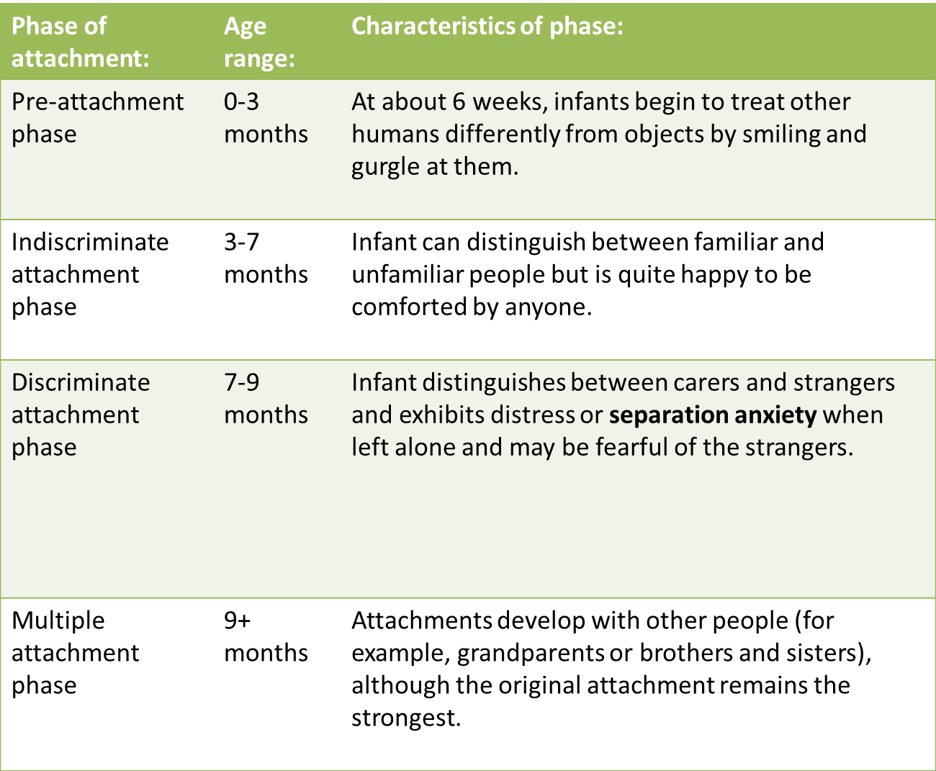
What are the stages of attachment?
Keywords
Attachment
Altricial
Reciprocity
Mimickry
Learning objectives:
To DEFINE attachment, and features of caregiver-infant interactions
To UNDERSTAND why attachments develop, and Schaffer’s key stages.
TO OUTLINE and EVALUATE research in caregiver-infant interactions.

Slide 12
Schaffer and Emerson
Complete the APFC of Schaffer and Emerson’s research.
Learning objectives:
To DEFINE attachment, and features of caregiver-infant interactions
To UNDERSTAND why attachments develop, and Schaffer’s key stages.
TO OUTLINE and EVALUATE research in caregiver-infant interactions.

Slide 13
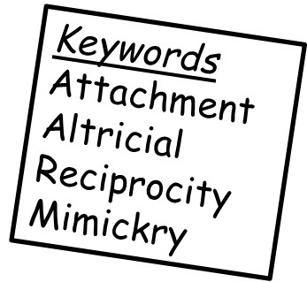
Do we find similar behaviours in animals?
Use page 110 in textbook, and phone research to answer the following:
What did Lorenz (1935) do? And what did he find?
What does this suggest about the underlying nature vs. nurture debate surrounding attachment?
However, what criticisms are there of his research? How might this affect the validity of the research?
Learning objectives:
To DEFINE attachment, and features of caregiver-infant interactions
To UNDERSTAND why attachments develop, and Schaffer’s key stages.
TO OUTLINE and EVALUATE research in caregiver-infant interactions.

